Slide 1
AP Coordinated Beamforming for EHT
Date: 2018-09-10
Authors:
Name | Affiliations | Address | Phone | email
Sudhir Srinivasa | Marvell
Hongyuan Zhang | Marvell |  |  | Hongyuan@marvell.com

Slide 2
AP Coordinated BF (Distributed MIMO)
The main idea of “Distributed” MIMO is to simultaneously use antennas distributed across multiple APs (transmitters) to communicate with one or more clients (receivers).
The increased number of transmit antennas provide higher beamforming and/or MU gain
  Higher overall network throughput and efficiency
  Higher Total Tx power: less regulatory limitation on “antenna array gains” (per AP basis)
This is especially relevant in mesh networks and enterprise deployments, where a given mobile client could be visible to multiple access points
Notes:
Following are some schemes used in dense Wifi deployments:
Usage of directional antennas.
APs will be using same BW (higher BW available).
On the intersection area, the CCI (if both APs are transmitting) is more.
Usage Band planning
Because of CCI, the band which is used by adjacent AP need to have higher separation.
Planning of band for each AP based on the location is required.
Spatial diversity
Use higher number of antenna to exploit the spatial diversity in the channel.
Requires more hardware and high cost.
Pcell
Use multiple-antenna placed at widely different location and use BF scheme to direct the transmission
Proposed Solution (SDM)
Similar to Pcell but use different APs to attain the effect of multiple antennas.
The co-operation of APs will be done as required.
Can be implemented using software update.

Slide 3
Distributed MIMO (DMIMO) Example
Consider a simple scenario where we have two APs, AP1 serving Clients 1 and 2; and AP2 serving Client 3
  AP1 and AP2 are assumed to be connected through a wired (or wireless/mesh BSS) backbone
  Client 2 is in the vicinity of both AP1 and AP2.
When AP1 is serving Client 2, AP2 has to remain silent to avoid collision.
Instead of AP2 being idle, it can be used to improve the link performance of AP1 to Client 2.
  AP1, together with AP2’s antennas acts as a virtual AP to the client
The concept can also be extended to multiple APs serving multiple clients
DMIMO
Notes:
Following are some schemes used in dense Wifi deployments:
Usage of directional antennas.
APs will be using same BW (higher BW available).
On the intersection area, the CCI (if both APs are transmitting) is more.
Usage Band planning
Because of CCI, the band which is used by adjacent AP need to have higher separation.
Planning of band for each AP based on the location is required.
Spatial diversity
Use higher number of antenna to exploit the spatial diversity in the channel.
Requires more hardware and high cost.
Pcell
Use multiple-antenna placed at widely different location and use BF scheme to direct the transmission
Proposed Solution (SDM)
Similar to Pcell but use different APs to attain the effect of multiple antennas.
The co-operation of APs will be done as required.
Can be implemented using software update.

Slide 4
Single vs Multiple Clients
Distributed Beamforming (Distributed MIMO to a single client)
  Full BW transmission to a single client in the vicinity of two or more APs
  Improves throughput (or RvR) of the client by combining antennas across all APs, potentially supporting increased Nss transmission.
Distributed MU-MIMO (Distributed MIMO to multiple clients)
  Full BW transmission to multiple clients
  Each AP can support one or more clients in its own network and one or more clients in the network of adjacent AP(s)
  The users are multiplexed spatially

Slide 5
PHY Related Challenges/Considerations
The APs can have vastly different impairments/configurations
  Frequency and timing offsets (CFO/SFO) and drifts
  Different transmit power/EVM
  LO Phase between APs (affects beamforming)
The APs need to pad/encode/interleave/tone-reorder/modulate the data identically
  Any padding/reserved bits in the payload/SIG fields need to be identical
  The scrambler seed (if any) between the two APs needs to be identical
Sounding and Feedback synchronization and overhead
Selection of APs and client(s) is not straightforward

Slide 6
Simulation on Impairment Tolerance
DMIMO to single client: 2 APs each with NTx = 4
Two separate client configurations:
  Configuration 1: NRx = 2 Nss = 2
  Configuration 2: NRx = 4 Nss = 4
HE packet with 2x+1.6us LTF
BW = 80MHz, LDPC
Assume explicit sounding, same impairments applied across NDP and Data
Channel: Separate DNLOS realizations between each AP and client
LDPC, with identical encoding across both APs
Residue CFO/SFO: Agnostic of sync + pre-compensation method
RvR parameters:
  Transmit power per Antenna = 15dBm
  Path loss exponent = 4.6

Slide 7
Simulation Scenarios Compared
Scenario | Description
4 x NRx, no DMIMO, no CFO | Single AP with NTx = 4 communicating with a NRx antenna client, no CFO
8 x NRx, no DMIMO, no CFO | Single AP with NTx = 8 communicating with a NRx antenna client, no CFO 3dB lower Tx power than 4 Tx or 8 Tx DMIMO (regulatory limit)
8 x NRx, DMIMO, no CFO | Two APs each with NTx = 4 communicating with a NRx antenna client, no CFO
8 x NRx, (AP, CFO) | Two APs each with NTx = 4 communicating with a NRx antenna client, Uniformly distributed CFO in the range [-a,a] is added for each AP for each transmission. a = 350Hz or 200Hz
8 x NRx, Imp ON | Two APs each with NTx = 4 communicating with a NRx antenna client, impairments added: CFO as above, plus: Delay of 0.2us and 0.4us for AP1 and AP2 TxEVM – AP1: -37dBm, AP2: -37dBm
Residue SFO (sampling offset correlated with residue CFO in ppm)
Regular impairments (PN, IQ, NF, etc) are always applied

Slide 8
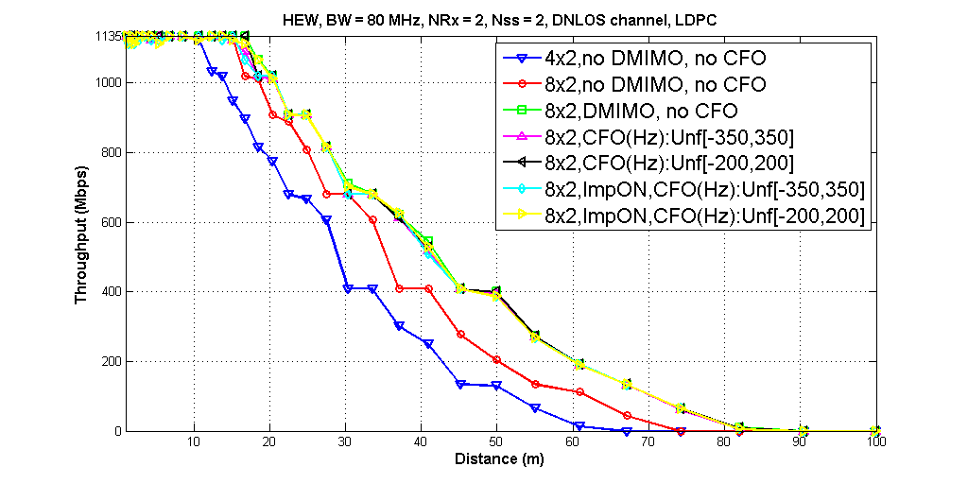

Slide 9
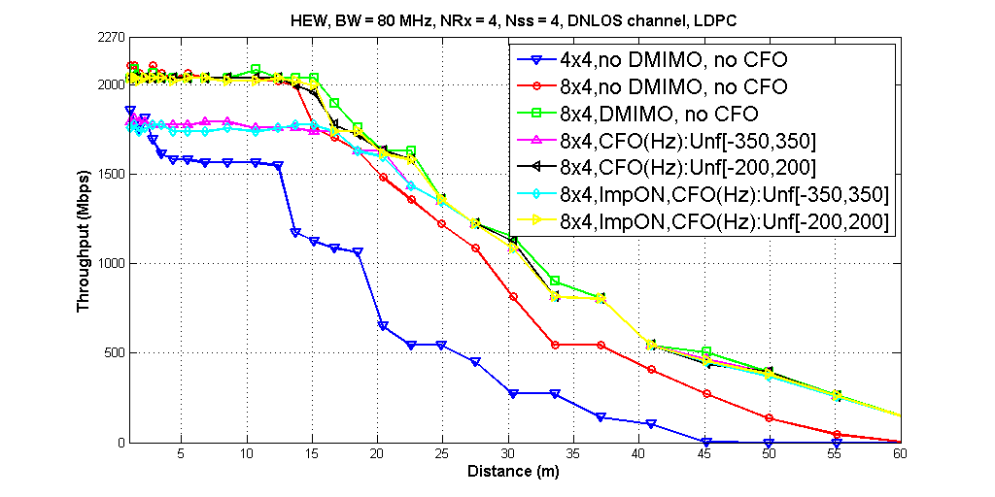
September 2018

Slide 10
Simulation Summary
CFO/SFO is the dominant impairment influencing the throughput
Following table compiles the maximum supported MCS in each simulated case
Simulation scenario | NRx = 2, Nss = 2 | NRx = 4, Nss = 4
4 x NRx, No DMIMO | MCS 11 | MCS 10
8 x NRx, No DMIMO | MCS 11 | MCS 11
8 x NRx, DMIMO | MCS 11 | MCS 11
CFO Unf - 350Hz | MCS 11 | MCS 9
CFO Unf - 200Hz | MCS 11 | MCS 10
Imp ON, CFO Unf - 350Hz | MCS 11 | MCS 9
Imp ON, CFO Unf - 200Hz | MCS 11 | MCS 10

Slide 11
Independent Sounding vs Synchronized Sounding
Independent sounding: each AP sounds and get feedback independently.
Synchronized sounding: two APs send sounding jointly with CFO/SFO/Timing pre-compensation.
  Implicit sounding should work too, but need to check sensitivity to residue Tx/Rx path imbalance post calibration.

Slide 12
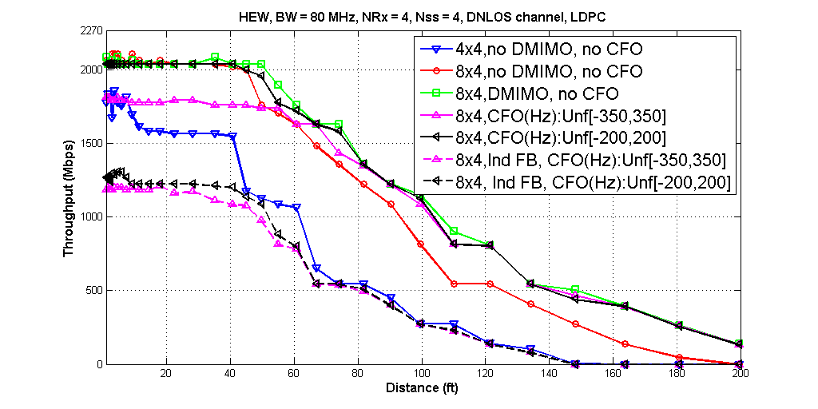
Sounding Comparison: Simulation

Slide 13
Summary
Distributed MIMO is a very compelling technology for EHT, since it offers clear gains in throughput and range compared to 11ax.
DMIMO for SU BF is also feasible for EHT due to reasonable complexity
The throughput is sensitive to the frequency offset between the APs
  Based on simulations, the residual CFO has to be tighter than 11ax ULMU (e.g. at +/-200Hz)
Performance with independent sounding steering feedback is drastically poorer
  Synchronized sounding, with pre-compensated CFO will be needed from the two APs to the client.
Next step: study impairment tolerance of Distributed-MUMIMO

