Slide 1
V2X Simulation Model
Date: 2018-09-10
Authors:

Slide 2
Abstract
A simulation model of a baseband 802.11p transceiver which can be used for research on V2X communications is presented in this submission.
Available on https://github.com/u-blox/ubx-v2x

Slide 3
Motivation
Promote collaboration among V2X experts on a common platform
Assess the performance of DSRC (ITS-G5) and NGV against competing access layer technologies
Support coexistence studies between DSRC (ITS-G5) / NGV and alternative technologies
Encourage the publishing of (reference) simulation code instead of just results, whenever possible

Slide 4
Introduction
ubx-v2x is a simulation model of a baseband 802.11p transceiver
Can be used for research of current or next-generation V2X systems
Provides a reference implementation of all the basic transmitter and receiver processing blocks
Also contains models for some “advanced” processing blocks such as
  Frequency offset estimation / correction (coarse, fine & residual)
  Frequency-domain channel estimation smoothing
  Time-domain channel estimation averaging
  (Abstract) channel estimation tracking mechanism
Includes implementations of the Car-2-Car channel models [1-4]

Slide 5
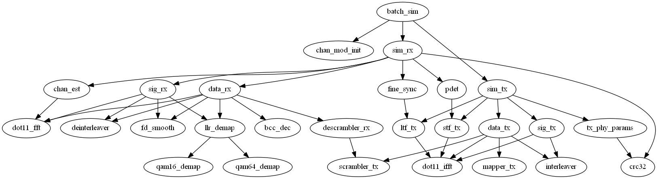
Top-level function dependency graph

Slide 6
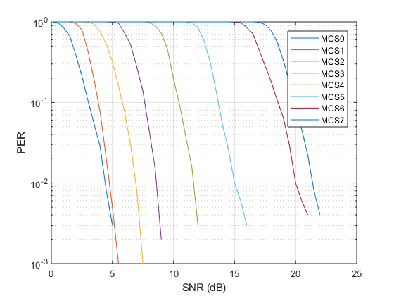
Example: AWGN Performance
The batch_sim script performs a Monte-Carlo simulation for:
  MCS 0 to 7
  Payload 300 bytes
  AWGN noise

Slide 7
MEX Acceleration
The high-level transmitter (sim_tx) and receiver (sim_rx) functions are compatible with the MATLAB Code Generation rules
This enables the automatic generation of C-code for use with a C-based simulator or an embedded system
Significant simulation performance gain can also be achieved by compiling the auto-generated C-code into binary MEX files

Slide 8
License
The code is distributed with an MIT-like, open source license
Copyright (C) u-blox. All rights reserved.
Permission to use, copy, modify, and distribute this software for any purpose without fee is hereby granted, provided that this entire notice is included in all copies of any software which is or includes a copy or modification of this software and in all copies of the supporting documentation for such software.
THIS SOFTWARE IS BEING PROVIDED "AS IS", WITHOUT ANY EXPRESS OR IMPLIED WARRANTY. IN PARTICULAR, NEITHER THE AUTHOR NOR U-BLOX MAKES ANY REPRESENTATION OR WARRANTY OF ANY KIND CONCERNING THE MERCHANTABILITY OF THIS SOFTWARE OR ITS FITNESS FOR ANY PARTICULAR PURPOSE.

Slide 9
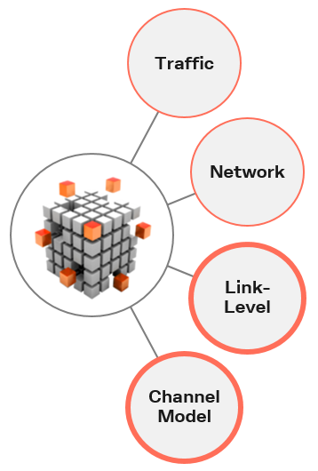










Next Steps
Investigate collaboration opportunities for extending the simulator with:
  Vehicular traffic simulation
  Network simulation
  Hardware-In-the-Loop simulation
A Work Item “V2X Simulation Platform” was initiated within Car-2-Car
  11 partners have expressed interest in this activity so far

Slide 10
Straw Poll
Do you support the use of any open-source simulation model similar to the one presented, for submissions to NGV whenever possible?
Y / N / A

Slide 11
References
[1] M. Kahn, "IEEE 802.11 Regulatory SC DSRC Coexistence Tiger Team V2V Radio Channel Models," IEEE 802.11-14/0259r0.
[2] I. Tan, W. Tang, K. Laberteaux and A. Bahai, "Measurement and Analysis of Wireless Channel Impairments in DSRC Vehicular Communications," 2008 IEEE International Conference on Communications, Beijing, 2008, pp. 4882-4888.
[3] P. Alexander, D. Haley and A. Grant, "Cooperative Intelligent Transport Systems: 5.9-GHz Field Trials," in Proceedings of the IEEE, vol. 99, no. 7, pp. 1213-1235, July 2011.
[4] L. Bernadó, T. Zemen, F. Tufvesson, A. F. Molisch and C. F. Mecklenbräuker, "Delay and Doppler Spreads of Nonstationary Vehicular Channels for Safety-Relevant Scenarios," in IEEE Transactions on Vehicular Technology, vol. 63, no. 1, pp. 82-93, Jan. 2014.

