Slide 1
WUR FDMA Padding Content
Date: 2018-09-10
Authors:

Slide 2
Introduction
In July meeting, it is agreed that all 20MHz sub-channel needs to pad to the same duration for WUR FDMA mode [1].
The padding content/waveform has NOT been finalized.
In this contribution, we investigate multiple padding options.

Slide 3
Recap: WUR FDMA Padding [1]
Primary
20MHz
Legacy
Preamble
BPSK Mark
WUR-Sync
WUR-Data
Secondary
20MHz
Legacy
Preamble
BPSK Mark
WUR-Sync
WUR-Data
WUR-Padding
Legacy
Preamble
BPSK Mark
WUR-Sync
WUR-Data
WUR-Padding
Secondary
40MHz
Legacy
Preamble
BPSK Mark
WUR-Sync
WUR-Data
WUR-Padding
The FDMA transmission on all 20MHz sub-channels shall have the same duration.
Padding is appended to the 20MHz sub-channels, whose duration is shorter than the length indicated by L-length field in L-SIG.

Slide 4
False Alarm Issue: 40MHz Example
Secondary 20:
STA2
Legacy
Preamble
BPSK Mark
WUR-Sync1
WUR-Data
Primary 20:
STA1 , STA3
Legacy
Preamble
BPSK Mark
WUR-Sync2
WUR-Data
WUR-Padding
Backoff+AIFS
AP
WUP1
WUP2
Padding
STA2
Wake up PCR1
STA1
Wake up PCR2
STA3
False Alarm and keeps decoding
STA1 and STA3 WUR both parked to Primary 20MHz subchannel
STA2 WUR parks on Secondary 20MHz subchannel
WUP1 wakes up both STA1 and STA2 using HDR and LDR, respectively.
If STA3 falsely detects SYNC and the false “MAC frame type” indicates a long frame, then STA3 will miss WUP2, which is intended to wake up STA3.
  If WUP1 Rx power at STA3 is high, STA3 WUR may abort when it detects significant energy drop at the end of WUP1
  For low SNR case, STA3 will more likely miss WUP2
  Same issue for WUP1 being a OBSS WUP

Slide 5
False Alarm Analysis: Random Data
  The simplest scheme is to pad random data with the same data rate.
  For a given threshold, as SNR increases, false alarm (FA) rate also increases.
  For simpler receiver with one threshold setting, the choice is tough.
  For fading channel, the FA rate will be higher, which limits threshold choice.

Slide 6
Padding Schemes
The FA study suggests better padding scheme which can suppress the FA rate during padding.
Three options:
  Option 1: Random Data padding
    Generate random padding bit sequence
    Construct the padding waveform using the same date rate as WUR-Data
  Option 2: Fixed Data padding
    Define a fixed padding bit sequence, and each bit is modulated with the same data rate and waveform as WUR-Data.
    Transmitter does NOT need to switch rate or waveform coding between WUR-Data and Padding.
  Option 3: Fixed Sync sequence padding
    Define a fixed padding bit sequence with the same waveform coding as WUR-Sync, i.e. each bit corresponding to 2us waveform.
    Transmitter needs to switch to SYNC generation after WUR-Data ends.

Slide 7

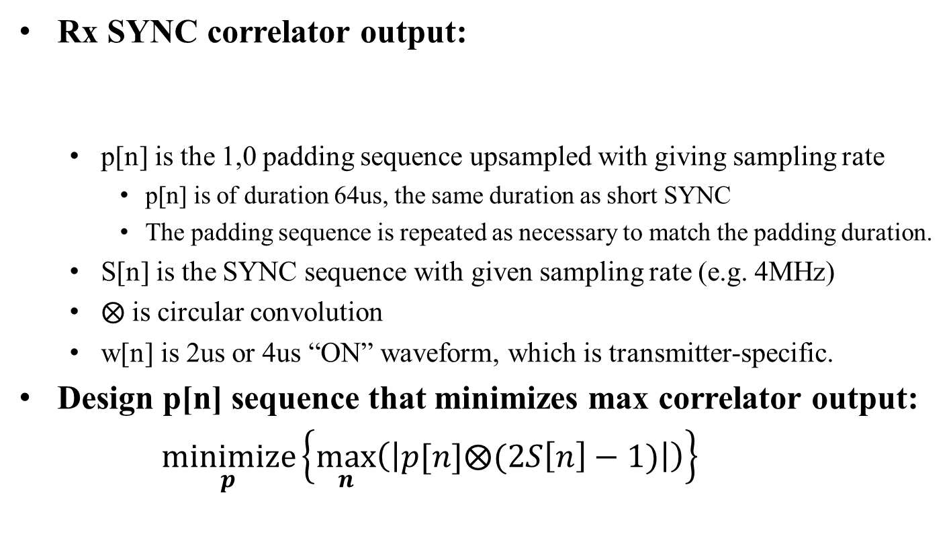
Fixed Padding Sequence Search
Rx SYNC correlator output:
  p[n] is the 1,0 padding sequence upsampled with giving sampling rate
    p[n] is of duration 64us, the same duration as short SYNC
    The padding sequence is repeated as necessary to match the padding duration.
  S[n] is the SYNC sequence with given sampling rate (e.g. 4MHz)
  $⨂$ is circular convolution
  w[n] is 2us or 4us “ON” waveform, which is transmitter-specific.
Design p[n] sequence that minimizes max correlator output:
$\underset{p}{minimize}\left\{\max_{n}\left(\left|p[n]⨂(2S\left[n\right]−1)\right|\right)\right\}{ }$
$$y=w[n]⨂p[n]⨂(2S\left[n\right]−1)==$$

Slide 8
Option 2: Fixed Data Padding
For both HDR and LDR, the optimal padding data is all-zero or all-one sequence.
With random phase/CSD, the waveform spectrum will not have spikes.

Slide 9
Option 3: Fixed Sync Sequence
Search through the entire 2^32 signal space
  No more than 4 consecutive zeros
  → 8us OFF, LDR max OFF
  Begins with <=2 consecutive zeros
  → 4us OFF, LDR OFF per bit
Numerical results
  Two sequences associated with min correlation peak value of 2:
    [0 1 0 1 0 1 0 1 0 1 0 1 0 1 0 1 0 1 0 1 0 1 0 1 0 1 0 1 0 1 0 1]
    [1 0 1 0 1 0 1 0 1 0 1 0 1 0 1 0 1 0 1 0 1 0 1 0 1 0 1 0 1 0 1 0]
    They corresponds to the all-one or all-zero HDR data pattern
    Padding can be implemented using the HDR waveform generator
  One example sub-optimal sequence with correlation peak value of 3:
    [0 1 0 0 1 0 1 0 0 1 0 1 0 1 1 0 1 0 0 1 0 1 0 1 0 0 1 0 1 1 0 1]

Slide 10
Simulations
System settings
  3rd order Butterworth LPF with cutoff 2.5MHz
  Only I path is considered at the receiver
  SNR: 20MHz definition
    The “ON” waveform SNR after LPF is ~9dB higher
Padding settings
  Padding patterns:
    Option 1: random data pattern for both HDR and LDR
    Option 2: all zero data pattern for both HDR and LDR
    Option 3: [0 1 0 0 1 0 1 0 0 1 0 1 0 1 1 0 1 0 0 1 0 1 0 1 0 0 1 0 1 1 0 1]
  Padding duration:
    Max for HDR subchannel: ((16+6)*8*16 – 6*8*4+64)us = 2.688ms
    Max for LDR subchannel: ((16+6)*8*16 – 6*8*16) us = 2.048ms
  Metric: False Alarm (FA) rate
    SYNC is detected if the normalized correlation output passes a given threshold
    Any SYNC detection within the padding duration is counted as a FA event

Slide 11
Result: SNR=-10dB
  All zero HDR pattern shows the smallest FA rate.
  Random HDR padding waveform has highest false alarm rate.
  All-zero HDR < Random noise ≈ sub-optimal 2us Seq < All-zero LDR

Slide 12
Result: SNR=-5dB
  All zero HDR pattern shows the smallest FA rate.
  Random HDR padding waveform has highest false alarm rate.
  All-zero HDR < Random noise ≈ sub-optimal 2us Seq < All-zero LDR

Slide 13
Result: SNR=0dB
  Random data padding shows higher FA rate as SNR increases
  All fixed padding schemes show relatively stable FA rate for all SNRs

Slide 14
Summary
For FDMA transmission with padding,
  WUR receiver may false trigger during padding, and
  miss the its own wake up packet, especially in low SNR range.
Investigated several padding options and they converge to the following three designs:
  Option 1: Random data padding
    No change to the transmitter state machine after WUR-Data end
  Option 2: All-zero or all one data padding
    No change to the transmitter state machine after WUR-Data end
    Relax WUR SYNC detection threshold choice
  Option 3: Repeating [0 1] or [1 0] SYNC sequence
    Much relaxed WUR SYNC detection threshold choice
    It is the same as all-zero or all-one HDR data
    Transmitter can choose to use SYNC or HDR WFG

Slide 15
FDMA Duration Discussion
“In FDMA case, PHY padding bits are appended to each 20 MHz channel to make the length of PPDU equal to the Length indicated in L-SIG” [2]
How to define the Length in the L-SIG is not specified?
  The Length will infer the amount of padding is needed.
We propose to define that
  the LSIG Length in a WUR FDMA packet is calculated based on the longest duration among all the non-punctured 20MHz sub-channels before padding.

Slide 16
References
[1] Rui Cao and etc., 11-18-1129-05-00ba, “Discussion on WUR FDMA padding issues”.
[2] Draft P802.11ba D0.4

Slide 17
Straw Poll 1
Do you agree that FDMA padding uses the following
  Option 1: Random data padding using the same WUR-Data rate
  Option 2: All-zero or all-one data padding using the same WUR-Data rate
  Option 3: Repeated [0 1] or [ 1 0] padding with each bit corresponds to 2us waveform

Slide 18
Straw Poll 2
Do you agree that FDMA padding uses the following?
  Option 1: All-zero data padding using the same WUR-Data rate
  Option 2: All-one data padding using the same WUR-Data rate

Slide 19
Straw Poll 3
Do you agree that FDMA padding uses the following?
  Option 1: Repeated [0 1] padding with each bit corresponds to 2us waveform
  Option 2: Repeated [1 0] padding with each bit corresponds to 2us waveform

Slide 20
Straw Poll 4
Do you agree with the following for FDMA?
  the LSIG Length in a WUR FDMA packet is calculated based on the longest duration among all the non-punctured 20MHz sub-channels before padding.

Slide 21
Appendix: False Alarm in DNLos

Slide 22
DNLos FA@-10dB

Slide 23
DNLos FA@-5dB

Slide 24
DNLos FA@0dB

