Slide 1
SOMA for EHT
Date: 2018-09-10
Authors:
Name | Affiliation | Address | Phone | Email
Junghoon Suh | Huawei |  |  | junghoon.suh@huawei.com
Osama Aboul-Magd |  |  |  | osama.aboulmagd@huawei.com
Jia Jia |  |  |  | justin.jia@huawei.com
Edward Au |  |  |  | edward.ks.au@huawei.com

Slide 2
Background
EHT SG is approved [1]
  Approve formation of an EHT SG (Extreme High Throughput Study Group) to develop a Project Authorization Request (PAR) and a Criteria for Standards Development (CSD) for a new 802.11 amendment for operating in the bands between 1 to 7.125 GHz, with the primary objectives:
  To increase peak throughput and improve efficiency
  To support high throughput and low latency applications such as video-over-WLAN, gaming, AR and VR
  With target start of the task group in May 2019
We propose Semi Orthogonal Multiple Access (SOMA) to improve the efficiency of 802.11

Slide 3
SOMA
Semi-Orthogonal Multiple Access
  Superposition transmission with adaptive power ratio on component constellations and Gray-mapped superposed constellation
  It is not just a superposition of multiple component constellations, but artificially designed to make the superposed constellation to be gray-mapped so that the Interference Cancellation doesn’t have to be necessary at the Near STA → Receiver is less complex
  Little changes to the current 802.11 Transceivers
    Data come from multiple STAs to form a constellation in the TX side
    Only the LLRs corresponding to the receiver will be retrieved in the STA side
  Technology is mature
    SOMA is a part of 3GPP LTE Advanced technologies
      Multi-User Superposition Transmission (MUST) in Section 6.3.3 of TS 36.211
      The gain is already proven in both Link and System Level
  SOMA was first presented in IEEE 802.11 WNG SC, July 2016
    16/943r0 Introduction to SOMA

Slide 4
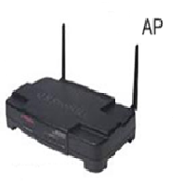

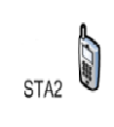
Superposition Transmission
Transmission signals:
OMA
Superposition
BW1=BW/2
P₁
Power
Power
BW2=BW/2
P₂
SNR = 0dB
Freq
SNR = 20dB
BW
Freq
OMA: P₁ = P₂ = 0.5
Superposition: P₁ = 0.2, P₂ = 0.8
 | OMA | Superposition
R₁ (bps/Hz) | 3.33 | 4.39 (+32%)
R₂ (bps/Hz) | 0.5 | 0.74 (+48%)
Source: Saito, et al, “Non-Orthogonal Multiple Access for Cellular Future Radio Access”, VTC, June 2013.

Slide 5
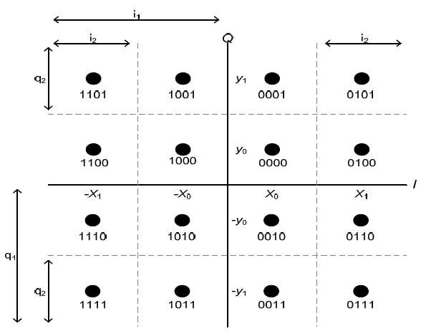
Re-cap
There are bits more reliable than others in a QAM constellation [2].
  The bits more reliable may be scheduled for a STA in lower SNR channel
  The bits less reliable may be scheduled for a STA in higher SNR channel
4 bits for 16-QAM: i₁i₂q₁q₂ where i₁i₂ are the in-phase components and q₁q₂ are the quadrature-phase components.
Here, i₁ and q₁ are the most reliable bits and i₂ and q₂ are the least reliable bits.
In the same way, for 6 bits (i₁i₂i₃q₁q₂q₃) of 64-QAM, i₁ and q₁ are the most reliable bits, i₂ and q₂ are the medium reliable bits, and i₃ and q₃ are the most reliable bits.
As for 256 QAM (i₁i₂i₃i₄q₁q₂q₃q₄) , i₁ and q₁ are the most reliable bits, i₂ and q₂ are the first medium reliable bits, i₃ and q₃ are the second medium reliable bits, and i₄ and q₄ are the least reliable bits.
16 QAM Constellation with Gray-mapping

Slide 6
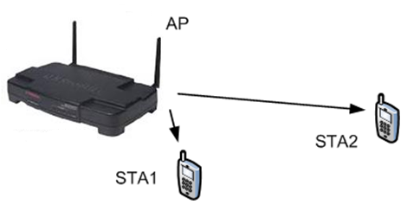
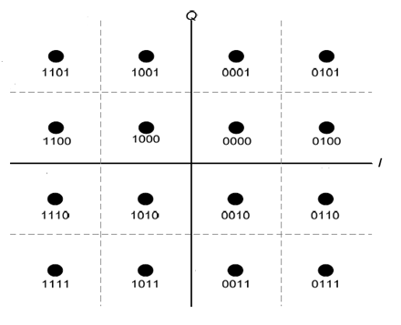
SOMA
For STA 1 (Near STA) and STA 2 (Far STA) in the figure beside, the SOMA is not just a superposition of two constellations from two STAs, but, instead, the property of more and less reliable bits in a constellation is used to schedule Far and Near STAs as seen in the figure below
For Near-STA to decode Near-STA bits, Far-STA bits need Not to be known
The Far-STA decodes its own signal, and treats Near-STA as noise just like a Superposition
The Near-STA performs the demodulation of the re-ceived signal, collecting the LLRs corresponding to the near coded bits, and then performs decoding of the near-STA codeword.
  Complexity in the Receiver side is reduced
SOMA can be applied with OFDMA and its throughput enhancement at AP side is significant, compared to the OFDMA only
STA2
STA1

Slide 7
TX/RX design flow for Single Stream based SOMA
STA 1
FEC Encoder
Interleaver
SOMA
Constellation
Mapper
Spatial
Mapping
To
Antenna
STA 2
FEC Encoder
Interleaver
IFFT
…..
…..
…..
STA N
FEC Encoder
Interleaver
De-inter-
leaver
STA 1
FEC Decoder
De-inter-
leaver
LLR
Computation
Channel
Estimation
and
Equalization
STA 2
FEC Decoder
FFT
…..
…..
….
STA N
FEC Decoder
De-inter-
leaver
The data of each STA are separately encoded and interleaved, before being combined for the SOMA constellation mapping.
The STA 1 through STA N represent the SOMA scheduled STAs.
Each STA can take the corresponding LLR information and take the De-interleaving separately, which will be followed by FEC Decoder for each STA to recover its data

Slide 8
Simulation for a single stream based SOMA
CSMA
Near STA1 original link: MCS3 (16QAM,1/2)
Far STA2 original link: MCS1 (QPSK, 1/2)
SOMA
Total Constellation: 16QAM
Near STA1 new link: MCS1 (2 less reliable bits of 16QAM, 1/2)
Far STA2 new link: MCS1 (2 more reliable bits of 16QAM, 1/2)

Slide 9
How to compute the System Goodput
STA Goodput
where R is a code rate and
M is a bit size per QAM constellation
System Goodput for CSMA (without consideration of contention period)
System Goodput for SOMA

Slide 10
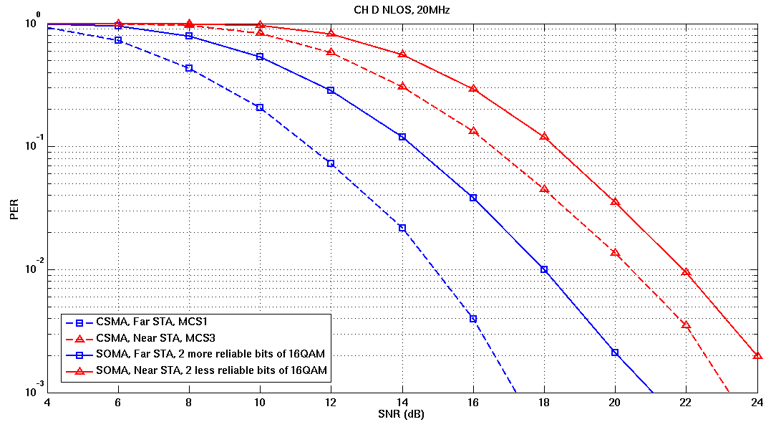
Performance Comparison-w/ CFO and PN

Slide 11
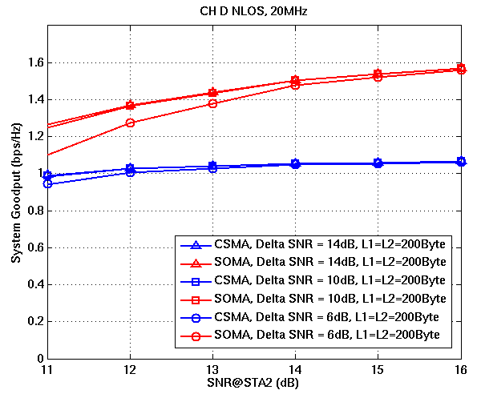
System Goodput Evaluation-w/ CFO and PN
Fixed SNR difference between STAs
Variable SNR at STA2

Slide 12
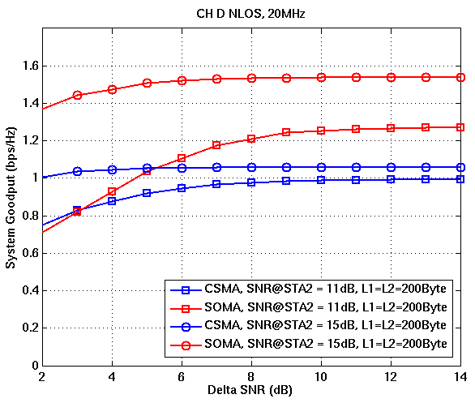
System Goodput Evaluation-w/ CFO and PN
Fixed SNR at STA2
Variable SNR difference between STAs

Slide 13
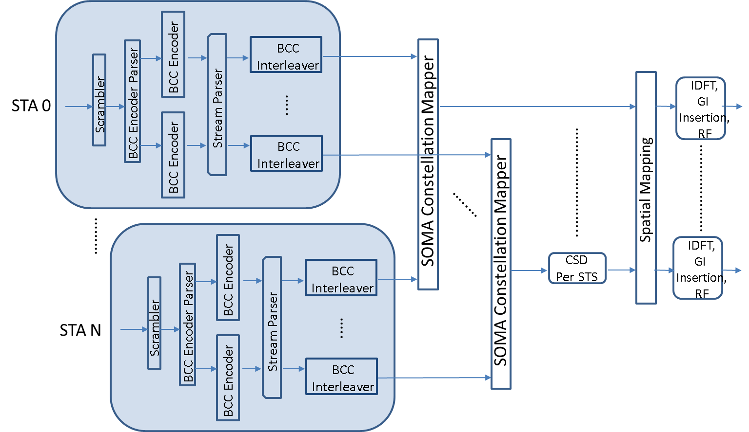
MIMO based SOMA

Slide 14
Simulation for MIMO based SOMA
16-QAM SOMA on top of 4X4 Open-loop SU-MIMO
  2 STA SOMA with each STA modulated in QPSK and MMSE MIMO detection
16-QAM SOMA on top of 2X2 Open-loop SU-MIMO
  2 STA SOMA with each STA modulated in QPSK and MMSE MIMO detection
Baseline performance to compare with
  8TX MU-MIMO scheduled with 2 STAs, each STA scheduled with 4 Streams and modulated in QPSK, respectively / 4TX MU-MIMO scheduled with 2 STAs (each 2 streams and in QPSK)
    Limited sounding error (No CSI Quantization error, No CSI feedback error, but real channel estimation using the LTFs)
    Zero-forcing BF in the TX, and MMSE detection in each STA
  4X4 SU-MIMO in QPSK and MMSE MIMO detection
Common simulation parameters
  Convolutional Encoding and its Viterbi decoding are used as FEC
  MCW (Multi Codeword), separate FEC is applied to each stream
  For the system Goodput, the SNR is Far STA’s SNR and the 1st STA’s SNR for MU-MIMO

Slide 15
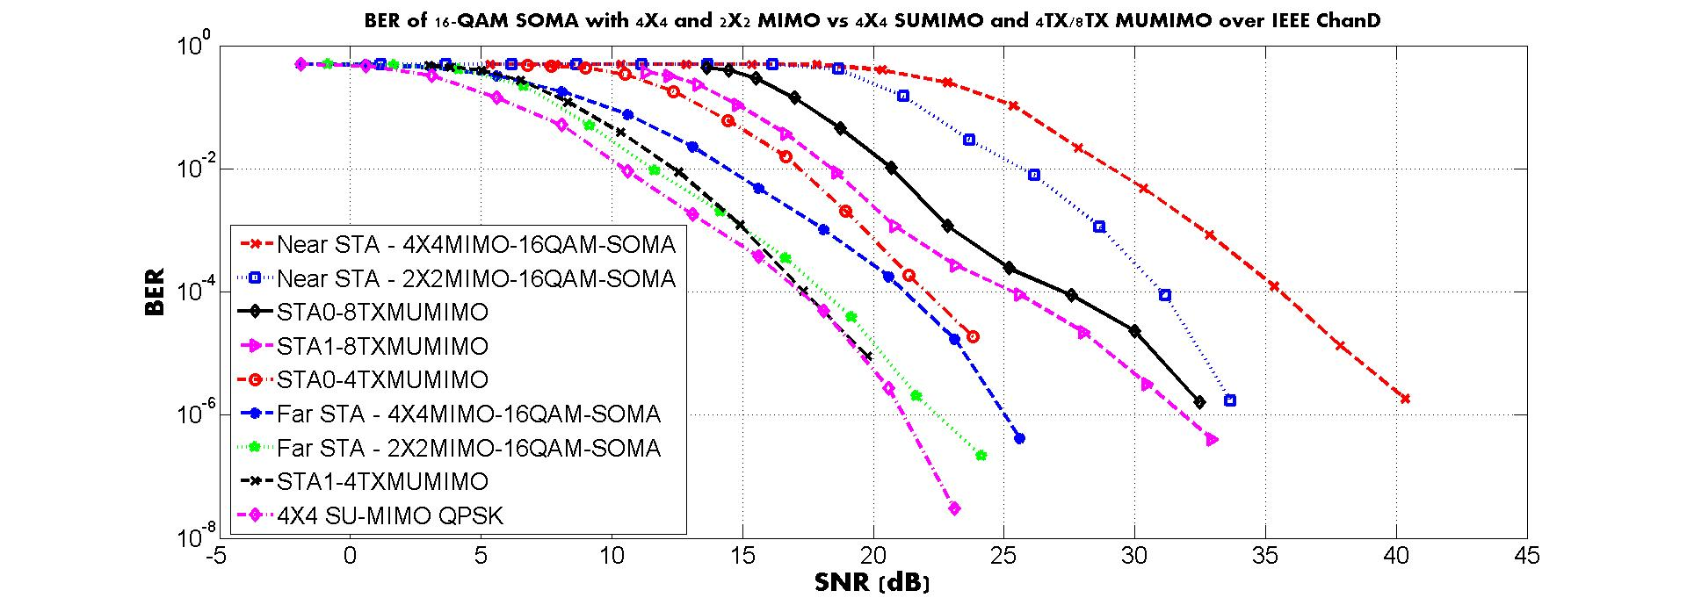
BER Performance comparison:
4X4 (2X2) 16QAM MIMO-SOMA vs 4X4 SU-MIMO vs 8TX/4TX 2STA MU-MIMO

Slide 16
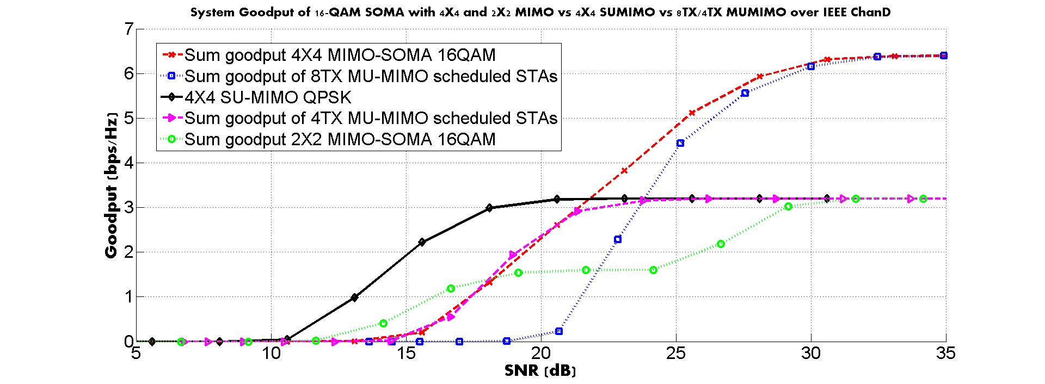
Goodput Performance comparison:
4X4 (2X2) 16QAM MIMO-SOMA vs 4X4 SU-MIMO vs 8TX/4TX 2STA MU-MIMO

Slide 17
Performance Summary: MIMO-SOMA
Goodput in the high SNR region for both 8X8 MU-MIMO with 2 STA scheduling and 4X4 16-QAM SOMA are both 6.4 bps/Hz
  MU-MIMO is achieved under the limited sounding errors (No CSI Quantization error, No CSI feedback error, but real channel estimation using the LTFs)
  We can see that 16-QAM SOMA is not worse than 8X8 MU-MIMO
  The number of Spatial streams are 4 streams smaller for 16QAM SOMA than 8X8 MUMIMO and the CSI feedback is not required for SOMA in achieving the similar performance
SOMA is not a competing technology against MU-MIMO, but rather, is a complementary technology, especially when the Close Loop MIMO is not available due to the time-variant channel and the available spatial resources are limited in the AP side.

Slide 18
Conclusions
As we saw from the simulation results, a similar throughput can be achieved with SOMA, consuming less spatial resources and CSI feedback overhead, compared to the MU-MIMO
SOMA shows a throughput gain over the CSMA
The SOMA technology is mature and relatively simple
  There is no significant change from the current 802.11 design flow
    Data come from multiple STAs to form a constellation in the TX side
    Only the LLRs corresponding to the receiver will be retrieved in the STA side
  SOMA is a part of 3GPP LTE Advanced technologies
    Multi-User Superposition Transmission (MUST) in Section 6.3.3 of TS 36.211
    The gain is already proven in both Link and System Level

Slide 19
Appendix
New Constellation for 16-QAM in case an adaptive power needs to be applied to each SOMA STA
Goodput performance of the SISO based 16-QAM SOMA
  with different delta-snr (SNR gap between Far and Near STA) and different alpha (power allocation factor)

Slide 20
Adaptive Power Allocation based 16-QAM
When is 0.2, the constellation becomes the 802.11ac 16-QAM
The receiver needs to know the to compute the right LLR

Slide 21
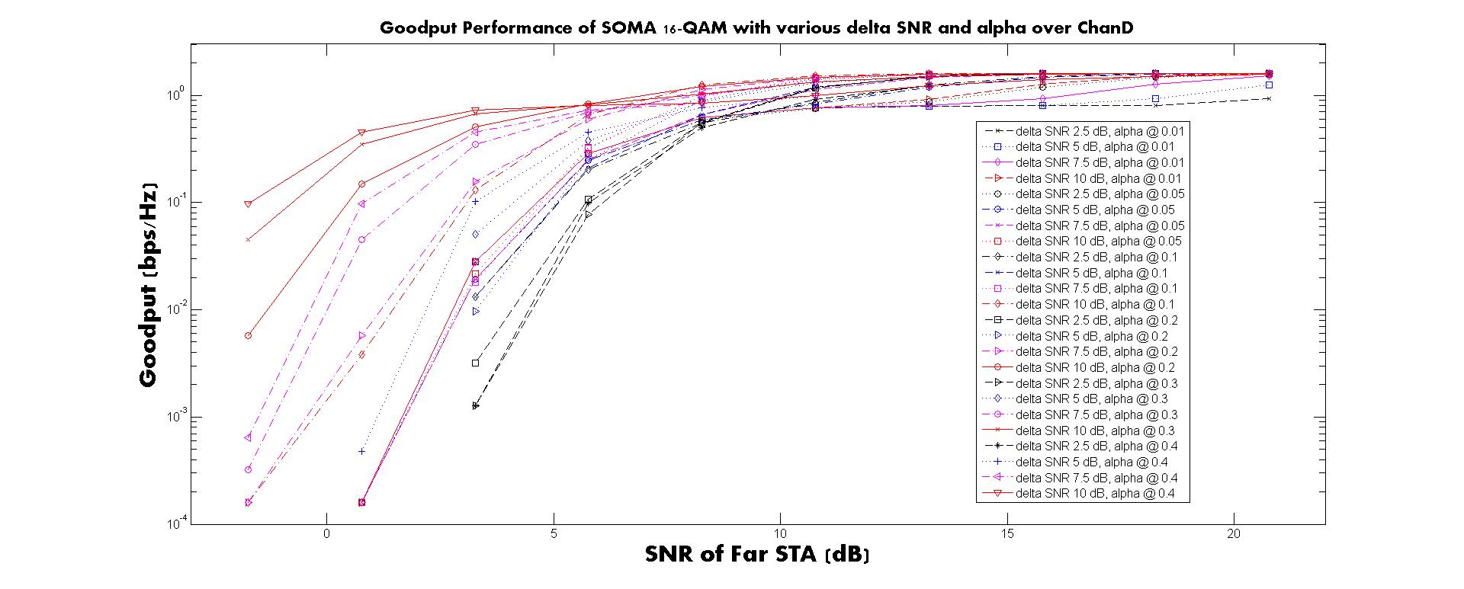
Goodput for 16-QAM SISO based SOMA

Slide 22
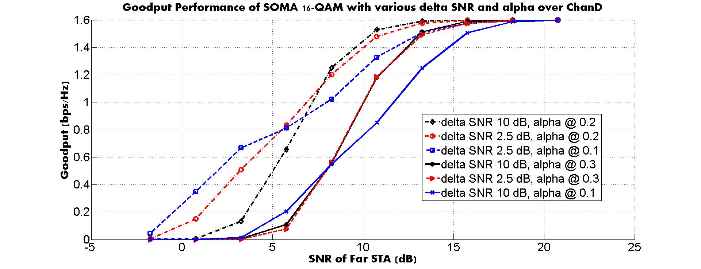
Goodput for 16-QAM SISO based SOMA:
Selected Curves

Slide 23
References
[1] R. Stacey, “18/1059r6 802.11 July 2018 WG Motions”, IEEE 802.11 WG, July 2018, San Diego CA, USA
[2] Saito, et al, “Non-Orthogonal Multiple Access (NOMA) for Cellular Future Radio Access”, VTC, June 2013

Slide 24
SP
Would you be willing to work on the SOMA during the EHT?
Y/N/Abs

