Slide 1
Discussions on the PHY features for EHT
Date: 2018-09-09
Authors:
Name | Affiliation | Address | Email
Xiaogang Chen | Intel | NE 25th Ave. Hillsboro, OR, US | Xiaogang.c.chen@intel.com
Qinghua Li
Feng Jiang
Kenney Thomas
Laurent Cariou
Stacey Robert
Ziv Avital
Tzahi Weisman
Assaf Gurevitz
Po-Kai Huang

Slide 2
Outline
Recapture of SG motions
PHY design assumptions for EHT
Potential PHY topics in EHT
Summary

Slide 3
Recapture of SG motions
Move to approve formation of an EHT SG (Extreme High Throughput Study Group) to develop a Project Authorization Request (PAR) and a Criteria for Standards Development (CSD) for a new 802.11 amendment for operating in the bands between 1 to 7.125 GHz, with the primary objectives:
  To increase peak throughput and improve efficiency
  To support high throughput and low latency applications such as video-over-WLAN, gaming, AR and VR
  With target start of the task group in May 2019

Slide 4
Consideration on the assumptions in EHT
Operating band
  EHT STAs are able to work in 6GHz, 5GHz and 2.4GHz band.
  Only have EHT/HE/non-HT PPDU in 6GHz.
    Non-HT is used to carry short packet;
    Mode reduction (no VHT/HT modes in 6GHz) to simplify test.
Channelization
  Include 20MHz/40MHz/80MHz/160MHz/320MHz in 6GHz band.

Slide 5
Consideration on the assumptions in EHT (Cont’d)
Coexistence with incumbents
  Master devices (AP) indicates the available channels in 6GHz.
    Master devides get these information from, e.g. data base.
  Subchannel/RU puncturing is used to accommodate the disabled frequency segment(s).
  Minimum CCA granularity is 20MHz
    Finer granularity will create significant changes in preamble design;
    Power of incumbents may be ignored in ED.

Slide 6
Potential EHT PHY Features – Collocated MIMO
16 SS
  MUMIMO could be the beneficiary of 16SS;
    16SS could be optional for EHT AP given reasonable feedback overhead;
      Implicit FB;
        One end (AP) calibration.
      More efficient explicit FB.
4096 QAM
    Keep the cadence of introducing a new modulation level per WiFi generation;
      64QAM-> 11n; 256QAM-> 11ac; 1024QAM-> 11ax; 4096QAM-> EHT
    Feature of eye catcher for marketing;
    Be applied only if beamforming is used;
      No new EVM requirement for 4096 QAM;
      BF gain compensates EVM gap (-35dB instead of -42dB);
        Expect more BF gain as long as more antennas are deployed.

Slide 7
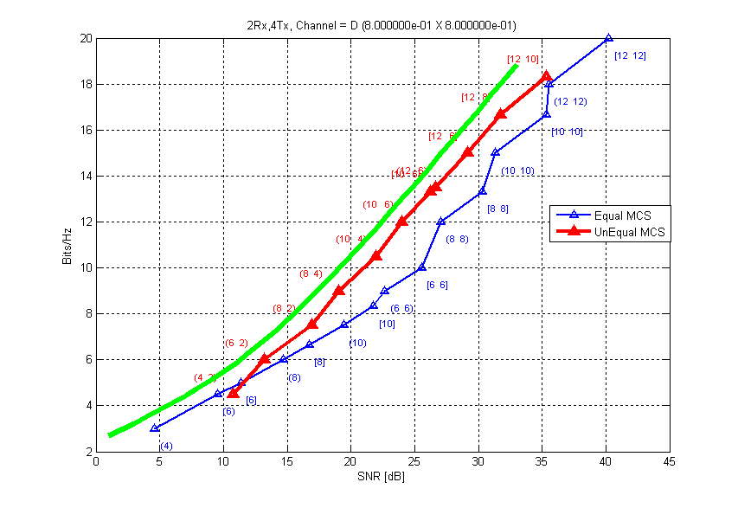
Potential EHT PHY Features – Collocated MIMO (cont’d)
Unequal MCS between different SS
  Highly correlated antennas increase the divergence of Eigen value between SS;
  Per SS SNR is feedback but not fully utilized.
  Unequal MCS can be studied to further improve the throughput
    Limit to SU-BF
    Limit to LDPC

Slide 8
Potential EHT PHY Features – Collocated MIMO (cont’d)
UL CQI measurement / UL Power control
  UL CQI helps TB RU selection;
  Efficient UL Power control is key to UL MUMIMO;
  Implementation based solutions
    AP uses reciprocal CQI in DL
      DL CQI is not a good reference due to BF;
      Unbalanced number of Tx/Rx antennas.
    AP leverages the UL traffic for CQI measurement / Power control
      UL BF can be applied in the client side and is transparent to AP;
      Data is not as efficient as NDP;
        Less STAs can be measured within one shot. Limited by Rx antennas at AP;
        Longer duration.
    NDP Short Feedback
        Can accommodate large number of STAs;
        But very sparse tone allocation.

Slide 9
Potential EHT PHY Features – Collocated MIMO (cont’d)
UL CQI measurement / Power control
  Potential solution in EHT
    UL NDP
      Has been defined in 11az;
      Can be used for implicit beamforming;
      Can be leveraged for UL CQI measurement / power control.

Slide 10
Potential EHT PHY Features – Distributed MIMO
Distributed MIMO (detailed analysis in back up slides)
  Multi-AP
    Some fancy design could complicate the implementation and defer EHT timeline;
    Simpler solutions need to be prioritized.
      Light coordination in Time/Frequency
        Less PHY changes comparing with the other two schemes.
      Nulling
        Coordination could be very complicated;
        Be polite to neighbor STAs is not free;
        Simplified version may be feasible with the sacrifice of flexibility;
      Joint processing
        The most complicated one from higher layer to PHY layer;
        Need extensive evaluation to justify the benefits.

Slide 11
Potential EHT PHY Features – Distributed MIMO (Cont’d)
Sounding feedback for distributed MIMO
  Use 11ax sounding procedure as baseline;
  Minimize the feedback modes on the client side;
  May need other feedback modes (besides the modes in 11ax) depends on the category of coordination.

Slide 12
Potential EHT PHY Features - Preamble
Green field preamble is not a good practice due to backward compatibility.
Auto detection
  Need to differentiate EHT, HE, non-HT, HT and VHT PPDU;
    It’s better to have a future proof solution instead of debating in every generation;
    It’s better if early termination can be achieved for intra PPDU power saving.
      11n STA treat 11ac/11ax PPDU as 11a PPDU;
      11ac STA treat 11ax PPDU as 11a PPDU and decode the whole PPDU;
      11ac/11ax treat EHT PPDU as ??
EHT-SIGB
  HE-SIGB information is well organized but frequency mapping is messy;
  Duplicated structure (1/2/1/2) over optimize the performance for wider BW and waste resource
  A decent frequency mapping scheme can be considered.

Slide 13
Potential EHT PHY Features – Tone Plan
Physical 20MHz boundary is not aligned with the 242 tone RU of 80MHz PPDU in 11ax.
  Troubles keep popping up in 11ax already;
  Better to apply an easy fix in EHT.
320MHz channel in 6GHz.
  Extend the 80MHz tone plan is a simpler approach;
  Collecting null tones (DC/Guard) with a new tone plan has marginal gain.

Slide 14
Potential EHT PHY Features – Incumbent Coexistence
11ax disabled subchannel could be a starting point;
  Finer puncturing granularities can be added;
    ~25% incumbents in 6GHz have BW <= 10MHz
    E.g. finer granularity can be 5 or 10MHz including guard.
Requirements for RU puncturing;
  Defining a mask
    DL Mask only as 11ax;
    Or DL+UL Mask.
  Leave to implementation
    More chance to be identified and blocked if a STA interferes incumbents

Slide 15
Potential EHT PHY Features – MultiBand Operation
Mostly MAC Topic;
  MAC layer aggregation should be prioritized;
  Assuming MAC aggregation can solve most issues;
  PHY layer aggregation is considered only if critical issue is passed to PHY.

Slide 16
Summary
To meet the tight timeline of EHT, essential PHY topics should be prioritized
  Preamble design;
  Tone plan;
  Incumbent Coex;
  Collocated MIMO enhancement;
  Distributed MIMO with minimal PHY changes;
  MultiBand (if anything pass to PHY).
Note: The sub-bullets are not ordered with priority.

Slide 17
Back up
Analysis of the PHY impacts from distributed MIMO

Slide 18
Frequency coordination
After the Master AP split the whole band (e.g. 80MHz) into subbands (e.g. 40MHz x 2). The coordinated APs
  Option I: use 40MHz mask and transmit 40MHz PPDU (BW = 40MHz in SIGA);
  Option II: use 80MHz mask and transmit 80MHz PPDU (BW = 80MHz in SIGA) with multi-AP OFDMA. Populate energy on 40MHz.
Options | I | II
Pros | Almost no PHY changes | Smooth AP transition and transparent to clients
Cons | Temporarily Mask change back and force; lose the flexibility of non-contiguous 40MHz; receive preamble on S20; | Need preamble & data boundary alignments; receive preamble on S20.

Slide 19
Nulling
Coordinating procedure could be complicated (next page)
  Victim STAs identify interferer and report to master AP;
  Master AP schedule nulling on different frequency;
  Persecution AP sound the victim STA in neighbor BSS;
  Persecution AP apply nulling in data Tx in nulling widow.
Challenges
  Create nulling for neighbor STA also reduce the freedom of persecution AP itself;
    Feasible for AP with larger number of antennas;
  Limited flexibility to null multiple directions;
  If pursuing to this direction, better to keep one nulling direction per RU for simplicity

Slide 20
Nulling (cont’d)

Slide 21
Joint processing
Clock drifting between two APs
  Could introduce FFT window offset, Frequency offset between two APs;
  Sounding feedback may not match the channel when data is sent;
  Clock drifting during data transmission is hard to trace and compensate.
Power imbalance between antennas
  Create illed-conditioned channel;
  The impact need further evaluation.

