Slide 1
802.1D in 802.11
Date: 2018-08-27
Authors:

Slide 2
Abstract
During discussion on resolution of LB232 CID 1014, observations were made that 802.11 sometimes references 802.1D, which diverges from 802.1Q
Participants debated whether 802.1D was necessary for 802.11
This submission explores the relationship between 802.1D and 802.11, and proposes a migration model.

Slide 3
State of 802.1D
The latest version of 802.1D is 802.1D-2004 (14 years ago)
It hasn’t been updated since 2004*, not because it is in a state of “ethereal perfection”, but rather because its features have been incorporated in other standards
  802.1Q (Bridges and Bridged Networks)
  802.1AC (MAC Service Definition)
  * Two amendments were added (but no integration into 802.1D standard), 802.17a (802.17 bridging support, 2004) and 802.16k (802.16 bridging support, 2007)

Slide 4
Should 802.11 reference an old standard?
Each standard evolves, and so do the associated practices
Referencing a standard is only meaningful if the standard is current, and reflects industry practices
A standard that is not updated shows that it is getting disconnected from the industry
The risk with referring to an old standard is that our standard may get a growing disconnect with the industry practices
  Using 802.1D as a reference already causes disconnects with 802.11ak

Slide 5
Can we remove old references?
802.11 references a standard that is old and not updated anymore
Is the content of that old standard integrated in a new standard?
Can 802.11 follow newer industry practices and reference the new standard?
Update 802.11 text and reference
yes
yes
no
no
Is the content of that old standard “current” for 802.11?
Integrate required old standard content into 802.11
yes
no
Remove references in 802.11

Slide 6
802.1D in 802.11(1.4md)
5.1.1.2 Determination of UP:
The QoS facility supports eight priority values, referred to as UPs. The values a UP may take are the integer values from 0 to 7 and are identical to the IEEE 802.1DTM priority tags. An MSDU with a particular UP is said to belong to a traffic category (TC) with that UP.

Slide 7
What does “identical to 802.1D priority tags” mean?
802.1D does not define priority “tags” but does define user priority parameters and values
  Intended so that “requests with a high priority may be given precedence over other request primitives made at the same station, or at other stations attached to the same LAN “ (6.3.9)
  Not visible in MAC directly (no tag), but internal to queuing process (other 802s define tagging)

Slide 8
What does “identical to 802.1D priority tags” mean?
802.1D allows a UP to be communicated between devices, and changed
  Can be modified by a bridge between two medias:
    “The MAC Sublayer maps the requested user priorities onto the access priorities supported by the individual media access method. The requested user priority can be conveyed to the destination station with the transmitted frame, using the priority signaling mechanisms inherent in some media access methods. “
    “Under normal circumstances, user priority is not modified in transit through the relay function of a Bridge; however, network management can control how user priority is propagated. “ (6.3.9)

Slide 9
802.1D priorities are not used for other purpose than expressing priority hierarchy
“The user_priority parameter is the priority requested by the originating service user. The value of this parameter is in the range 0 (lowest) through 7 (highest).
The access_priority parameter is the priority used by the local service provider to convey the request. It can be used to determine the priority attached to the transmission of frames queued by the local MAC Entity, both locally and among other stations attached to the same individual LAN, if the MAC method permits. The value of this parameter, if specified, is in the range 0 (lowest) through 7 (highest).” (6.4.1)

Slide 10
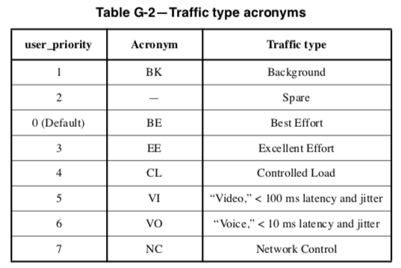
802.1D envisioned up to 8 traffic types
“Up to” means that 1 to 8 queues are defined
  802.11 works on this assumption of 8 queues
Spare is conceived as an burst overflow queue for BE traffic (lower priority than BE)

Slide 11
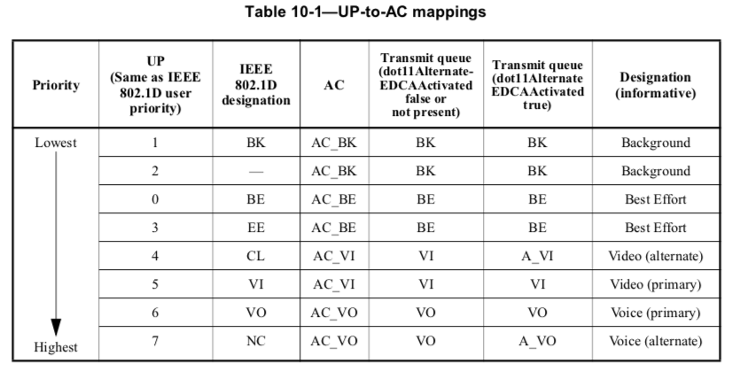
802.11 uses 802.1D UP hierarchy
Higher Number / tag is reflective of a higher priority intent

Slide 12
However, does 802.11 borrow anything else from 802.1D “tags”?
802.1D defines traffic types and performance targets:
Voice (UP 6), < 10 ms latency and jitter
  802.11 UP 6 does not work under this target assumption
Video (UP 5), < 100 ms latency and jitter
  802.11 UP 5 does not work under this target assumption
Controlled load (UP 4), “important business applications subject to some form of “admission control,” from pre-planning of the network requirement at one extreme to bandwidth reservation per flow at the time the flow is started at the other”. (G.1.)
  802.11 UP 4 belongs to AC_VI and maps to traffic only loosely related to the above characterization

Slide 13
However, does 802.11 borrow anything else from 802.1D “tags”?
802.1D defines traffic types and performance targets:
Excellent Effort (UP 3), “or “CEO’s best effort,” the best-effort type services that an information services organization would deliver to its most important customers.” (G.1)
  802.11 UP 3 belongs to BE category, and can be used to internally provide higher service differentiation then the bulk AC_BE queue (implementation-dependent)
Best Effort (UP 0) “LAN traffic as we know it today “ (G.1)
  This definition has no meaning for 802.11 in 2018
  Best Effort is our default queue

Slide 14
However, does 802.11 borrow anything else from 802.1D “tags”?
802.1D defines traffic types and performance targets:
Spare (UP 2): not defined in 802.1D-2004
  However, Annex G.3 defines various traffic type mixes and mentions that, in the case of an 8 queue mix, “from the point of view of defining defaults at the present time it seems reasonable to allocate an additional priority around best effort to support bandwidth sharing management for bursty data applications.”
  Contributions from these years further explain the intent as BE overflow (with lower priority than primary BE)
  802.11 UP 2 clearly belongs to BK category (not to BE), its usage is not defined as a BE overflow (as BE bursts are not remarked)

Slide 15
However, does 802.11 borrow anything else from 802.1D “tags”?
802.1D defines traffic types and performance targets:
Background (UP 1): “bulk transfers and other activities that are permitted on the network but that should not impact the use of the network by other users and applications.” (G.1.)
  802.11 UP 1 matches this intent

Slide 16
Conclusion 1
802.11 uses the same User Priority hierarchy system as 802.1D (UP 0 to 7)
802.11 does not use the UP names that 802.1D uses (Excellent Effort etc.)
802.11 does not use exactly the same traffic categorization definition as 802.1D
We do not need to reference 802.1D if what we mean is “we use 0 to 7, 7 being highest priority”

Slide 17
Segue 1
“The values a UP may take are the integer values from 0 to 7 and are identical to the IEEE 802.1DTM priority tags” is misleading:
  There is no priority tag in 802.1D
  The values we use do not have all the same names and intents
We should stop referring to 802.1D for our UPs

Slide 18
Proposal 1
Change 5.1.1.2:
The QoS facility supports eight priority values, referred to as UPs. The values a UP may take are the integer values from 0 to 7. A higher UP is reflective of a higher priority intent and are identical to the IEEE 802.1DTM priority tags. An MSDU with a particular UP is said to belong to a traffic category (TC) with that UP. The UP is provided with each MSDU at the medium access control service access point (MAC SAP) either directly, in the UP parameter, or indirectly, in a TSPEC or SCS Descriptor element designated by the UP parameter.

Slide 19
Proposal 2
“Fix” table 10-1:
Suggest delete column. We do not use the 802.1D traffic designations
Suggest delete. If this means “we also use 0 to 7”, then it has no value. If it means that higher number means higher priority, the meaning is already conveyed on the left

Slide 20
Proposal 3
Remove Annex R references to 802.1D:
R.3.3 Example of QoS mapping from different networks
IEEE 802.1D 802.11 UPs map to EDCA ACs, as described in Table 10-1. The use of DSCP sets differs from network to network. Table R-1 shows examples of DCSP mappings.

Slide 21
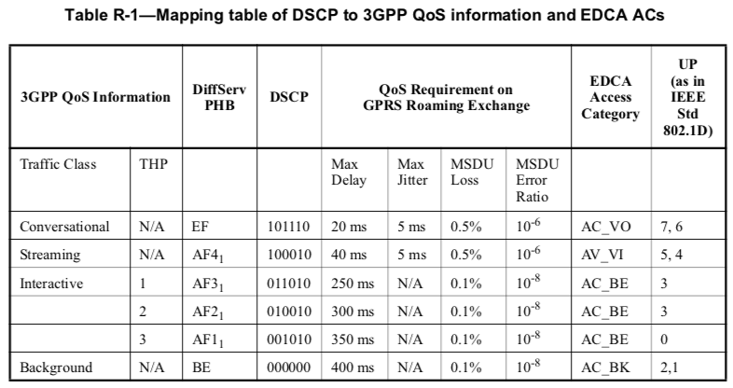
Proposal 3
Suggest delete. This is not only “not needed”, but is also misleading in its current form (e.g. 802.1D Voice nowhere allows for 20 ms delay, but 10 ms, only, UP 7 is not for Conversational, etc.
Remove Annex R references to 802.1D:

Slide 22
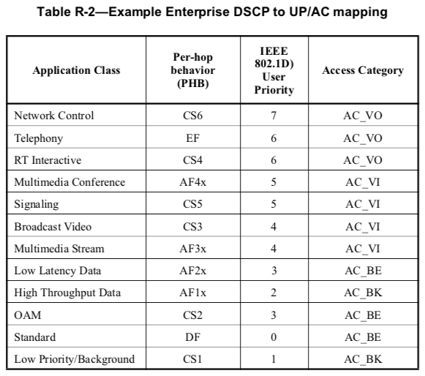
Proposal 3
Remove Annex R references to 802.1D:
Suggest change to IEEE 802.11 UP*
* 18-0354-01 made additional
suggestions for this table content

Slide 23
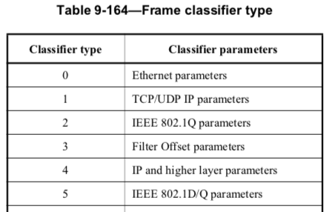
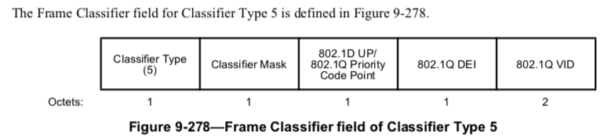
802.1D is also used in 802.11 9.4.2.30
9.4.2.30 TCLAS element

Slide 24
We Probably can’t touch 9.4.2.30
9.4.2.30 TCLAS element
For Classifier Type 5 when used to match an IEEE 802.1D-2004 frame [B23], the classifier parameter is only the User Priority, and the DEI and VID parameters are ignored. For Classifier Type 5 when used to match an IEEE 802.1Q frame, the classifier parameters are: Priority Code Point, Drop Eligibility Indicator (DEI), and VLAN ID (VID).
The 802.1D UP/802.1Q Priority Code Point subfield contains the value to be matched to the appropriate type frame header in the 4 LSBs; the 4 MSBs are reserved.
The 802.1Q DEI subfield contains the value to match against an IEEE 802.1Q frame header, in the LSB; the 7 MSBs are reserved. When matching an IEEE 802.1D-2004 frame header, this subfield is ignored.
The 802.1Q VID subfield contains the value to match against an IEEE 802.1Q frame header, in the 12 LSBs; the 4 MSBs are reserved. When matching an IEEE 802.1D-2004 frame header, this subfield is ignored.
  This is true, as 802.1D does not include DEI and VID
  We cannot change this without affecting 802.1D compatibility
  This will become obsolete along with 802.1D

Slide 25
We ‘can’ update provisions from 802.11-2007/11i
M4 Integration service versus bridging
There are a number of differences between the IEEE 802.11 integration service and the service provided by an IEEE 802.1D bridge [B23]. In the IEEE 802.11 architecture a portal provides the minimum connectivity between an IEEE 802.11 WLAN and a non-IEEE-802.11 LAN. Requiring an IEEE 802.1D bridge in order to be compliant with IEEE Std 802.11 would unnecessarily render some implementations noncompliant.
The most important distinction is that a portal has only one “port” (in the sense of IEEE Std 802.1D, for example) through which it accesses the DS. This renders it unnecessary to update bridging tables inside a portal each time a STA changes its association status. In other words, the details of distributing MSDUs inside the IEEE 802.11 WLAN need not be exposed to the portal.
Another difference is that the DS is not an IEEE 802 LAN (although it carries IEEE 802 LLC SDUs). Requiring that the DS implements all behaviors of an IEEE 802 LAN places an undue burden on the architecture.
Finally, it is an explicit intent of this standard to permit transparent integration of an IEEE 802.11 WLAN into another non-IEEE-802.11 LAN, including passing bridge PDUs through a portal. While an implementer might wish to attach an IEEE 802.1D bridge to the portal (note that the non-IEEE-802.11 LAN interface on the bridge need not be any particular type of LAN), it is not an architectural requirement of this standard to do so.

Slide 26
Where does this come from?
In 802.11-1999, DS was defined as a logical ”portal” between 802.11 and non-802.11 LANs
However, the definition was not strict enough
  11f found the need to better define the DS function for IAPP support
  e.g. 11-01-0102-02-000f found that the DS function matches 802.1D bridging function, in that it keeps MAC table and forward frames accordingly
  e.g. 11-04-1573-00-0apf (11revma train) suggests that the AP integrates an 802.1D MAC entity (see next slide)

Slide 27
Where does this come from?
11i WG found difficulty implementing 802.1X that relies on the strict concept of “port”
  802.1X relies on “port-based” authentication, which is only possible with a port; port in 802.1X-2001 relied on 802.1D-1998 definition of bridged ports
  e.g. 11-04-0738-00-0wng proposes to create an 802.1D port function within the AP, to allow for 802.1X
Bridging to non-802.3 networks was also sometimes difficult
  e.g. 11-05-0159-00-0apf suggests a better definition of DS, or “portal”, to allow SAP integration and bridging to Apple Talk and IPX
    Turns out “portal” did not work well as the term was used for specific function in 802.11s

Slide 28
Therefore, in 802.11-2007, two terms appear
“802.1D port”, allowing 802.1X without having to redefine 802.1X
  portal has only one “port” (in the sense of IEEE Std 802.1D, for example) through which it accesses the DS (802.11-Revmd13. M4)
”802.1D bridge”, allowing proper alignment of SAP and MAC functions with 802.1 (instead of a “nearly-trivial Ethernet/802.3 to 802.11 bridge implementation” [11-05-0159-00])
  Bridges perform specific functions, like relaying, filtering of frames, in a clearly defined architecture (ports with associated MAC functions connected through the bridging function)

Slide 29
Is an 802.1D bridge/port different from an 802.1Q bridge/port?
Port is not formally defined in 802.1D
  However, 802.1D-2004 7.2 defines that a bridge has at least two ports, each port transmits and receives frames to and from the LAN to which it is attached, and has an individual MAC Entity that provides the Internal Sublayer service (that handles individual frame)
  This definition allows for 802.1X 6.3 (in 802.1X-2004) to provide a port-based access control, using each connecting client SA
802.1Q has the same definition of a “bridge” and “port” (802.1Q-2018 8.2), but add more optional functions
  And in fact 802.1X-2010 just calls for a bridge port as “a port of an IEEE 802.1D or IEEE 802.1Q Bridge”.

Slide 30
Can we risk updating the M4 text?
M4 Integration service versus bridging
There are a number of differences between the IEEE 802.11 integration service and the service provided by an IEEE 802.1D bridge [B23]. In the IEEE 802.11 architecture a portal provides the minimum connectivity between an IEEE 802.11 WLAN and a non-IEEE-802.11 LAN. Requiring an IEEE 802.1D bridge in order to be compliant with IEEE Std 802.11 would unnecessarily render some implementations noncompliant.
Replacing 802.1D with 802.1Q keeps both sentences true
Asserting that requiring an 802.1Q bridge is too much is even more meaningful, especially as APs also connect to trunks
An even better option is to refer to 802.1 bridge

Slide 31
Can we risk updating the M4 text?
M4 Integration service versus bridging
The most important distinction is that a portal has only one “port” (in the sense of IEEE Std 802.1D, for example) through which it accesses the DS. This renders it unnecessary to update bridging tables inside a portal each time a STA changes its association status. In other words, the details of distributing MSDUs inside the IEEE 802.11 WLAN need not be exposed to the portal.
Another difference is that the DS is not an IEEE 802 LAN (although it carries IEEE 802 LLC SDUs). Requiring that the DS implements all behaviors of an IEEE 802 LAN places an undue burden on the architecture.
802.1Q defines the role of the port just like 802.1D (but adds more possible functions to the “port” in the context of various SPT variants)
Updating with 802.1Q does not change the meaning in this context

Slide 32
Can we risk updating the M4 text?
M4 Integration service versus bridging
Finally, it is an explicit intent of this standard to permit transparent integration of an IEEE 802.11 WLAN into another non-IEEE-802.11 LAN, including passing bridge PDUs through a portal. While an implementer might wish to attach an IEEE 802.1D bridge to the portal (note that the non-IEEE-802.11 LAN interface on the bridge need not be any particular type of LAN), it is not an architectural requirement of this standard to do so.
The sentence remains true with 802.1Q
  802.1D is a subset of 802.1Q in this context
802.1D would not allow connection to an 802.1 trunk, but:
  Attaching an 802.1Q bridge also attaches the 802.1D subset
  Assuming that implementers would not envision to connect to a trunk (802.1Q) is restrictive
  We could change to 802.1Q or mention both

Slide 33
We can Fix 802.11s provisions
14.11.1 Overview of interworking between a mesh BSS and a DS
A mesh STA that has access to a DS is called a mesh gate. Mesh STAs in an MBSS access the DS via the mesh gate. An MBSS functions like an IEEE 802 LAN segment that is compatible with IEEE Std 802.1D. The MBSS appears as a single access domain.
An MBSS may contain two or more mesh gates. When multiple mesh gates in an MBSS have access to the same DS, the MBSS has more than one “port” (in the sense of IEEE Std 802.1D-2004, for example) through which it accesses the DS. Accordingly, broadcast loops may occur. Therefore, mesh gates should implement a loop preventing protocol in the DS.
NOTE—In the DS a typical implementation uses the Rapid Spanning Tree Protocol (RSTP) as specified in IEEE Std 802.1D-2004. With RSTP the resulting active DS topology forms a tree. Then, even if multiple mesh gates connect with the same DS, the MBSS only accesses the DS through a single mesh gate.

Slide 34
Why is 802.11s referring to 802.1D?
The references started in 2004
Back then, 802.1i and 802.1e were using 802.1D for port and priority ‘tags’ (respectively), and 802.1D was the de-facto 802.1 bridge reference protocol for 802.11
e.g. 11-03-0867-00-0wng suggests that making mesh network interconnection with 802.3 may imply conforming to 802.1D (transparent bridging, STP support), which is complex
  Later work (e.g. 11-04-0354-01) suggest a gateway function with limited 802.1D function
  11-05-0562-04-000s suggests that the job of the mesh portal is to connect to wired networks, e.g. 802.1D type, using a bridge function

Slide 35
The Reference changed in 2009
Before 2009, the MP integrated a bridge function (802.1D type)
  CID 1029 in 11-09-0115-01-000s reminded of the 802.11-2007 text in slide 25 (asking for 802.D function is too much)
802.11s then reverted to a simpler form, where the MBSS is a LAN compatible with 802.11D
  In that it bridges and keeps a MAC address table for each side
  Wording became simpler (e.g. from 11-07-0335-00-000s redline draft 1.0 to 1.1 11A.4.1 included “This clause describes the behavior of a Mesh Portal (MPP) to enable bridging of a layer-2 WLAN Mesh to other IEEE 802 LAN segments in a manner compatible with IEEE 802.1D”… “ The MPP consists of an MP collocated with bridging functionality”, collocation was removed

Slide 36
We can Fix 802.11s provisions
14.11.1 Overview of interworking between a mesh BSS and a DS
A mesh STA that has access to a DS is called a mesh gate. Mesh STAs in an MBSS access the DS via the mesh gate. An MBSS functions like an IEEE 802 LAN segment that is compatible with IEEE Std 802.1D. The MBSS appears as a single access domain.
Compatible is not compliant, the meaning is that mesh gates allow for L2 bridging (bridge function)
We go back to slide 32 / M4 conversation (compatibility with 802.1D is compatibility with 802.1Q)

Slide 37
We can Fix 802.11s provisions
14.11.1 Overview of interworking between a mesh BSS and a DS
A mesh STA that has access to a DS is called a mesh gate. Mesh STAs in an MBSS access the DS via the mesh gate. An MBSS functions like an IEEE 802 LAN segment that is compatible with IEEE Std 802.1D. The MBSS appears as a single access domain.
An MBSS may contain two or more mesh gates. When multiple mesh gates in an MBSS have access to the same DS, the MBSS has more than one “port” (in the sense of IEEE Std 802.1D-2004, for example) through which it accesses the DS. Accordingly, broadcast loops may occur. Therefore, mesh gates should implement a loop preventing protocol in the DS.
NOTE—In the DS a typical implementation uses the Rapid Spanning Tree Protocol (RSTP) as specified in IEEE Std 802.1D-2004. With RSTP the resulting active DS topology forms a tree. Then, even if multiple mesh gates connect with the same DS, the MBSS only accesses the DS through a single mesh gate.

Slide 38
We can Fix 802.11s provisions
14.11.1 Overview of interworking between a mesh BSS and a DS
An MBSS may contain two or more mesh gates. When multiple mesh gates in an MBSS have access to the same DS, the MBSS has more than one “port” (in the sense of IEEE Std 802.1D-2004, for example) through which it accesses the DS. Accordingly, broadcast loops may occur. Therefore, mesh gates should implement a loop preventing protocol in the DS.
The conversation is still around the concept of port, which is same in 802.1Q

Slide 39
We can Fix 802.11s provisions
14.11.1 Overview of interworking between a mesh BSS and a DS
NOTE—In the DS a typical implementation uses the Rapid Spanning Tree Protocol (RSTP) as specified in IEEE Std 802.1D-2004. With RSTP the resulting active DS topology forms a tree. Then, even if multiple mesh gates connect with the same DS, the MBSS only accesses the DS through a single mesh gate.
RSTP is specified in 802.1Q (absorbed 802.1D for this function, 13.4 in 802.1Q-2018)
RSTP is common for L2 bridged networks

Slide 40
Compatibility with 802.11ak
11ak proposes to correct M4:
There are a number of differences between the IEEE 802.11 integration service and the service provided by an IEEE 802.1D bridge [B23]. In the IEEE 802.11 non-GLK architecture, a portal provides the minimum connectivity between an IEEE 802.11 WLAN system and a non-IEEE-802.11 LAN. Requiring an IEEE 802.1D or IEEE 802.1Q bridge in order to be compliant with IEEE Std 802.11 would unnecessarily render some implementations noncompliant.
Finally, it is an explicit intent of this standard to permit transparent integration of an IEEE 802.11 WLAN into another non-IEEE-802.11 LAN, including passing bridge PDUs through a portal. While an implementer might wish to attach an IEEE 802.1D or IEEE 802.1Q bridge to the portal (note that the non-IEEE-802.11 LAN interface on the bridge need not be any particular type of LAN), it is not an architectural requirement of this standard to do so.

Slide 41
Compatibility with 802.11ak
11ak still references 802.1D:
general link (GLK): A point-to-point connection between two instances of the IEEE 802.1D Internal Sublayer Service that uses an IEEE 802.11 wireless link between stations (STAs). A general link is suitable for use in an IEEE 802.1Q bridged network. (3.2)
General links connect through a STA to an IEEE 802.1D Internal Sublayer Service instance. Note that IEEE 802.11 UPs are IEEE 802.1D priorities that differ from IEEE 802.1Q priorities. For example, in IEEE Std 802.1D, priority 2 is lower than priority 0 while in IEEE Std 802.1Q it is higher. (annex R.3.4)
It would be worth reaching out to 11ak authors to check if this could be solved

Slide 42
Conclusion 2
By integrating these changes, we open 802.11 to more compatibility with 802.1Q and 802.1AC, which are the new 802.1D incumbents
802.11 also removes dependency on old protocols and removes some inaccuracies and ambiguities (e.g. ‘tags’, compatibility with 802.1D networks, but not 802.1Q etc.)

