Slide 1
1st Vice Chair Report - Sept 2018 - Waikoloa
Date: 2018-09-14
Authors:

Slide 2
Abstract
Agenda Items for 1st Vice Chair -
M3.3 II Other WG meeting plans
M3.4 II Meeting room locations
M3.5 II Next meeting reminder
M3.6 II Meeting registration
M3.7 II Recording attendance
M3.8 II File server
M3.9 II Breakfast, breaks, Social logistics
Friday:
  F3.1.1 II Straw Poll of membership regarding this meeting location
  F3.1.2 DT Future venues status and discussion

Slide 3
Monday–
802.11 Opening Plenary
802.11 First Vice Chair Report

Slide 4
Top Ten Things to Know about
2018 September 802 Wireless Interim –
Hilton Waikoloa, Waikoloa, Hawaii

Slide 5
IEEE 802 Wireless Top 10
1. Social tickets are included with meeting registration for all paid IEEE 802 Wireless participants and their guests.
  * Wednesday September 12th, 6:30 – 8:30 PM
  * Networking+
  * 1 hour hosted bar by Hilton Waikoloa Village
  * Light refreshments (menu posted on corkboard)
  * Musical entertainment by IEEE 802W Alumni:
  Charlie Perkins
Guest badges are available at the Registration Desk.
(Pickup by 1:30 pm)
Notes:
ROOM RATES
• SINGLE OCCUPANCY: 5100.00 THB per night*
o Inclusive of breakfast and in-room High Speed Wi-FI.
o Rates are subject to tax.
• DOUBLE OCCUPANCY: 5500.00 THB per night*
o Inclusive of breakfast and in-room High Speed Wi-FI.
o Rates are subject to tax.
• EXTRA ADULT*: 2500.00 THB per night
o Inclusive of breakfast and in-room High Speed Wi-FI.
o Rates are subject to tax.
IEEE 802 GROUP RATE DEADLINE
Friday October 19, 2018, 5:00 PM Pacific Time

Slide 6
IEEE 802 Wireless Top 10
2. Registration Hours:
  Sunday 6:00 – 8:00 PM
  Monday & Tuesday 7:30 AM – 5:00 PM
  Wednesday 7:30 AM – 1:30 PM
3. In case of an Emergency or After Hours (including evenings)
  Please text Dawn at: +1 (408) 594-1342
  If no reply: please call!

Slide 7
IEEE 802 Wireless Top 10
4. Meeting Space Requests or Issues
  Contact Dawn
  To Contact Dawn.
    Text or Call: +1 (408) 594-1342
    Email: dawns@facetoface-events.com
    Skype: dslykhouse

Slide 8
IEEE 802 Wireless Top 10
5. AV Issues:
  Screens and Audio equipment: Contact Dawn
  Projector Management: Linespeed manages Projectors
      Please note the following:
      At the completion of each meeting – Please Power off the projector
      Projector Failure – Contact any Linespeed Staff Member
      End of Meeting Day – Please Power Off the projector

Slide 9
IEEE 802 Wireless Top 10
6. Network Help Desk – Network Issues
  Network Help Desk located near Waikoloa I
  Please report any disruption of service to a Linespeed staff member at the Network Help Desk.

Slide 10
IEEE 802 Wireless Top 10
7. Food & Beverage:
Location: Lagoon Lanai
Hours:
  * Continental Breakfast: 7:30 – 8:30 AM
  * Morning Coffee: 10:00 – 11:00 AM
  * Afternoon Coffee & Tea: 3:00 – 4:00 PM
  with Afternoon Snacks
FOR REGISTERED IEEE 802W MEETING ATTENDEES ONLY!

Slide 11
IEEE 802 Wireless Top 10
8. Lunch Service:
Location: Lagoon Lanai
Time: 12 NOON – 1:30 PM
Daily lunch menus are posted on the meeting board.
FOR REGISTERED IEEE 802W MEETING ATTENDEES ONLY

Slide 12
IEEE 802 Wireless Top 10
9. EVENT OFFICE:
    MEETING PLANNER: FTF Events – Waikoloa 1
    NOC: Linespeed – Waikoloa 1
Have a great meeting and MAHALO!

Slide 13

JOIN US AT A SOCIAL RECEPTION WITH MUSICAL ENTERTAINMENT BY IEEE 802 ALUMNI, CHARLIE PERKINS Hilton Waikoloa, Lagoon Lanai 6:30 PM – 8:30 PM WEDNESDAY, 12 SEPTEMBER Name Badges Required for Entry* *Badges Available at Registration Desk until 1:30 PM Wednesday

Slide 14
M3.3 Other WG meeting plans
802.1 (Meeting in Oslo, Norway Sept 10-14)
802.3 (Meeting in Spokane, WA Sept 10-14)
802.11 802.15 802.18 802.19
802.21 802.24 802.22
Treasurer Report: 11-18/1400r0
Patent policy (in IEEE-SA bylaws), patent policy (slide set), and antitrust guidelines

Slide 15
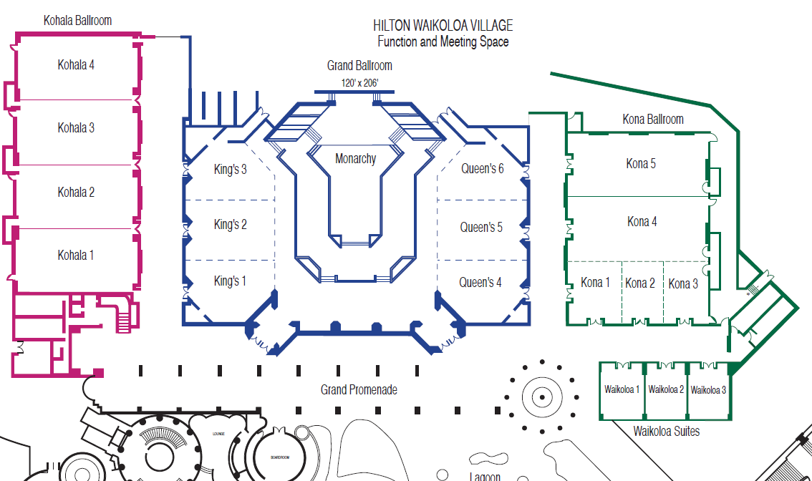
M3.4 Meeting Room Locations

Slide 16
Online Calendar Schedule
The WG meetings can also be added to your calendar.
802.11 WG meeting calendar is here: http://schedule.802world.com/ics/show?group=11
Other WGs and the 802 EC calendar are also available.
Note: the schedule on this calendar will be updated as will IMAT.

Slide 17
3.5 Next meeting reminder
Next 802 Plenary: November 11-16, 2018
BANGKOK MARRIOTT MARQUIS QUEEN’S PARK
Bangkok, Thailand
Event Information: http://802world.org/plenary
Plenary Registration: https://www.regonline.com/ieee802plenaryNovember2018
Hotel Reservations
Hotel address: 199 Sukhumvit Soi 22, Klong Ton, Klong Toey
Bangkok, 10110 Thailand
* Information Website: * Phone: # +66 2 059 5555

Slide 18
M3.6 II Meeting registration
Total Registrations – 283 – Saturday 4pm
802.11 | 214 | 74%
802.15 | 55 | 19%
802.18 | 3 | 1%
802.19 | 3 | 1%
802.21 | 6 | 2%
802.22 | 0 | 0%
802.24 | 1 | 0%
Unknown | 1 | 0%

Slide 19
M3.7 Recording attendance
It is a requirement that attendees record their participation at an 802.11 session and declare their affiliation. This record is usually made using the IMAT attendance system.
  If you wish to participate without recording attendance, send an email per session to the WG 2nd vice chair declaring your participation and affiliation. You cannot gain or maintain 802.11 voting membership using this method.
You must record 75% attendance of required 802.11 slots in a session for that session to count towards gaining or maintaining 802.11 voting membership
  You need a single IEEE-SA web account
    The IEEE SA web account requires a working email address
    do not remove your email address from the account
  Use the email address associated with that web account when registering attendance
    If you change email addresses, update the web account, don’t create a new web account, or your membership status may not be calculated properly
  Record attendance using this URL: IMAT.IEEE.ORG/

Slide 20
M3.8 Local File Document Server information
Links for Attendance, Documents, Registration and information about the session can be found at ieee802.linespeed.io (we recommend creating a bookmark).
Accessible from the Local Wi-Fi network:
SSID: IEEE802 -- Password: ieeeieee

Slide 21
802.11 Mid-Week Plenary
Agenda Items:
2.5 – Announcements
5.1 – Room Change Reports

Slide 22
JOIN US AT A SOCIAL RECEPTION WITH MUSICAL ENTERTAINMENT BY IEEE 802 ALUMNI, CHARLIE PERKINS Hilton Waikoloa, Lagoon Lanai 6:30 PM – 8:30 PM WEDNESDAY, 12 SEPTEMBER Name Badges Required for Entry* *Badges Available at Registration Desk until 1:30 PM Wednesday

Slide 23
W5.1 Room Change Requests
Release:
TGba PHY AdHoc – Wednesday PM2
NGV – Thursday AM1
TGba -- Thursday AM2
TGbb -- Thursday AM2
Add:

Slide 24
802.11 WG Closing Plenary
Agenda Items:
3.1.1 – Straw Poll
3.1.2 -- Future venues status and discussion

Slide 25
F3.1.1 -Straw Poll regarding this meeting location
Straw Poll:
How many people would like to come back to this venue?
  Yes -- 58
  No – 19
Like the Social – 41
Disliked the Social – 3
Did not go to Social – 15

Slide 26
F3.1.2: Future Venue Insight
2019 Future Venues
January 13-18, Hilton St Louis at the Ballpark
March 10-15, Hyatt Regency Vancouver and Fairmont Hotel Vancouver, Vancouver, Canada
May 12-17, Grand Hyatt Atlanta in Buckhead, Atlanta, Georgia, USA
July 14-19, Austria Congress Centre, Vienna, Austria
September 15-20, Marriott Hanoi, Hanoi, Vietnam (TBC)
November 10-15, Hilton Waikoloa Village, Kona, HI, USA

Slide 27
References
Plenary Meeting Status File: EC-16/66r3
https://mentor.ieee.org/802-ec/dcn/16/ec-16-0066-03-00EC-802-plenary-future-venue-contract-status.xlsx

