Slide 1
60GHz Passive Location Justification
Date: 2018-07-05
Authors:

Slide 2
Abstract
We discuss the justification of 60GHz passive location protocols. We examine whether passive location would provide lower power consumption on mobile 60HGz stations and medium time used for location.

Slide 3
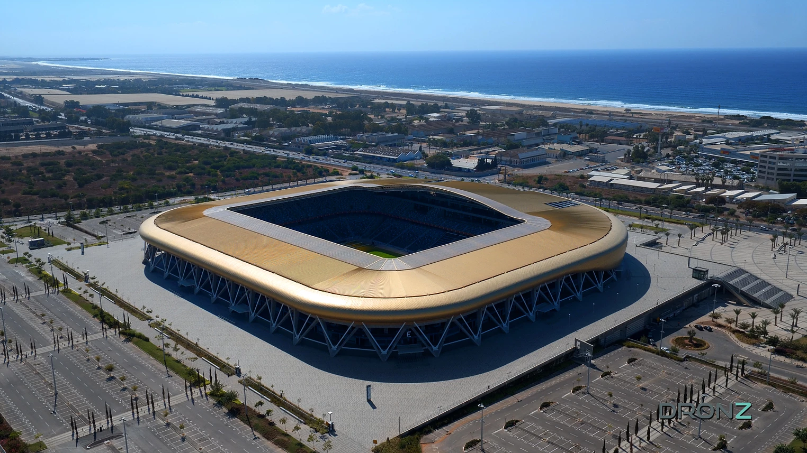
Case I: 60GHz passive location in stadium
Location APs stationed above stadium.
3APs stationed above each block of 50x50 meters,
20m above seats
In each block of 50x50 meters there are ~2500 seats
30-50 users need location service concurrently.
They need location computation every 1s.
Using active location they will use 3ms (each) to do that (sector sweep + BRP).
20 users per AP - 60ms. 6% of AP time. Some contention issues.
Passive location - 3ms per 1s - 0.3% of AP time - however, occasionally STAs may want to acquire passive location schedule. Not clear whether it is optimal to do it using <6GHz band.

Slide 4

Case II – 60GHz passive location in a mall
Accurate location in shopping mall
Area of mall 12x50m, 2 floors.
3 APs located on ceiling above second floor, 10m apart.
10 users need location service
Using active location they will use 3ms each to do that (sector sweep+BRP)
5 users per AP - 15ms - 1.5% of AP time.
Passive location, 3ms per 1s - 0.3of AP time.

Slide 5
References

