Slide 1
July 2018
doc.: IEEE 11-18-1238-00-00bb.
Project: IEEE 802.11bb Task Group
Submission Title: IEEE 802.11bb Reference Channel Models for Underwater Environments
Date Submitted: July 06, 2018
Source: Murat Uysal (Ozyegin University), Farshad Miramirkhani (Ozyegin University), Tuncer Baykas (Istanbul Medipol University), Khalid Qaraqe (Texas A&M University at Qatar), and Mohamed Abdallah (Hamad Bin Khalifa University).
Address: Ozyegin University, Nisantepe Mh. Orman Sk. No:34-36 Çekmekoy 34794 Istanbul, Turkey
Voice: +90 (216) 5649329, Fax: +90 (216) 5649450, E-Mail: murat.uysal@ozyegin.edu.tr
Abstract: This contribution proposes LiFi reference channel models for underwater environments.
Purpose: To introduce reference channel models for the evaluation of different PHY proposals.
Notice: This document has been prepared to assist the IEEE 802.11. It is offered as a basis for discussion and is not binding on the contributing individual(s) or organization(s). The material in this document is subject to change in form and content after further study. The contributor(s) reserve(s) the right to add, amend or withdraw material contained herein.
Release: The contributor acknowledges and accepts that this contribution becomes the property of IEEE and may be made publicly available by 802.11.
Submission
M. Uysal, F. Miramirkhani, T. Baykas, et al.

Slide 2
July 2018
doc.: IEEE 11-18-1238-00-00bb.
IEEE 802.11bb
Reference Channel Models for Underwater Environments
Submission
M. Uysal, F. Miramirkhani, T. Baykas, et al.

Slide 3
July 2018
doc.: IEEE 11-18-1238-00-00bb.
Outline
  Introduction
  Channel Modeling Approaches in the Literatures
  Overview of Channel Modeling Methodology
  Sea Surface and Sea Bottom Modeling
  Optical Characterization of Water and Particles
  Scattering Phase Function
  Underwater Scenario under Consideration: Empty Sea
  Channel Impulse Responses (CIRs)
  Effective Channel Responses
  Channel Characteristics
Conclusions
Submission
M. Uysal, F. Miramirkhani, T. Baykas, et al.

Slide 4
July 2018
doc.: IEEE 11-18-1238-00-00bb.
Channel Modeling Approaches in the Literatures
Radiative Transfer Equation (RTE) [1, Chapter 9] can be employed to fully characterize underwater light propagation. However, RTE involves integro-differential equation which does not yield a general analytical solution.
Monte Carlo Ray Tracing [2-4] can be used to generate channel impulse response for a given underwater environment.
As a basic tool, the Beer-Lambert formula [5] can be used to calculate underwater path loss. It assumes line-of-sight (LOS) transmission and ignores the possibility of receiving scattered photons.
[1] S. Arnon, J. Barry, G. Karagiannidis, R. Schober, and M. Uysal, Advanced optical wireless communication systems, Cambridge, U. K.: Cambridge Univ. Press, 2012.
[2] C. Gabriel, M. A. Khalighi, S. Bourennane, P. Leon, and V. Rigaud, “Monte-Carlo-based channel characterization for underwater optical communication systems,” IEEE/OSA J. Opt. Commun. Netw., vol. 5, no. 1, pp. 1-12, 2013.
[3] V. Guerra, C. Quintana, J. Rufo, J. Rabadan, and R. Perez-Jimenez, “Parallelization of a Monte Carlo ray tracing algorithm for channel modelling in underwater wireless optical communications,” Procedia Technology, vol. 7, pp. 11-19, 2013.
[4] S. Tang, Y. Dong, and X. Zhang, “Impulse response modeling for underwater wireless optical communication links,” IEEE Trans. Commun., vol. 62, no. 1, pp. 226-234, 2014.
[5] C. D. Mobley, B. Gentili, H. R. Gordon, Z. Jin, G. W. Kattawar, A. Morel, P. Reinersman, K. Stamnes, and R. H. Stavn, “Comparison of numerical models for computing underwater light fields,” Appl. Opt., vol. 32, no. 36, pp. 7484-7504, 1993.
Submission
M. Uysal, F. Miramirkhani, T. Baykas, et al.

Slide 5
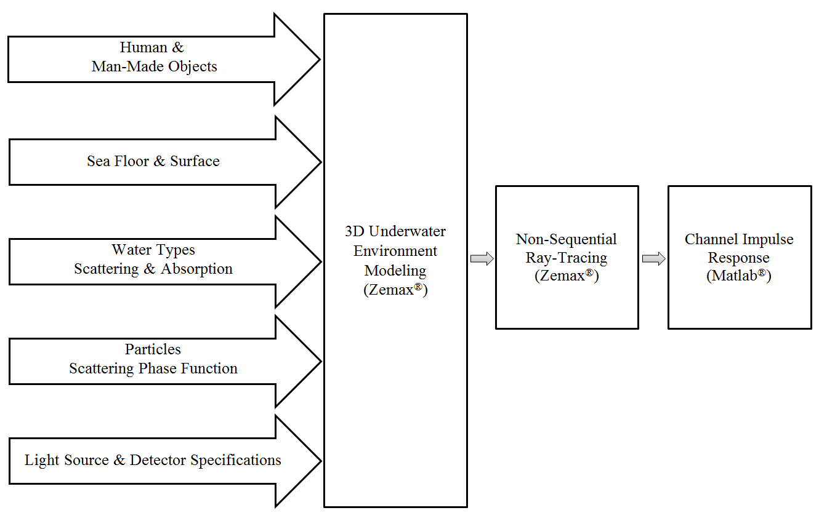
July 2018
doc.: IEEE 11-18-1238-00-00bb.
Overview of Channel Modeling Methodology^{[6]}
[6] F. Miramirkhani, and M. Uysal “Visible light communication channel modeling for underwater environments with blocking and shadowing,” IEEE Access, vol. 6, no. 1, pp. 1082-1090, 2018.
Submission
M. Uysal, F. Miramirkhani, T. Baykas, et al.

Slide 6
July 2018
doc.: IEEE 11-18-1238-00-00bb.
Sea Surface and Sea Bottom Modeling
  We assume mud for the sea bottom and consider purely diffuse reflections.
  To characterize the reflection and refraction of transmitted rays from the sea surface, we use Fresnel equations given by
Submission
M. Uysal, F. Miramirkhani, T. Baykas, et al.

Slide 7
July 2018
doc.: IEEE 11-18-1238-00-00bb.
Optical Characterization of Water and Particles
  Absorption, Scattering and Extinction Coefficients
  Gordon & Morel Model [7]
  Haltrin & Kattawar Model [8]
[7] C. D. Mobley, Light and Water: Radiative transfer in natural waters, Academic Press, June 1994.
[8] V. I. Haltrin, “Chlorophyll-based model of seawater optical properties,” Appl. Opt., vol. 38, no. 33, pp. 6826-6832, 1999.
Submission
M. Uysal, F. Miramirkhani, T. Baykas, et al.

Slide 8
July 2018
doc.: IEEE 11-18-1238-00-00bb.
Optical Characterization of Water and Particles
  Chlorophyll Concentration Depth Profiles [9]
[9] L. J. Johnson, R. J. Green, and M. S. Leeson, “Underwater optical wireless communications: depth dependent variations in attenuation,” Appl. Opt., vol. 52, no. 33, pp. 7867-7873, 2013.
Submission
M. Uysal, F. Miramirkhani, T. Baykas, et al.

Slide 9
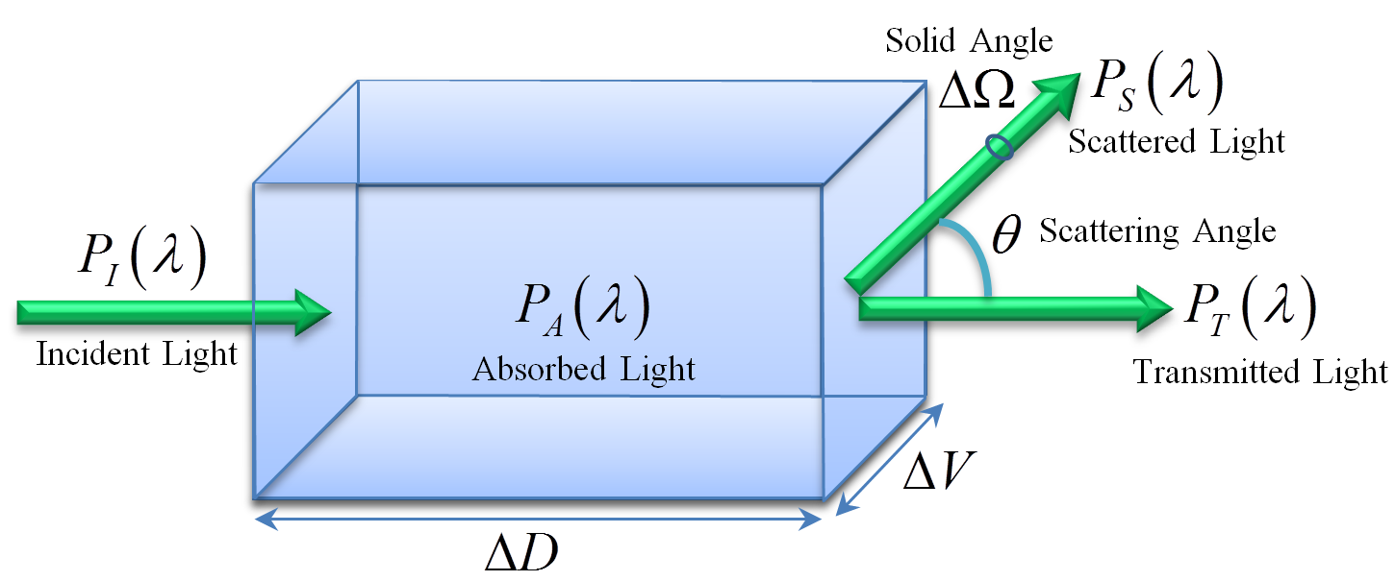
July 2018
doc.: IEEE 11-18-1238-00-00bb.
Scattering Phase Function
  Scattering Phase Function
Mie Scattering
One-Term Henyey-Greenstein
Two-Term Henyey-Greenstein
Submission
M. Uysal, F. Miramirkhani, T. Baykas, et al.

Slide 10
July 2018
doc.: IEEE 11-18-1238-00-00bb.
Channel Impulse Response (CIR)
  Based on Monte Carlo Ray Tracing.
  Sobol sampling is used for speeding up ray tracing.
  The Zemax® non-sequential ray-tracing tool generates an output file, which includes all the data about rays such as the detected power and path lengths for each ray.
  The data from Zemax® output file is imported to MATLAB® and using these information, the multipath CIR is expressed as
P_{i} = the power of the i^{th} ray
τ_{i} = the propagation time of the i^{th} ray
δ(t) = the Dirac delta function
N_{r} = the number of rays received at the detector
Submission
M. Uysal, F. Miramirkhani, T. Baykas, et al.

Slide 11
July 2018
doc.: IEEE 11-18-1238-00-00bb.
Effect of LED Response
  In addition to the multipath propagation environment, the low-pass characteristics of the LED sources should be further taken into account in channel modelling.
  LED Model 1 [10]
  LED Model 2 [11]
  : 3 dB cut-off frequency of the LED
[10] L. Grobe, and K. D. Langer, “Block-based PAM with frequency domain equalization in visible light communications,” In IEEE Globecom Workshops (GC Wkshps), pp. 1070-1075, 2013.
[11] M. Wolf, S. A. Cheema, M. Haardt, and L. Grobe, “On the performance of block transmission schemes in optical channels with a Gaussian profile,” In 16th International Conference on Transparent Optical Networks (ICTON), pp. 1-8, 2014.
Submission
M. Uysal, F. Miramirkhani, T. Baykas, et al.

Slide 12
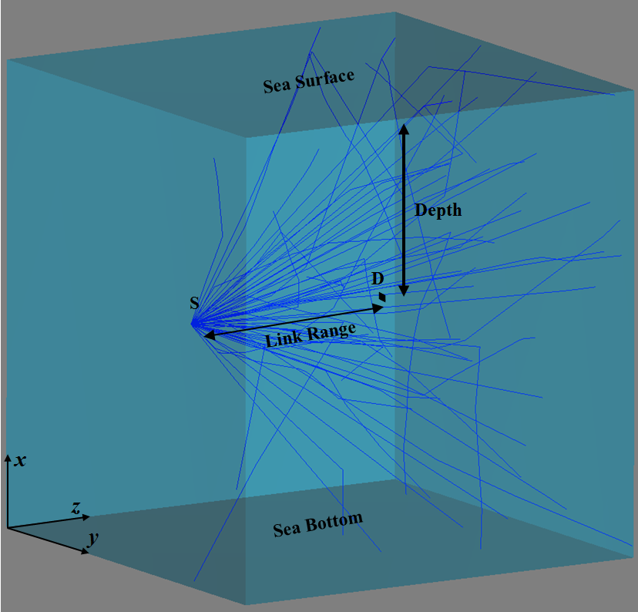
July 2018
doc.: IEEE 11-18-1238-00-00bb.
Simulation Scenario: Empty Sea
We consider the scenario illustrated in figure below where the transmitter-receiver pair is placed at a depth of 45 m with 20 m distance apart in empty coastal water.
Submission
M. Uysal, F. Miramirkhani, T. Baykas, et al.

Slide 13
July 2018
doc.: IEEE 11-18-1238-00-00bb.
Simulation Parameters
Transmitter specifications | Power: 1 Watt LED brand: Super Blue Cree® XR-E [12] Viewing angle: 60º [12]
Receiver specifications | Aperture diameter: 5 cm [13] Field of view: 180º [13]
Link Range (m) | 20
Depth (m) | 45
Water type | Coastal- S₈ group (C_{c}: 0.8~2.2 mg/m³) [9]
Absorption, scattering and extinction coefficients (m⁻¹) | 0.0508, 0.2116, 0.2624
Scattering phase function | OTHG
Mean cosine of scattering angles | 0.9470
[12] B. Tian, F. Zhang, and X. Tan, “Design and development of an LED-based optical communication system for autonomous underwater robots,” In IEEE/ASME Int. Conf. Advanced Intelligent Mechatronics (AIM), pp. 1558-1563, 2013.
[13] C. Gabriel, M. A. Khalighi, S. Bourennane, P. Léon, and V. Rigaud, “Channel modeling for underwater optical communication,” in Proc. IEEE Global Communication Conf. (GLOBECOME’11), pp. 833-837, Dec. 2011.
Submission
M. Uysal, F. Miramirkhani, T. Baykas, et al.

Slide 14
July 2018
doc.: IEEE 11-18-1238-00-00bb.
CIR Results
Submission
M. Uysal, F. Miramirkhani, T. Baykas, et al.

Slide 15
July 2018
doc.: IEEE 11-18-1238-00-00bb.
CIR Results
Submission
M. Uysal, F. Miramirkhani, T. Baykas, et al.

Slide 16
July 2018
doc.: IEEE 11-18-1238-00-00bb.
Effective Channel Responses
For the effective channel responses, the “LED Model 1” with cut-off frequency of 20 MHz is considered.
Submission
M. Uysal, F. Miramirkhani, T. Baykas, et al.

Slide 17
July 2018
doc.: IEEE 11-18-1238-00-00bb.
Channel Characteristics
(m) | (ns)
1 | 7.95 | 6.80×10⁻³
2 | 7.95 | 1.60×10⁻³
3 | 7.95 | 6.70×10⁻⁴
4 | 7.97 | 3.53×10⁻⁴
5 | 7.97 | 2.16×10⁻⁴
6 | 7.98 | 1.37×10⁻⁴
7 | 7.99 | 9.60×10⁻⁵
8 | 7.99 | 6.64×10⁻⁵
9 | 8.04 | 5.15×10⁻⁵
10 | 8.08 | 4.01×10⁻⁵
11 | 8.26 | 2.89×10⁻⁵
12 | 8.08 | 2.43×10⁻⁵
13 | 8.11 | 1.88×10⁻⁵
14 | 8.34 | 1.64×10⁻⁵
15 | 8.62 | 1.24×10⁻⁵
16 | 8.32 | 9.82×10⁻⁶
17 | 8.53 | 7.97×10⁻⁶
18 | 8.84 | 6.42×10⁻⁶
19 | 8.97 | 6.02×10⁻⁶
20 | 9.54 | 5.19×10⁻⁶
Submission
M. Uysal, F. Miramirkhani, T. Baykas, et al.

Slide 18
July 2018
doc.: IEEE 11-18-1238-00-00bb.
Conclusions
  This contribution proposes LiFi reference channel models for underwater environments to assist the IEEE 802.11bb.
Submission
M. Uysal, F. Miramirkhani, T. Baykas, et al.

Slide 19
July 2018
doc.: IEEE 11-18-1238-00-00bb.
Acknowledgement
This publication was made possible by the NPRP award [NPRP 8-648-2-273] from the Qatar National Research Fund (a member of the Qatar Foundation). The statements made herein are solely the responsibility of the authors.
Submission
M. Uysal, F. Miramirkhani, T. Baykas, et al.

