Slide 1
MESHMERIZE
A resilient mesh for dynamic topologies
Date: 2018-07-10
Authors:
Name | Affiliation | Address | Phone | Email
Sreekrishna Pandi | Technical University of Dresden, Germany | TU Dresden, Deutsche Telekom Professur für Kommunikationsnetze, 01062 Dresden. |  | sreekrishna.pandi@tu-dresden.de
Simon Wunderlich |  |  |  | simon.wunderlich@tu-dresden.de
Frank Gabriel |  |  |  | frank.gabriel@tu-dresden.de
Frank Fitzek |  |  |  | frank.fitzek@tu-dresden.de

Slide 2
Objectives
Present our research on resilient mesh networks
Explain our underlying technology
Discuss the potential for standardisation under the IEEE 802.11 umbrella

Slide 3
Motivation
5G is coming
  Dynamic low-latency applications
    Connected cars, UAVs, Mobile robotics, smart cities, etc.
  Cellular connectivity will NOT reach last mile everywhere
    Farming lands, remote streets, Space, deep indoors, Mines, etc.
    Dynamic, distributed and decentralized connectivity technology needed
No standardised dynamic network protocol available
  IEEE802.11s is the closest (standardised) competitor.

Slide 4
State of the Art
IEEE802.11s
  Designed for static networks
  Supports Unicast and Multicast/Broadcast routing
  Long downtime (~15sec) when link/path changes
IEEE802.11p
  Designed for (dynamic) vehicular networks
  No Routing. Only single-hop broadcasts
Other technologies
  LTE V2V - Still predominantly dependant on cellular network for channel access and scheduling
  Non-Standardised mesh networking protocols – Also designed for static networks

Slide 5
Meshmerize
A novel mesh routing protocol for dynamic networks
Based on Opportunistic Routing
  Exploits the broadcast (overhearing) nature of the wireless medium
Routes over multiple paths to achieve high resilience
Can use advanced coding techniques to achieve:
  Low latency
  Ideal throughput-resilience trade off

Slide 6
Classical vs Meshmerize
D
D
S
S

Slide 7
Classical vs Meshmerize
D
D
~15 sec
S
S

Slide 8
Classical vs Meshmerize
D
D
~15 sec
S
S

Slide 9
Classical vs Meshmerize
D
D
~15 sec
S
S
Can use advanced coding techniques to introduce smart redundancies

Slide 10
Network Coding - in a nutshell
Classical Network
Packets are acknowledged
Lost packets are resent
Z
Z
Y
Y
X
X
S
D
Coded Network
No packet specific retransmissions
Only sufficient number of linear combinations needed.
Z
Z
Y
Y
3x+7y+5z
7x+9y+2z
2x+8y+2z
X
X
S
D
Encoder
Decoder

Slide 11
Network Coding - in a nutshell (2)
Z
7x+9y+2z
Y
3x+7y+5z
3x+7y+5z
7x+9y+2z
7x+9y+2z
10x+16y+7z
X
S
R
D
Encoder
Recoder
Decoder
Recoding
Unique feature in network coding
Has excellent properties; Allows efficient multipath and multi-hop networks

Slide 12
Network Coding - in a nutshell (3)
7x+9y+2z
3x+7y+5z
Z
7x+9y+2z
Y
R
10x+16y+7z
X
S
Recoder 1
D
3x+7y+5z
7x+9y+2z
Encoder
Decoder
Recoder 2
4x+2y-3z
R
7x+9y+2z
3x+7y+5z
7x+9y+2z

Slide 13
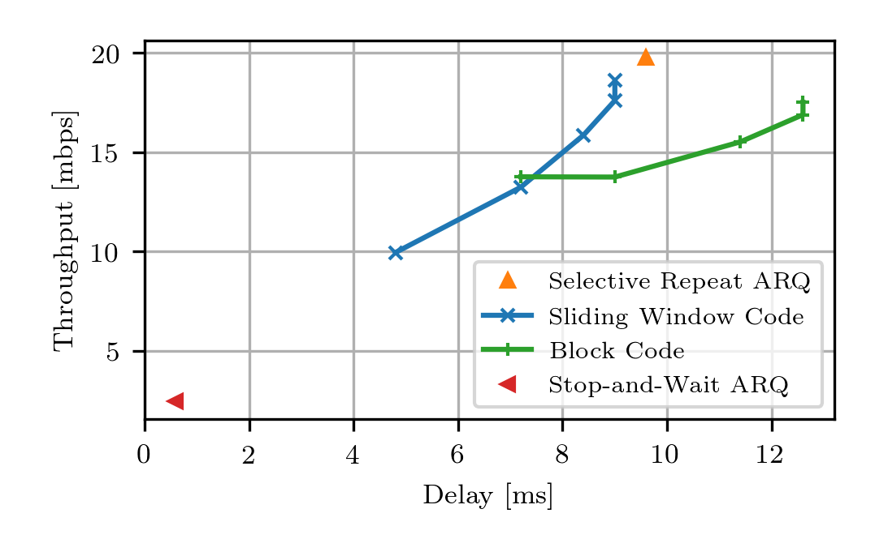
Low latency sliding-window coding
Special modes of coding reduce the latency further, as opposed to classical block codes
Can achieve granular trade-off between Throughput and Latency depending on application
Notes:
channel model with the following parameters:loss: 1%loss burst: 8forward delay: 4 (slots)feedback delay: 4 (slots)slot size: 0.6ms (=20 mbit/s for packet size 1500 bytes)

Slide 14
Current Status
Protocol designed and implemented in specific hardware
  Sits on OSI Layer 2
  Simply serves as a virtual Ethernet interface; Transparent to all higher layers
  Agnostic of the Physical layer
Custom (MCS) rate selection mechanism
  The ideal transmission MCS is selected corresponding to a set of neighbours, not just one particular one.
Tested on top of IEEE802.11p and IEEE802.11g PHYs

Slide 15
Challenges in Global Implementation
Opportunistic routing is great for WLAN. But it requires some modifications in standard 802.11 drivers
  Disable acknowledgements
  Set custom MCS for packets
  Receive / handle packets of all MAC addresses (monitor mode?)
  NO CHANGE in Medium Access Control
  NO CHANGE in PHY
Hence, standardisation could help.

Slide 16
Next Steps – Standardisation?
Looking for feedback
  Is this a candidate for standardisation under 802.11?
  How do we go about it? Study Group?
  Feedback about the technology? Any interesting use cases in your field of work?
Happy to discuss, collaborate, and develop with other interested research and industry partners

Slide 17
THANK YOU

