Slide 1
EVM Formulation for OOK Waveform
Date: 2018-07-09
Authors:

Slide 2
Introduction
EVM (Error Vector Magnitude) is a typical metric for measuring transmit modulation accuracy
For OFDM signal in 11/a/n/ac/ax, the EVM is measured for QAM symbols in frequency domain [1][2]
For .11ba, a new formulation may be needed to measure the EVM for OOK symbols in time domain

Slide 3

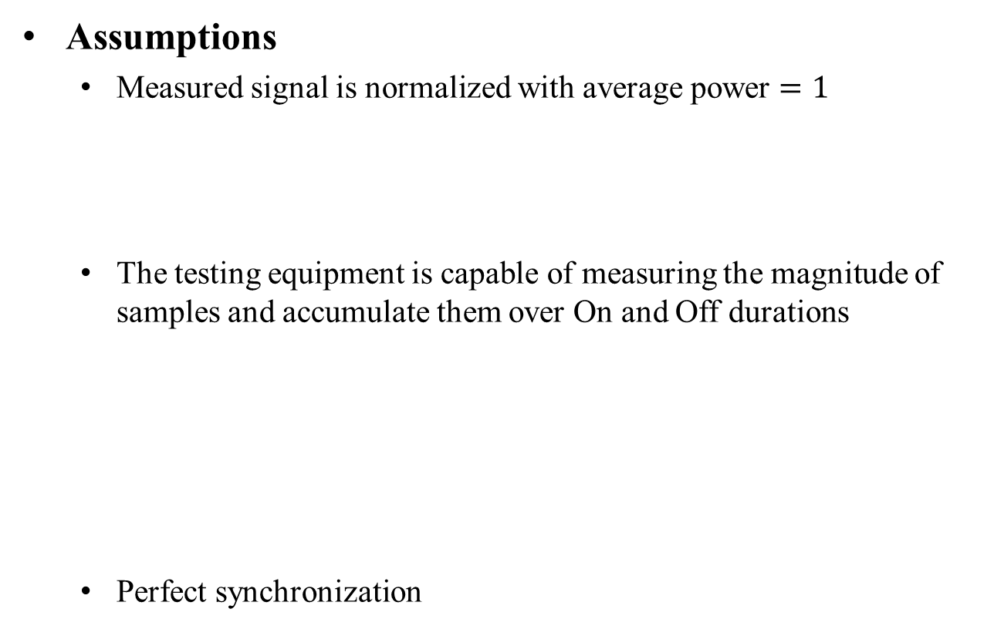
EVM for OOK Symbols
Assumptions
  Measured signal is normalized with average power $=1$
  The testing equipment is capable of measuring the magnitude of samples and accumulate them over On and Off durations
  Perfect synchronization
“Off”
“On”
0
$$\sqrt{2}$$
|I| or |Q|
Measured Samples
On
Off
Time

Slide 4
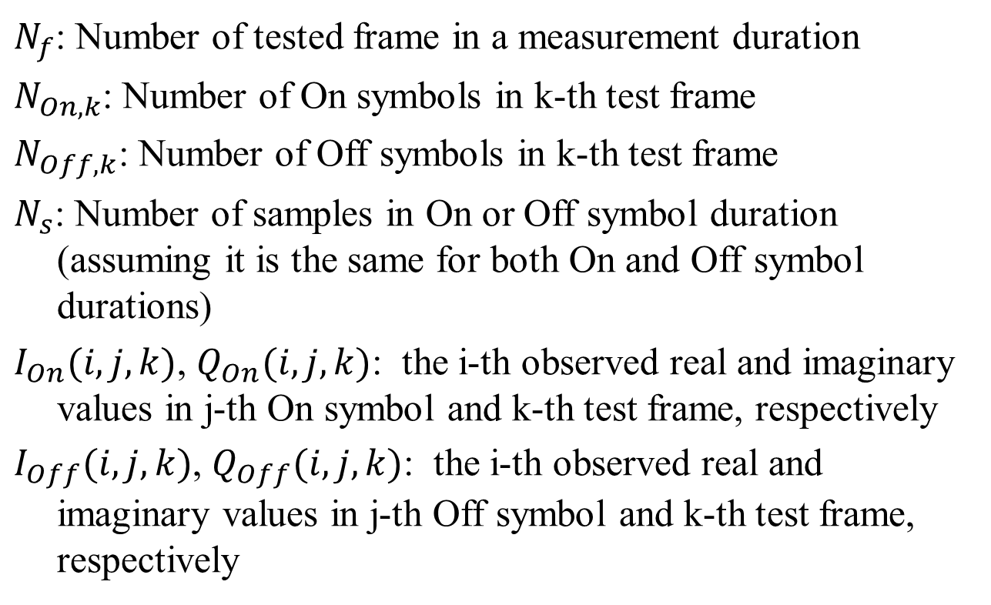
Some Notations
$N_{f}$: Number of tested frame in a measurement duration
$N_{On, k}$: Number of On symbols in k-th test frame
$N_{Off,k}$: Number of Off symbols in k-th test frame
$N_{s}$: Number of samples in On or Off symbol duration (assuming it is the same for both On and Off symbol durations)
$I_{On}(i,j,k)$, $Q_{On}(i,j,k)$: the i-th observed real and imaginary values in j-th On symbol and k-th test frame, respectively
$I_{Off}(i,j,k)$, $Q_{Off}(i,j,k)$: the i-th observed real and imaginary values in j-th Off symbol and k-th test frame, respectively

Slide 5
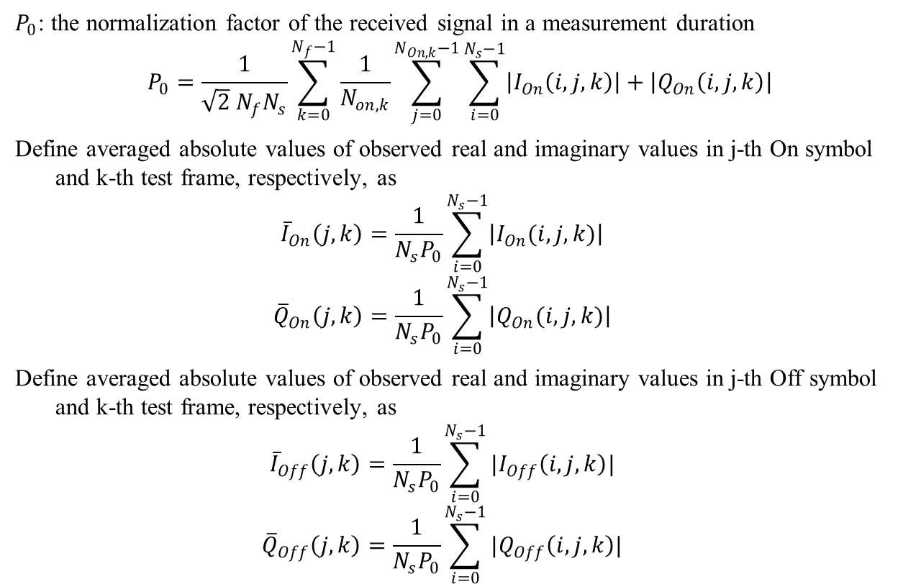
Some Notations (cont.)
$P_{0}$: the normalization factor of the received signal in a measurement duration
$$P_{0}=\frac{1}{\sqrt{2} N_{f}N_{s}}\sum_{k=0}^{N_{f}−1}{\frac{1}{N_{on,k}}\sum_{j=0}^{N_{On,k}−1}{\sum_{i=0}^{N_{s}−1}{\left|I_{On}\left(i,j,k\right)\right|+\left|Q_{On}\left(i,j,k\right)\right|}} }$$
Define averaged absolute values of observed real and imaginary values in j-th On symbol and k-th test frame, respectively, as
$${\overline{I}}_{On}\left(j,k\right)=\frac{1}{N_{s}P_{0}}\sum_{i=0}^{N_{s}−1}{\left|I_{On}(i,j,k)\right|}$$
$${\overline{Q}}_{On}\left(j,k\right)=\frac{1}{N_{s}P_{0}}\sum_{i=0}^{N_{s}−1}{\left|Q_{On}(i,j,k)\right|}$$
Define averaged absolute values of observed real and imaginary values in j-th Off symbol and k-th test frame, respectively, as
$${\overline{I}}_{Off}\left(j,k\right)=\frac{1}{N_{s}P_{0}}\sum_{i=0}^{N_{s}−1}{|I_{Off}\left(i,j,k\right)|}$$
$${\overline{Q}}_{Off}\left(j,k\right)=\frac{1}{N_{s}P_{0}}\sum_{i=0}^{N_{s}−1}{{|Q}_{Off}\left(i,j,k\right)|}$$

Slide 6

EVM Expression based on Averaged RMS
Then, the averaged RMS of WUR portion of all test frames is
$$Error_{RMS}=\frac{1}{N_{f}}\sum_{k=0}^{N_{f}−1}{\sqrt{\frac{1}{{(N}_{On,k}+N_{Off,k})}\left(\sum_{j=0}^{N_{On,k}−1}{{\left({\overline{I}}_{On}\left(j,k\right)+{\overline{Q}}_{On}\left(j,k\right)−\sqrt{2}\right)}^{2}}+\sum_{j=0}^{N_{Off,k}−1}{\left[{\overline{I}}_{Off}\left(j,k\right)+{\overline{Q}}_{Off}\left(j,k\right)\right]}\right)}}$$
|I|+|Q|
Time
Normalized Eye Diagram

Slide 7
References
[1] “Part 11: Wireless LAN Medium Access Control (MAC) and Physical Layer (PHY) Specifications”, 2016
[2] “IEEE P802.11ax™/D3.0, Amendment 6: Enhancements for High Efficiency WLAN”, 2018

