Slide 1
Comparison of Symbol Randomization Techniques
Date: 2018-MM-DD
Authors:

Slide 2
Introduction
In May we brought up the issue of Spectral Lines in the PSD due to repeated use of the same MC-OOK On symbol [1]
We proposed Symbol Phase Randomization for addressing this issue
Recently Miguel, et. al., showed some simulations, using Symbol CSD Randomization [2]
The apply CSD to each MC-OOK On Symbol. They randomly choose the CSD from a set of eight CSD values
In this presentation they calculated the maximum power in a 1 MHz band, and stated that it is lower using this technique, since the spectrum ends up being flatter

Slide 3
Simulations
We did some quick simulations of both Random Phase and Random CSD to investigate the PSD
Symbols
2 µs: [1, 1, 1, 0, -1, 1, -1];
4 µs: [1, 1, 1, -1, -1, -1, 0, -1, 1, -1, -1, 1, -1]
Phase Randomization
Randomly choose from N phases: $\left(0,\frac{1}{N},\frac{2}{N}, …\frac{N−1}{N}\right)×2 π$
Multiply the On Symbol by $exp⁡(i θ)$
CSD Randomization
Randomly choose from N CSD values: $\left(0,\frac{1}{N},\frac{2}{N}, …\frac{N−1}{N}\right)×M$, where M is the duration of the On Symbol
Simulate 10000 random bits, of Data Field only
Plot PSD

Slide 4
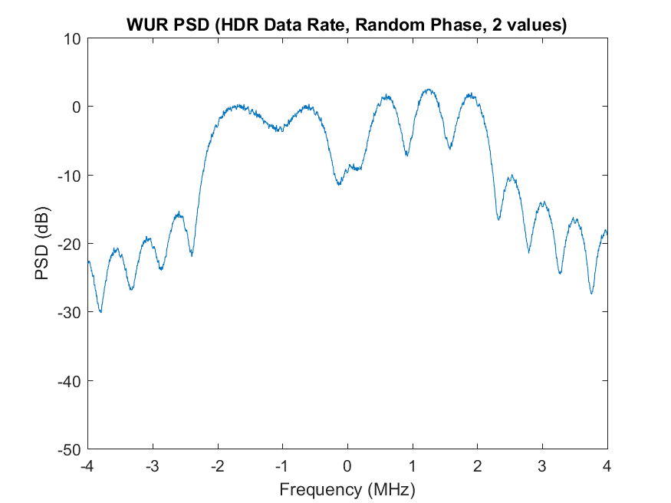
HDR – Random Phase (2 possible phases)
Similar to PSD in [1]

Slide 5
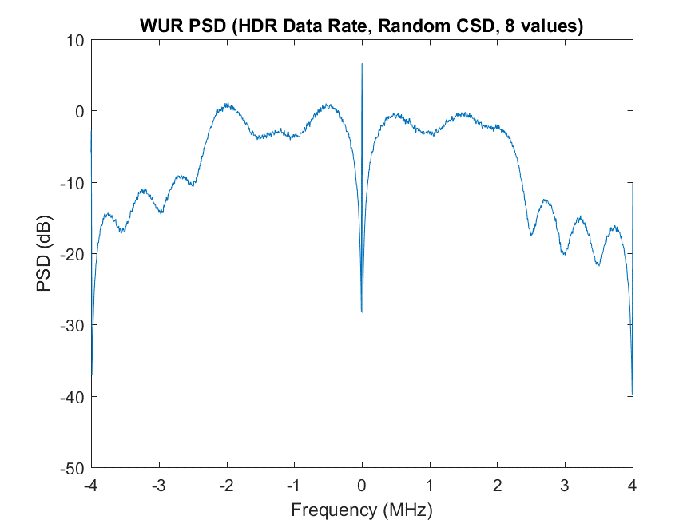
HDR – Random CSD (8 possible CSD values)
One spectral line still present

Slide 6
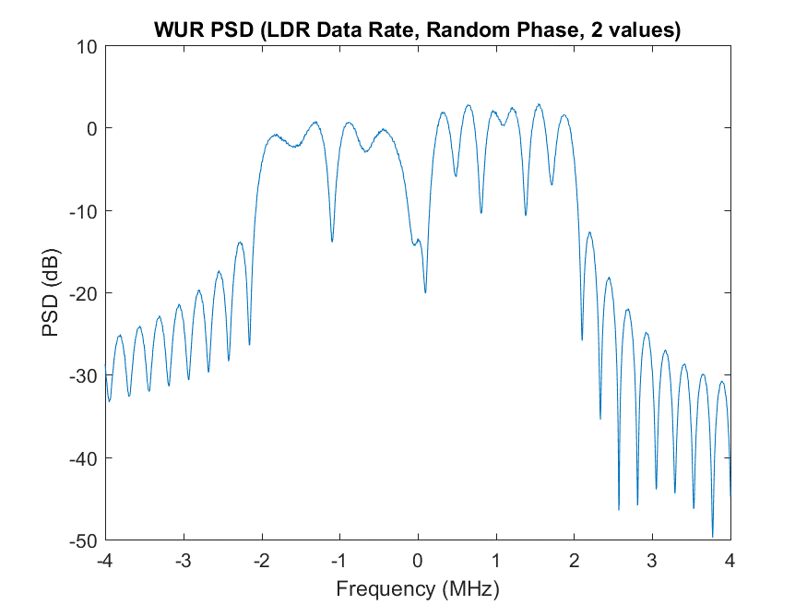
LDR – Phase Randomization (2 possible phases)
Similar to PSD in [1]

Slide 7
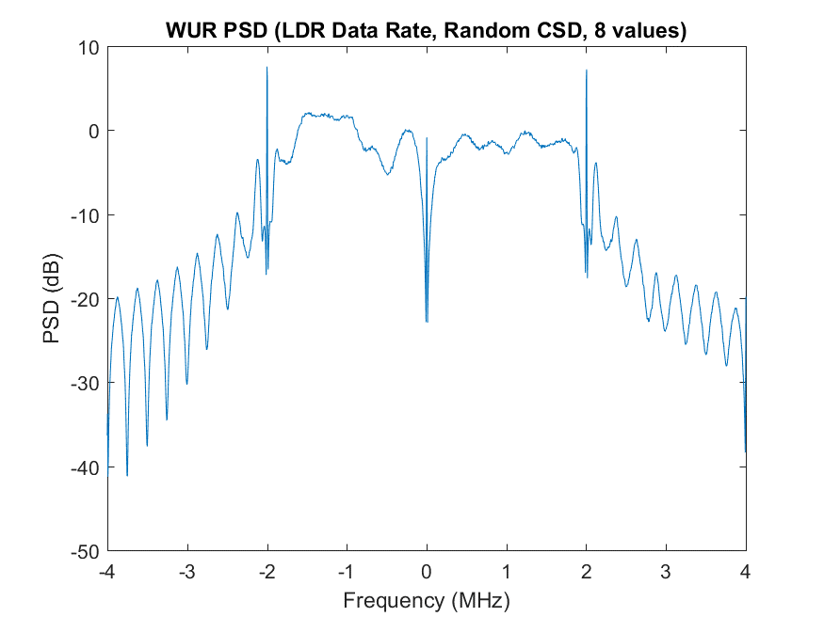
LDR – CSD Randomization (8 possible CSD Values)
Still several spectral lines

Slide 8
Observations
We see some spectral lines in our random CSD simulations
In particular, we see a spectral line at DC
The MC-OOK On symbol has a DC component, as a result of adding the cyclic prefix. There is no DC prior to adding the cyclic prefix
Applying a random CSD does not impact the DC component, so we believe that is the reason the DC component still exists
The other spectral lines we observe in the LDR PSD may have a similar explanation

Slide 9
Conclusions
We have concerns about the random CSD approach since we observe some spectral lines when using this approach

Slide 10
References
Steve Shellhammer, Bin Tian and Richard Van Nee, “WUR Power Spectral Density,” IEEE 802.11-18/824r1, May 2018
Miguel Lopez, Dennis Sundman, and Leif Wilhelmsson, “Spectral lines in MC-OOK,” July 2018

