Slide 1
Comparison of 2 µs MC-OOK Symbols
Date: 2018-MM-DD
Authors:

Slide 2
Introduction
Up until now we had focused on simulating with our own MC-OOK symbol designs
We decided to simulate with another design and compare the results
We focused on the HDR which uses the 2 µs symbol for both the Sync and Data fields
We simulated:
Symbol Label | Coefficient List (32-pt IFFT) | Comment
A | [1, 1, 1, 0, -1, 1, -1] | Our Proposal [1]
B | [1, 1, -1, 0, -1, -1, 1] | Proposal from Vinod and Shahrnaz [2]
We got very similar results in Channel Model D but different results in AWGN
So we investigated further to see if we could identify the AWGN simulation difference

Slide 3
Channel Model D Simulations

Slide 4
AWGN Simulations

Slide 5
SNR from Simulations
 | AWGN SNR (dB) | Model D SNR (dB)
Symbol A | -4.01 | 2.19
Symbol B | -3.27 | 2.47
AWGN simulation results with Symbol A are about 0.74 dB better than for results with Symbol B
This is significant and quite aperient in the curves
Channel Model D simulation results with Symbol A are about 0.28 dB better than for results with Symbol B

Slide 6
Study
We looked into the characteristics of the MC-OOK On Symbol to see if we could identify any characteristic that might explain the difference in the AWGN simulation performance
This is the list of characteristics which we consider
Symbol PAPR
Plot of absolute value of time domain waveform
Plot PSD of Data Field with random data using the On symbol, including phase randomization to remove spectral lines
I/Q imbalance as a function of phase rotation
Variation in the sum of samples, at 4 MHz, as a function of timing offset
Eye Diagram with rectangular receive matched filter

Slide 7
PAPR
Symbol Label | PAPR (dB)
A | 2.25
B | 3.40
Symbol A has low PAPR, which was a design criteria, so this makes sense

Slide 8
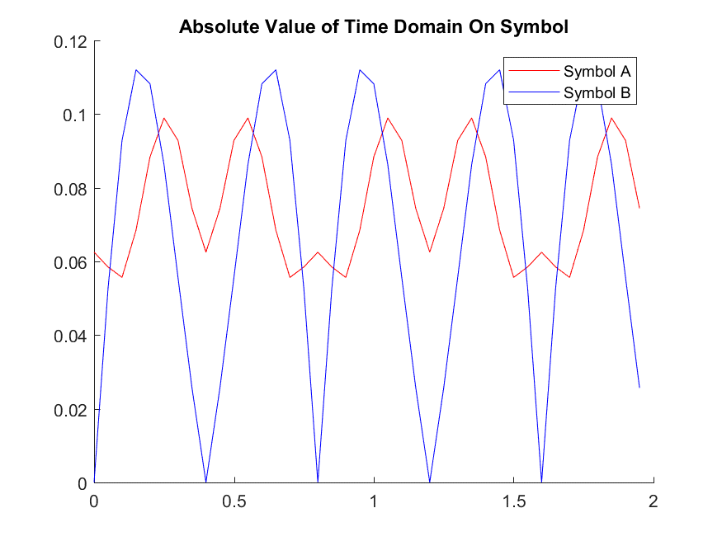
Plot of Absolute Value of Time Domain Waveform
Symbol B has much Larger Signal Fluctuation
In particular it drops to zero multiple times during the symbol period

Slide 9
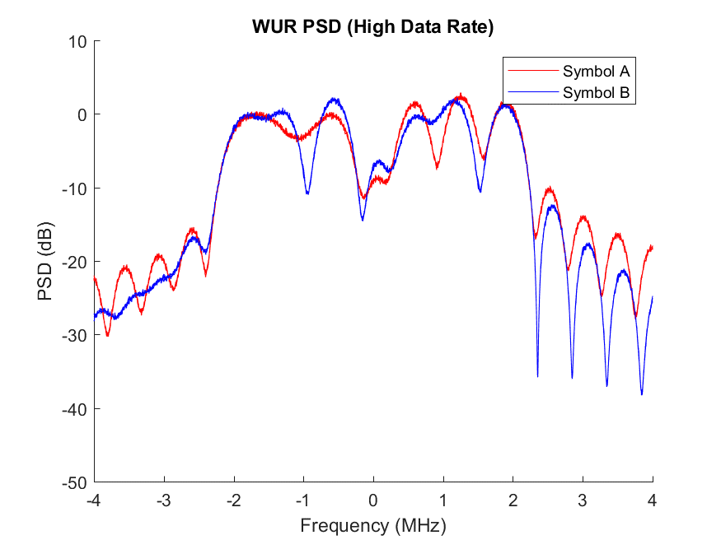
PSD
Somewhat similar PSD

Slide 10
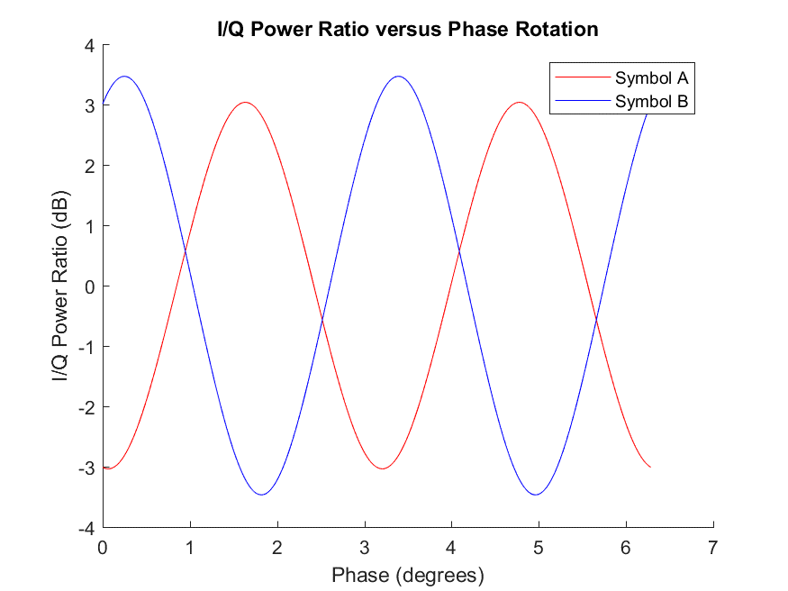
I/Q Power Ratio
Symbol A has slightly lower I/Q power variation

Slide 11
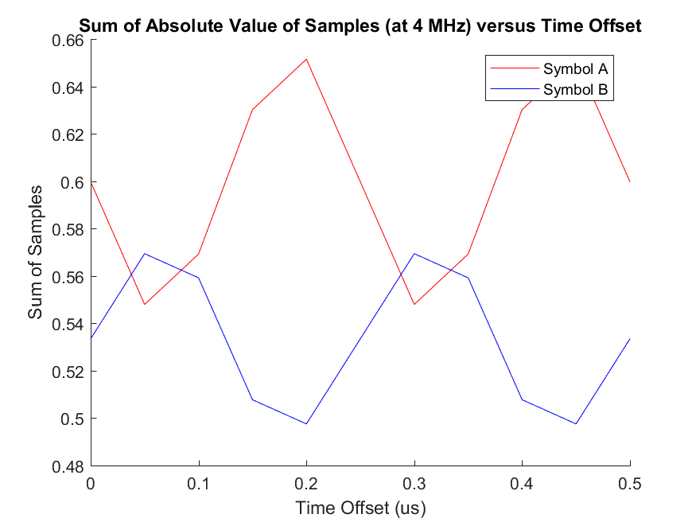
Sum of Absolute value of Samples versus Time Offset
Symbol A has significantly higher “sum of samples” than Symbol B

Slide 12
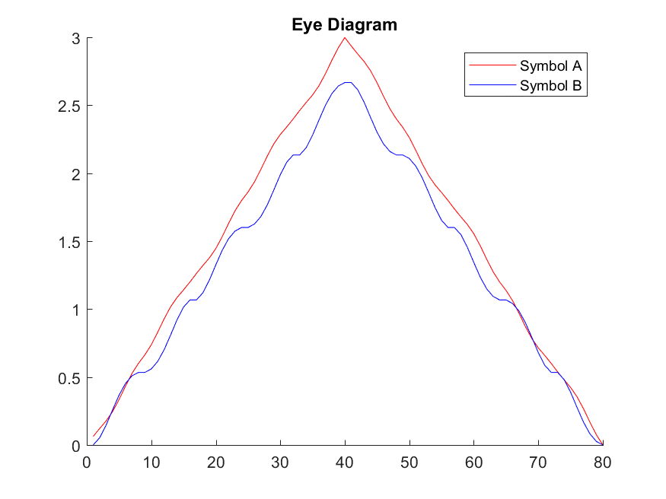
Eye Diagram
Symbol A has a little better Eye Diagram

Slide 13
Conclusions
It is our opinion that the reason we saw significant difference in the AWGN simulations is that Symbol B has larger signal fluctuations, and when sampled at 4 MHz the sum of these 8 samples may have lower total than for Symbol A
Symbol A has a relatively constant signal envelope so that the sum of the samples is relatively constant for both good timing alignment and also with any timing offset

Slide 14
References
Steve Shellhammer and Bin Tian, “MC-OOK Symbols and CSD Recommendations,” May 2018
Vinod Kristem, Shahrnaz Azizi, Thomas Kenney, “2 us OOK waveform generation,” IEEE 802-11/492r2, March 2018

