Slide 1
MU sounding improvements
Date: 7/8/2018
Authors:

Slide 2
Introduction
The 802.11 WG approved the formation of an EHT TIG to initiate discussion on new 802.11 features for bands between 1 and 7.125 GHz:
  with the primary objective to increase peak throughput
  candidate features include but are not limited to:
    320 MHz bandwidth, multiband aggregation and operation
    16 spatial streams

Slide 3
Summary
As part of the scope of EHT, enhancements to sounding should be considered
  16 SS most useful for MU, for which sounding is a must
    See [1] for potential gains of MU
  Sounding overhead will grow further (compared to 11ac/11ax) when increasing N_{SS} from 8 to 16
  Aside from 16 SS, other kinds of MIMO enhancements will also require overhead reduction

Slide 4
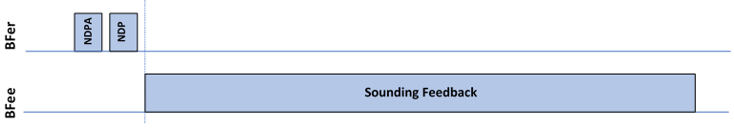
Current Sounding
MU precoding requires CSI
  11ac and 11ax define only explicit feedback to learn CSI
Most airtime taken up by CSI feedback (Compressed Beamforming Frame)
  Length of CBF will grow further with increasing number of streams

Slide 5
Improvements in 11ax
Sounding protocol essentially identical to 11ac, with minor improvements
  Partial BW feedback
  CQI feedback (not useful for MU-MIMO)
  CSI airtime reduction using TB sounding sequence
Further improvements are needed in EHT to control sounding overhead

Slide 6
Implicit feedback
Implicit sounding avoids overhead from CSI feedback
For implicit feedback to work:
  BFer must be calibrated
  BFee must send packet appropriate for channel estimation
    BW, #streams = #antennas, …
  BFee must send packets at appropriate time intervals
    Ideally as determined by BFer
Item 1 may be achieved in a number of ways
  See e.g. [2]
Items 2 and 3 can not currently be guaranteed

Slide 7
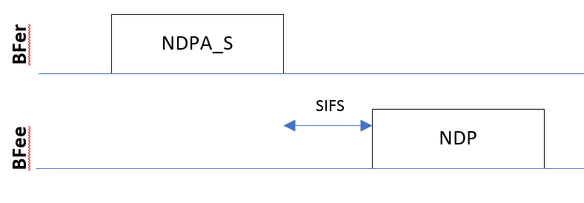
Possible Sounding enhancement
Allow the BFer to solicit packets suitable for channel estimation in the reverse direction
  Assuming calibration can be achieved
  Responding packet equal (or similar) to NDP
  BFer is responsible for implicit channel estimation
Huge reduction in sounding overhead

Slide 8
Soliciting NDPs
BFee responds to NDPA_S within SIFS with NDP
NDPA_S identifies (one or more) STAs that should respond
NDP should be sent with #streams= # BFee antennas
  Direct mapping or unitary Spatial mapping
In case of UL MU, NDPs use number of LTFs indicated by NDPA_S, with specific streams assigned to different STAs

Slide 9
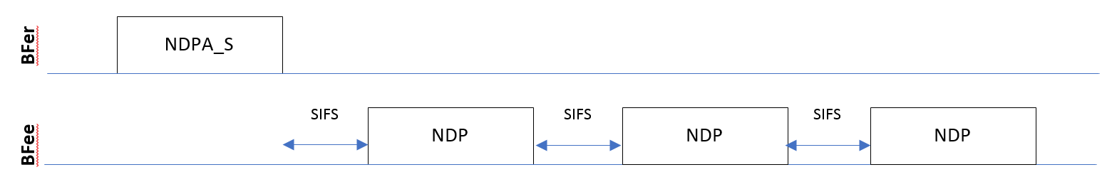
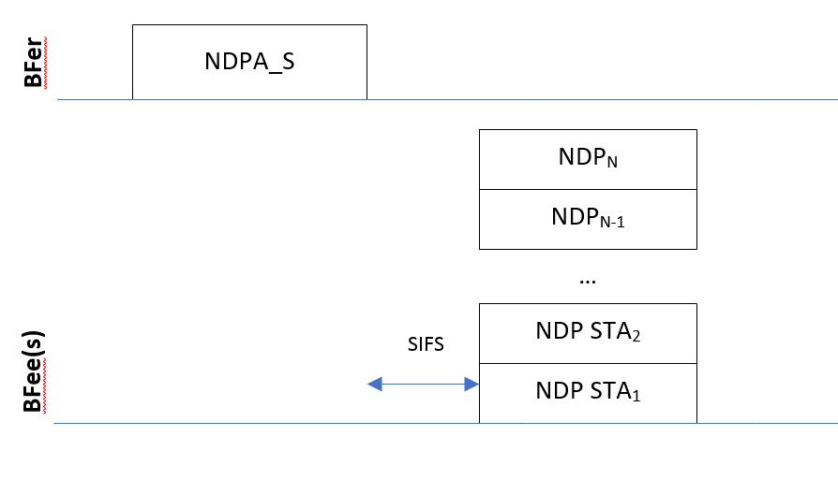
Possible variants
Multi-STA sequential feedback
UL-MU based feedback

Slide 10
Conclusion
Given the current scope of EHT, the following features should be considered as part of the scope:
  Enhancements to sounding with the goal of reducing sounding overhead (especially for MU)
  Enhancements to enable or facilitate implicit sounding

Slide 11
References
[1] 16 Spatial Stream Support in Next Generation WLAN, IEEE 802.11-18/818r3
[2] Reconsidering Implicit Feedback for Beamforming, IEEE 802.11-18/509r1

