Slide 1
Discussion on EHT timeline and scope
Date: 2018-07-09
Authors:

Slide 2
Abstract
The IEEE 802.11 WG approved on May 11th 2018 the formation of a topic interest group (TIG), called Extremely High Throughput (EHT), to initiate discussions on new 802.11 features for bands between 1 and 7.125 GHz [1]
The objective is to have the EHT task group (TG) formed by early 2019 with the target to have an EHT amendment available in two years, i.e. on 2021 [1]
We support both the formation of the EHT TG and the 2 year amendment cycle

Slide 3
Background
The IEEE 802.11 WG approved on May 11th 2018 the formation of a TIG, called EHT, to initiate discussions on new 802.11 features for bands between 1 and 7.125 GHz [1]
  The EHT’s primary objective is to increase peak throughput to support high throughput applications such as video-over-WLAN, augmented reality (AR) and virtual reality (VR)
  Suitable candidate features include, but are not limited to
    More spatial streams (16 spatial streams),
    More bandwidth (320MHz bandwidth), and
    Multiband switching, aggregation and operation

Slide 4
Background
The objective is to have the EHT TG formed by early 2019 with the target to have an EHT amendment available in 2 years, i.e. by early 2021 [1]
  The EHT TG would be the first of the kind, most probably followed by a sequence of similar TGs, with each one of them providing selected PHY/MAC improvements in 2 years cycles [1][2]

Slide 5
Proposal
For 802.11 to remain competitive and allow producing a new amendment in 2 years, we propose that EHT TG should be a focused effort with clearly defined features
Suitable candidate features may be:
  More spatial multiplexing → usage of 16 (or more) spatial streams
  More bandwidth → usage of 320MHz (or more) bandwidth (across the 5GHz and 6GHz band)
  Multiband operation → usage of fast switching, aggregation, traffic steering, load balancing
  This last feature may stretch the boundaries of the 2 years cycle, unless the SG can define in the PAR the switching/aggregation architecture that the TG needs to follow

Slide 6
More spatial streams
802.11ax successfully deploys SU-MIMO and DL MU-MIMO with 8 spatial streams
We support that EHT TIG or the related study group (SG) analyses the potential benefits of leveraging spatial multiplexing further with SU-MIMO and DL MU-MIMO with 16 spatial streams or more
  The rich indoor scattering and high angular spread result in low channel correlation among receivers, which are the basis for a good massive MIMO performance
  This feature would increase cell throughput (2x or more [3]) and reduce latency - as there are more channel access opportunities
  We would like to see this feature in the EHT, in 2 years

Slide 7
More spatial streams
The larger number of degrees of freedom opens the opportunity for different MIMO modes of operation
  Significant gains may be brought by:
    16 SS for DL/UL MU-MIMO with 1, 2, 4, and 8 antennas per receiving station
    Simultaneous CSI acquisition from multiple receiving stations to mitigate overhead and delay
    CSI acquisition from stations not associated with the transmitter - extended measurement report - to facilitate interference mitigation
    Null steering as an interference coordination/co-existence mechanism

Slide 8
More bandwidth
802.11ax successfully uses the 160MHz bandwidth available in the 5GHz band
We support that EHT TIG/SG studies the potential benefits of leveraging the more bandwidth, 320 MHz or more, across the 5GHz and 6GHz band
  In the near future, it is likely to have 320MHz or more bandwidth available across the 5GHz and 6GHz bands
  This feature would increases cell throughput (2x or more) and reduce latency - as there are more channel access opportunities
  We would like to see this feature in the EHT, in 2 years*

Slide 9
More bandwidth
When considering the 6GHz band, we propose that EHT TIG/SG studies the potential changes needed with respect to previous amendments, imposed by the regulations in this new band
  Reusing existing techniques in the 802.11 is preferred to support the 2 years cycle

Slide 10
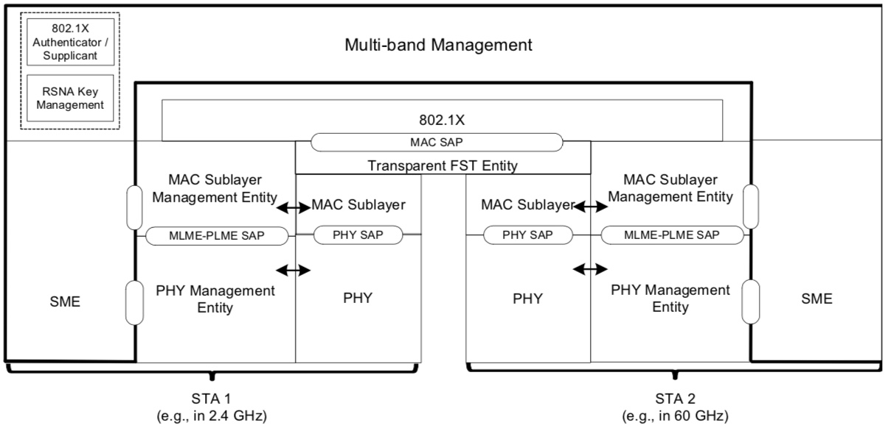
Multiband operation
Transparent Fast Session Transfer (FST) provides a very solid and good basis for multiband operation and the EHT multiband solution should be build upon it

Slide 11
Conclusion
We support both the formation of the EHT TG and the 2 year amendment cycle

Slide 12
References
[1] IEEE 802.11-18/0789r10, “Extreme Throughput (XT) 802.11”
[2] IEEE 802.11-18/0846r2, “Next Generation PHY/MAC in Sub-7GHz”
[3] IEEE 802.11-18/0818r3, “16 Spatial Stream Support in Next Generation WLAN ”

