Slide 1
Follow up discussions on Throughput Enhancement
Date: 2018-07-09
Authors:

Slide 2
Abstract
In IEEE May meeting, it was agreed that increase peak throughput will be the primary objective of EHT group[1].
  Candidate features include: 320 MHz bandwidth, multiband aggregation and operation, and 16 spatial streams etc.
In [2], we discussed a number of candidate features for throughput enhancement.
In this contribution, we share some further thoughts on some key candidate features.

Slide 3
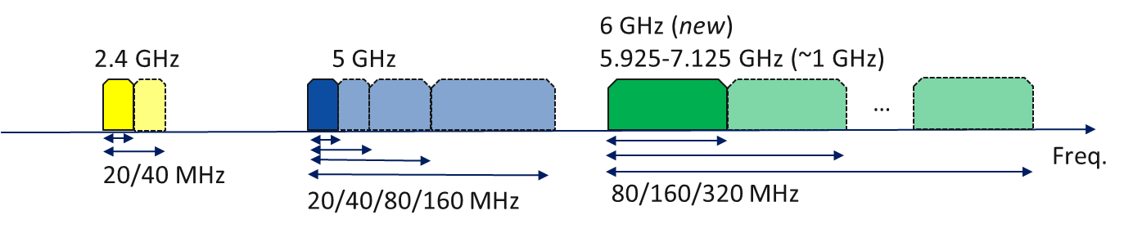
Multi-band operation in 2.4/5/6GHz bands
Multi-band operation in 2.4/5/6GHz is a natural extension of existing dual-band operating AP/STAs.
Benefits:
  Easy way to improve the peak throughput by supporting wider band operation such as 320MHz.
  Support high throughput data pipe in 6GHz band.
  Balance for range and throughput: Long range traffic in 2.4GHz band and high throughput traffic on 5/6GHz band.

Slide 4
Multi-Band Operation –
Synchronized or unsynchronized?
Synchronized Multi Band
  All bands transmit in a synchronized way
  Need to wait CCA idle on all bands before transmission → Low efficiency
    Long waiting time on early idle bands.
    Need schemes to hold the idle channel.
Unsynchronized Multi Band
  Each band has independent channel access.
    Higher channel access efficiency
  Optimized throughput with per band individual MCS
    Channel condition and regulatory power limits are
    different for different bands. Independent MCS on each
    band will achieve optimal throughput.
Unsynchronized Multi Band Operation
is preferred.
f
Band 3
Band 2
Waiting
time
Band 1
t
Packet arrive
Band 3
Band 2
Band 1
t

Slide 5
Multi-Band Operation – Single anchor channel or multiple anchor channels?
Primary channel vs Anchor channel
  Primary channel: The common channel of operation for all STAs that are member of the BSS
  Anchor channel: The channel on which beacon and other broadcast frames are transmitted. It’s not required that all PPDU transmission to include the anchor channel.
Single anchor channel
  Only one anchor channel for all bands.
    Channel access, CCA will still be independent for each band.
  All the STAs’ operating bands must include at least one anchor channel. → Unbalanced traffic on different bands and congestion on anchor channel.
Multiple anchor channels
  STA may only operate on a subset of
  AP’s operating bands.
    AP and STA may be mandate to support at least one of the 2.4G and 5GHz band. In this case, no need to define a anchor channel for 6GHz band.
  AP will be able to optimize the system performance by assigning STAs to different set of bands based on load balance, range of the STA, traffic type of the STA etc.
Recommend to support multiple primary channels
Anchor
channel
Band 1
Band 2
Band 3
Anchor
channel
Anchor channel
Band 1
Band 2
Band 3

Slide 6
Flexible channel aggregation
Flexible channel aggregation may include different types of frequency domain resource aggregation within one operating band
  For example:
    Channel/frequency segment aggregation. For example 20+40, 40+80 etc.
    More flexible preamble puncturing and
    RU aggregation for a STA etc.
  Channel/segment aggregation and preamble puncturing targeting at scenarios with narrow band interference or DFS channels.
    AP side feature, require capability to have spectrum masks for punctured channel(s)
    Synchronized operation recommended to avoid self interference between channels.
  RU aggregation for a STA: AP allocated multiple RUs to a STA.
    Not for scenario with narrow band interference between RUs. This mode is targeting at better utilizing the frequency resources and easier RU allocation for AP.
    In UL OFDMA, RU aggregation does not require the STA to apply spectrum mask for the gap between the allocated RUs.

Slide 7
Benefits of Flexible channel aggregation
Significantly increase the throughput in practical scenario with narrow band interferences or DFS active on secondary channel(s).
  Avoid dramatically reduce the operating BW and severe throughput drop.
Avoid waste of frequency resources.
  Example: Allocating 2 STAs on 20MHz OFDMA PPDU.
    Allow RU106+RU26 aggregation will avoid waste of the middle 26 tone RU.
      ~12% throughput gain for 20MHz case, ~15% throughput gain for 80MHz case.
Diversity gain by distributed RU aggregation.
  Instead of one large physical RU, logic RU with distributed pattern will
  achieve spectrum diversity gain.
Supporting optimal multi-user selection and RU allocation.
  Best RUs for a STA may not be contiguous.
  Throughput can be maximized if AP assign optimized RU combination to a STA.
  STA may feedback best N RUs to help AP on RU allocation.
Primary channel
Interfered channel
Clean secondary
channels
Combined 26 tone RU
1,3,5,7,9 as logic RU 1
Logic RU 2

Slide 8
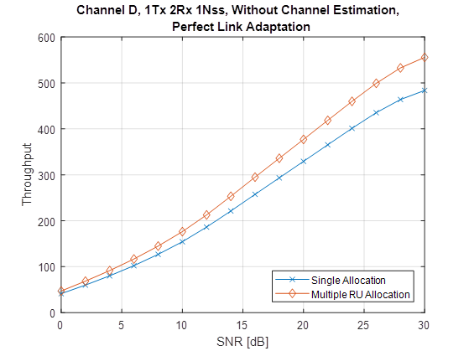
Avoid waste of frequency resource
Center 26 tone RUs in 20MHz
and 80MHz are more likely to
be wasted.
Simply allow aggregation
with neighboring RUs will
bring ~15% throughput gain.
RU106
RU26
80MHz

Slide 9
Localized Vs. Distributed
PER performance
  106 RU per STA vs. 4x26 RUs per STA
  As shown in the figure, diversity gain can be achieved.

Slide 10
Challenge of Flexible channel aggregation
BCC Interleaver/LDPC tone mapper design for aggregated channels/RUs
  Aggregated channel/RU will have new number of data subcarriers. No BCC interleaver and LDPC tone mapper parameters are defined for these new sizes.
  Due to large number of possible combinations, define new parameters for all possible combination seems not possible.
RU allocation signaling overhead
  With wider BW and RU aggregation, the RU allocation signaling overhead may increase significantly.
  Overhead of simple extension to current HE-SIG-B may not be acceptable.
Spectrum mask for punctured channels
  Not clear whether spectrum mask defined for punctured channel in 11ax can provide enough interference suppression.
  Could be difficult to define better spectrum mask for punctured channels.

Slide 11
More spatial streams
More spatial stream is another scheme to enhance the throughput and spectrum efficiency [3].
Benefits
  Supporting more spatial streams for MU-MIMO will bring significant throughput enhancement.
    Results of PHY rate increase for DL/UL MU-MIMO scenarios are shown in [3].
Challenge of 16 spatial stream support
  Higher sounding feedback overhead
  Larger buffer needed for sounding report
  → Low overhead sounding feedback scheme is critical.

Slide 12
Sounding Feedback Overhead
Compressed Beamforming report overhead
  Compressed beamforming method for 16 antennas and 320MHz will require large feedback overhead
  In particular, we are interested in overhead reduction for 16x1 and 16x2 cases
  Examples:
    80MHz 16x1 feedback transmission using MCS0 UL 20MHz HE PPDU requires 4.4ms air time
    With 300 Mbps rate for the CBR and ignored segmentation and MAC header overheads: the worst case air time is about 7 ms.
  Please see appendix for the detailed table of feedback overhead.

Slide 13
Summary
In this contribution three potential topics are discussed
  Multi band Operation
  Flexible channel aggregation
  16 spatial streams
We shared our thoughts on benefits and challenges of the topics
  Multi-Band Operation: we suggest unsynchronized multi-band operation with multiple primary channels
  Flexible channel aggregation:
    we listed a number of possible modes of in-band channel aggregation and their benefits.
    The challenges include interleaver/tone mapper design, resource allocation signaling overhead and power mask for punctured channel
  16 spatial streams: Sounding feedback overhead problem need to be solved.

Slide 14
References
[1] 11-18-0789-10-0wng-extreme-throughput-802-11
[2] 11-18-0857-00-0wng-beyond-802-11ax-throughput-enhancement-utilizing-multi-bands-across-2-4-5-6ghz-bands
[3] 11-18-0818-03-0wng-16-spatial-stream-support-in-next-generation-wlan

Slide 15
Appendix

Slide 16
Nr | Nc | BW | Ng | CB | FT | CBR bits | Duration in us at 300 Mbps
2 | 1 | 80 | 4 | Fine | SU | 2512 | 8
2 | 1 | 80 | 16 | Coarse | SU | 392 | 1
8 | 1 | 80 | 4 | Fine | SU | 17512 | 58
8 | 1 | 80 | 16 | Coarse | SU | 2696 | 9
8 | 2 | 80 | 4 | Fine | SU | 32520 | 108
8 | 2 | 80 | 16 | Coarse | SU | 5008 | 17
8 | 8 | 80 | 4 | Fine | SU | 70064 | 234
8 | 8 | 80 | 16 | Coarse | SU | 10816 | 36
16 | 1 | 80 | 4 | Fine | SU | 37512 | 125
16 | 1 | 80 | 16 | Coarse | SU | 5768 | 19
16 | 2 | 80 | 4 | Fine | SU | 72520 | 242
16 | 2 | 80 | 16 | Coarse | SU | 11152 | 37
16 | 8 | 80 | 4 | Fine | SU | 230064 | 767
16 | 8 | 80 | 16 | Coarse | SU | 35392 | 118
16 | 16 | 80 | 4 | Fine | SU | 300128 | 1000
16 | 16 | 80 | 16 | Coarse | SU | 46208 | 154
2 | 1 | 80 | 4 | Fine | MU | 5008 | 17
2 | 1 | 80 | 16 | Coarse | MU | 1032 | 3
8 | 1 | 80 | 4 | Fine | MU | 29008 | 97
8 | 1 | 80 | 16 | Coarse | MU | 5640 | 19
8 | 2 | 80 | 4 | Fine | MU | 54016 | 180
8 | 2 | 80 | 16 | Coarse | MU | 10512 | 35
8 | 8 | 80 | 4 | Fine | MU | 120064 | 400
8 | 8 | 80 | 16 | Coarse | MU | 23616 | 79
16 | 1 | 80 | 4 | Fine | MU | 61008 | 203
16 | 1 | 80 | 16 | Coarse | MU | 11784 | 39
16 | 2 | 80 | 4 | Fine | MU | 118016 | 393
16 | 2 | 80 | 16 | Coarse | MU | 22800 | 76
16 | 8 | 80 | 4 | Fine | MU | 376064 | 1254
16 | 8 | 80 | 16 | Coarse | MU | 72768 | 243
16 | 16 | 80 | 4 | Fine | MU | 496128 | 1654
16 | 16 | 80 | 16 | Coarse | MU | 96384 | 321

Slide 17
Nr | Nc | BW | Ng | CB | FT | CBR bits | Duration in us at 300 Mbps
2 | 1 | 320 | 4 | Fine | SU | 10008 | 33
2 | 1 | 320 | 16 | Coarse | SU | 1544 | 5
8 | 1 | 320 | 4 | Fine | SU | 70008 | 233
8 | 1 | 320 | 16 | Coarse | SU | 10760 | 36
8 | 2 | 320 | 4 | Fine | SU | 130016 | 433
8 | 2 | 320 | 16 | Coarse | SU | 19984 | 67
8 | 8 | 320 | 4 | Fine | SU | 280064 | 934
8 | 8 | 320 | 16 | Coarse | SU | 43072 | 144
16 | 1 | 320 | 4 | Fine | SU | 150008 | 500
16 | 1 | 320 | 16 | Coarse | SU | 23048 | 77
16 | 2 | 320 | 4 | Fine | SU | 290016 | 967
16 | 2 | 320 | 16 | Coarse | SU | 44560 | 149
16 | 8 | 320 | 4 | Fine | SU | 920064 | 3067
16 | 8 | 320 | 16 | Coarse | SU | 141376 | 471
16 | 16 | 320 | 4 | Fine | SU | 1200128 | 4000
16 | 16 | 320 | 16 | Coarse | SU | 184448 | 615
2 | 1 | 320 | 4 | Fine | MU | 20008 | 67
2 | 1 | 320 | 16 | Coarse | MU | 4104 | 14
8 | 1 | 320 | 4 | Fine | MU | 116008 | 387
8 | 1 | 320 | 16 | Coarse | MU | 22536 | 75
8 | 2 | 320 | 4 | Fine | MU | 216016 | 720
8 | 2 | 320 | 16 | Coarse | MU | 42000 | 140
8 | 8 | 320 | 4 | Fine | MU | 480064 | 1600
8 | 8 | 320 | 16 | Coarse | MU | 94272 | 314
16 | 1 | 320 | 4 | Fine | MU | 244008 | 813
16 | 1 | 320 | 16 | Coarse | MU | 47112 | 157
16 | 2 | 320 | 4 | Fine | MU | 472016 | 1573
16 | 2 | 320 | 16 | Coarse | MU | 91152 | 304
16 | 8 | 320 | 4 | Fine | MU | 1504064 | 5014
16 | 8 | 320 | 16 | Coarse | MU | 290880 | 970
16 | 16 | 320 | 4 | Fine | MU | 1984128 | 6614
16 | 16 | 320 | 16 | Coarse | MU | 385152 | 1284

