Slide 1
Discussion on EHT Study Group Formation
Date: 2018-07-09
Authors:

Slide 2
Background
As presented in [1] and [2], there is a need for the new EHT TG to focus, among other objectives, on increased peak throughput and capacity, with 40Gbps as the peak rate (4X throughput improvement compared with 11ax)
Several features were presented as candidates for increasing the peak rate:
  Wider bandwidth (320MHz)
  16 Spatial Streams
  Multi-channel/Multi-band aggregation
We believe that the EHT TG should focus on improving efficiency & throughput for all use cases, not just peak throughput scenarios
In this presentation, we discuss some typical usage scenarios, and some potential features for improving the performance in these scenarios

Slide 3
Typical Usage Scenarios
In order to reach the peak rate mentioned in the previous slide, the following needs to happen:
  320MHz BW is available
  16 stream transmission
In many scenarios, the above will not take place; thus we should consider additional, more typical usage scenarios, such as:
  AP with 4 or 8 antennas
  Available BW is narrow/punctured (this is after all an unlicensed spectrum)
  Cases where MU-MIMO is not effective
Consider as a typical example a home scenario, where the channel may be shared with many neighboring APs

Slide 4
Improved Efficiency for Typical Usage Scenarios
As briefly mentioned in [1], improvements can be applied to 11ax features, in order to enhance the performance
Considering alternative, more efficient technologies in unlicensed bands, we should consider techniques to improve the efficiency
These improvements are of course not limited to the peak throughput scenario but to all scenarios – including the majority of scenarios mentioned in the previous slide
In the next slide, we give some examples of features which are candidates for such typical usage scenario improvements

Slide 5
Candidate Technology Considerations
To improve efficiency and throughput, in addition to the features discussed in [1], we can consider several features below (not necessarily in order of priority) [3]:
  Hybrid ARQ (HARQ)
    Improves performance by combining retransmissions; widely used in other technologies such as LTE
  Semi-Orthogonal Multiple Access (SOMA)
    Yields throughputs similar to MU-MIMO with no CSI feedback overhead
  Efficient use of 6GHz band
    Make use of the new band more efficiently to support video applications
  AP Coordination
    Improve throughputs and provide more opportunities for parallel transmissions by using multiple APs
  Full Duplex
    Reduced latency, increased throughput, improved channel access
    Please see Appendix A of this contribution for some supporting materials of the above proposed features.

Slide 6
Feature Selection and Timeline Considerations
A general consensus has been observed at Warsaw meeting:
  802.11 WG would like to accelerate the development of 802.11 PHY/MAC projects
For EHT, one of the proposals is to aim at a limited set of features as the EHT’s scope at the EHT SG formation time, so as to have a limited duration for the EHT SG, i.e., the Timeline Option #1 below.
However, there are concerns that the Timeline Option #1 does not provide much time for feature harmonization and selection for such an important project, therefore would prefer to having more time for EHT SG, i.e., the Timeline Option #2 below.
Option #1’s timeline:
Option #2’s timeline:
  2018 September: Motion PAR and CSD in the WG closing plenary
  2018 November: WG final approval of the PAR and CSD
  2018 November: EC approval of the PAR
  2019 January: First meeting of the task group
  2019 January: Motion PAR and CSD in the WG closing plenary
  2019 March: WG final approval of the PAR and CSD
  2019 March: EC approval of the PAR
  2019 May: First meeting of the task group
EHT TIG &
feature selection
PAR & CSD
development
PAR & CSD
approved
EHT TG Begins
Option #1
EHT TIG
PAR & CSD development as well as feature selection
PAR & CSD approved
EHT TG Begins
Option #2
July 2018
September 2018
November 2018
January 2019
March 2019
May 2019

Slide 7
Consideration on the EHT SG Formation Motion
The two options of the timelines to initiate the EHT project:
  Option #1: Defining the project scope when forming the EHT SG, i.e., in the July meeting;
  Option #2: Defining the project scope in the EHT SG, i.e., from July to November meeting;
Therefore, we can consider two options of the EHT SG formation motion text:
  Option #1: clearly specify the intended scope of the EHT project;
  Option #2: leave the scope open for further discussions in the EHT SG, where there may be two variants of the motion text:
    Option #2a: provide some high-level description of the project objectives
    Option #2b: re-use some of the EHT TIG formation text
In the next three slides, we give some more details about the proposed EHT SG formation motion text, in order to facilitate the discussions in the EHT TIG;
Among those options, we are fairly open and would like to work with the group to quickly reach consensus on this matter, so that the EHT SG can be formed timely.

Slide 8
Suggested EHT SG Formation Motion Text – Option #1
Move to approve formation of an EHT SG (Extreme High Throughput Study Group) to develop a Project Authorization Request (PAR) and a Criteria for Standards Development (CSD) for a new 802.11 amendment for the bands between 1 to 7.125 GHz, with the primary objectives:
  To increase peak throughput and improve efficiency
    candidate features include: 320 MHz bandwidth, multiband aggregation and operation, 16 spatial streams, HARQ, SOMA, AP Coordination, and efficient use of the 6GHz band;
  To support high throughput and low latency applications such as video-over-WLAN, AR and VR

Slide 9
Suggested EHT SG Formation Motion Text – Option #2a
Move to approve formation of an EHT SG (Extreme High Throughput Study Group) to develop a Project Authorization Request (PAR) and a Criteria for Standards Development (CSD) for a new 802.11 amendment for the bands between 1 to 7.125 GHz, with the primary objectives:
  To increase peak throughput and improve efficiency
  To support high throughput and low latency applications such as video-over-WLAN, AR and VR

Slide 10
Suggested EHT SG Formation Motion Text – Option #2b
Move to approve formation of an EHT SG (Extreme High Throughput Study Group) to develop a Project Authorization Request (PAR) and a Criteria for Standards Development (CSD) for a new 802.11 amendment for the bands between 1 to 7.125 GHz:
  with the primary objective to increase peak throughput
  candidate features include but are not limited to: 320 MHz bandwidth, multiband aggregation and operation, and 16 spatial streams
  To support high throughput applications such as video-over-WLAN, AR and VR

Slide 11
Summary
We think that the EHT TG should focus on increasing peak throughput as well as improve efficiency for typical usage scenarios
We presented candidate features for improving the efficiency, as well as two possible timelines for feature selection and developing the PAR & CSD
Respective to these two possible timelines, we presented three possible motion texts for the EHT SG formation

Slide 12
References
802.11-18/0789r10: EXtreme Throughput (XT) 802.11
802.11-18/0818r3: 16 Spatial Stream Support in Next Generation WLAN
802.11-18/0846r2: Next generation PHY MAC in sub-7GHz

Slide 13
Straw Poll #1
Which option do you support for the EHT TG formation timeline?
Option #1 as shown below
Option #2 as shown below
Don’t care
Option #1 timeline:
Option #2 timeline:
  2018 September: Motion PAR and CSD in the WG closing plenary
  2018 November: WG final approval of the PAR and CSD
  2018 November: EC approval of the PAR
  2019 January: First meeting of the task group
  2019 January: Motion PAR and CSD in the WG closing plenary
  2019 March: WG final approval of the PAR and CSD
  2019 March: EC approval of the PAR
  2019 May: First meeting of the task group

Slide 14
Appendix A
Supporting Materials for Proposed Candidate Features

Slide 15
Hybrid ARQ (HARQ) (1)
Hybrid ARQ (HARQ) is a feature widely used in various wireless technologies such as UMTS and LTE (where it is mandatory)
Unlike ARQ where incorrectly decoded packets are discarded at the receiver and are then retransmitted (by the transmitter), with HARQ - soft combining (or combining of equalized tones) is enabled
  This means that the LLRs respective to incorrectly decoded packets are stored in memory and combined with retransmissions of the same information bits, increasing the probability for correct packet detection (after retransmission)
Due to the improved performance (after HARQ combining), practical wireless systems employing HARQ also use a lower fade margin in the rate selection algorithm – this means that the rate selection mechanism often effectively uses a higher MCS

Slide 16
Hybrid ARQ (HARQ) (2)
In CSMA/CA systems (such as 802.11) the rate selection algorithm uses a larger fade margin (relative to cell coordination systems) because the interference level has big fluctuations (among other issues - due to hidden nodes); hence HARQ can yield significant benefits to CSMA systems
Both Chase Combining (CC) HARQ – where the same coded bits are retransmitted, and Incremental Redundancy (IR) HARQ – where (slightly) different info and parity bits are retransmitted, can be considered
In an Aggregated MPDU (A-MPDU) transmission, only failed MPDUs are retransmitted (unlike LTE where the entire TB is retransmitted)
  HARQ should be applied to these MPDUs only, hence saving medium time and memory resources

Slide 17
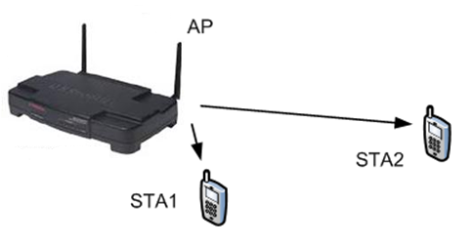
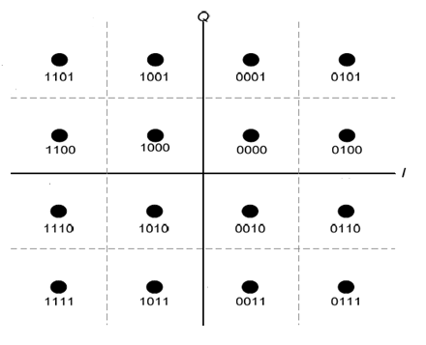
SOMA (1)
Semi-Orthogonal Multiple Access
  Superposition transmission with adaptive power ratio on component constellations and Gray-mapped superposed constellation
For STA 1 (Near STA) and STA 2 (Far STA) in the figure beside, the SOMA is not just a superposition of two constellations from two STAs, but, instead, the property of more and less reliable bits in a constellation is used to schedule Far and Near STAs as seen in the figure below
For Near-STA to decode Near-STA bits, Far-STA bits need Not to be known
The Far-STA decodes its own signal, and treats Near-STA as noise just like NOMA
The Near-STA performs the demodulation of the received signal, collecting the LLRs corresponding to the near coded bits, and then performs decoding of the near-STA codeword.
  Complexity in the Receiver side is reduced
SOMA can be applied with OFDMA and its throughput enhancement at AP side is significant, compared to the OFDMA only
STA2
STA1

Slide 18
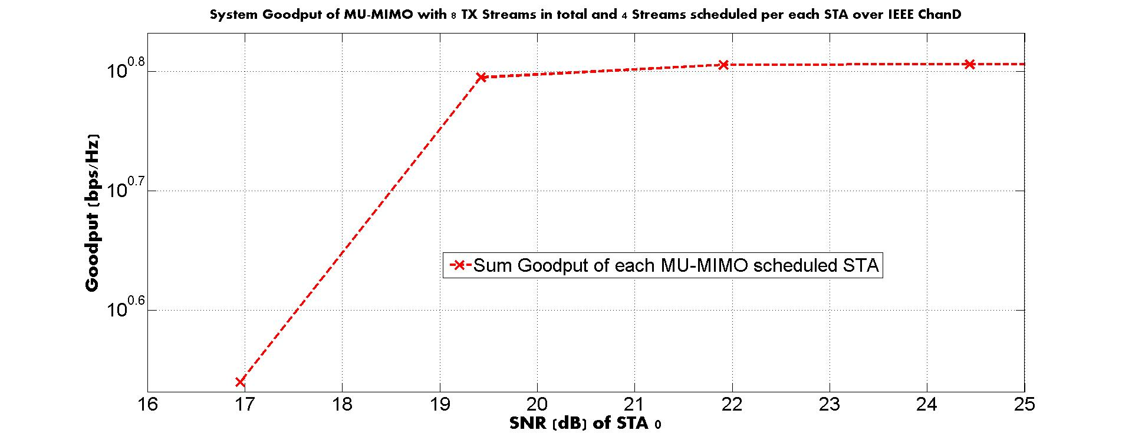
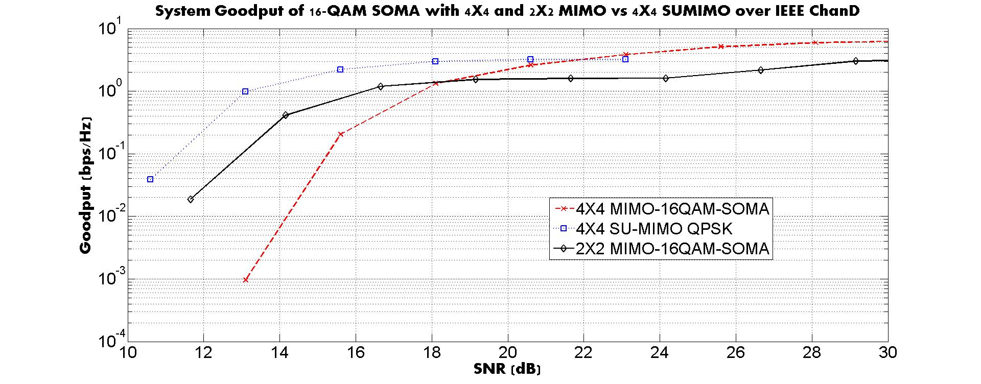
SOMA (2)
MIMO-Based SOMA:
SOMA can be applied on top of MIMO environment and the similar performance is achieved with no CSI feedback
According to the results beside, Goodput in the high SNR region for both 8X8 MU-MIMO with 2 STA scheduling and 4X4 16-QAM SOMA are both 6.4 bps/Hz, and the SNR to reach 6.4 bps/Hz for 8X8 MU-MIMO is slightly better than 16-QAM SOMA, however
  MU-MIMO is achieved with ZF-BF under the perfect sounding assumption (No AWGN during the sounding, No CSI Quantization error, No CSI feedback error, but real channel estimation using the LTFs)
  We can infer that 16-QAM SOMA is not worse than 8X8 MU-MIMO
  The number of Spatial streams are 4 streams smaller for 16QAM SOMA than 8X8 MUMIMO and the CSI feedback is not required for SOMA in achieving the similar performance

Slide 19
Efficient Use of 6GHz Band
6GHz band allocation potentially provides 802.11-based WirelessLAN technology a good opportunity to enable lots of mechanisms / features for system performance improvements;
Efficient use of 6GHz band should be one of the key drivers for next-gen PHY/MAC project in IEEE 802.11;
Some features have been proposed in previous EHT contributions related to 6GHz band, e.g.,
  wider channel bandwidth (e.g., up to 320MHz channel)
  multi-band aggregation/operation
  In addition, some other features / mechanism should be also considered in EHT for an efficient use of 6GHz band, e.g.,
  Improvements to the current scheduling based channel access mechanisms, e.g., trigger-based channel access / PCF/HCCA/RAW/TWT/…
  Introduction of some new and differentiated scheduling schemes / rules, to further reduce the channel contention and collision;
  Efficient channel access in multiple domains, including time domain, frequency domain, space domain, etc.

Slide 20


AP Coordination (1)
Coordinated scheduling: to mitigate/reduce the number of collisions from APs/STAs in the other BSSs.
  A distributed mechanism
  Increase the number/probability of parallel transmissions in a more coordinated way than spatial reuse
  Some message exchanges between APs are required
Coordination
Interference controlled

Slide 21
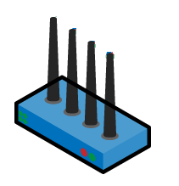

AP Coordination (2)
Coordinated beamforming
  Simultaneous downlink transmission without co-channel interference by beamforming, such as pointing Nulling Point to other STAs, or distributed joint beamforming
  Suitable in managed deployment, for example, company office, hotel.
  Benefit to area throughput and consistent user experience in area
  Requires coordinated downlink scheduling, improved MU sounding to reduce overhead, synchronization etc.
Interference nulling
Distributed joint beamforming
AP
Coordination
Coordination
AP Core
AP Remote
AP Remote
Nulling point
Nulling point
Coordinated APs
Distributed AP

Slide 22
Full Duplex
Full Duplex (FD) is a technology to allow a device to simultaneously transmit and receive signals using the same time-frequency resource. FD can double the throughput for each allocated channel and furthermore improve the total system capacity.
In addition, the inherent capability of FD can provide an opportunity to reduce round-trip latency for data transmission to increase STA/system level efficiency.
Furthermore, FD can solve the hidden node problem.
Application of FD technology to 802.11 has been being investigated in 802.11 FD TIG. A number of contributions show the benefits and feasibility of FD to be applied to 802.11.
FD can be a key candidate technology to meet the requirements on throughput and efficiency improvement of the next generation Wi-Fi, i.e., extremely High Throughput (EHT).

