Slide 1
Multi-AP Enhancement and Multi-Band Operations
Date: 2018-06-07
Authors:
Name | Affiliations | Address | Phone | Email
Jianhan Liu | Mediatek |  |  | jianhan.liu@mediatek.com
Thomas Pare
Yongho Seok
James Wang
Frank Hsu
James Yee

Slide 2
Introduction
The proposed technical directions for EHT are mainly advanced AP features. Some performance enhancements needed for Stations too.
  Enhancements for both AP and Stations are beneficial to market success of EHT.
320MHz and 16 spatial streams are optional features, EHT needs some mandatory features to make sure the fast market adoption.
The following features should be preferred:
  Market needed features
  Features without adding significant hardware cost

Slide 3
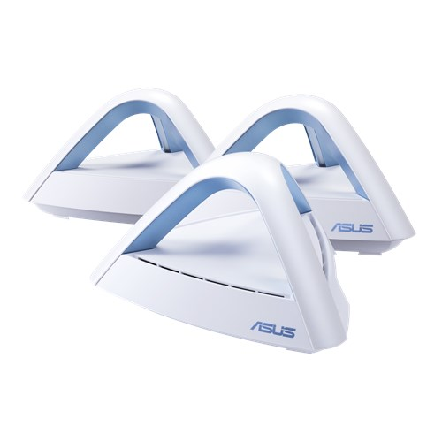


Feature 1: Enhancements for Multi-AP Systems
Mesh WiFi (Multi-AP solution) is well accepted in the market for better coverage, easy deployment and high throughput.
It is desirable to enhance the performance of Mesh WiFi by joint optimization of MAC and PHY for multi-AP systems.
  The hardware has already appeared in the market.
    Unlike 16 spatial streams, there is little cost added.
  There exists good technologies to enhance the performance of multi-AP systems.
    Distributive MIMO, Coordinative transmissions, spatial/time/frequency sharing and reuse, efficient relay schemes, etc.
Asus
Google
Netgear

Slide 4
One Example for Enhancements for Multi-AP Systems
For example, enabling the joint multi-AP transmissions.
  As shown in the figure, AP 1 send the coordinative signaling to AP 2 and AP 3 to initiate the joint transmissions.
  AP 2 and AP 3 transmit/receive data to/from multiple STAs using OFDMA and/MU-MIMO within one data packet.
    Note that STA 2 and STA 3 are on different resource units (RU). Each RU is a frequency segment.
    STA 1 and STA 4 are on the same resource unit using MU-MIMO.
  Each RU can be transmitted with multiple spatial streams.

Slide 5

Future 2: Cooperative Multi-Band Operation
Dual-Band AP have the capability to transmit on the 2.4 GHz and 5GHz wireless band.
  AP forms a Wi-Fi networks (or BSS) on 2.4GHz or 5GHz. The transmission is either on 2.4GHz or 5GHz band.
Simultaneous Dual-Band AP enables two separate Wi-Fi networks (or BSS) operating simultaneously on 2.4GHz and 5GHz band.
  Note that Simultaneous Dual-Band AP can concurrently transmission signals on 2.4 GHz and 5GHz, however, these two signals must be transmitted to two stations.

Slide 6
Future 2: Cooperative Multi-Band Operation
We propose the multi-band operation schemes that achieves higher network throughput and better flexibility.
  The scheme requires station having simultaneous transmission and reception capability on different wireless band.
  Two transmitters on different bands do independent CCA. The transmissions can be joint or independent.
  Full duplex can be enabled by independent multi-band operation using FDD mode.

Slide 7
One example: Assisted Channel by Multi-Band Operation
Why we need assisted channel?
  Current 11ax MU transmissions requires stations’ information for better scheduling and resource allocation.
    The current information gathering and feedback schemes using the same data channels and channel accessing schemes add significant overheads and therefore become inefficient.
  For spatial reuse, fast link adaptations, and efficient channel aggregation, timely information gathering and feedbacks are required.
    In current WLAN, due to listen-before-talk constraint, the control information exchange can not be in-time.

Slide 8
Assisted Channel by Multi-Band Operation
WiFi signals and Independent assist channel signals can be transmitted simultaneously because they are operated on separate channels and they use separate transceivers.
The channel access schemes for independent channel can be controlled listen-before talk to provide in-time information.

Slide 9
Summary and EHT Timeline
We present two features for EHT:
  Enhancement for multi-AP systems by enabling joint multi-AP transmissions and smart scheduling.
  Enable Multi-Band Operation to improve throughput and to enable FDD duplex.
EHT Timeline and Study Group
  We think the features for EHT need more discussions and it is too early to finalize the feature list when we form the EHT study group.
  We prefer that the first task group meeting starts in May 2019.

