Slide 1
Framework for enhancing DN-SRD co-existence
Date: September 2018
DCN: 11-18-1150-01-00ay
Name | Affiliation | Address | Phone | Email
Aditya V. Padaki | Samsung | 1301 E. Lookout Dr, Richardson, TX 75082. |  | a.padaki@samsung.com
Jianhua Mo |  |  |  | jianhua.m@samsung.com
Boon Loong Ng |  |  |  | b.ng@samsung.com
Charlie Zhang |  |  |  | jianzhong.z@samsung.com

Slide 2
Overview
Trade offs between Inter-DN distance, DN link parameters, DN link performance, and co-existence
Example mechanism for managing co-existence
Certain aspects for further consideration

Slide 3
Co-existence framework
DN-SRD co-existence framework should
  protect the interests of both DN and SRDs
  offer flexibility in design and deployment without rigid requirements
  desirably be forward compatible
    given that DN infrastructure could well be a long term deployment
We provide some charts that can be used for further analysis in upcoming discussions and deployment guidelines
NOTE: In this presentation, for convenience
  ‘DN’ is used to refer to DMG or EDMG STAs that are employing the TDD protocol
  ‘SRD’ is used to refer other DMG and EDMG STAs

Slide 4
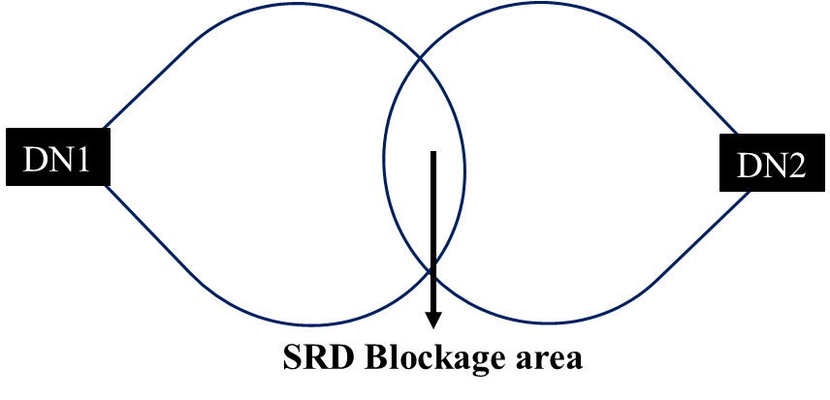
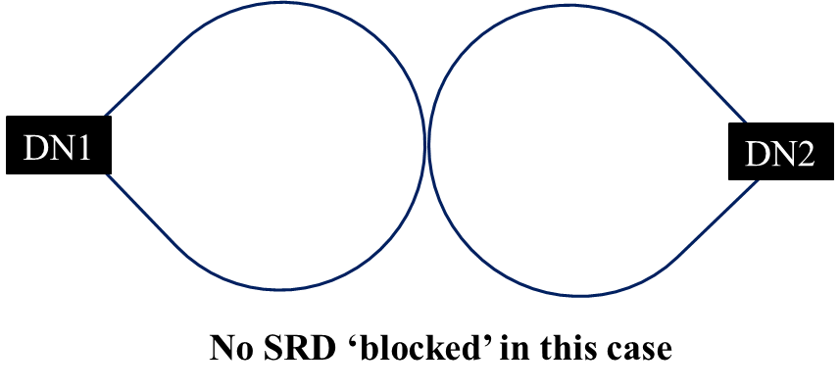
Transmit Power/EIRP considerations
Recap: Dual DN blockage is when both the DNs exceed the CCA threshold
Rx Power > –68 dBm
Rx Power > –68 dBm

Slide 5
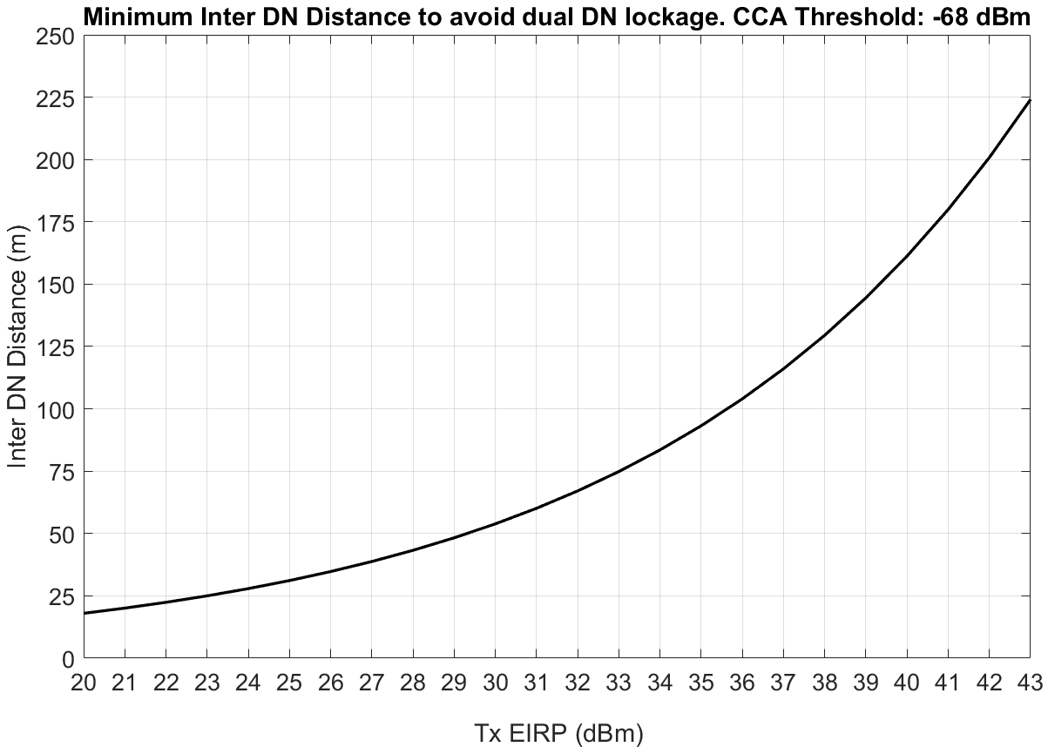

Min Inter DN Distance to avoid Dual Blockage
Path loss model: $PL_{LOS}=32.4+21\log_{10}\left(d_{3D}\right)+20\log_{10}{f_{c}}$

Slide 6
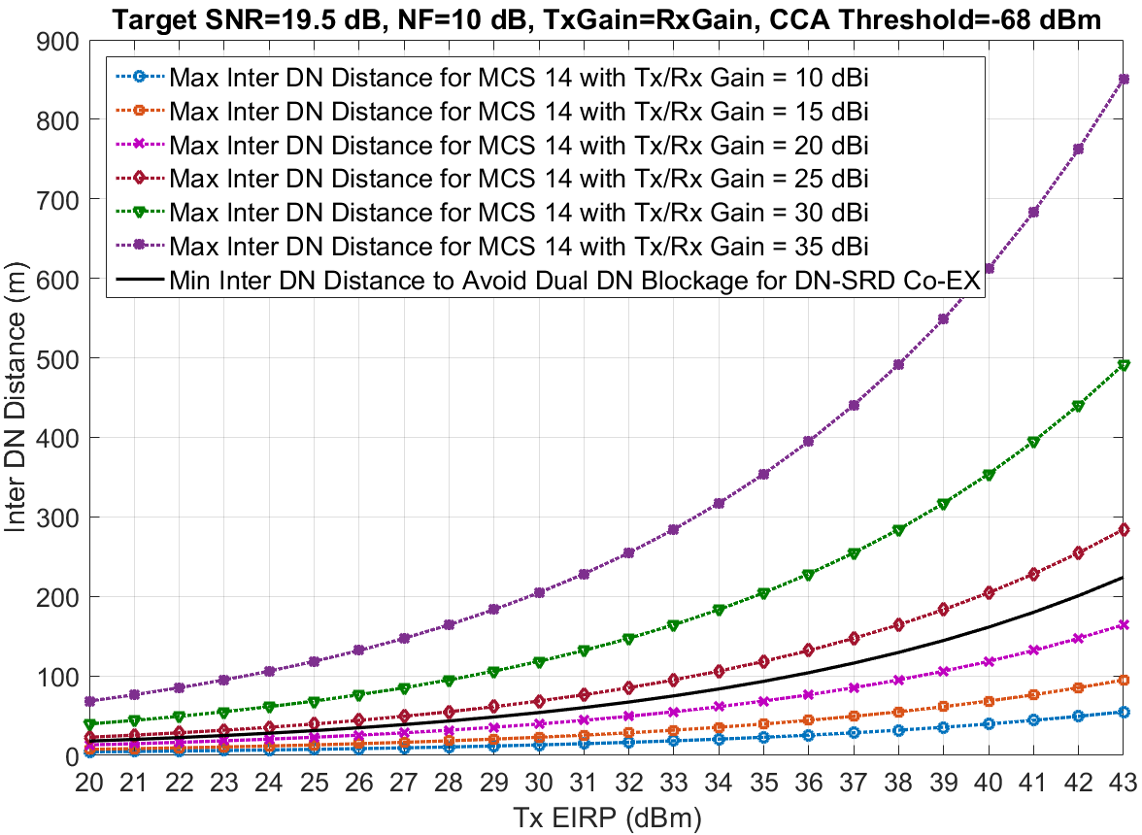
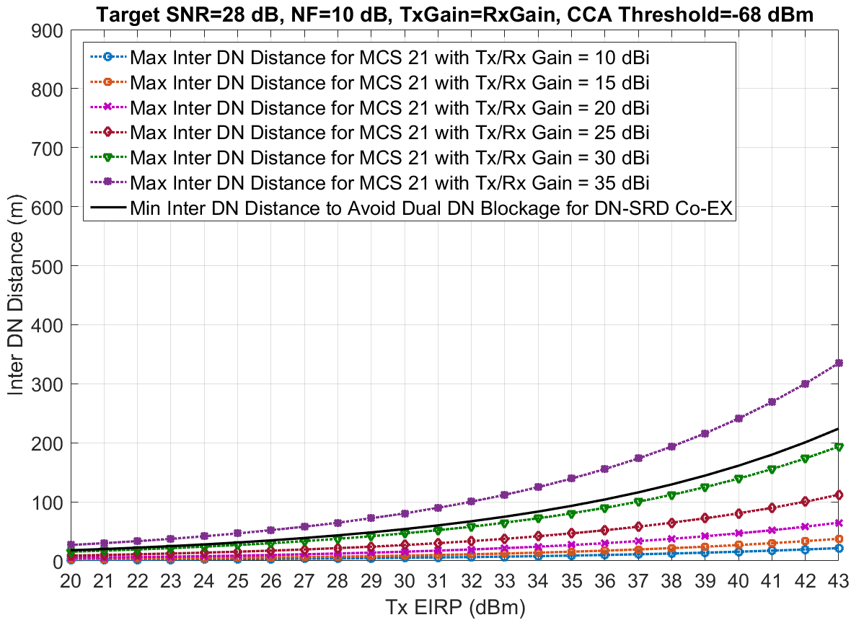
EIRP to meet a target SNR and required inter DN distance to avoid dual DN blockage
Region of operation avoid dual DN blockage
Region of operation avoid dual DN blockage
Observation for deployment guidelines: Higher DN Tx/Rx Gain helps in meeting the MCS/SNR target while ensuring Co-EX.

Slide 7
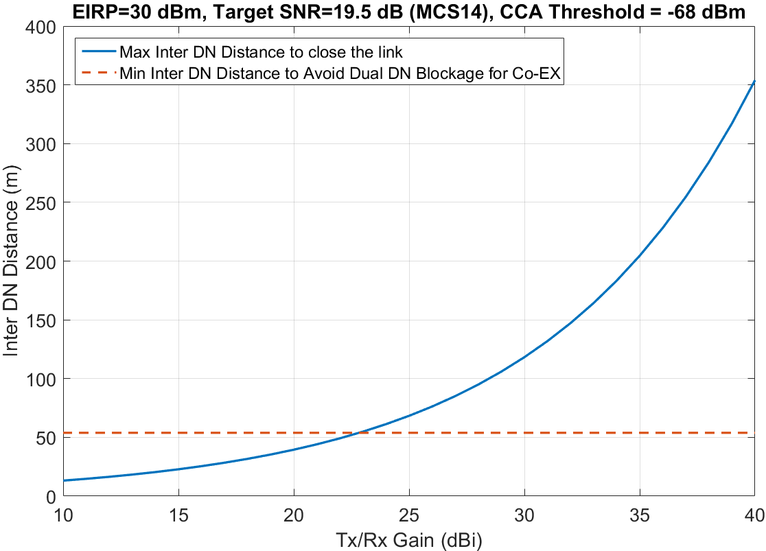
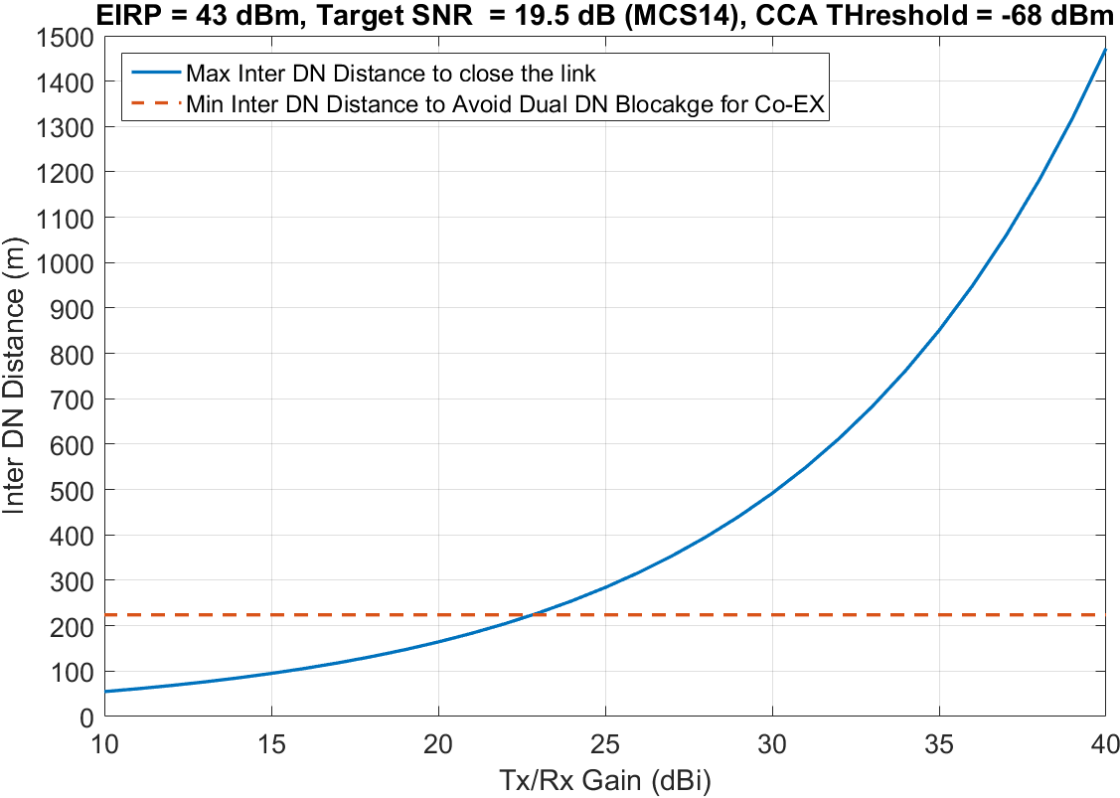
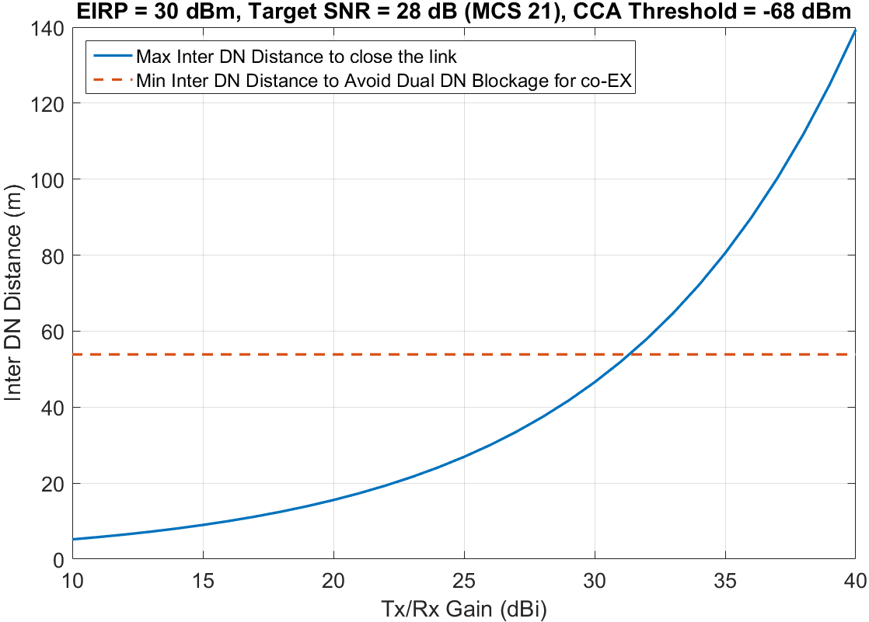
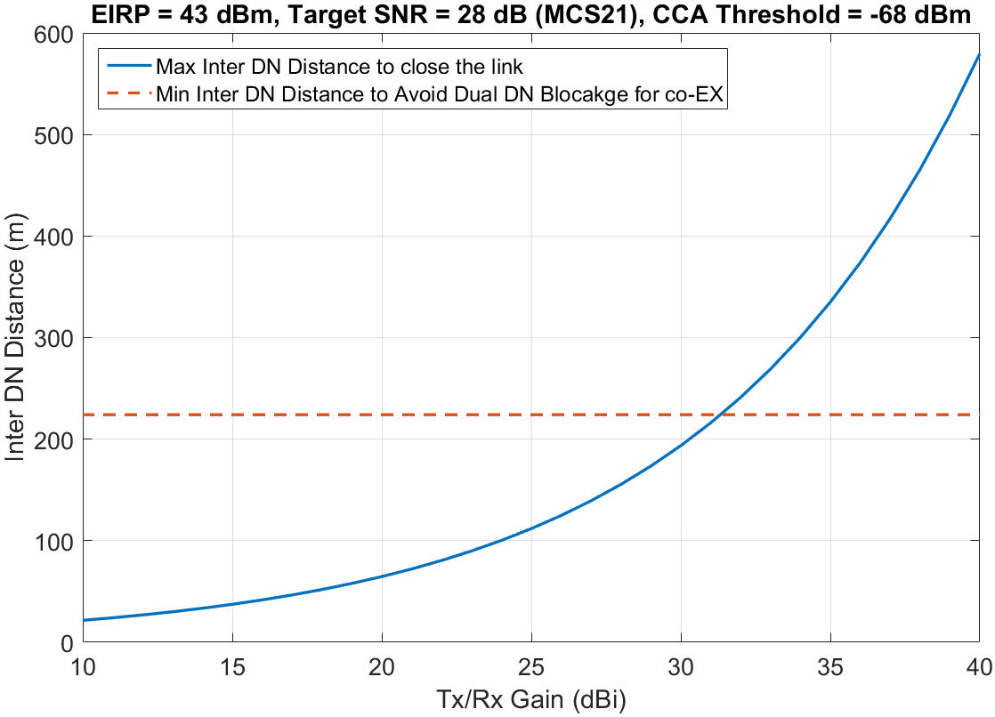
Tx/Rx Gain vs Inter-DN Distance
Plots show Tx/Rx Gain required to achieve the target SNR for a given Tx EIRP
Higher Tx/Rx Gain required to avoid Dual DN Blockage and close DN links with target SNR
  Depends on Target SNR/MCS
  Depends on EIRP
For a given Inter-DN Distance, if target SNR/MCS is set to avoid dual DN blockage
  This can limit the DN performance
  Even when SRDs are absent, DNs’ target SNR will be limited

Slide 8
Enabling Co-Existence
If for example, DN knows that there are no SRDs blocked, then it can optimize its transmissions further
  If SRDs are blocked, then it can take some actions to enhance co-existence
Currently, no mechanism for DN to ascertain if SRDs are blocked
  DN being oblivious to this info can limit their performance and DN-SRD co-EX
We present an example mechanism through which SRD can indicate DN that it is being blocked

Slide 9
Example Mechanism: DTI Interval for SRD detection
Proposed frame structure
SRD knows if there is a TDD-SP slot assigned from the ESE
If SRD is unable to access the channel for a time T_{max} then SRD will transmit a preamble
  Since perfect sync between SRD and DN is not possible, DN will try coarse alignment
  It will transmit the preamble soon after BTI frame
    Design itself is robust for complete misalignment as discussed further
Preamble time length << DN-SRD Co-EX period
Beacon interval = 1024ms
BTI
DN-SRD Co-EX
SP
(with TDD channel access)
SP
(with TDD channel access)
…
SP
(with TDD channel access)
BTI
DN-SRD Co-EX
…

Slide 10
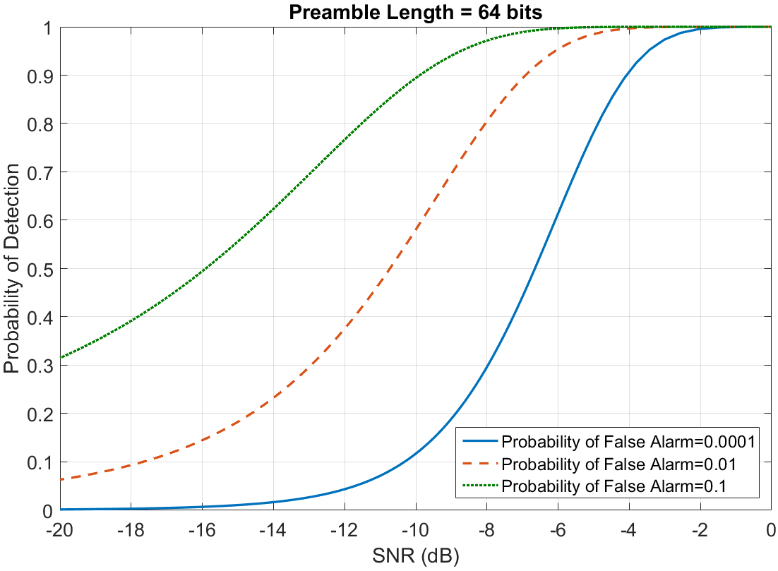
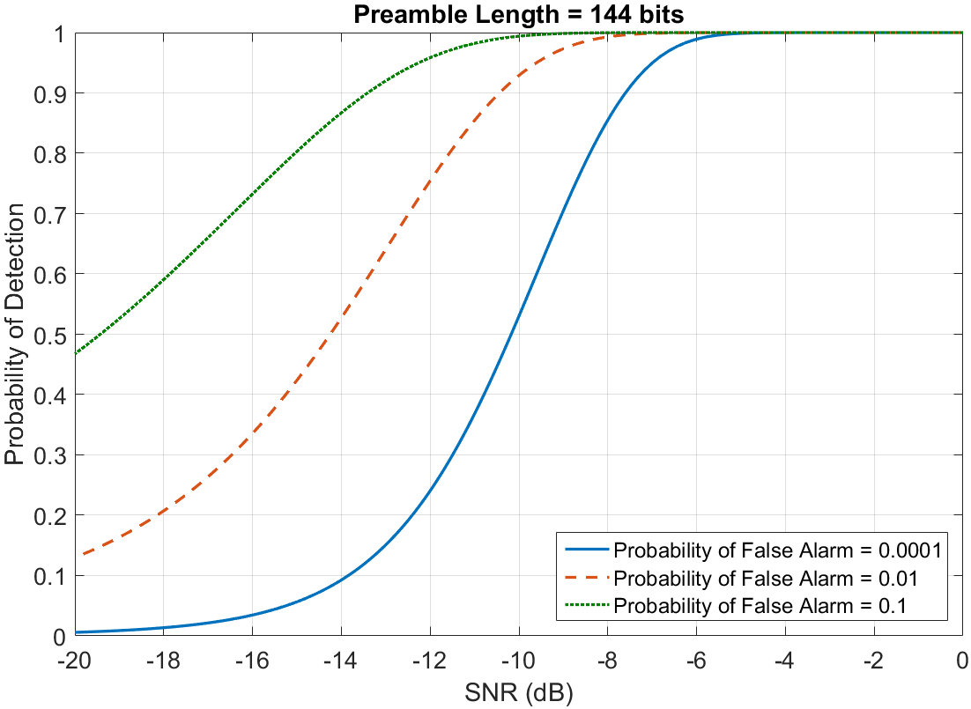

Preamble Detection at DN
Example: Consider preamble length 64 bits (less than half of control frame preamble length) and 144 bits (control frame preamble length)
What preamble SNR is required at DN for matched filter detection?
$$p_{d}=Q\left(p_{fa}−\sqrt{\frac{E}{N_{0}}}\right), where E is energy of the signal (proportional to preamble length)$$

Slide 11
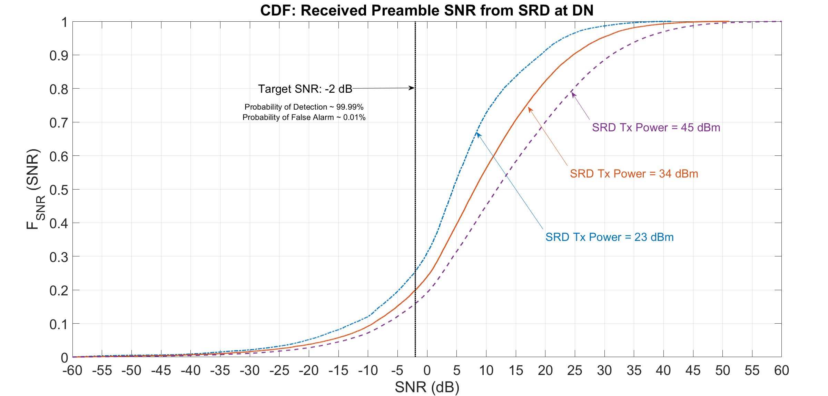
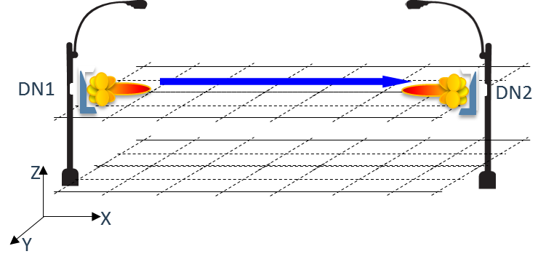
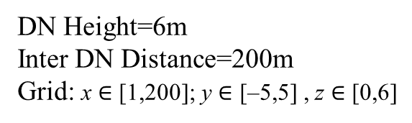
Received Preamble SNR CDF at DN
For a false alarm rate of 0.01%, the CDF of receive SNR is as shown
  Even with 23 dBm Tx EIRP of SRD, preamble (of 64 bits) is detected 75% of the time
SRD had random location, directivity w.r.t DN
Shows DN can successfully detect the presence of SRD
DN Height=6m
Inter DN Distance=200m
Grid: x $∈$ [1,200]; y $∈$ [–5,5] , z $∈$ [0,6]

Slide 12
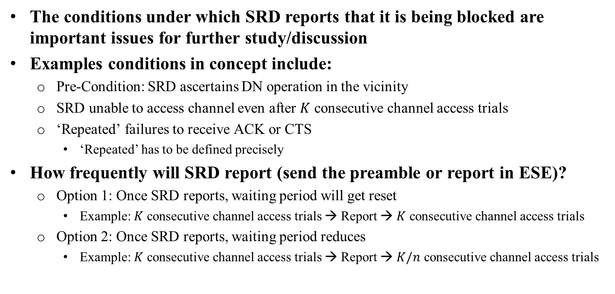
Conditions for SRD to Report Blockage (for further study)
The conditions under which SRD reports that it is being blocked are important issues for further study/discussion
Examples conditions in concept include:
  Pre-Condition: SRD ascertains DN operation in the vicinity
  SRD unable to access channel even after $K$ consecutive channel access trials
  ‘Repeated’ failures to receive ACK or CTS
    ‘Repeated’ has to be defined precisely
How frequently will SRD report (send the preamble or report in ESE)?
  Option 1: Once SRD reports, waiting period will get reset
    Example: $K$ consecutive channel access trials → Report → $K$ consecutive channel access trials
  Option 2: Once SRD reports, waiting period reduces
    Example: $K$ consecutive channel access trials → Report → $K/n$ consecutive channel access trials

Slide 13
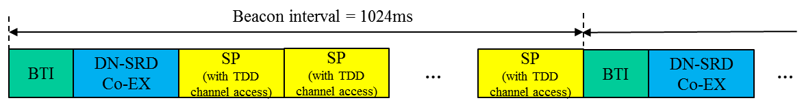
Example DN Actions (for further study)
Example (optional) DN actions upon receiving reports from SRD
  Change DN TDD-SP duty cycling period
  Reduce target SNR (or target MCS)/transmit power
  Pause for one TDD-SP (to allow SRD to establish a link)
Example scenarios if and when DN should take action
  Preamble time length << DN-SRD Co-Ex period
  DN to take action only if multiple preambles are detected in one DN-SRD Co-Ex period
  Alternatively, DN to monitor consecutive DN-SRD periods and only if multiple preambles are detected in consecutive DN-SRD Co-EX periods, DN takes some action

Slide 14
Straw Poll
Should there be a mechanism within 802.11ay draft for managing co-existence between DMG/EDMG STAs employing TDD-SP with other DMG/EDMG STAs (not employing TDD protocol)?

