Slide 1
Improving System Efficiency using Full Duplex Based Collision Detection
Date: 2018-30-04
Authors:

Slide 2
Background
Full Duplex technology, currently discussed in the 802.11 FD TIG, has a number of benefits, such as throughput gain, latency etc.
One of the benefits which was already mentioned is an ability to detect collisions caused by simultaneous transmissions
The main idea is, while transmitting, to detect a valid 802.11 signal being transmitted in parallel, and take some action in order to prevent wasting time or allow one packet to be correctly decoded
In this presentation we will show how collision detection can be used to significantly improve the efficiency of an 802.11 network

Slide 3
Collision Problem Formulation
Most 802.11 devices use the EDCA method to access the medium
A STA senses the medium and reduces the counter (by a slot) when the medium is free; when the counter reaches zero, the STA starts transmitting
When the counter of two or more stations reaches zero at the same time, the STAs start transmitting simultaneously and hence a collision occurs
The colliding STAs cannot recognize that there is a collision, thus the transmission time will be wasted (in most cases) – not decoded correctly – for all transmitters
BO Counting
Wasted time period
STA0
3
2
1
STA1
5
4
3
2
1
Time

Slide 4
Using FD for Collision Detection
STAs that support FD technology should be able to recognize another 802.11 transmission by listening while transmitting
We assume that the detection of the Legacy fields L-STF and L-LTF is possible in presence of self-interference regardless of the ability to detect the data portion
BO Counting
Collision Detected
STA0
3
2
1
L-STF
L-LTF
L-STF Detection Period
STA1
5
4
3
2
1
L-STF
L-LTF
Collision Detected
Time

Slide 5
FD assisted EDCA access
We want to use the ability to detect a collision (CD) to improve the efficiency and reduce wasted time caused by collisions
In case of CD, a possible simple action for every STA to take is to drop the ongoing transmission and repeat medium access with a newly generated CW value
The non-FD capable STAs may detect an energy drop and then resume medium access after an AIFS interval
This can lead to reduction of the wasted period
BO Counting
Wasted time period
STA0
New BO Counting
3
2
1
L-STF
3
2
1
STA1
5
4
3
2
1
L-STF
5
4
3
CCA BUSY
STA2
20
19
18
17
16
CCA BUSY
15
14
13
8usec
AIFS
Collision detected,
transmission is aborted

Slide 6
Gain of FD assisted EDCA access
What can be achieved using this (simple) FD solution in terms of reducing the wasted time?
  Every STA that didn’t decode the L-SIG field of one of the colliding packets will set and keep its CCA based on energy level, and may access the medium after a duration as low as AIFS + 1 slot
  The STAs that have decoded the L-SIG field of one of the colliding packets will remain silent for the duration calculated from the L-SIG field
  Thus we understand that wasted time can be reduced to at least AIFS + slot
  However, what if the collided STAs (only) can resolve the collision event between them, decide who should retransmit the packet and then obtain the medium before any other STA attempts to do that?
  We try to understand what can be the theoretical limit assuming such a protocol is feasible

Slide 7
FD assisted EDCA access with Contention Resolution
Assuming fast collision resolution is feasible we would like to maximize channel utilization in most of the cases, hopefully including collision with Legacy STAs or STA w/o FD
This can be achieved, for example, using the following procedure:
  During the L-STF (8usec) listen and detect other transmissions (if any)
  If there is no collision, continue transmission
  If there is a collision, start collision resolution including:
    Decide if retransmission is possible
    Decide who should retransmit
BO Counting
Contention Resolution
BO Counting
STA0
3
2
1
L-STF
Retransmission
STA0 (Legacy)
3
2
1
L-STF
STA1
5
4
3
2
1
L-STF
STA1
5
4
3
2
1
L-STF
Transmitting is aborted
Transmitting is aborted
Contention Resolution and abort Tx
8usec
Time
Time

Slide 8
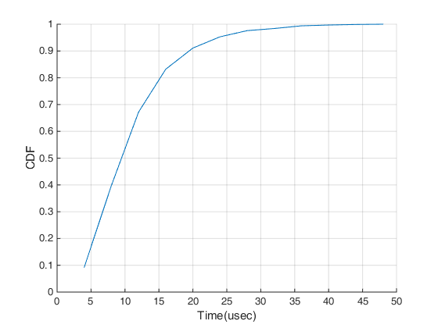
Simulated Scenarios
We simulated three different approaches:
  Existing (half-duplex) EDCA (with CWmin of 15)
  FD assisted EDCA solution (with CWmin of 15
  and smaller CW for fast retransmission)
  Collision resolution with the following CDF of
  required time ( in 90% of the cases <20usec )
STAs transmit with random packet size using EDCA method
The channel utilization was computed as the ratio between the time of successfully transmitted packet (no PER) and entire time used for backoff + transmissions

Slide 9
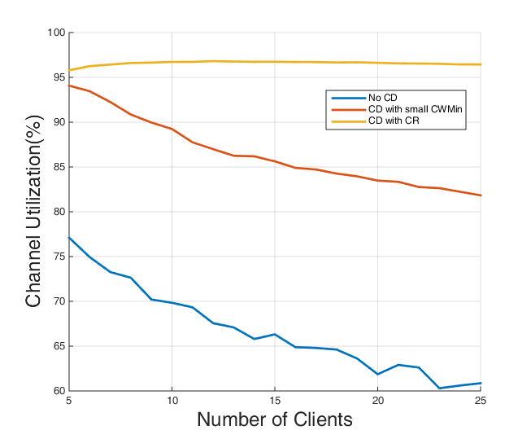
Simulation Results
Its clear that both FD assisted EDCA
methods outperform the existing
method with no CD
We can see that even for the case
of a low number of STAs, there
is a significant gap between
existing EDCA efficiency and
FD-assisted EDCA

Slide 10
Summary
Collision detection can be a use case to investigate during FD standard discussions
Using FD for collision detection can significantly improve the efficiency of the system
The presented results shows a theoretical limit for the gain that can be achieve using FD for collision detection

