Slide 1
LC Outdoor Usage Models
Date: 2018-05-08
Authors:
Name | Affiliation | Address | Phone | Email
Tuncer Baykas | Istanbul Medipol University |  |  | tbaykas@ieee.org
Khalid Qarage | Texas A&M University at Qatar

Slide 2
Terminology
Usage Model – A usage model is the combination of all the things below; not to be confused with a use case which is the specific set of steps to accomplish a particular task.
Pre-Conditions – Initial conditions before the use case begins.
Environment – The type of place in which the network of the use case is deployed, such as home, outdoor, hot spot, enterprise, metropolitan area, etc.
Application – A source and/or sink of wireless data that relates to a particular type of user activity. Examples are streaming video and VoIP.
Traffic Conditions – General background traffic or interference that is expected while the use case steps are occurring. Overlapping BSSs, existing video streams, and interference from cordless phones are all examples of traffic conditions.
Use case – A use case is task oriented. It describes the specific step-by-step actions performed by a user or device. One use case example is a user starting and stopping a video stream.

Slide 3
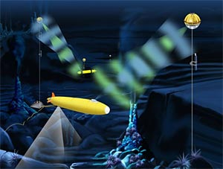
Usage Model 6: Underwater Communication
Pre-Conditions
Acoustic communication in underwater environment have poor throughput whereas RF waves are attenuated by water molecules. LC is deployed to provide reliable wireless connectivity for divers, underwater vehicles and buoy.
Environment
All communications are within water. The communication area depends on how many multihop the system can support. The environment is extermely unstable. The fading should be studied for robustness.
Applications
Underwater sensor networks. Video transmission from robot submarines. Communication between divers.
Maximum data rate lightly compressed video: 50 Mbps, delay < 5 ms, 1.0E-8 PER, 99.9% reliability.
Sensor network 1 Mbps
Distance between LC APs ranges from 1-100 meters.
Traffic Conditions
Both uplink and downlink are using LC.
Potential interference from currents, sea animals, divers.
Pointing is a challenge
Multiple LC modules had to be deployed to ensure communication.
Use Case
Water quality sensor network which communications with buoys. 802.11ah or 802.11af could be used at the buoy to communicate with the shore. A multihop network between divers. Military institutions would be interested in this use case, thanks to its limited range.

Slide 4
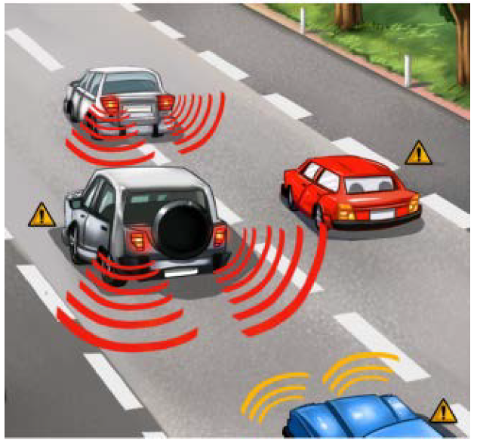
Usage Model 7: V2V Communication
Pre-Conditions
If communication between vehicles requires not to create RF interference while being robust to outside interference VLC is an promising communication technique.
Environment
The distance between vehicles change between 1 meter to 50 meters. The links could experience fading due to vibrations from the vehicles.
Applications
Secure communication between vehicle convoys.
Trafic information. Road status information.
Voice communication.
Maximum data rate lightly compressed video: 50 Mbps, delay < 5 ms, 1.0E-8 PER, 99.9% reliability.
Sensor network. 1 Mbps
Distance between LC APs ranges from 1-50 meters
Traffic Conditions
No interference caused by RF radiation.
Both uplink and downlink are using LC or hybrid communication is possible.
Potential interference from environment is possible. Sunrise, sunset etc.
Use Case
802.11 has already 802.11p on the RF side. LC can provide an interference free support to hat system.
Another use is between ships, which is already tested by the American navy. [2]

Slide 5
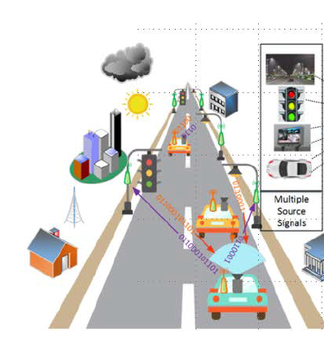
Usage Model 8: I2V and V2I Communications
Pre-Conditions
Street lights, traffic lights or any signage can be used for IoT and smart city applications. The information can be distributed via the lights and can be collected by sensor and carlight levels.
Environment
In outdoor scenarios, distances range from 1 to 10 m. LC devices are deployed, at streetlights, traffic lights . LOS is mandatory. The duration of communication is short.
The lighting levels are low.
Applications
The system is designed for smart city applications.
The streetlights distributed information from specific locations. The cars can provide secure information to the streest lights.
The system can be used just for broadcasting, two way communcation and hybrid communications.
Traffic Conditions
The duration for the communication is short so fast association is necessary for uplink communication. For downlink communication the effect of weather including sunlight,fog, etc should be considered.
.

Slide 6
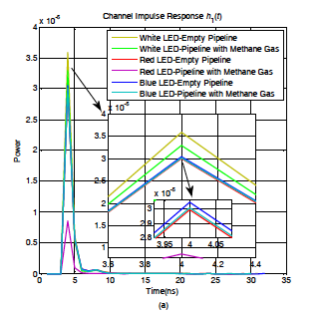
Usage Model 9: Pipeline Communications VLC in extreme environments
Pre-Conditions
The conditions of the usage model starts the ban of RF communication combined with low throughput of acoustic communication of pipelines.
The gases in the environment is dissimilar of atmosphere.
Environment
Distances range from 100m to 400m. LC inside the pipeline as a apart of multihop sensor network.
LC shouldn’t affect the flow of gases and it should be low power.
Applications
The main application is using VLC as a sensor network.
1 Mbps is more than enough while the range and the battery life should be maximized.
Traffic Conditions
No interference no change in conditions. But the conditions are harsh. The system should allow multihop communication.

Slide 7
Summary of Key metrics [12]
UC # | Distance | Throughput | Latency | Signal strength (lux) | Applications and Characteristics
6 | <50m | 1Mbps~50Mbps | <5ms | 150-1500 | -Sensor Networks -Diver, Submarine Comunications
7 | <50m | 1Mbps~50Mbps | <5ms | 2,000-8,000 (Transmitter) | -Compressed video -Dynamic -Peer to Peer
8 | <10m | 1Mbps~50Mbps | <5ms | 2,000-8,000 (Transmitter) | -Multi-AP, Multi-STAs -Dynamic peer to peer communication
9 | <100m | 1Mbps |  | 150 | -Sensor Network

Slide 8
References
11-17/1631r1 “Use Cases for 802.11 Light Communications” Tuncer Baykas (Medipol University)
https://newatlas.com/us-navy-signal-lamps-fltc-texting/50523/
Miramirkhani, F., Uysal, M., Narmanlioglu, O., Abdallah, M., & Qaraqe, K. (2018). Visible Light Channel Modeling for Gas Pipelines. IEEE Photonics Journal.
Anous, Noha, Mohamed Abdallah, Murat Uysal, and Khalid Qaraqe. "Performance Evaluation of LOS and NLOS Vertical Inhomogeneous Links in Underwater Visible Light Communications." IEEE Access (2018).
Uysal, M., Ghassemlooy, Z., Bekkali, A., Kadri, A., & Menouar, H. (2015). Visible light communication for vehicular networking: performance study of a V2V system using a measured headlamp beam pattern model. IEEE Vehicular Technology Magazine, 10(4), 45-53.

