Slide 1
Benchmarking of 802.11ax against eMBB Indoor Hotspot requirements using IMT-2020 simulation methodology
Date: 2018-05-10
Authors:

Slide 2
Abstract
This presentation is a continuation of the benchmarking of 802.11ax capabilities vis-à-vis the IMT-2020 requirements for eMBB Indoor Hotspot and Dense Urban scenarios [1].
In our presentation [2] in the previous 802.11 meeting, we had used an analytical approach using the IMT-specified and 3GPP-used configurations to conclude that 802.11ax can meet the above requirements.
In this contribution, we present the results of our simulations to draw similar conclusions.
The simulations adhere to the methodology specified by ITU for self-evaluating a RAT for IMT-2020 [3]. This is the same procedure that is being used in 3GPP for simulation based self-evaluation of NR and LTE for IMT-2020.
The simulation based approach being quite effort-intensive, we have covered the eMBB Indoor Hotspot scenario in this presentation while we continue to work on the eMBB Dense Urban scenario.

Slide 3
Outline
Objective
Simulation setup
Simulation configuration and assumptions
Simulation methodology
Results
Conclusions
Next Steps
References

Slide 4
Objective (1)
According to the IMT-2020 self-evaluation criteria, a candidate RAT needs to meet the minimum requirements for the following salient metrics for any given use case in eMBB:
Peak Spectral Efficiency
Peak Data Rate
5%ile User Spectral Efficiency
5%ile User Experienced Data Rate
Average Spectral Efficiency
Area Traffic Capacity
Mobility
Per the ITU guidelines, the above metrics have to be evaluated as follows:
Peak Spectral Efficiency and Peak Data Rate have to be evaluated analytically.
5%ile User Spectral Efficiency, Average Spectral Efficiency and Mobility have to be evaluated based on the simulation methodology specified by ITU.
5%ile User Experienced Data Rate is derived from 5%ile User Spectral Efficiency, while the Area Traffic Capacity is derived from the Average Spectral Efficiency.

Slide 5
Objective (2)
In our previous contribution we had presented the following for DL and UL:
Evaluations to show that 802.11ax meets the requirements for Peak Spectral Efficiency and Peak Data rate for the Indoor Hotspot and Dense Urban use cases.
Analytic estimates to show that 802.11ax should meet the requirements for 5%ile User Spectral Efficiency and Average Spectral Efficiency for Indoor Hotspot and Dense Urban use cases.
The ITU self evaluation of these metrics require simulation results which we did not have. So, we had reused the evaluation assumptions and geometry SINR results presented in 3GPP for IMT-2020 self evaluation ([4]).
In the current contribution:
We present 802.11ax simulation results for the DL 5%ile User Spectral Efficiency and Average Spectral Efficiency in the Indoor Hotspot use case.
The 5%ile User Experienced Data Rate and the Area Traffic Capacity are analytically derived from the 5%ile User Spectral Efficiency and Average Spectral Efficiency respectively.
So, this would complete the effort of evaluating 802.11ax DL performance in the Indoor Hotspot use case per the ITU criteria of self-evaluating a RAT for IMT-2020.
Note: The current contribution does not contain simulation data on mobility since the mobility requirement needs to be satisfied mandatorily only for the uplink. We plan to present uplink simulation data in the next meeting.

Slide 6
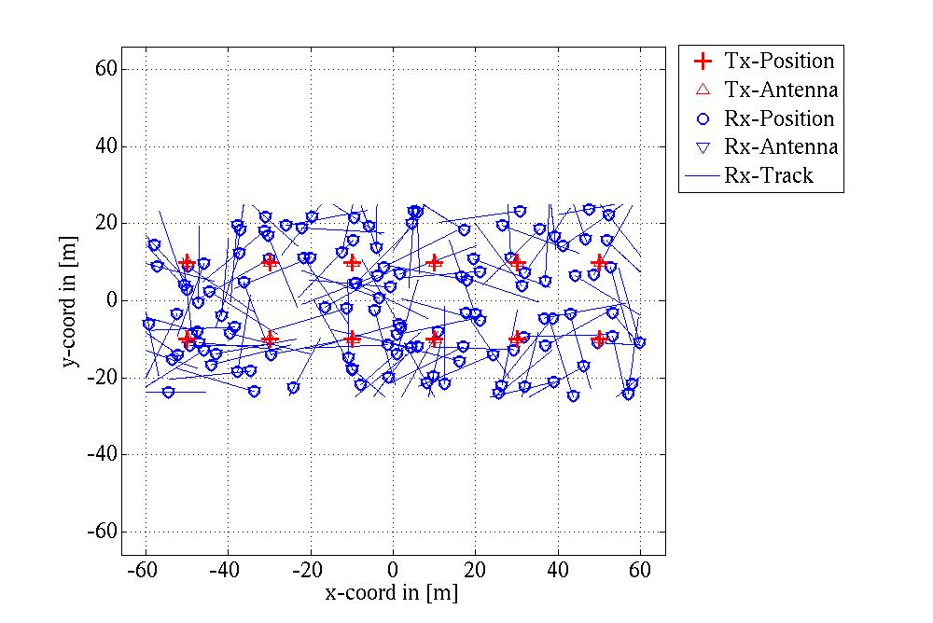
Simulation setup
The simulations adhere to the self-evaluation methodology specified by ITU ([3]).
The simulator has been calibrated against the IMT-2020 simulation data presented by multiple companies in 3GPP ([4], [5]), with respect to salient channel model parameters such as the geometry SINR, coupling loss, singular values, delay spread, spread of azimuth/elevation departure/arrival angles. This benchmarking step ensures the accuracy of the simulation output in this presentation.
The eMBB network topology consists of 12 BSs and 120 UEs as shown below.
A constant speed of 3 kmph is assigned to each UE. We model actual physical movement of the UEs, whereas only notional mobility (i.e. only fades at the rate of 3 kmph) could have sufficed. In our model, the UEs are contained within the network layout by being reflected from the network edge once they reach it.

Slide 7
Simulation configuration and assumptions
Configuration:
Simulation bandwidth : 20 MHz
BS Tx power : 24 dBm, UE Tx power: 23 dBm
BS Antenna gain: 5 dBi, UE antenna gain: 0 dBi
BS noise figure: 5 dB, UE noise figure : 7 dB
BS antenna configuration : Omni uniform linear array 8Tx/8Rx with 5 dBi gain in intended direction.
UE antenna configuration : Omni uniform linear array 8Tx/8Rx with with 0 dBi gain.
The complete configuration is specified in the ITU guidelines for self-evaluating a RAT ([3]).
Additional assumptions:
Perfect CSI at the transmitter
SVD based beamforming
Max MU-MIMO factor of 2
Full interference in the DL from all BSs assuming all BSs are always transmitting at the same time

Slide 8
Simulation configuration and assumptions
Antenna configuration:
The IMT-2020 Indoor Hotspot configuration allows upto 256 Tx/Rx at the BS and upto 8 Tx/Rx at the UE.
However, in the simulations we have used only 8 Tx/Rx at the BS and UE in order to conform to the current capabilities of 802.11ax.
We have done this even though the IMT-2020 evaluation permits the inclusion of features and/or extensions that may be available in the future.
Note also that an antenna configuration with greater than 8 Tx-Rx can be implemented at both BS and UE without standards support. For example, the 3GPP antenna patterns allow for vertical/horizontal/polarization elements where vertical elements may not increase the dimension of the channel matrix. Hence, such schemes do not require standards support for larger CSI feedback, but can provide higher diversity and gain.
We have also assumed omni antennas whereas directional antennas can be used. Directional antennas provide higher gain (with appropriate beam-training) and also attenuate interference from unintended directions.
MU-MIMO factor: A BS-UE antenna configuration of (BS Tx/Rx, UE Tx/Rx) = (256/256, 8/8) or even (8/8, 8/8) allows for a large MU-MIMO factor that can significantly increase the spectral efficiency. However, in the current simulations we have restricted the MU-MIMO factor to 2.
Interference from neighboring BSs: We have assumed full interference, since in the simulator we have not yet implemented schemes that can reduce interference from other BSs such as Interference Coordination and Cancellation, Partial Frequency Reuse etc.
1e), 2) and 3) have been chosen in order to reduce implementation complexity in the simulator. We intend to generate results without these restrictions in the next meetings.
Note that all of the above factors will lead to simulation results that are more conservative than what is expected in practice.

Slide 9
Simulation methodology
12 BSs are assigned fixed locations in the 120m by 50m layout as shown in Slide 6.
120 UEs are placed randomly in the layout and assigned random directions to move with a speed of 3 kmph.
The 8x8 channel between each UE and BS is estimated at each time snapshot.
There are 5 time snapshots (or samples) per 1m of movement. This amounts to 1 sample ~ 240ms.
The RSSI at each UE from a BS is calculated as the sum of power from all sub-paths and antenna links.
Each UE is associated with the BS that has the strongest DL RSSI.
Beamforming based on Singular Value Decomposition (SVD) is used where the SVD is calculated for each RU (9 RUs make 20 MHz).
The CDF of SU-MIMO and MU-MIMO spectral efficiencies over users, frequency and time is plotted.

Slide 10
Results (1)
The graphs in this section show the potential DL spectral efficiency of 802.11ax with SU-MIMO and 2-factor MU-MIMO.
The CDFs have been generated by calculating the spectral efficiency for each time snapshot in the simulator (the definition of a time snapshot is provided in the previous slide).
SU-MIMO: Spectral efficiency for each user for each RU, assuming that SU-MIMO is the only available option. The spectral efficiency is calculated as the maximum of the spectral efficiencies for each number of possible 1 to 8 spatial streams.
2-factor MU-MIMO: Spectral efficiency for each combination of 2 users connected to the same BS for each RU, assuming 2-factor MU-MIMO is the only available option. The spectral efficiency is calculated as the maximum of the spectral efficiencies for each number of possible spatial streams for individual users in the combination.
Note that the spectral efficiency of 802.11ax simulated in this manner is conservative since:
It does not consider multi-user scheduling gain
Restricts the choice to either fully SU-MIMO or fully 2-factor MU-MIMO and hence does not consider the gain possible by dynamically allocating a user to either SU-MIMO or MU-MIMO based on whichever scheme gives the best user/system throughput.
This is in addition to the conservative antenna configuration, interference coordination and MU-MIMO factor choices described earlier.

Slide 11
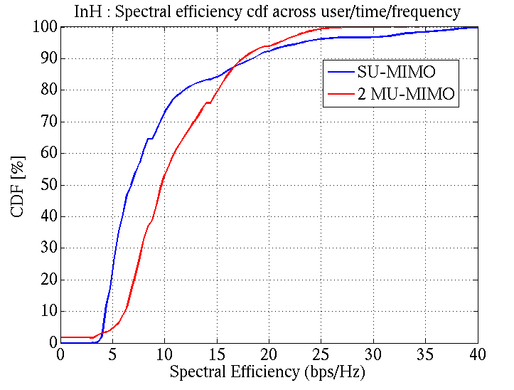
Results (2)
The pre-scheduling per-user DL spectral efficiencies are as follows.
SU-MIMO:
5%ile = 4 bits/s/Hz
Average = 9.5 bits/s/Hz
2-factor MU-MIMO:
5%ile = 5.1 bits/s/Hz
Average = 11.1 bits/s/Hz
With 10 users per BS, a simple equal-time scheduler, 10% target PER and the L1/L2 overhead of 0.44% and 1.26% respectively (as calculated in our previous presentation [2]), the spectral efficiencies are as:
SU-MIMO:
5%ile = 0.35 bits/s/Hz
Average = 8.41 bits/s/Hz
2-factor MU-MIMO:
5%ile = 0.45 bits/s/Hz
Average = 9.82 bits/s/Hz
Conclusion: The simulations show that 802.11ax in its current configuration, satisfies the IMT-2020 Indoor Hotspot DL 5%ile and Average spectral efficiency requirements of 0.3 bits/s/Hz and 9 bits/s/Hz.

Slide 12
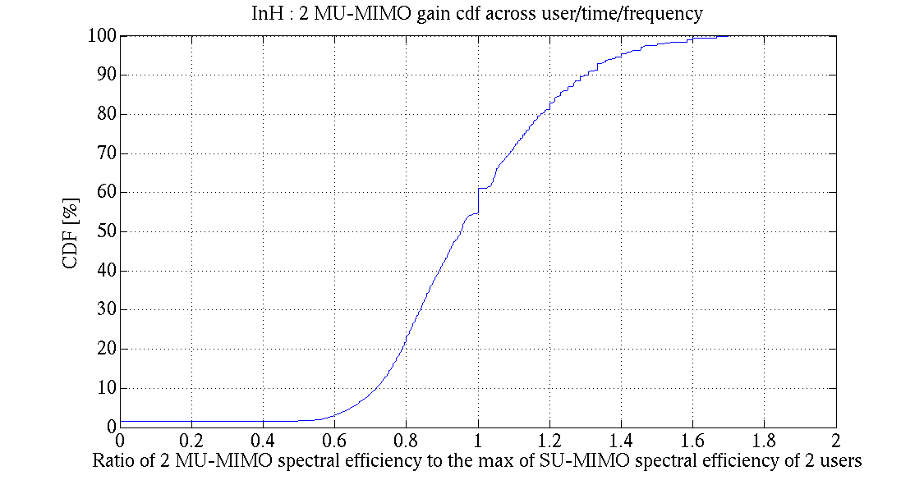
Results (3)
The simulation data in the previous slide showed that 802.11ax DL satisfies the IMT-2020 Indoor Hotspot requirements even without considering any scheduling gain.
The simulation data below quantifies the increase in spectral efficiency that is possible in the Indoor Hotspot topology if a BS scheduler dynamically selects the transmission scheme (between SU-MIMO and 2-factor MU-MIMO) based on whichever provides higher throughput at any given snapshot.
It plots the CDF of the ratio of spectral efficiencies of 2-factor MU-MIMO to the max SU-MIMO for the individual UEs.
The CDF is calculated over each instance of UE combination, RU and time snapshot in the simulator.
Observations
The CDF shows that there are ~50% instances where the MU-MIMO spectral efficiency is higher than the max SU-MIMO spectral efficiency and about ~50% instances where SU-MIMO is higher than MU-MIMO. So, in all these cases, the spectral efficiency of 802.11ax (or any other RAT) can be increased by an intelligent scheduler dynamically selecting the appropriate transmission mode, MU-MIMO or SU-MIMO.
For simplicity, we have limited our simulator implementation to 2-factor MU-MIMO. For higher MU-MIMO factors, the MU-MIMO gains and opportunities over SU-MIMO would be higher, further increasing the spectral efficiency.
Conclusion
There are multiple knobs that can be used to further increase the spectral efficiency of 802.11ax, even if the conservative results themselves satisfy the IMT-2020 Indoor Hotspot requirements.

Slide 13
Conclusions
802.11ax simulations were performed using the configuration and methodology specified by ITU for self evaluating a RAT for IMT-2020 compliance.
Simulations were performed for the downlink of the Indoor Hotspot use case. Simulation results for the uplink and for the Dense Urban use case will be presented at the subsequent meetings.
The simulations show that even with conservative assumptions, 802.11ax downlink in its currently standardized configuration, is able to comfortably satisfy the 5%ile Spectral Efficiency and Average Spectral Efficiency requirements for Indoor Hotspot.
The 5%ile User Experienced Data Rate is derived analytically from 5%ile Spectral Efficiency, while the Area Traffic Capacity is derived analytically from the Average Spectral Efficiency.
So, 3) and 4) together mean that 802.11ax downlink satisfies the 5%ile Spectral Efficiency, 5%ile User Experienced Data Rate, Average Spectral Efficiency and Area Traffic Capacity requirements for Indoor Hotspot.
The remaining metrics of Peak Spectral Efficiency and Peak Data Rate have to be evaluated analytically per the ITU methodology and it has already been shown in the presentation [2] that 802.11ax satisfies these metrics.
Conclusion: 802.11ax DL even in its currently standardized form satisfies the IMT-2020 requirements for Indoor Hotspot.

Slide 14
Next Steps
Simulate 802.11ax uplink for Indoor Hotspot.
Simulate 802.11 downlink and uplink for Dense Urban

Slide 15
References
[1] Minimum requirements related to technical performance for IMT-2020 radio interface(s); DRAFT NEW REPORT ITU-R M.[IMT-2020.TECH PERF REQ]; 22/Feb/2017; ITU Radiocommunication Study Groups
[2] IEEE 802.11-18/0517r0, 802.11ax for IMT-2020 EMBB Indoor Hotspot and Dense Urban, March, 2018
[3] Guidelines for evaluation of radio interface technologies for IMT-2020; DRAFT NEW REPORT ITU-R M.[IMT-2020.EVAL]; 22 February 2017; ITU Radiocommunication Study Groups
[4] RT-170019, “Summary of email discussion “[ITU-R AH 01] Calibration for self-evaluation”, Huawei, December 2017
[5] R1-181802435, On the IMT-2020 Self-Evaluation Performance metrics and Evaluation, Intel February, 2018
[6] 3GPP TR 38.901, Study on channel model for frequencies from 0.5 to 100 GHz

