Slide 1
802.11 NGV Background and some problems to solve
Date: 2017-05-07
Authors:

Slide 2
Abstract
The 802.11a and 802.11p technologies that make up DSRC systems:
PHY: 802.11a: The 10MHz PHY
MAC: 802.11p: Operation Outside the Context of a BSS (OCB)
Some problems for NGV to solve.

Slide 3
10MHz PHY
DSRC operates in 10 MHz and 20 MHz channels in the 5.9 GHz band
In the USA this is regulated by
FCC Part 90 Subpart M https://www.ecfr.gov/cgi-bin/text-idx?node=sp47.5.90.m (Roadside Units)
FCC Part 95 Subpart L https://www.ecfr.gov/cgi-bin/text-idx?node=sp47.5.95.l (On-Board Units)
And similar regulations in other countries, but one key takeaway from these regulations is the 10 MHz channelization
In IEEE 802.11-2016 the only 10 MHz PHY is the “802.11a” PHY described in clause 17.
The clause 19 (HT / 11n) PHY describes 20 and 40 MHz channels
The clause 21 (VHT / 11ac) PHY describes 20 MHz and wider channels.
The main thing NGV needs to do is define a “new” 10 MHz PHY.

Slide 4
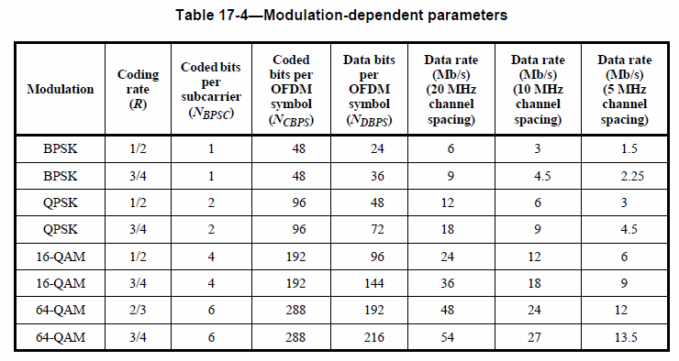
10 MHz PHY from 802.11a-1999
*From IEEE Std 802.11-2016
Note that of the 8 rates in the table, 3, 6 and 12 Mb/s are mandatory rates.

Slide 5
New PHY Capabilities
In the next few slides I present the PHY capabilities information field from 802.11n, 802.11ac and draft 802.11ax.
This shows, at a high level, the new features added to newer PHYs. In particular, the new features that required capability to be communicated (when joining a BSS).
It also highlights the increasing diversity of PHY features available to 802.11 stations to use when transmitting frames.

Slide 6
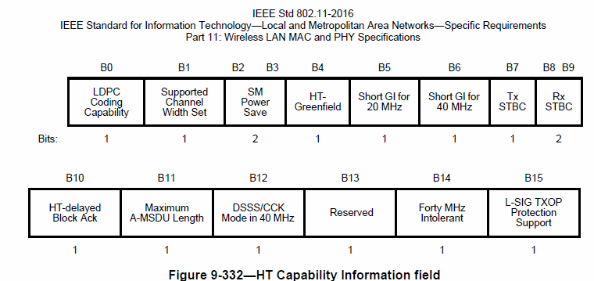
802.11n (HT) PHY Capabilities
*From IEEE Std 802.11-2016

Slide 7
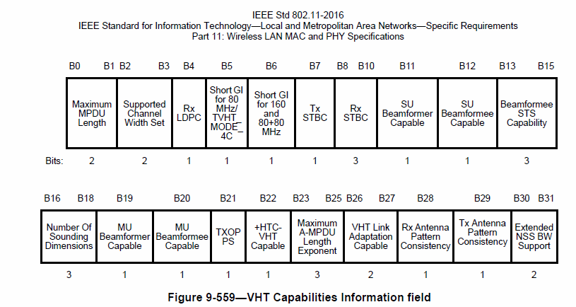
802.11ac (VHT) PHY Capabilities
*From IEEE Std 802.11-2016

Slide 8
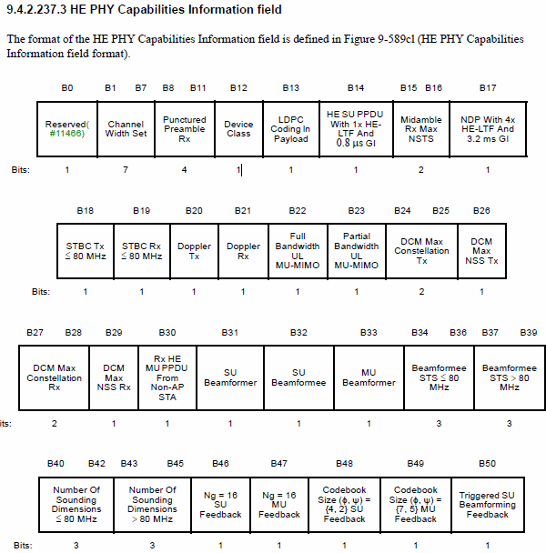
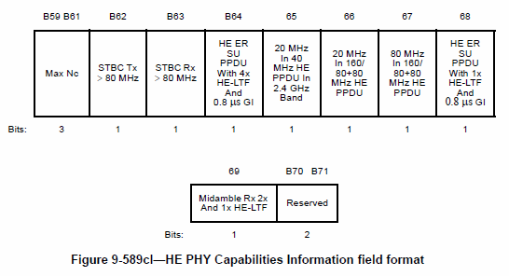
802.11ax (HE) PHY Capabilities
DRAFT
*From IEEE 802.11ax D2.2

Slide 9
PHY Issues for NGV SG to solve
Which of the 11n, 11ac (and 11ax?) PHY enhancements are needed by automotive applications?
Which of the 11n, 11ac (and 11ax?) PHY enhancements can be used in 10 MHz channels?
Which can be used unchanged?
Which require changes?
Should the changes be done within Clause 19 (HT – 11n) or Clause 21 (VHT – 11ac), or a new PHY Clause specific to NGV?

Slide 10
802.11p
Operation outside the context of a BSS allows two modes:
Broadcast information addressed to all STAs within vicinity.
Unicast information addressed between a pair of STAs.
Example DSRC applications:
Basic Safety Messages (BSM) → Broadcast information V2V
Signal Phase and Timing (SPaT) → Broadcast information from stoplights
Wave Service Announcement (WSA) → Broadcast information about services
These applications which are in use today typically use broadcast, and typically use a fixed MCS rate.

Slide 11
802.11p capability negotiation
The broadcast nature of these transmissions means there may be no ability to negotiate capabilities with the intended receiving STAs.
Lack of capability negotiation may affect the backwards/forwards interoperability of new PHY technologies.

Slide 12
A specific problem
10.7 Multirate support
10.7.1 Overview
Some PHYs have multiple data transfer rate capabilities that allow implementations to perform dynamic rate switching with the objective of improving performance. The algorithm for performing rate switching is beyond the scope of this standard, but in order to provide coexistence and interoperability on multirate-capable PHYs, this standard defines a set of rules to be followed by all STAs.
Only the data transfer rates of the mandatory rate set of the attached PHY are guaranteed to be supported when a STA for which dot11OCBActivated is true transmits a Management or Data frame. A higher layer protocol entity within a STA in which dot11OCBActivated is true might negotiate a rate outside the mandatory rate set. *From 802.11-2016
Multirate behavior of STAs for which dot11OCBActivated is true may need updating by NGV. Even if we were to punt this to “a higher layer protocol entity” to do the negotiation, what changes are needed to 802.11 to support using new rates?

Slide 13
Summary
PHY:
The main thing NGV needs to do is update the 10 MHz PHY. (from clause 17)
There are many features in 11n, 11ac and 11ax to choose from. (HT, VHT, HE)
MAC:
NGV also needs to address backwards interoperability, compatibility, coexistence etc.

Slide 14
References
https://mentor.ieee.org/802.11/dcn/18/11-18-0513-02-0wng-802-11-for-next-generation-v2x-communication.pptx
IEEE 802.11-2016
IEEE 802.11ax D2.2

