Slide 1
Next Generation Home Use Case
Date: 2018-05-07
Authors:
Name | Company | Address | Phone | Email
Yusuke Tanaka | Sony |  |  | Yusuke.YT.Tanaka@sony.com
William Carney |  |  |  | William.Carney@sony.com
Yuichi Morioka |  |  |  | Yuichi.Morioka@sony.com
Laurent Cariou | Intel
Robert Stacey
James Yee | Mediatek
Gabor Bajko
James Wang
Sigurd Schelstraete | Quantenna |  |  | sigurd@quantenna.com
Huizhao Wang |  |  |  | hwang@quantenna.com
Ambroise Popper |  |  |  | apopper@quantenna.com
Sean Coffey | Realtek

Slide 2
Motivation
As TGax makes progress toward completion, 802.11 WG should investigate what comes next, to further extend the improvements the spec will deliver
Significant changes are taking place within the Home Environment - use cases not originally conceived during HEW TG formation bear further investigation
The presentation is offered to help seed a discussion towards Post Ax direction, first focusing at the Home

Slide 3
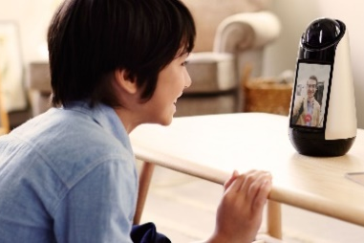
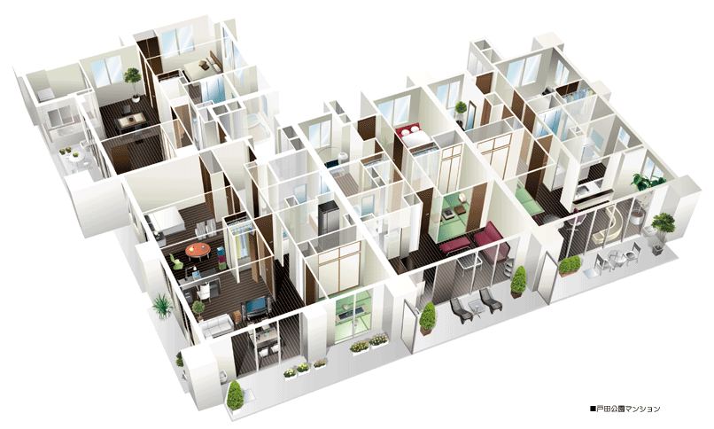
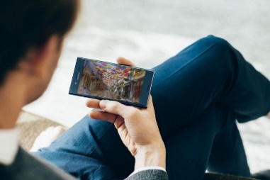


Changes in Home Environment
User demand in the home environment is accelerating with the emergence of new services and also the enhancement of existing services
  Home Agent / Robotics
  UHD Video
  Next Generation Home Environment
Remote Office
  VR/AR

Slide 4
Emergence of New Services
Home Agent / Home Robotics
  Devices gather voice, video and sensor information and upload them to a processing unit. High data rate content will be both produced and consumed by machines, a disruptive use case.
  Key Requirement
    UL Data Rate of < Gbps per room (e.g. 6 rooms)
Remote Office
  Ever-growing trend of people working from home. Users communicate interactively with colleagues using video/audio streaming, screen sharing and file transfer.
  Key Requirement
    UL/DL Data Rate of < Gbps

Slide 5

Enhancement of Existing Services
UHD Video
  Users enjoy UHD (8K) video provided by VOD services on portable devices in own rooms.
  Key Requirement
    DL Data Rate of < Gbps per family member (e.g. 3 members)
VR/AR
  Users play games with VR/AR headmount device in own room.
  Key Requirement
    DL Data Rate of > Gbps per player (e.g. 1 player)

Slide 6
Inter Room Operation
User will require inter-room connectivity for flexible use
Trend towards multi-AP in the home to compensate coverage
Sub 7GHz operation is suitable for these use cases
Guest Room
Children’s Room
Kitchen
UHD Video
Inter-room use case
= Post 11ax area (sub 7GHz)
VR/AR
VR/AR
Intra-room use case
= 11ay area (60GHz)
Terminal
Agents
Remote Office
UHD
Remote AP
Wireless Backhaul
Main AP
Bedroom
Home Office
Living Room

Slide 7
Next Gen Home Requirements
Service | UL/DL | Data Rate | Links per Home
Home Agent | UL | < Gbps | 6
Remote Office | UL/DL | < Gbps | 1
UHD Video | DL | < Gbps | 3
VR/AR | DL | > Gbps | 1
Above 10Gbps peak rate across the home environment is necessary to meet future user demand for such uses
802.11ax peak data rate is 9.6Gbps (160MHz, 1024-QAM, r=5/6, Nss= 8, 0.8us GI) just shy of this demand
Above 10Gbps is also a requirement for competitor tech
  User will bring next gen devices home and will expect them to work as well within the home using 802.11 post-ax technology

Slide 8
Potential Enablers
The new requirements points strongly to further extension to 11ax to increase the peak throughput in the home
Wider Bandwidth/More Spatial Streams:
  Wider bandwidth such as 320MHz operation is an obvious source of higher peak rate. Inter-band carrier aggregation may also be considered. More spatial streams such as 16 SS at AP may also be considered.
Inter/Intra-Network Messaging:
  Some MAC level messaging within/between BSSs should be considered for better utilization of wider bandwidth and more spatial streams. Features defined in 802.11k, r, v should be reused/updated.
Spatial Reuse Refinement:
  To better utilize wider bandwidth and more spatial streams, 11ax spatial reuse mechanism should be clean-up/refined.

Slide 9
Summary
User demand in the home environment will continue to grow with emergence of new services and enhancement of existing services requiring above 10Gbps peak date rate
It is proposed that 802.11 WG study the evolving requirements in the home, so the technology can continue to satisfy our users

