Slide 1
802.11 Working Group May 2018
Ex Chair’s Extended Statistics Report
Authors:
Date: 2018-05-09

Slide 2
Abstract (very)
This presentation is an extension of the WG chair’s statistics report presented at the closing plenary.
Statistics
Observations
What’s next
Exhortations

Slide 3
Quotation
There are three kinds of lies: lies, damned lies, and statistics.
Attributed (probably wrongly) to Benjamin Disraeli

Slide 4
The search for the right metric
Has always been key to our work – “You can't control what you can't measure” (Tom de Marco, 1982)
Possible metrics
  Comment resolutions per hour of committee time (R/t = 10-20)
  New denial-of-service attacks per amendment (A/A)
  New power-saving mechanisms per MAC engineer (PS/ME)
  Nano-decibels of additional diversity gain per new interleaving feature (ndB/Int)
  Number of cans of diet cola per career (c/c)

Slide 5
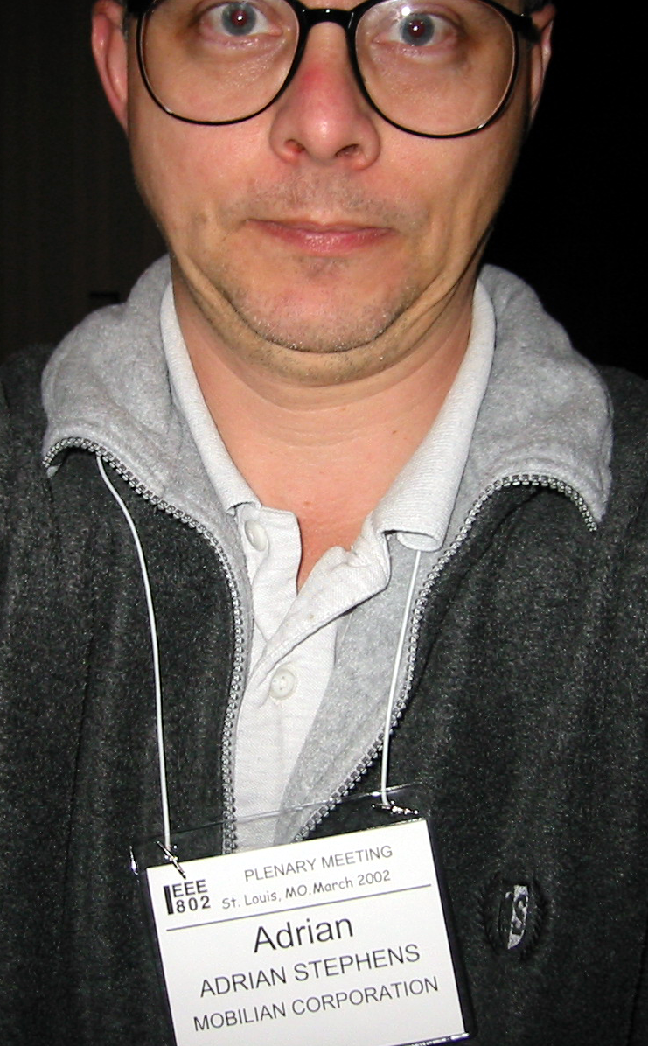
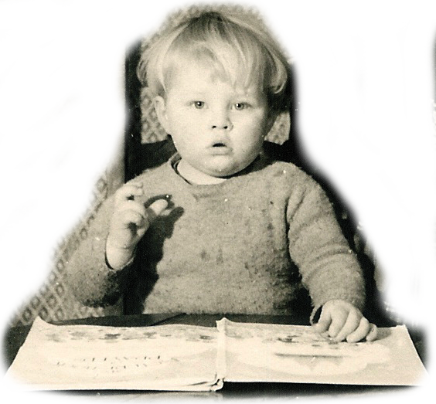
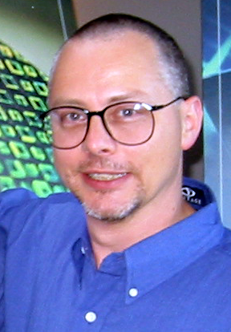
Meetings
First attendance January 2001.
Missed 3 sessions due to an illness in the family.
A total of ~99 sessions
Which, consuming 1 cookie per session day results in 495 cookies

Slide 6
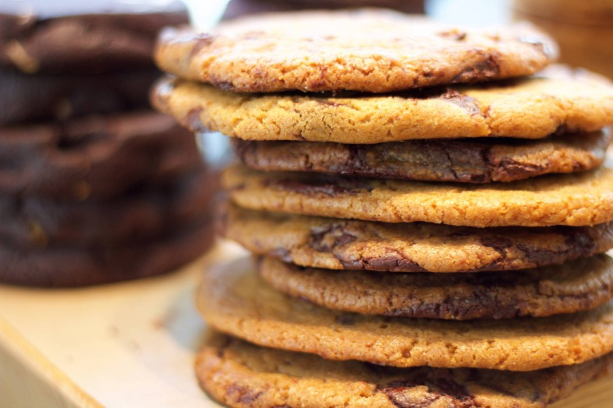
Weight / Mass (for the purists)
A “meeting standard” 125 mm cookie weighs about 125 g (~4.5 oz)
In January 2001, Adrian weighed 533 cookies (147 lb, 66.7 kg)
In March 2018, Adrian weighed 635 cookies (175 lb, 79.4 kg)
The increase in weight is 102 cookies
The Weight Gained Ratio (WGR), defined as the number of cookies consumed versus the increase in weight is 102 / 495**,
which is 0.2 cookies/cookie
WGR = 0.2
** Includes fudge factor and chip factor

Slide 7

Documents
First contribution (as a non-attendee) was to provide the Ad-hoc power saving text in about 1991.
Adrian has posted 2002 document revisions, which is 3.7% of the total number of documents since 2000 (54614 at the time of writing).
Assuming an average of 10 pages per document, that’s 20,020 pages.
A sheet of 80 gsm A4 weighs 5 g, or 40 milli-cookies
The total weight of documentation produced is 800 cookies, or 1.3 fat-adrians
The Document Production Ratio (DPR), defined as the weight of documents to the weight of cookies consumed is 800/495, or 1.6 cookies/cookie
DPR = 1.6

Slide 8
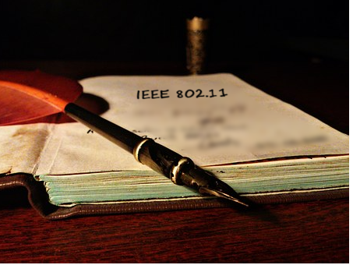
Pages edited
TGn ~ 600 pages
REVmb ~ 3000 pages
REVmc ~ 3000 pages
Total is ~ 6.3 kpages, or 252 cookies.
The pages edited ratio (PER), defines as the weight of the pages edited divided by the weight of the cookies consumed is 252/495 = 0.51 cookies/cookie
PER = 0.51
Frame-maker V0

Slide 9


Summary of former chair’s statistics
DPR > PER > WGR
> >

Slide 10
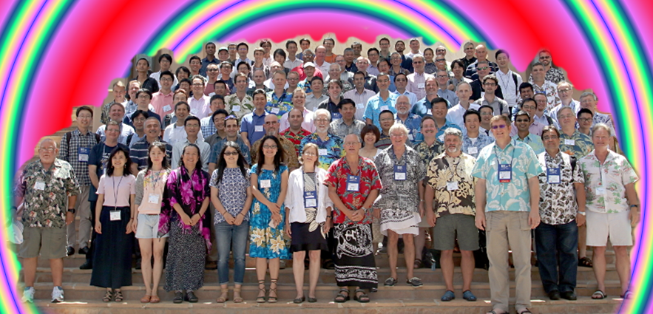
Personal observations
This standards group has proven to be an opportunity for me to develop from someone whose focus was entirely technical to a leadership position.
It is immensely rewarding to engineers (such, I still classify myself) to see the result of our work in people’s hands, in this case, billions of them.
It is also immensely rewording to see the impact that improved communications can make to improve people’s lives.
Perhaps the most personally rewarding thing of all is are the friendships forged among people of like mind – friendships that survive being on opposite sides

Slide 11
FAQ: What’s next for Adrian?
Family: son (1), husband (1), father (3), grandfather (5 or 7, according to definition)
Music – classical piano. Church, keyboard player.
Tinkering with IT/networking stuff at home
Gardening. Woodwork. Photography.
Editor of local community association magazine
Some consultancy on 802.11-related matters
Only travel for pleasure – no more 802.11 meetings

Slide 12
Exhortations
Exhortation
noun
1.
the act or process of exhorting.
2.
an utterance, discourse, or address
conveying urgent advice or recommendations.
Don’t be afraid of engaging in
public debate
Persist - keep at it!
If you want to have influence – serve
Keep it simple
  Everybody in the room will usually agree to keep it simple “as long as I can get my unique/cool feature in”.
  You must do better than that – group consensus about expected timing & stick to it.
I am confident that this group is in very safe hands and I wish success to you all in the future.

Slide 13
Thank you

Slide 14

That’s it
Exeunt Adrian stage left

