Slide 1
TDD Coexistence
Date: 2018-05-07
Authors:

Slide 2
Abstract
Discussion of TDD Coexistence Issues with 802.11ay and 802.11ad

Slide 3
Outline
Background
Fundamental technical issues for coexistence
Protecting legacy devices
Proposed remedies

Slide 4
Background (1)
IEEE 802.11-17/1288r2 Tgay Coexistence Assurance Document addresses coexistence of 802.11ay with legacy 802.11ad devices, as well as 802.11aj, and 802.15 devices
802.11ay Section 11.33 also addresses coexistence
TDD creates new challenges that have not yet been addressed
non-TDD STAs in an overlapping BSS will have no knowledge of a TDD SP
Extended Schedule element is not shared from one BSS to another
Reception of an Extended Schedule element in a Beacon or Announce frame from a neighboring BSS will be ignored
With no knowledge of the rules of an SP, a non-TDD STA will revert to CBAP and wait until the medium is clear in order to transmit

Slide 5
Background (2)
TDD creates new challenges that have not yet been addressed (continued)
STAs operating in TDD mode will not yield the medium to STAs in a non-overlapping BSS
11-18-0488-01-00ay has shown that fixed wireless access STAs can create overlapping BSS with both fixed wireless and more typical mobile wireless devices
Coexistence measurements examined in 11-18-0488-01 underestimate the impact of interference, since real devices will be more sensitive than the CCA threshold requirement (-68 dBm)
11-18-0194-01-00ay advocates use of TDD for indoor consumer applications, which, if adopted, would make overlapping TDD / non-TDD common

Slide 6
Overlapping TDD BSS / Non-TDD PBSS (1)
Frames transmitted by the TDD STA during the TDD SP set the NAV at the Non TDD PCP (Either preamble or entire packet are received)
Cannot transmit, nor respond to RTS
The Non-TDD PBSS is essentially shut down when the TDD STA is transmitting
When the TDD STA is receiving, the Non TDD PCP restarts, causing interference in the other direction
TDD AP
TDD Frames
TDD STA
Non TDD PCP
Interference
TDD Frames
Non TDD STA

Slide 7
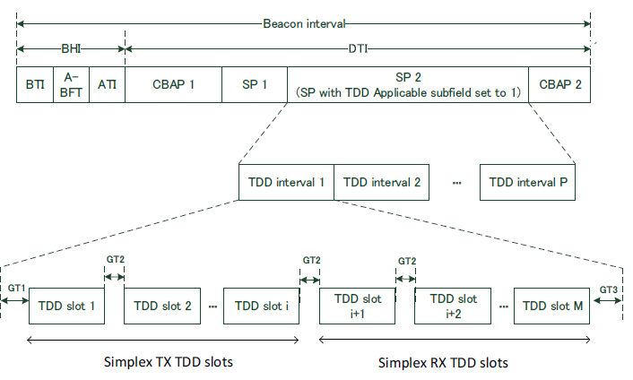
Overlapping TDD BSS / Non-TDD PBSS (2)
The structure of the TDD
SP makes its usage with
adjacent non-TDD PBSS/BSS
problematic.
Neighboring PBSS that is shutdown
during TX TDD slots will start
transmitting during RX RDD slots,
creating interference into the TDD
BSS.
Interference into PBSS Here
Interference from PBSS Here

Slide 8
Protecting Legacy and Devices
802.11ay devices are obligated to co-exist with legacy 802.11ad and 802.15.3 devices
TDD operation (as defined in D1.1 10.37.6.2.2 SP with TDD channel access) will not co-exist with a neighboring BSS/PBSS of any type, TDD, .11ay CBAP, or legacy CBAP
Operation with TDD will require restrictions to prevent interference to neighboring PBSS/BSS

Slide 9
Proposed Remedies
Remedies to protect legacy and EDMG devices
Mandate transmit power control during use of TDD
Restrict the use of TDD to outdoor only
Mandate channel sensing for overlapping BSS / PBSS before and during the use of TDD
DMG Protected Period (802.11-2016 10.36.6.6)
Remedies to protect EDMG devices
Allow intra-PBSS / BSS signaling (TBD) to indicate interference from TDD

Slide 10
Straw Poll
Do you support adding mandatory co-existence mechanisms to the 802.11ay draft to protect DMG and EDMG STAs from DMG or EDMG STAs that are employing the TDD protocol?

