Slide 1
Self-Interference Cancellation in Full Duplex for 802.11
Date: 2018-05-08
Authors:

Slide 2
Introduction
WLANs are extensively deployed worldwide. According to Wi-Fi Alliance [1], the cumulative Wi-Fi device shipments will be over 20-billion units in 2018. Large quantities of Wi-Fi devices are used in dense environments demanding advanced technologies to improve the spectrum efficiency in WLANs.
A device with wireless Full Duplex (FD) capability can simultaneously transmit and receive wireless signals sharing the same frequency resource, which provides the potential to double the spectral efficiency of bidirectional links compared to the corresponding half-duplex transmission.
The most challenging work in FD development is to efficiently and sufficiently cancel the self-interference (SI) which is transmitted by a FD-capable device and received by the same device through transceiver coupling and multipath reflections.
This contribution analyzes the components of SI and the requirements for a FD-capable receiver to cancel the SI, overviews several self-cancellation techniques potentially to be considered in FD for 802.11 and evaluates the impact of self-interference cancellation level to the WLAN performance.

Slide 3
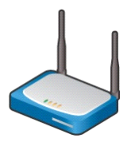
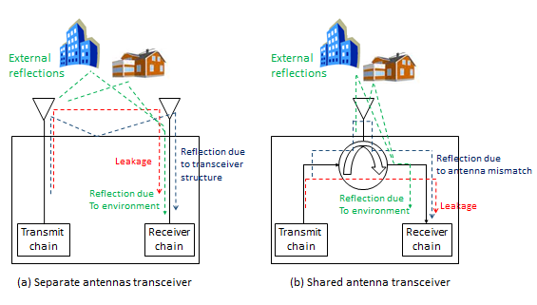
Full-Duplex Transceiver
Example FD architectures
Self-interference
Self-interference
TX
TX
RX
RX
Self-interference
TX/RX
Half duplex
Full duplex
Full duplex
STA #1
AP
Half duplex
Full duplex
AP
Asymmetric FD
STA #2
STA
Symmetric FD
Self-interference paths
internal leakage and possible reflections due to antenna / transceiver structure: quasi-static, short-delay, strong paths
external reflections from surrounding: time-varying, longer-delay, weaker paths
Using different antenna elements sharing the same antenna element

Slide 4
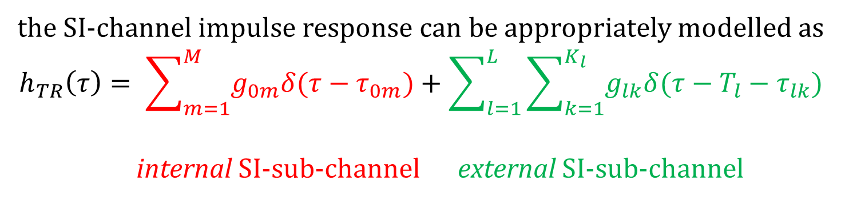
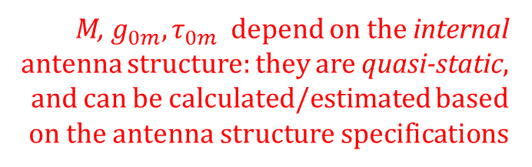
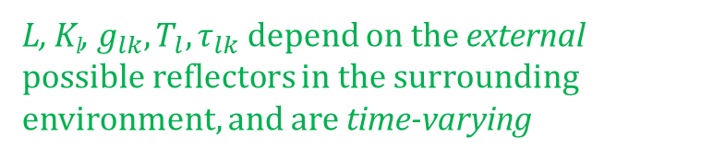
Self-Interference Channel
L is the number of clusters in the external SI,
K_{l} is the number of paths in the lth cluster

Slide 5
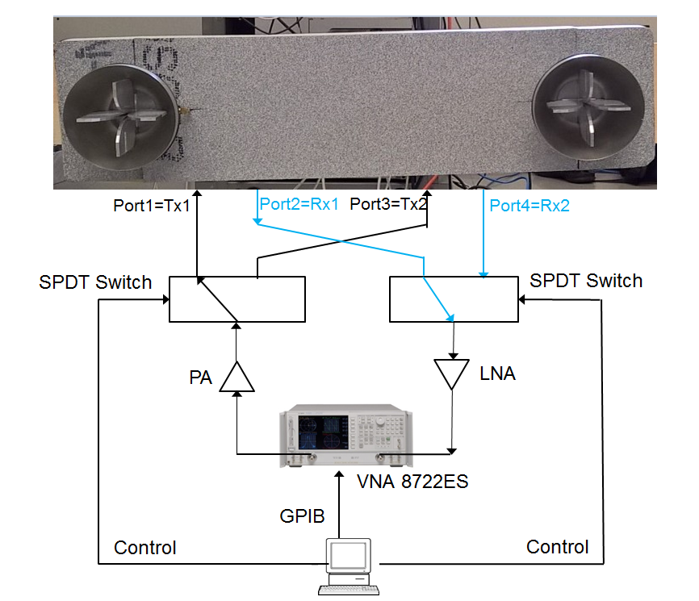
Wideband 2x2 MIMO SI Channel Sounding System [2]
VNA setting parameters
Sweep 2.2-2.7 GHz
Output power 5 dBm
IF bandwidth 100 Hz
Measured SI-channel frequency
response samples
Time-varying SI-channel impulse
response samples obtained from
the measured SI-channel frequency
response
SI-channel power delay profile(PDP)
is calculated

Slide 6
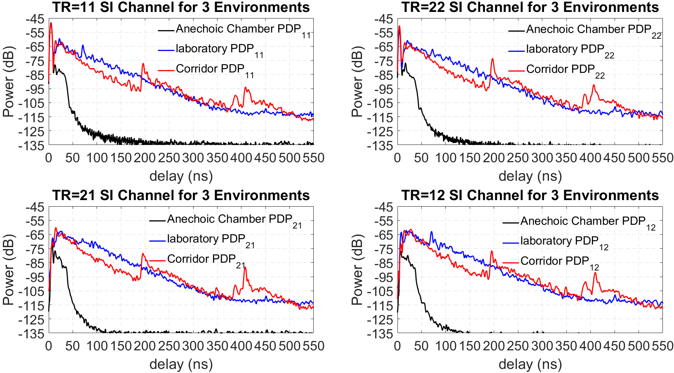
SI-Channel Power Delay Profile (PDP) [2]

Slide 7
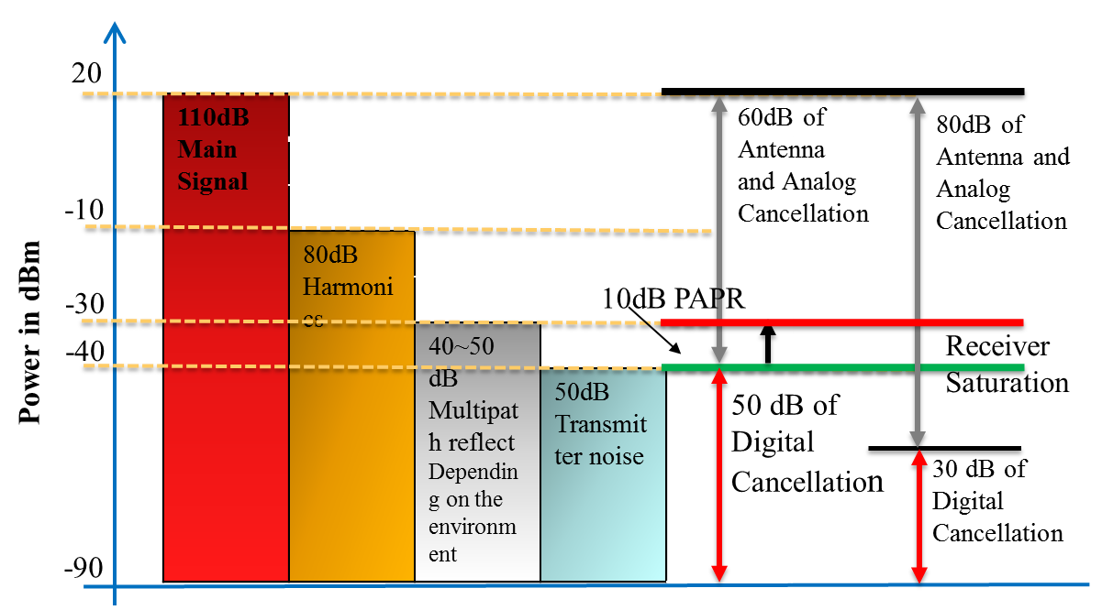
Challenges in Full-Duplex Transmission
Strong self-interference
- linear components: leakage from Tx to Rx,
possible reflections due to antenna/transceiver,
and reflections from environment. The main interference signal power could be about the same level of the Tx power ;
- nonlinear components: nonlinear distortion
due to Tx power amplifier (PA), which is about
30 dB lower than the main signal in linear SI [4];
- Tx noise: due to PA noise and phase noise, which is about -50 dBm [4].
Noise floor
Assume indoor environment; Tx power: 20 dBm; Rx noise figure (NF): 6 dB; margin (Io): 5 dB; BW=20MHz
noise floor
= -90 dBm
It requires an FD receiver to have an SIC ability in a level of 20-(-90) = 110 dB in order to reduce the main interference signal to the noise floor power level.
Requirements for analog/digital SIC
TX Noise Floor [dB] = DAC Noises + TX Gain + TX NF
*
Replicas of distorted TX signal
Random noise
Intended Rx signal
SI
ANT
ANT
Due to insufficient Rx dynamic range, large SI can saturate the Rx LNA/ADC, and intended Rx signal is compressed / wiped out
PA
LNA
ADC quantization noise
=>
ADC & UC
ADC & DC
only SI
Modulator
Demodulator

Slide 8
Link Budget
Receive desired signal power:
  Pr = Pt + Gt + Gr – Lp with assumptions of
  - Pr (receive power) (dBm)
  - Pt (transmitter output power) = 20 dBm
  - Gt (transmitter antenna gain) = 6 dBi
  - Gr (receiver antenna gain) = 6 dBi
  - Lp (path loss) (note: channel model-D for Typical Office [3] is considered)
  Lp(d) = L_{FS}(d_{BP})+35*log10(d/d_{BP}) for d > d_{BP} (=10m)
  where L_{FS} is free space path loss at d_{BP} ; d is Tx-Rx separation distance (m); d_{BP} (= 10m) is the breakpoint distance
  Noise floor N_{floor} = -90 dBm (BW=20MHz; receiver noise figure (NF): 6 dB; interference margin (Io): 5 dB)
  Link budget
SIC levels (dB) | d = 40 m |  |  |  | d = 80 m
 | Pr = -49dBm |  | SNR=41dB |  | Pr = -59.7dBm |  | SNR=30.3dB
 | Residue SI (dBm) | SINR(dB) |  | data rate (Mbps) / 11ax MCSs | Residue SI (dBm) | SINR(dB) |  | data rate (Mbps) / 11ax MCS
90 | -70 | 21 |  | 43.9 / MCS4 | -70 | 10 |  | 7.3 / MCS0
95 | -75 | 26 |  | 73.1 / MCS7 | -75 | 15 |  | 21.9 / MCS2
100 | -80 | 31 |  | 87.8 / MCS8 | -80 | 20 |  | 43.9 / MCS4
105 | -85 | 35 |  | 97.5 / MCS9 | -85 | 24 |  | 58.5 / MCS5
110 | -90 | 38 |  | 121.9 / MCS11 | -90 | 27 |  | 73.1 / MCS7

Slide 9
Implementation of SI Cancellation
RFFE isolation
Two main challenges in RF/Analog SIC:
Design an RF front end (RFFE) with >30dB T/R Isolation
Design an RF/Analog SIC on chip with ~40-50dB Cancellation
Challenge in digital SIC
Limitation of ADC range
Tx Antenna
Rx Antenna
d₁
a₁
…
…
Variable
delays
Variable
attenuators
∑
+
…
…
d_{n}
a_{n}
RF/Analog SIC
DAC
&
UC
ADC
&
DC
BB/Digital SIC
-
Tx
Digital
BB
Rx
Digital
BB

Slide 10
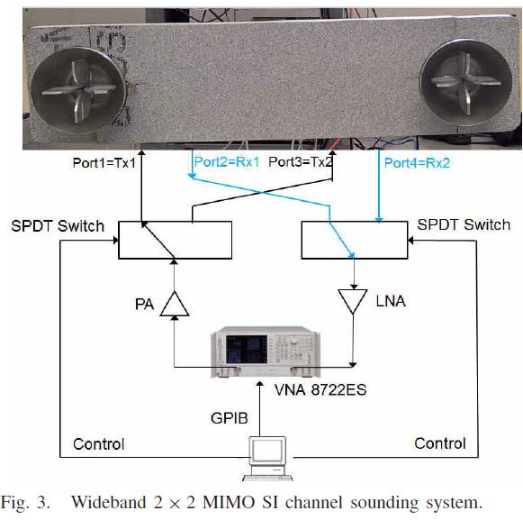
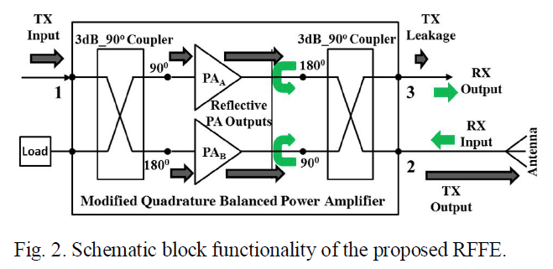
RFFE/Analog SIC - Possible Approaches
In terms of RF front-end isolation, both single antenna (same for Tx & Rx) solutions (using a circulator or alternatives) and multiple antenna solutions are applicable
  Separating multiple antennas into Rx & Tx yields high isolation, however this may limit the MIMO capabilities
In terms of analog SIC, Multiple RF/Analog Tap “Weighted” Delay Lines [6] and Two RF Tap Delay Lines “Weighted” & Tunable [8] are considered to be practical for Wi-Fi chipsets.
Separate
T/R
Antennas [2]
Single T/R Antenna
with a modified QBPA [7]

Slide 11
Digital Interference Cancellation
Digital self interference cancellation is the last line of defense against self-interference, but is limited by ADC dynamic range
  Digital-domain cancellation can suppress self-interference only up to the effective dynamic range of the ADC
  Now 12-bit ADC with 11-bit ENOB is mostly implemented in 802.11ac chip, yielding an effective dynamic range of 6.02*(11-2)=54.18dB [5]
  One bit to budget an additional headroom of 6 dB (depending on the received PAPR)
  One bit to place the quantization-error floor 6 dB below noisy floor
Reconstructing self interference channel with following considerations
  Linear component of self interference
  -> caused by the leakage over the circulator after analog cancellation and the delayed reflections from the environment.
  -> need to buffer more samples in the packet and use samples from future to estimate the current SI
  Nonlinear component self interference due to power amplifier/oscillator
  -> caused by nonlinearity characteristics of radio circuit
  -> may consider using Tayler series expansion, estimate the coefficients, regenerate the harmonics and cancel the nonlinear components

Slide 12
Digital Interference Cancellation
Working assumptions
The target of the digital SIC module is to complete interference mitigation and bring the SNR to the desired level;
Assume that the analog part provides up
to 50dB of interference mitigation. Thus the
residual interference (linear component) at
input to digital SIC is around -30dBm
(nonlinear component is 30 dB below);
Assume that the highest level of the received (desired) signal is -67dBm while the Rx noise floor is -90dBm.
Power Level
+20dBm
Tx signal
Interference Linear Component
-30dBm
Interference Nonlinear Component
-60dBm
-72dBm
Desired Signal
-67dBm
-95dBm
Noise Floor
-90dBm

Slide 13
Digital Interference Cancellation
Transfer function
Assume that the Tx signal consists of linear and nonlinear parts (generated by Tx PA) and harmonics higher than 5th order are ignored;
Assume memoryless model of Tx nonlinearity, thus every nonlinear component depends only on the signal transmitted at the same time sample;
Assume linear transfer function is considered from Tx to Rx (including analog reflections, multipath and analog SIC). The received signal in digital domain is given by:
where is an equivalent transfer function with a delay spread of K samples, is the Tx baseband signal, is AWGN, and are the coefficients of the nonlinear part and is the received signal.
Tayler series expansion ->

Slide 14
Digital Interference Cancellation
Two-step Solution
To estimate the transfer function of the linear part, then subtract the estimated signal from the received signal and then estimate the transfer function of the nonlinear components.
1st stage: Define the minimization problem
where N is the number of time samples used for estimation and is a known Tx signal.
Using vector/matrix notation, the solution is given by the least-squares estimator.
2nd stage
- subtract the estimated part from the received signal
- using the estimated transfer function and assuming we have a residual linear component, update the model for the resulting signals
- redefine the minimization problem as:

Slide 15
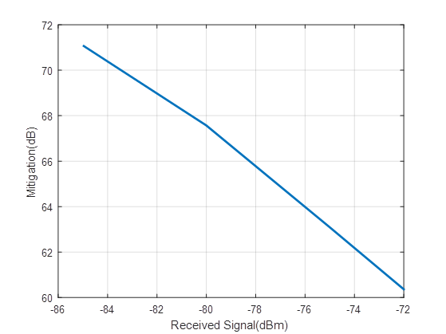
Simulation Results
A two-step mitigation procedure with the following parameters is simulated:
  - Transfer function with maximum delay of
  4 samples implemented by a Rayleigh
  channel
  - Rx signal of -72:-85dBm
  - Number of time samples used for
  estimation: 256
It can be seen on the right that in presence
of strong received signal, an SI mitigation of
~61dB can be achieved implying that in most
of the cases we are below the noise level

Slide 16
Summary
Asymmetric and symmetric Full-Duplex (FD) architectures have been reviewed.
Self-interference channel impulse response has been analyzed and the measurement results have shown that external reflections are relatively strong in the indoor environment.
Link budget has shown that FD can achieve high data rate transmission for mid-range communications in WLAN.
Several techniques on Tx/Rx antenna isolation, RF analog self-interference cancellation and digital self-interference cancellation have been reviewed and discussed, which demonstrate the potential of FD to be practically deployed in WLAN.

Slide 17
References
[1] https://www.wi-fi.org/news-events/newsroom/wi-fi-alliance-publishes-2018-wi-fi-predictions
[2] Fei Chen, Robert Morawski, Tho Le-Ngoc, “Self-Interference Channel Characterization for Wideband 2x2 MIMO Full-Duplex Transceivers using Dual-Polarized Antennas”, IEEE Transactions on Antennas & Propagation, Vol. 66, No. 4, April 2018.
[3] IEEE 802.11-03/940r1.
[4] D. Bharadia, E. McMilin and S. Katti, “Full Duplex Radios”, Proc. of the ACM SIGCOMM 2013, Hong Kong, China, Aug. 2013.
[5] https://www.design-reuse.com/umc/adc-c-78/
[6] T. Zhang et al, “A 1.7-to-2.2GHz Full-Duplex Transceiver System with >50dB Self-Interference Cancellation over 42MHz Bandwidth”, ISSCC 2017.
[7] D. Regev et al, “Modified Re-Configurable Quadrature Balanced Power Amplifiers
for Half and Full Duplex RF Front Ends”, Wireless and Microwave Circuits and Systems (WMCS), 2018 Texas
[8] T. Huusari et al, “Wideband Self-Adaptive RF Cancellation Circuit for Full-Duplex Radio: Operating Principle and Measurements”, 2015 IEEE 81st Vehicular Technology Conference (VTC Spring)

Slide 18
Appendix - Design Implications
What does the processing described in the previous slides mean in terms of design complexity? We give a high-level description and rough approximation of the complexity, area and timing
The main assumptions:
  8 Complex MAC units
  256 samples and a channel memory of 4 are used, so is matrix of 256 x 4 and is a vector of size 256 x 1
  The two stages described in previous slides, where we compute ,
  are of similar complexity
Using a typical matrix inversion module, approximately ~450 cycles are needed for the first stage, and ~1000 cycles are needed for both stages

Slide 19
Appendix - Design Implications
The first stage is shown, the second is similar
All blocks use the same 8 MAC units, so all is executed serially – one block at a time
The area (inc. MUXs, registers, FSM and P&R) is ~25 Ku2 @16nm
With 640MHz clock, this translates into <2usec processing time

