Slide 1
Full-Duplex based MAC enhancements
Date: 05/04/2018
Authors:

Slide 2
Introduction
The ultimate promise of Full-Duplex (FD) operation is doubling the BW available to Wi-Fi transmissions
  Requires full cancellation of overlapping signals to below some noise threshold
    Both RF and baseband processing needed
    Challenging
Whether a full doubling can be achieved will also depend on traffic situation

Slide 3
Summary
Full-duplex (FD) application need not be restricted to doubling the BW available to data
We can consider MAC enhancements that are built on some form of FD, but provide gain in a more “traditional” way
  We give two examples to illustrate this notion
    RTS/CTS replacement
    Collision detection to enhance CSMA
We propose to consider this use of FD as part of the scope of an FD project

Slide 4
Example 1: FD-based CTS
Consider a scenario with hidden nodes:
  STA1 and STA2 are hidden from each other
  STA1 and STA2 both send data to the AP
RTS/CTS can resolve this, however use of RTS can not be imposed by the AP#
#Although this is now an optional feature in 11ax

Slide 5
Hidden node scenario without RTS/CTS
Without RTS/CTS most transmissions will collide at the AP

Slide 6
FD-based CTS
Use FD to enhance the existing MAC protocol
Receiver (AP) sends a CTS while receiving a packet from STA1 or STA2
  After establishing that the packet is intended for the AP (requires at least partial processing of preamble)
  During this CTS transmission the AP operates in FD mode (for a limited time)
    Transmit CTS while receiving data
The CTS is received by both STA1 and STA2
Any contending STA should stop contention as a result

Slide 7
Illustration of FD-based CTS

Slide 8
Network simulation result
No FD CTS
With FD CTS

Slide 9
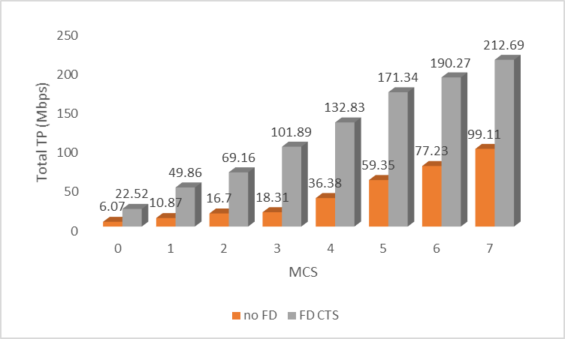
Performance

Slide 10
Example 2: FD-enhanced CSMA
In a highly congested network, the backoff counters are increased exponentially to try to mitigate collisions
  Depending on traffic type and number of STAs, residual collisions may remain, even after CW reaches CWmax
  Every collision leads to loss of packet and occupies the medium for the duration of the packet
FD can be used to terminate colliding frames early

Slide 11
FD-enhanced CSMA
Upon detection of a collision at the transmitter, stop the ongoing transmission to clear the medium
  Need limited FD capability to sense while transmitting

Slide 12
Network simulation result

Slide 13
Network simulation result for 50 STAs

Slide 14
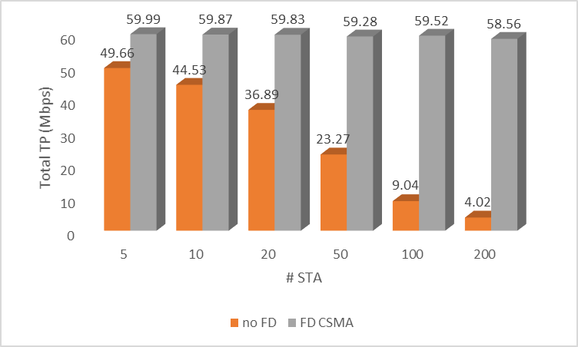
Performance for different #STA

Slide 15
Conclusion
Full-Duplex can be used to theoretically double the BW available to Wi-Fi transmission
Full-Duplex can also help in other ways to enhance network performance
  FD enables the feature, but gains come from collision avoidance and/or better airtime usage (in non-FD mode)
The focus of FD should not exclusively be on doubling the BW
FD-based MAC enhancements should be considered as part of the scope of Full-Duplex activity
  Two examples given here
  Other opportunities?

