Slide 1
NGV Doppler Channel Modeling
Date: 2018-05-08
Authors:

Slide 2
Introduction
IEEE NGV study group has been formed to study the evolution of 802.11 technology for next-generation V2X communications [1].
It is important to develop multipath fading channel models with Doppler for NGV studies.
In this contribution, we provide an overview of one set of Car-to-Car (C2C) Channel models.

Slide 3
C2C Channel Model
One set of C2C channel models were introduced for DSRC channels and used for tests [2]
These models stem from three field trials [3, 4, 5], and define the RMS delay spread and Doppler profiles for five common scenarios:
  Rural LOS, Highway LOS, Urban Approaching LOS, Urban Crossing NLOS and Highway NLOS
These five C2C channel models can be good reference for NGV channel model development.

Slide 4

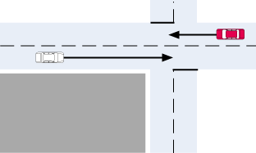
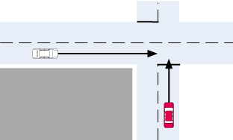
C2C Channel Scenarios [2]
Rural LOS: Intended primarily as a reference result, this channel applies in very open environments where other vehicles, buildings and large fences are absent.
Urban Approaching LOS: Two vehicles approaching each other in an Urban setting with buildings nearby.
Urban Crossing NLOS: Two vehicles approaching an Urban blind intersection with other traffic present. Buildings/fences present on all corners.

Slide 5
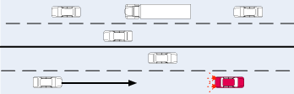
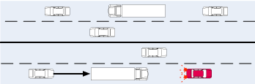
C2C Channel Scenarios [2]
Highway LOS: Two cars following each other on Multilane inter-region roadways such as Autobahns. Signs, overpasses, hill-sides and other traffic present.
Highway NLOS: As for Highway LOS but with occluding trucks present between the vehicles.

Slide 6
C2C Model Values
Table 1: Rural LOS Parameters
Table 4: Highway LOS Parameters
 | Tap1 | Tap2 | Tap3 |  | Units
Power | 0 | -14 | -17 |  | dB
Delay | 0 | 83 | 183 |  | ns
Doppler | 0 | 90 | -54 |  | Km/h
Profile | Static | HalfBT | HalfBT
 | Tap1 | Tap2 | Tap3 | Tap4 | Units
Power | 0 | -10 | -15 | -20 | dB
Delay | 0 | 100 | 167 | 500 | ns
Doppler | 0 | 126 | -90 | 162 | Km/h
Profile | Static | HalfBT | HalfBT | HalfBT
Table 2: Urban Approaching LOS Parameters
Table 5: Highway NLOS Parameters
 | Tap1 | Tap2 | Tap3 | Tap4 | Units
Power | 0 | -8 | -10 | -15 | dB
Delay | 0 | 117 | 183 | 333 | ns
Doppler | 0 | 43 | -29 | 90 | Km/h
Profile | Static | HalfBT | HalfBT | HalfBT
 | Tap1 | Tap2 | Tap3 | Tap4 | Units
Power | 0 | -2 | -5 | -7 | dB
Delay | 0 | 200 | 433 | 700 | ns
Doppler | 0 | 126 | -90 | 162 | Km/h
Profile | Static | HalfBT | HalfBT | HalfBT
Table 3: Urban Crossing NLOS Parameters
 | Tap1 | Tap2 | Tap3 | Tap4 | Units
Power | 0 | -3 | -5 | -10 | dB
Delay | 0 | 267 | 400 | 533 | ns
Doppler | 0 | 54 | -18 | 108 | Km/h
Profile | Static | HalfBT | HalfBT | HalfBT

Slide 7
Example Simulation
Simulation settings for C2C
  DSRC 10MHz, 1Tx-1Rx-1SS
  LENGTH: 300B for DSRC safety applications
  Sample-by-sample C2C Doppler modeling
    Multipath channel evolves for every sample for the Doppler effect

Slide 8
PER Performance of C2C Channels
2dB

Slide 9
Summary
C2C channels provide statistical models for five common car-to-car communication scenarios.
These models can be helpful to the development of channel modeling for next-generation V2X communications.
Sample-by-sample Doppler model and its PHY simulations are preferred for NGV to evaluate various application scenarios and frame formats.
  The “simplified” symbol by symbol Doppler model won’t capture the Doppler shift effect (ICI) across sub-carriers.
Exploring other models too, e.g. for longer range or other usage scenarios.

Slide 10
Reference
[1] Hongyuan Zhang and etc., “802.11 For Next Generation V2X Communications”, IEEE 802.11-18/0513r2.
[2] Kahn, Malik, “IEEE 802.11 Regulatory SC DSRC Coexistence Tiger Team V2V Radio Channel Models,” IEEE 802.11-14/0259r0.
[3] Ian Tan, Wanbin Tang, Ken Laberteaux, Ahmad Bahai , “Measurement and Analysis of Wireless Channel Impairments in DSRC Vehicular Communications,” Electrical Engineering and Computer Sciences University of California at Berkeley, April 2008.
[4] Paul Alexander, David Haley, Alex Grant , “Cooperative Intelligent Transport Systems: 5.9-GHz Field Trials,” Proceedings of The IEEE Volume:99 , Issue 7, July 2011
[5] Laura Bernado, Thomas Zemen, Fredrik Tufvesson, Andreas F. Molisch, Christoph F. Mecklenbrauker , “Delay and Doppler Spreads of Non-Stationary Vehicular Channels for Safety Relevant Scenarios,” May 2013

