Slide 1
Project: IEEE P802.11 Study Group for Light Communications
Submission Title: Commercial Solutions for Classified (CSfC) for Li-Fi
Date Submitted: 28 April 2018
Source: Ryan Mennecke, Edward Holzinger [JHUAPL]
Address: 11100 Johns Hopkins Road, Laurel, MD 20723, USA
Voice:[+1-240-228-7477], FAX: [+1-240-228-0789], E-Mail:[ryan.mennecke@jhuapl.edu]
Re:
Abstract: This presentation provides information on the Classified Solutions for Computing (CSfC) program adopted by the USG DOD in accordance with accreditation an acceptance of commercial vendor products into classified and non-classified communication solutions.
Purpose: Contribution to IEEE 802.15.11
Notice: This document has been prepared to assist the IEEE P802.11 Light Communications Study Group. It is offered as a basis for discussion and is not binding on the contributing individual(s) or organization(s). The material in this document is subject to change in form and content after further study. The contributor(s) reserve(s) the right to add, amend or withdraw material contained herein.
Release: The contributor acknowledges and accepts that this contribution becomes the property of IEEE and may be made publicly available by P802.11.

Slide 2
Commercial Solutions for
Classified (CSfC) for Li-Fi
Ryan Mennecke, Edward Holzinger [JHUAPL]

Slide 3
CSfC program and the benefits
CSfC
  DoD program that streamlines vendor commercial equipment accreditation and acceptance
  To be utilized in classified and non classified DOD computing environments
Vendor product integration into DOD communication solutions
Opportunities exist to develop the LiFi Standard (IEEE/IETF) and for LiFi vendors to develop their products with this use-case in mind

Slide 4
Why does the DOD need CSfC?
Issues with current classified computing accreditation process
  Government-off-the-shelf (GOTS) products take years to develop and field
  Limited attack surface allows adversaries to focus efforts
Benefits of using Commercial technology
  Commercial applications and technologies are moving significantly faster than their government counterparts
  Use of advanced encryption algorithms have become ubiquitous in commercial technology
Core CSfC principles
  Leveraging industry innovation to deliver secure network solutions quickly
  Rely on strong security principles
    Proper configuration management
    Multilayer data protection
    Diversity of hardware and software implementation

Slide 5
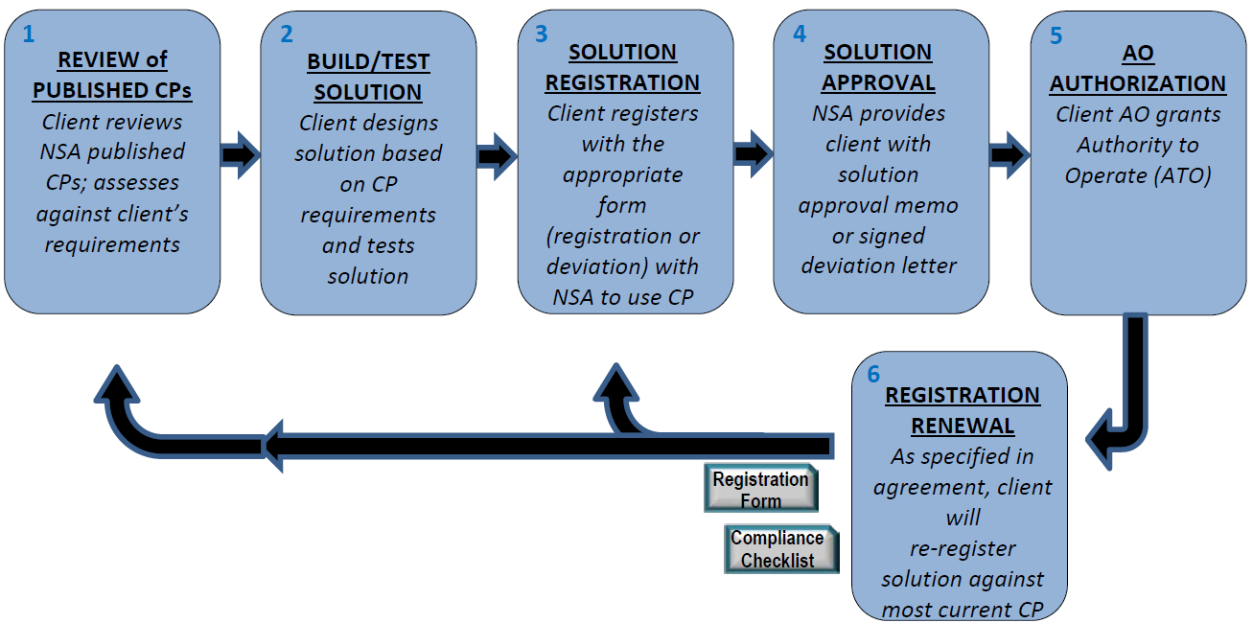
CSfC Solution Registration/Approval Process
Commercial Component Developers
Protection Profiles (PP)
CSfC Component List
https://www.nsa.gov/resources/everyone/csfc/assets/files/csfc-customer-handbook.pdf

Slide 6
Capability Packages (CP)
  2 Li-Fi applicable CPs
    Mobile Access^{[4]}
    Campus WLAN^{[5]}
  Packages revolve around the same common themes
    Defense in depth
      At least doubly encrypted data
    Vendor diversity
      Hardware/Software
https://www.nsa.gov/resources/everyone/csfc/capability-packages/

Slide 7
The Mobile Access Capability Package (MACP)
CSfC Component List
https://www.nsa.gov/resources/everyone/csfc/assets/files/csfc-customer-handbook.pdf

Slide 8
Commercial Product CSfC-Listed Process
Build products in accordance to USG approved Protection Profile(s)
Submit products for testing using the Common Criteria Process
Memorandum of Agreement (MoA) with NSA
Complete and submit the CSfC Questionnaire for each product
https://www.nsa.gov/resources/everyone/csfc/assets/files/csfc-customer-handbook.pdf

Slide 9
Protection Profiles (PP)
Protection Profiles (PP) are standards-based requirements documents, developed by National Information Assurance Partnership (NIAP), that specify in-depth technical and security requirements for various categories of products
Vendors build their products to meet the requirements of the PP
Vendors hire a Common Criteria Testing Laboratory (CCTL) to independently verify conformance to the Protection Profiles
https://www.niap-ccevs.org/Profile/PP.cfm

Slide 10
CSfC Components List
Once the product passes the CCTL evaluation, the product gets placed on the NSA CSfC Components List
Minor version upgrades don’t require a re-evaluation, but any major version upgrades DO require a CCTL re-evaluation
https://www.nsa.gov/resources/everyone/csfc/components-list/

Slide 11
Summary
LiFi DOES have the ability to replace WiFi in CSfC solutions especially those built against the MACP and Campus WLAN CP
LiFi PP will utilize the IEEE or IETF RFC Li-Fi standard once completed
LiFi PP would probably look similar to that of existing WLAN PP
Opportunities exist to augment the development of the LiFi IEEE 802 and for LiFi vendors to develop their products with this use-case in mind
https://www.nsa.gov/resources/everyone/csfc/

