Slide 1
Next Generation PHY/MAC in Sub-7GHz
Date: 2018-05-10
Authors:

Slide 2
Outline
Timeline and Proposed Standard Procedure
Important Use Cases
Requirements and Candidate Technologies

Slide 3
Thoughts on the Timeline
2003
2004
2007
2009
2012
2013
2017
2018
2019
2023
Sep 2002
Mar 2007
Feb 2012
Mar 2013
Sep 2017
HT SG: 12 months
802.11n
11n SG: HT
Draft 2.0
VHT SG: 18 months
802.11ac
11ac SG: VHT
Draft 2.0
HEW SG: 12 months
802.11ax
11ax SG: HEW
Draft 2.0
SG for next PHY/MAC: ?
Next PHY/MAC (see next slides)
NG SG
 | SG Formation | PAR | First LB | First LB>75% | Last LB | Last SB
11n | Sep 2002 | Sep 2003 | April 2006 | Mar 2007 | Dec 2008 | July 2009
11ac | Mar 2007 | Sep 2008 | June 2011 | Feb 2012 | Feb 2013 | Nov 2013
11ax | Mar 2013 | Mar 2014 | Nov 2016 | July 2018? | ? | ?
Next PHY/MAC | July 2018? | ?
If the LB for IEEE 802.11ax D3.0 is started after the May 2018 interim and the LB is passed, then the draft amendment is relatively stable and it is reasonable to plan for the next PHY/MAC release.
Besides, there is no difference for the SG actual creation time between motion it in May vs July due to 802EC

Slide 4
Thoughts on Standard Development (1)
It took a long time to develop a new major PHY/MAC amendment.
  The PARs are written in a generic manner
  Mostly because there are many features considered
Approx. time line for n/ac
PAR and CSD
Technical Contribution
Letter Ballot
Sponsor Ballot
1 year
2 years
2 years
0.5 year
Study Group
Task Group

Slide 5
Thoughts on Standard Development (2)
Can we improve the standards development process to shorten the time for bringing new technologies to the market?
  Take IEEE 802.1 as an example. Some of its projects, e.g., 802.1Qcc, 802.1Qcd, are completed in 2 years, and these projects were developed with very narrow scopes.
Is it an appropriate time to take a deep dive on our WG process?
Is there any benefit of starting a project with very narrow scopes?
  For example, define a PAR with a very focused set of features

Slide 6
Proposed approaches (1)
Option 1: Divide a major PHY/MAC amendment into multiple projects, each with a narrowly-defined feature set
  In WNG SG, discuss market-driven features, and prioritize the features into multiple projects
  It is possible to develop a PAR and CSD without forming a study group. For example,
    the PAR of TGmd was developed in the Working Group. See: http://www.ieee802.org/11/email/stds-802-11/msg02506.html
    Nothing needed for SG to prepare a PAR in 802 OM. See: https://mentor.ieee.org/802-ec/dcn/17/ec-17-0090-21-0PNP-ieee-802-lmsc-operations-manual.pdf
PAR, CSD for set 1
Contributions for set 1
Letter Ballot for set 1
Sponsor Ballot for set 1
Project 1 (approx. 1.5~2 years)
PAR, CSD for set 2
Contributions for set 2
Letter Ballot for set 2
Sponsor Ballot for set 2
Project 2 (approx. 1.5~2 years)
Certification program outside of IEEE for set 1
Certification program outside of IEEE for set 2

Slide 7
Proposed approaches (2)
Option 2: Divide a major PHY/MAC amendment into multiple phases within a task group, each phase with a narrowly-defined feature set
  A few issues need to be considered, e.g., can we roll-in text for set 2 into the draft amendment if the letter ballot for set 1 is passed? Can we follow 11m approach for the roll-in?
PAR, CSD for whole project
Contributions for set 1
Letter Ballot for set 1
Phase 1 (approx. 1.5~2 years)
Contributions for set 2
Letter Ballot for set 2
Phase 2 (approx. 1.5~2 years)
Certification program outside of IEEE for features in Phase 1
Certification program outside of IEEE for features in Phase 2

Slide 8
Important Use Cases for Next Gen
Video Transmission
  VR (Page 9 & 10)
  8k (Page 11)
Improved IoT Support
  See page 12
Industrial Wi-Fi
  See page 13 & 14

Slide 9



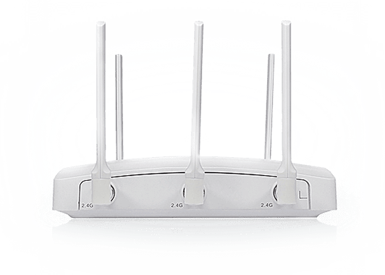




VR Use Cases
VR Movie, VR Gaming, Virtual Social, VR Live Broadcasting
  AP plays a key role in VR system
Bad Experience:
  Insufficient image clarity
  Image smearing
  Black border
  Dizziness
  Head display is very heavy because
  of lots of image processing
Cloud VR
Home VR
Portable VR

Slide 10
VR Requirement
The requirement of VR is calculated in the following table
Typical requirement of VR for Wireless Transmission
  Total latency should <20ms, T(compression & decompression)=~10ms, T(display)=5ms, T(rendering)=1ms?
  → RTT Latency 5~10ms
  To meet the above latency requirement, raw stream or lightly compressed stream is preferred
  → PHY Link Throughput > 40Gbps
 | PPD | Horizontal FOV | Vertical FOV | Monocular Video Resolution | Bits per Pixel | Frame Rate | Yuv444/ yuv420 | Raw Rate (Gbps) | Lightly Compressed Rate (Gbps) | Compressed Rate (Gbps) | RTT Latency
Partial Immersion | 30 | 210 | 100 | 6300*3000 | 12 | 60 | 3/1.5 | 2D, 40.83/ 20.42 | 2D, 4.83/ 2.04 | 2D, 0.48/ 0.20 | 10ms
 |  |  |  |  |  |  |  | 3D, 81.66/ 40.84 | 3D, 9.66/4.04 | 3D, 0.97/0.40
Deep Immersion | 45 | 360 | 100 | 16200*4500 | 12 | 90 | 3/1.5 | 2D, 236.20/118.10 | 2D, 23.6/ 11.8 | 2D, 2.36/1.18 | 5ms
 |  |  |  |  |  |  |  | 3D, 472.40/236.20 | 3D, 47.2/23.6 | 3D, 4.72/2.36
Ultimate Immersion | 60 | 360 | 120 | 21600*7200 | 12 | 144 | 3/1.5 | 2D, 806.22/403.11 | 2D, 80.62/ 40.31 | 2D, 8.06/4.03 | 5ms
 |  |  |  |  |  |  |  | 3D, 1612.44/806.22 | 3D, 161.24/80.62 | 3D, 16.12/8.03

Slide 11
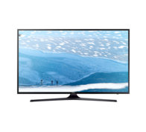


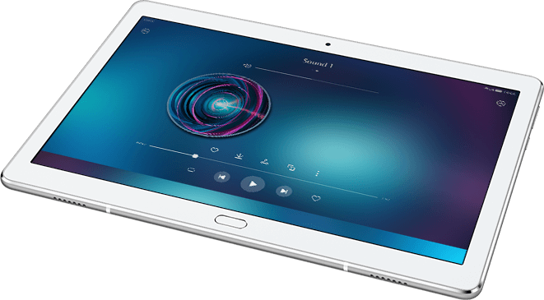
4K/8K Video
Uncompressed 8K Video is more and more important for home/Enterprise
  CCTV Signals
  Wireless HDMI
  Cloud Streaming
  (VDI/Live Broadcasting/…)
RAW Stream
Traffic | Subtype | Description | Rate, Mbps | Packet Error Rate | Jitter, ms | Delay, ms
Videos | Video Uncompressed | 4k*2k pixels, 12bits/pixels, 60fps | 6000 | 1e-8 | 10 | 10
 |  | 8k*4k pixels, 12bits/pixels, 60fps | 23000 | 1e-8
 | Video Lightly Compressed | 4k*2k, Motion JPEG2000 | 600 | 1e-7 | 20 | 20
 |  | 8k*4k, Motion JPEG2000 | 2400 | 1e-7 | 20 | 20
 | Video Compressed | 4k*2k pixels, 60fps | 100 | 3e-7 | 20 | 20
 |  | 8k*4k pixels, 60fps | 250 | 3e-7 | 20 | 20

Slide 12
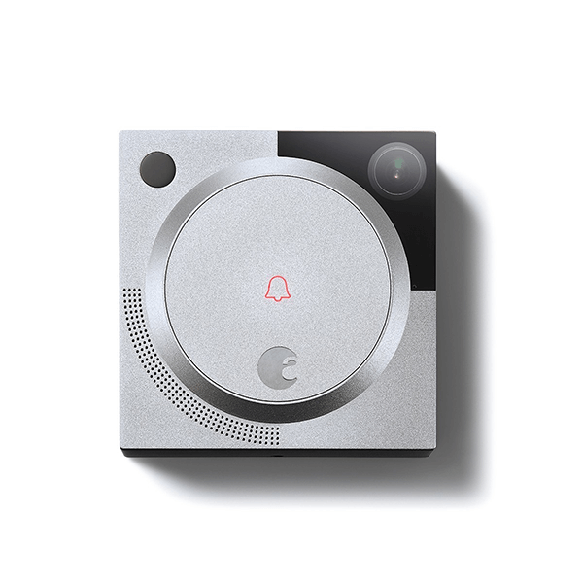


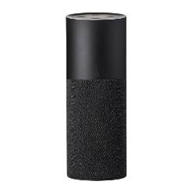
IoT-Fi
Wi-Fi IoT has been supported by 11b, 11n, and 11ax
  Power efficiency is not so good as the other technologies
  Other technologies cannot coexist with Wi-Fi very well
Target of IoT-Fi: work with main stream Wi-Fi in both 2.4GHz and 5-7GHz very well with more efficient power consumption
Voice/Video
Voice
Control
Control
Data Report
Sensors,
Meters,
…
Voice
Control/Voice

Slide 13
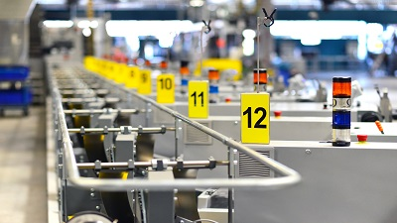
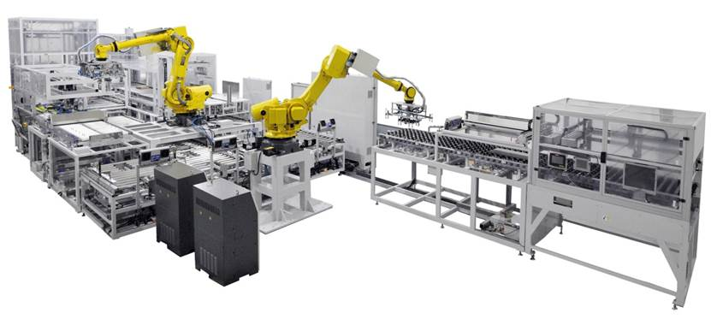
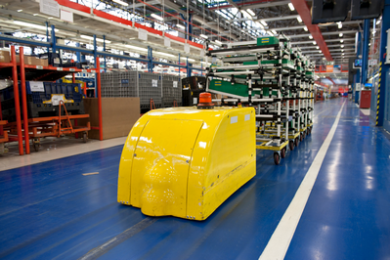

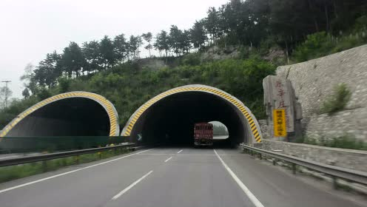

Industrial Wi-Fi
Industrial 4.0 requires lots of intelligent equipment and operation
Wi-Fi should play a key role in the connection
Textile Industry:
Interconnection of Devices
Assembly Line:
Control of Robotic Arms
Warehouse:
Location of Materials;
Location and Control of Robots
Chemical/Materials:
Wireless Monitoring and remote management
Highway Management:
Video Backhaul and Equipment Tracking
Manufacturing:
Wireless monitoring and Management of Equipment

Slide 14
Requirement of Industrial Wi-Fi
There are many systems in industrial scenario operating independently, e.g., monitoring system, mechanical control, system maintenance, etc. → Wi-Fi can be a united access method for all the systems.
Detailed Requirements of Industrial Wi-Fi
  Latency
  More reliable transmission→ Overcome interference, temperature change, etc.
  Security
Scenarios | Automation | Monitoring | Mechanical Control | Motion Control
Latency | <50ms | <100ms | 10-50ms | <10ms

Slide 15
Summary of Requirements
Enhanced PHY link throughput
  Compared to 11ac, 11ax only has minor enhancement on link throughput
  NG should has significant throughput enhancement over 11ax. For example, peak throughput: 40Gbps?
Enhanced AP throughput
  Larger number of users per AP than 11ax
Reliable Transmission
  Lower PER
Latency
  Less than 5-10ms for VR application
  Less than 10-100ms for Industrial Wi-Fi
Network Efficiency
  Further mitigate inter-BSS interference
Power Efficiency
  Similar to other low power technologies at IoT only STA side

Slide 16
Discussion of Candidate Technologies
For example, the following technologies can be considered based on requirements
To match the proposed approaches on standard development, the above features can be grouped as follows for instance assuming that features ① - ⑦ are adopted
PHY Link Throughput
① Full Duplex (Co-channel STR)
VR/Video
AP Throughput
② AP Collaboration
Reliable Transmission
③ Larger Bandwidth
IoT-Fi
④ More Spatial Streams
Network Efficiency
Industrial Wi-Fi
⑤ IoT Mode narrower than 20MHz
Power Efficiency
Latency
⑥ Multi-Band Operation (Channel Aggregation, more scheduling, etc)
⑦ New Modulation/Coding
⑧ HARQ
⑨ Enhanced Spatial Reuse
Project1/Phase1: ③⑥
Project2/Phase2: ④②①
Project3/Phase3: ⑤⑦

Slide 17
Way Forward
Consider the following between now and the end of July plenary:
  for the Working Group to take a deep dive on the standards development process and see if any improvement is needed.
  for the WNG SC to discuss on and prioritize features of next PHY/MAC amendment if the direction is to consider PARs with narrow focus.

Slide 18
Thank You

Slide 19
Reference
[1]. http://sd.iqilu.com/share/article/4642056.html
[2]. http://wearablesinsider.com/2017/02/e-skinny-xenomas-smart-shirt/
[3]. http://www.fxiang.com/item/id/VlGkaW37aQEA.html
[4]. http://toc.cassianetworks.com/collections/products/light/
[5]. 11-13-0657-06-0hew-hew-sg-usage-models-and-requirements-liaison-with-wfa

Slide 20
SP1
Which option on page 6 and 7 do you like to speed up the standard development of a major PHY/MAC project?
  Option 1
  Option 2
  Abs
  Neither/Other option

Slide 21
SP2
Do you agree the use cases listed on page 8 should be considered in the next gen development?
  Video Transmission (Y/N/Abs)
  IoT-Fi (Y/N/Abs)
  Industrial Wi-Fi (Y/N/Abs)

