Slide 1
Efficient TDD slot schedule mechanism
Date: 2018-05-08
Authors:
Name | Company | Address | Phone | Email
Saehee Bang | LG Electronics |  |  | saehee.bang@lge.com
Kiseon Ryu |  |  |  | kiseon.ryu@lge.com
JinMin Kim |  |  |  | jinmin1230.kim@lge.com
JinSoo Choi |  |  |  | js.choi@lge.com
SungJin Park |  |  |  | allean.park@lge.com
SunWoong Yun |  |  |  | Sunwoong.yun@lge.com
Sang G. Kim |  |  |  | sanggook.kim@lge.com
Solomon Trainin | Qualcomm |  |  | strainin@qti.qualcomm.com
Kazuyuki Sakoda | Sony |  |  | Kazuyuki.Sakoda@sony.com

Slide 2
Introduction
Scheduling for mmWave Distribution Networks was proposed. [1]
We propose an efficient method to schedule the repeatedly allocated TDD slots by reducing the signaling overhead of the TDD Slot Schedule element

Slide 3
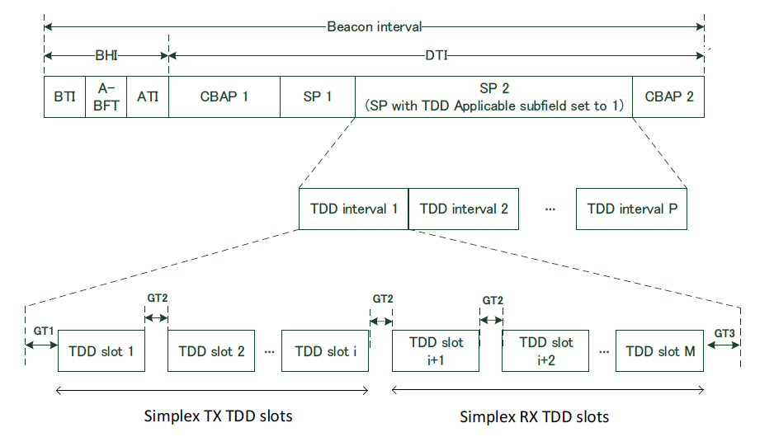
Recap [1]
According to [1] , a scheduling structure for the mmWave network is defined.

Slide 4
Issue
For DMG STAs that are continuously connected, the same scheduling may be repeated over the TDD SP as following cases :
  Odd and even nodes (DN) can be transmitted periodically over the TDD SP. [2]
  Or other low level use case [3] :
    Display
    TV / sound equipment (speaker)
The AP/PCP can indicate the repeated TDD SPs over multiple BIs by setting the Allocation Block Duration validity subfield to 0 in the TDD Slot Structure element. However, TDD Slot Schedule element does not include this kind of indication.
TDD Slot Schedule element shall include the TDD slot bitmap information for all TDD intervals indicated by the TDD Slot Schedule element even though the same TDD slots over multiple TDD intervals are assigned to a STA.
We propose the efficient signaling method to reduce the overhead of the repeated TDD slot assignment

Slide 5
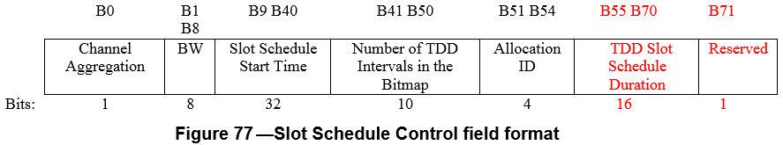
Proposal
An AP can indicate whether or not the TDD slot schedule is repeated by the proposed TDD Slot Schedule Duration subfield in the TDD Slot Schedule element.
Followings are the proposed text:
  TDD Slot Schedule Duration subfield indicates the duration from the start of the first TDD interval to the end of the last TDD interval in which the schedule takes effect.
  The Bitmap and Access Type Schedule and the Slot Category Schedule of the TDD slots covered by the bitmap are repeated during the time indicated in the TDD Slot Schedule Duration field
  TDD Slot Schedule Duration subfield size is 16 bits and indicated with the unit of us.

Slide 6
Summary
We propose the method to reduce the overhead of TDD Slot Schedule element.
  By reducing the overhead of the TDD slot bitmap information which is repeated
  By reducing the overhead of the Announce frame which contains the same TDD slot schedule information
We propose the modification of TDD Slot Schedule element as follows :
  The TDD Slot Schedule Duration subfield to indicate the duration of the TDD intervals including TDD slots allocated to a STA.

Slide 7
Straw poll
Do you agree to include the text for TDD slot schedule duration mechanism proposed in (11-18-0842-00-00ay-Efficient TDD slot schedule mechanism) to the spec draft?

Slide 8
Reference
[1] Draft P802.11ay_D1.0
[2] 11-17-1321-00-00ay-features-for-mmw-distribution-network-use-case
[3] 11-18-0194-01-00ay-distribution-network-use-case-for-consumer-devices

Slide 9
Annex (Analysis)
Assumption (refer to IEEE 802.11-17/1321r0)
  Bandwidth grant duration: 25.6ms (16 superframes)
  Superframe: 1.6ms (4 frames)
  Frame(TDD Interval): 400us (6 slots)
  Slot: 66us
  Size of the Bitmap and Access Type Schedule subfield and Slot Category Schedule subfield in the TDD Slot Schedule element (X)
    Min: 1 TDD Interval, 6 slots: 2B+2B = 4 Byte.
    Max: 64 TDD Intervals, 384 slots: 96B +96B = 192 Byte
  Size of the TDD Slot Schedule element (Y)
    Min: 10+4=14B
    Max: 10+192=202B

Slide 10
Annex (Analysis)
Result
  If 2 TDD Intervals are assigned to a STA and 1 repetition is applied,
    The overhead of (X) is reduced from 8B to 4B and the overhead of (Y) is reduced from 18B to 14B.
    Then, we can get 50% overhead reduction of (X) and 22% overhead reduction of (Y).
  If 64 TDD Intervals are assigned to a STA and 1 repetition is applied,
    The overhead of (X) reduced from 192B to 96B and the overhead of (Y) is reduced from 202B to 106B.
    Then, we can get 50% overhead reduction of (X) and 48% overhead reduction of (Y).
  If MCS 1 is applied for two cases above,
    For the first case, transmission time is reduced from 0.374us to 0.29us.
    For the second case, transmission time is reduced from 4.2us to 2.2us.
If we allow more than 1 repetition, then the gain is increased dramatically.

