Slide 1
Co-existence of Distribution Nodes and Short Range Devices
Date: May 23, 2018
DCN: 11-18-0833-01-00ay
Name | Affiliation | Address | Phone | Email
Aditya V. Padaki | Samsung Research America | 1301 E. Lookout Dr, Richardson, TX 75082, USA. |  | a.padaki@samsung.com
Jianhua Mo |  |  |  | jianhua.m@samsung.com
Boon Loong Ng |  |  |  | b.ng@samsung.com
Charlie Zhang |  |  |  | jianzhong.z@samsung.com

Slide 2
Overview
Introduction
  Why co-existence important?
  What’s been done until now?
  What’s lacking?
Problem Setup
  Interference heat maps
  SINR CDFs
  Throughput CDFs
Simulation Parameters
Simulation Results
NOTE: In this presentation, ‘Tx Power’ means EIRP.

Slide 3
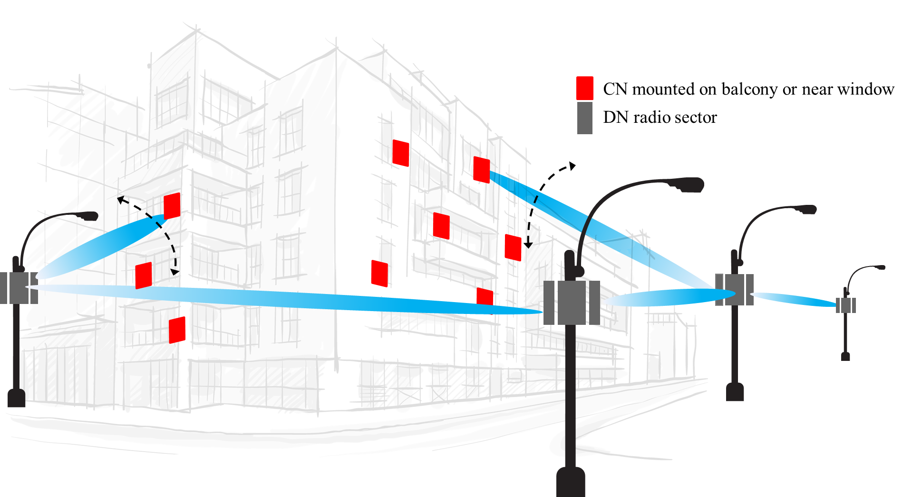
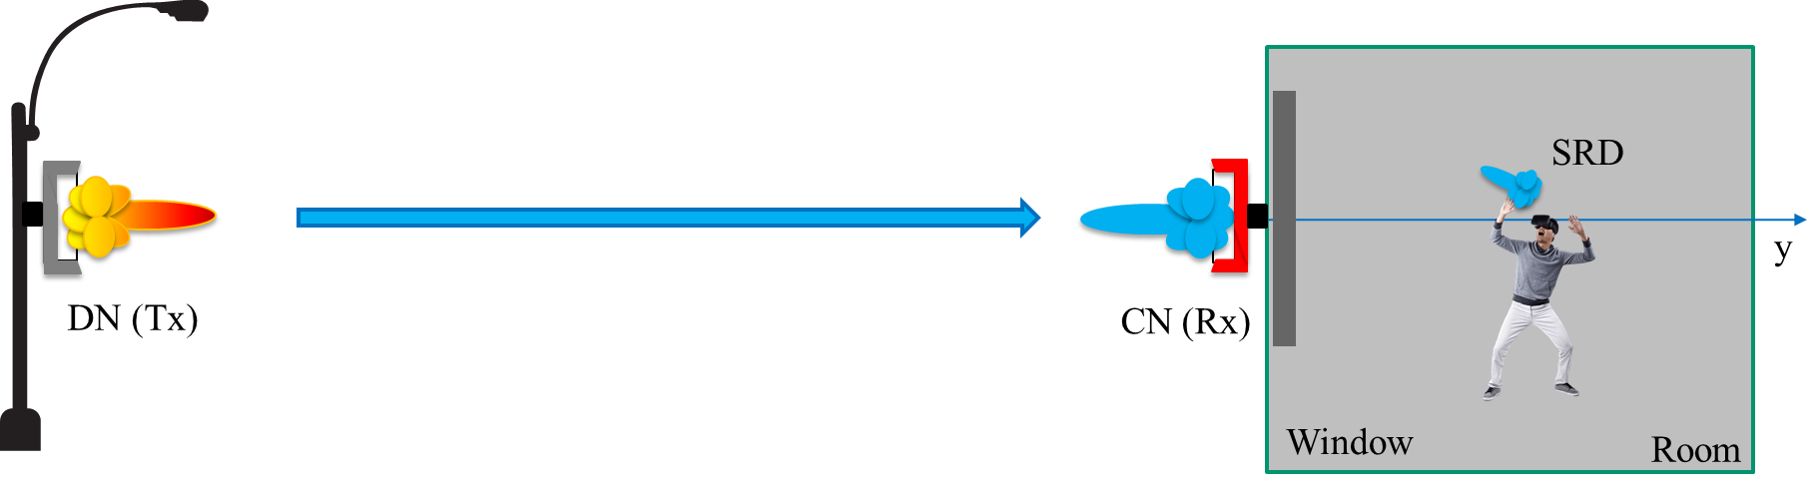
Introduction
Distribution Nodes (DN) may impact the Short Range Devices (SRD)
Ensuring co-existence between DN and SRD is important to design and deployment of distribution network
Extensive co-existence analysis is required to protect SRDs
Experimental studies have been carried out in the previous contributions [1][2]
Analysis for more test cases and DN deployment scenarios required
Ways to enhance co-existence need to be studied
Figures source: IEEE 802.11-18/0131r0
Notes:
131, 488

Slide 4
Co-existence Study Simulations
Intuitive presentation of interference power experienced by SRDs
  Interference power heat map as a function of SRD distance, height, and antenna pattern
  Generation of received (interference) power CDF
Given SRD link is established, study the performance degradation
  What is the impact of DN operation on SRD throughput?
  Simulations to generate CDFs of SINR and data rate for various scenarios

Slide 5
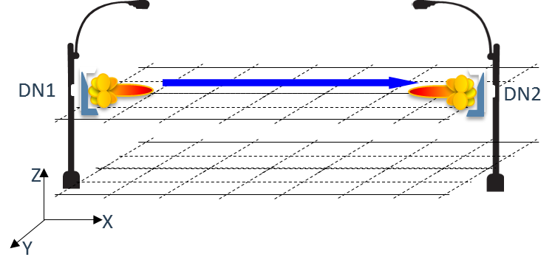
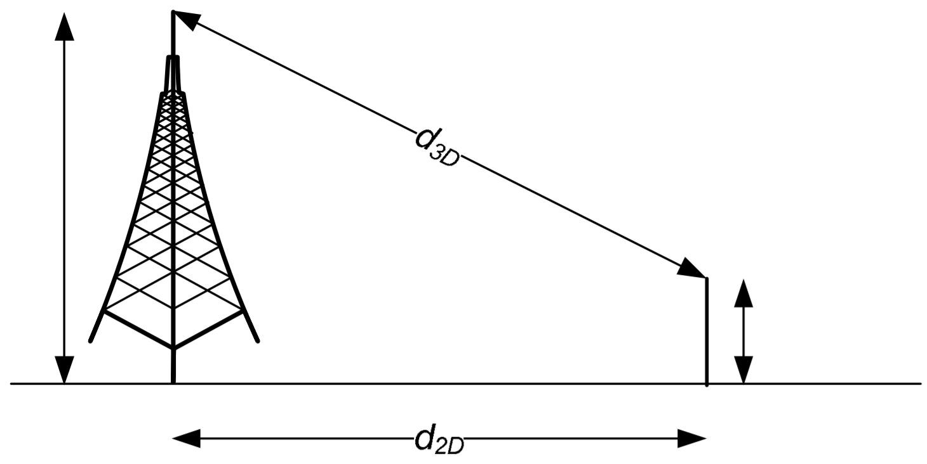
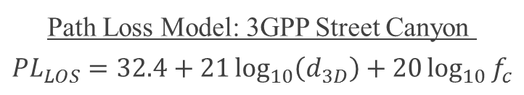
Generation of Interference Heat Map
Fix the parameters
  Locations of FWA Tx and FWA Rx,
  Tx power
  Antenna array configuration/beam pattern
Form layers of 2-D grids at various vertical heights
Compute the Rx power at each intersection of the grid lines
  3GPP Street Canyon path loss model for 60 GHz [3]
Assume omni-directional Rx antenna for SRD devices for the purpose of CCA threshold calculation
Repeat for different parameters
Path Loss Model: 3GPP Street Canyon
$$PL_{LOS}=32.4+21\log_{10}\left(d_{3D}\right)+20\log_{10}{f_{c}}$$

Slide 6
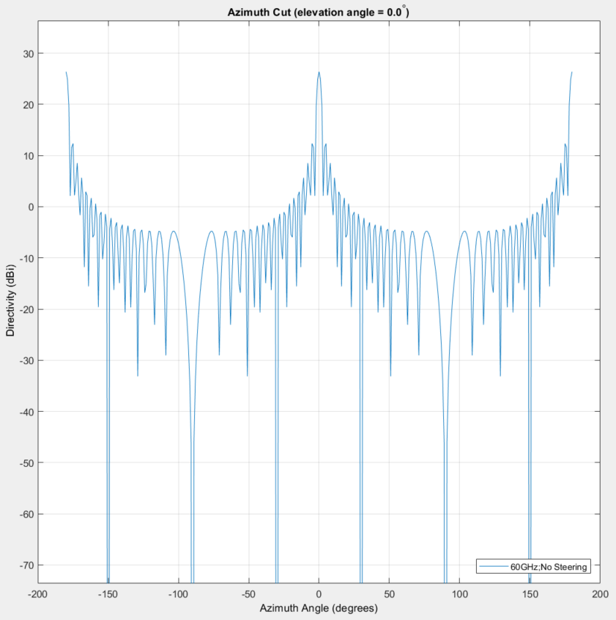
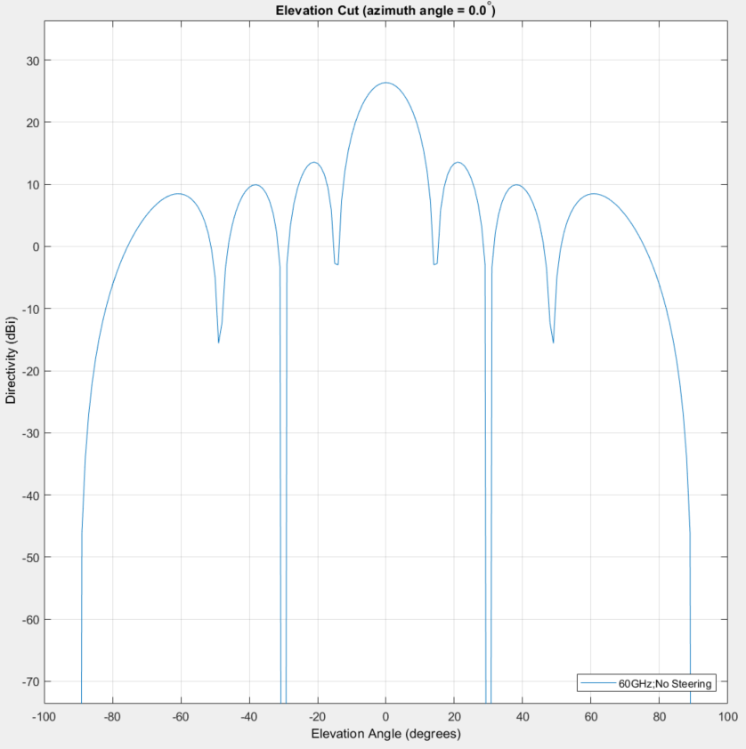
DN Antenna directivity pattern (36Hx8V)

Slide 7
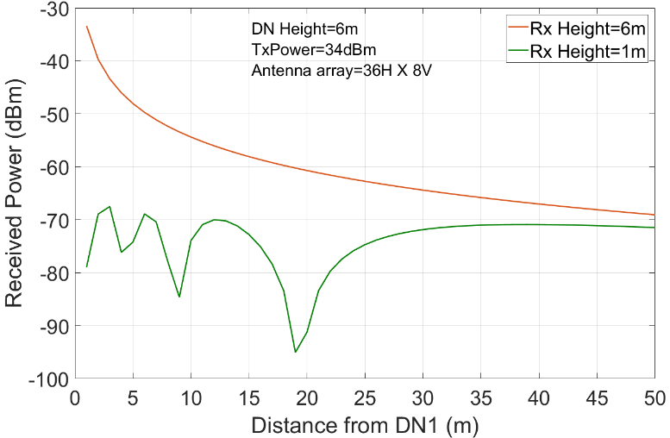
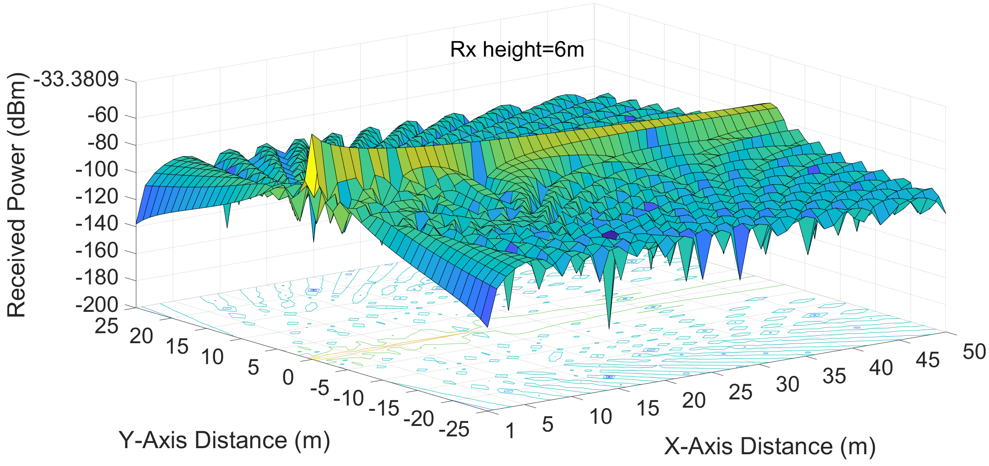
Interference Heat Map
Example interference heat map for SRD Rx Height=6m (worst case scenario)
Signal level drops considerably
Received Power level along y=0 for two levels of Rx height
Results similar to [2]

Slide 8
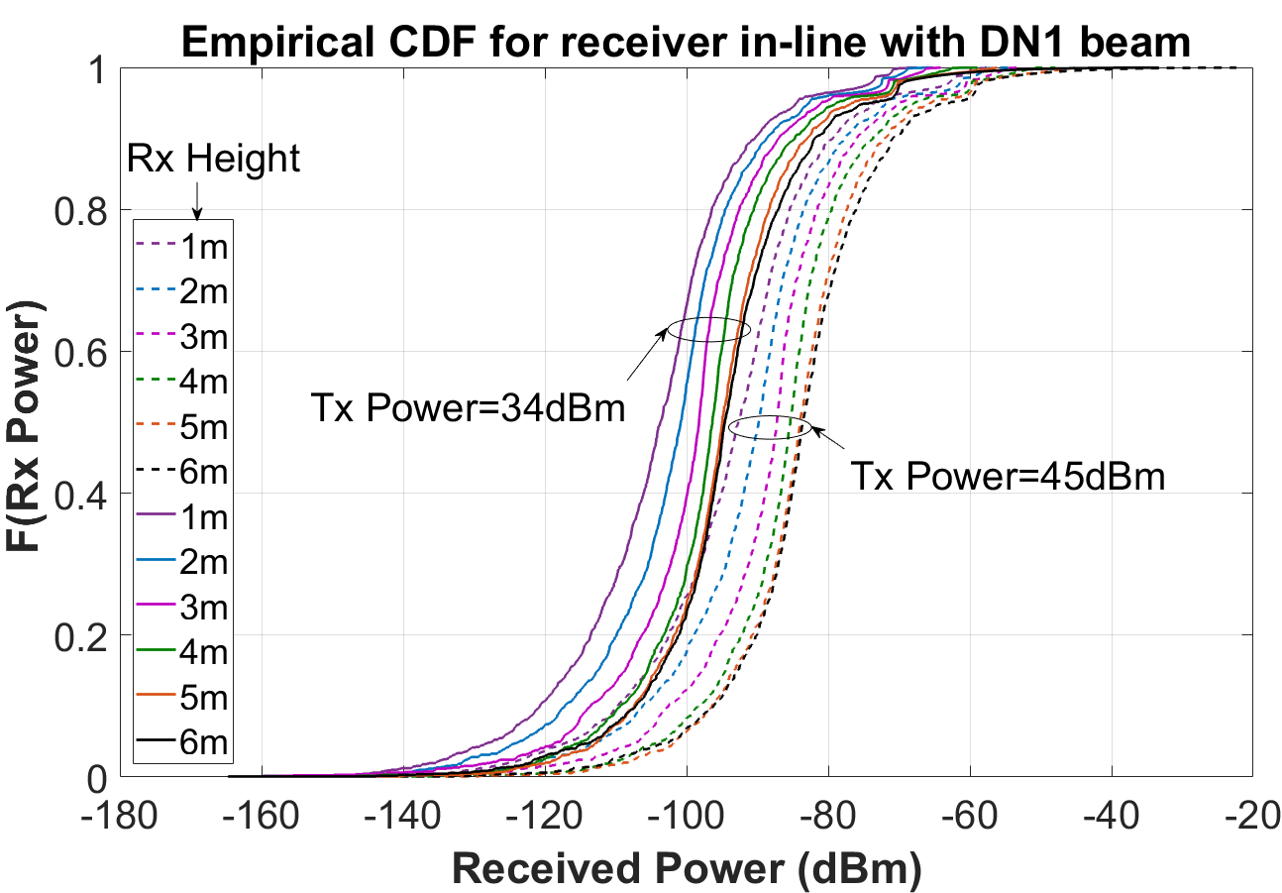
CDFs of Interference Received Power
(power control)
Use the data collected to generate CDFs of received power
Intuition for different types of scenarios
CCA Threshold

Slide 9
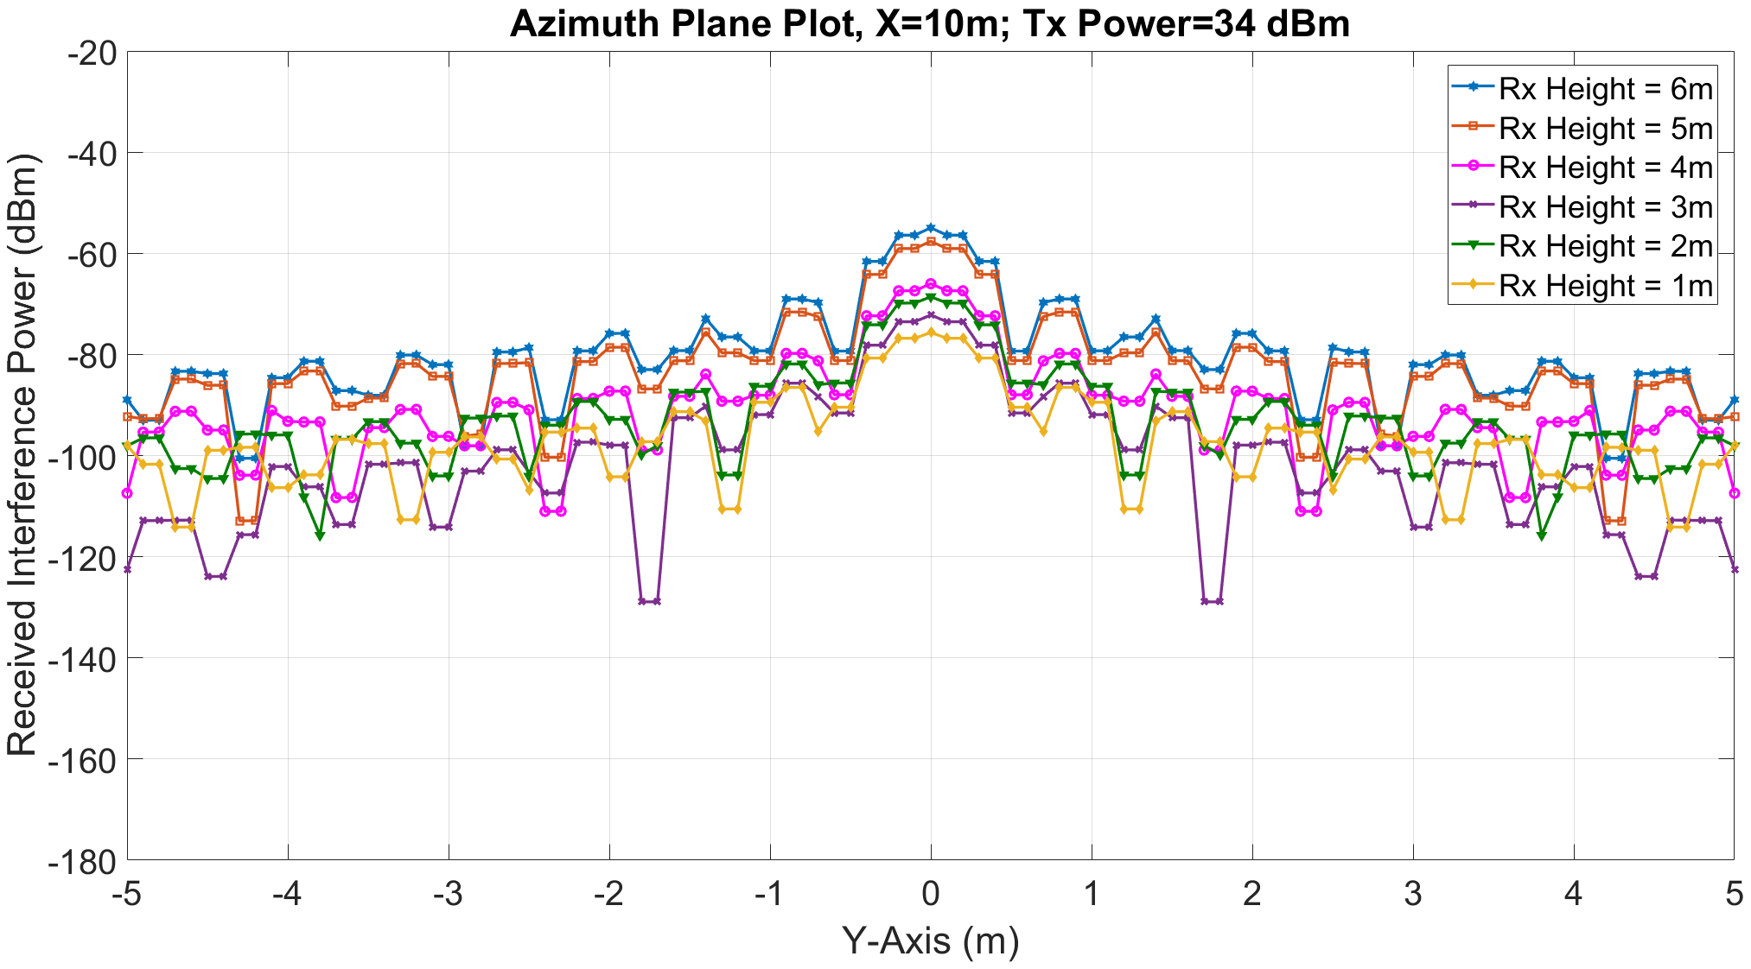
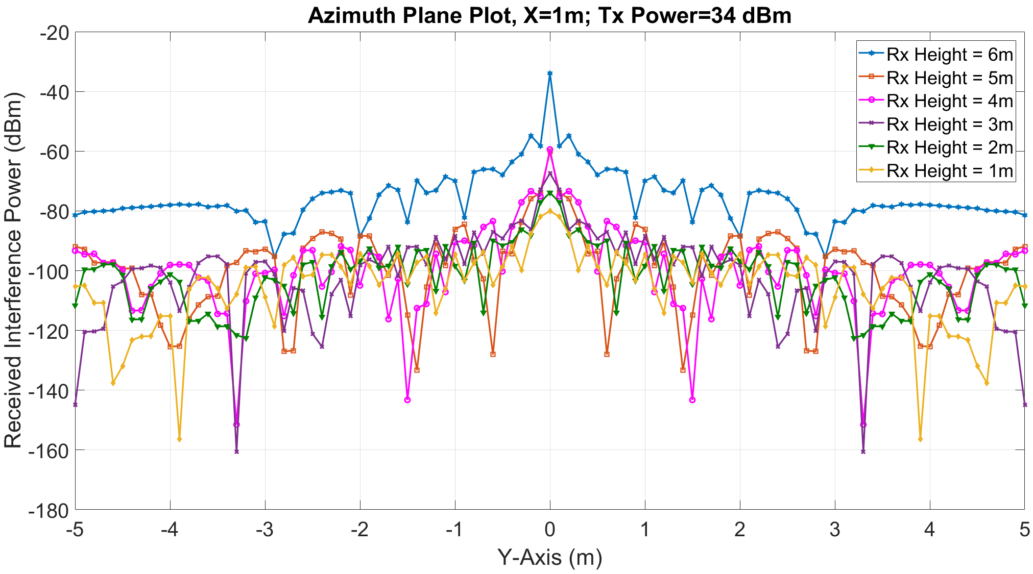
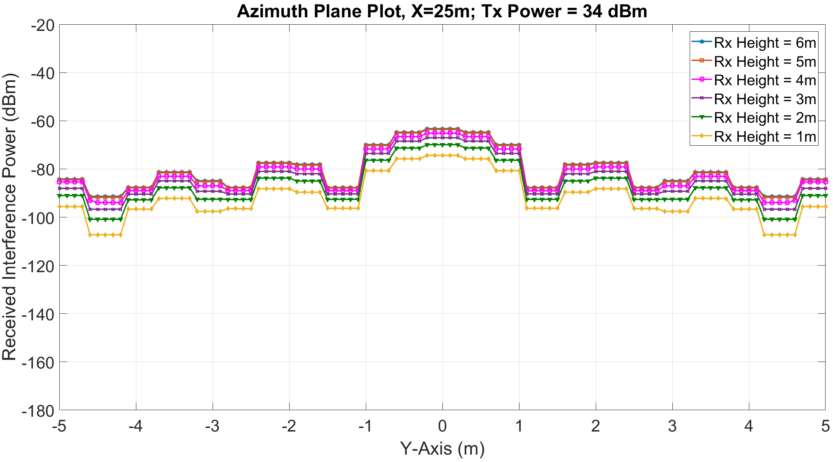
Azimuth-Elevation Variation of Interference
Received power drops with y-axis

Slide 10
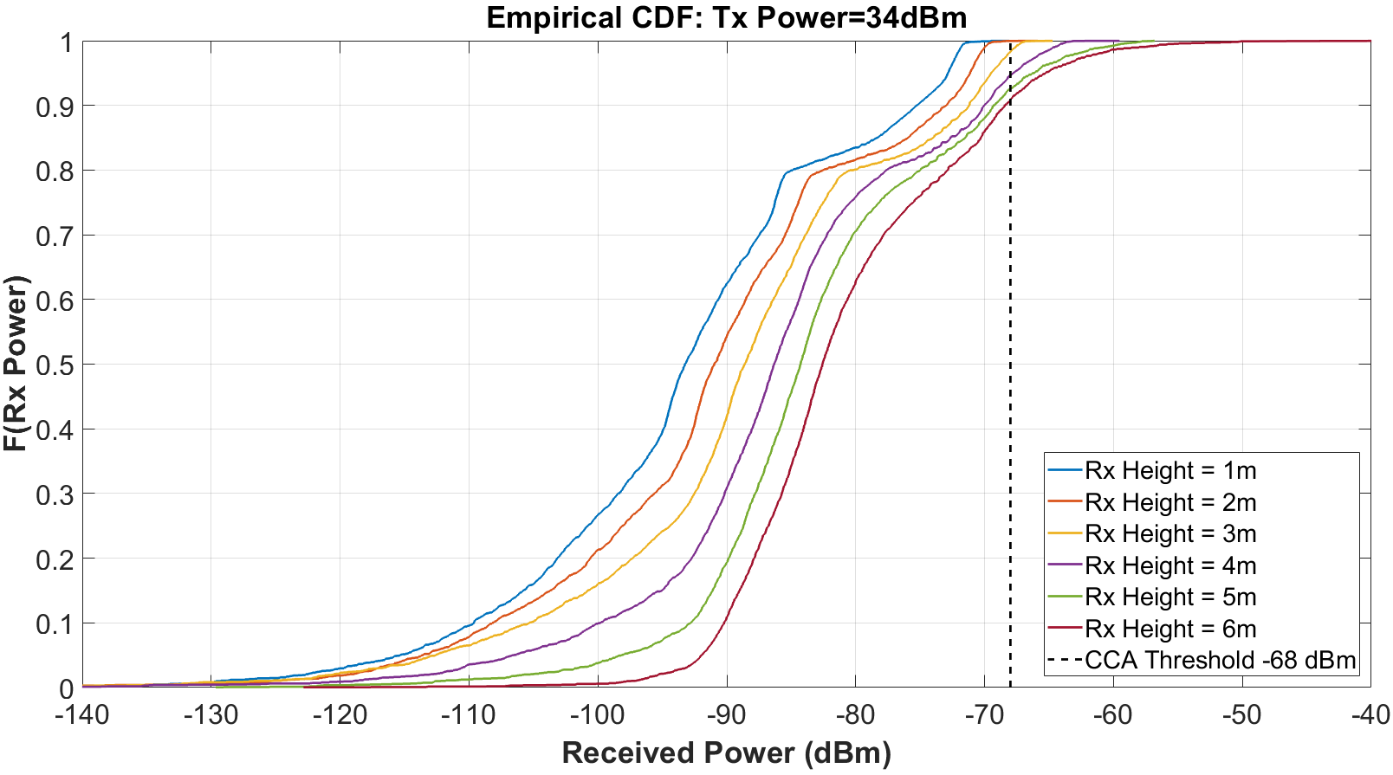
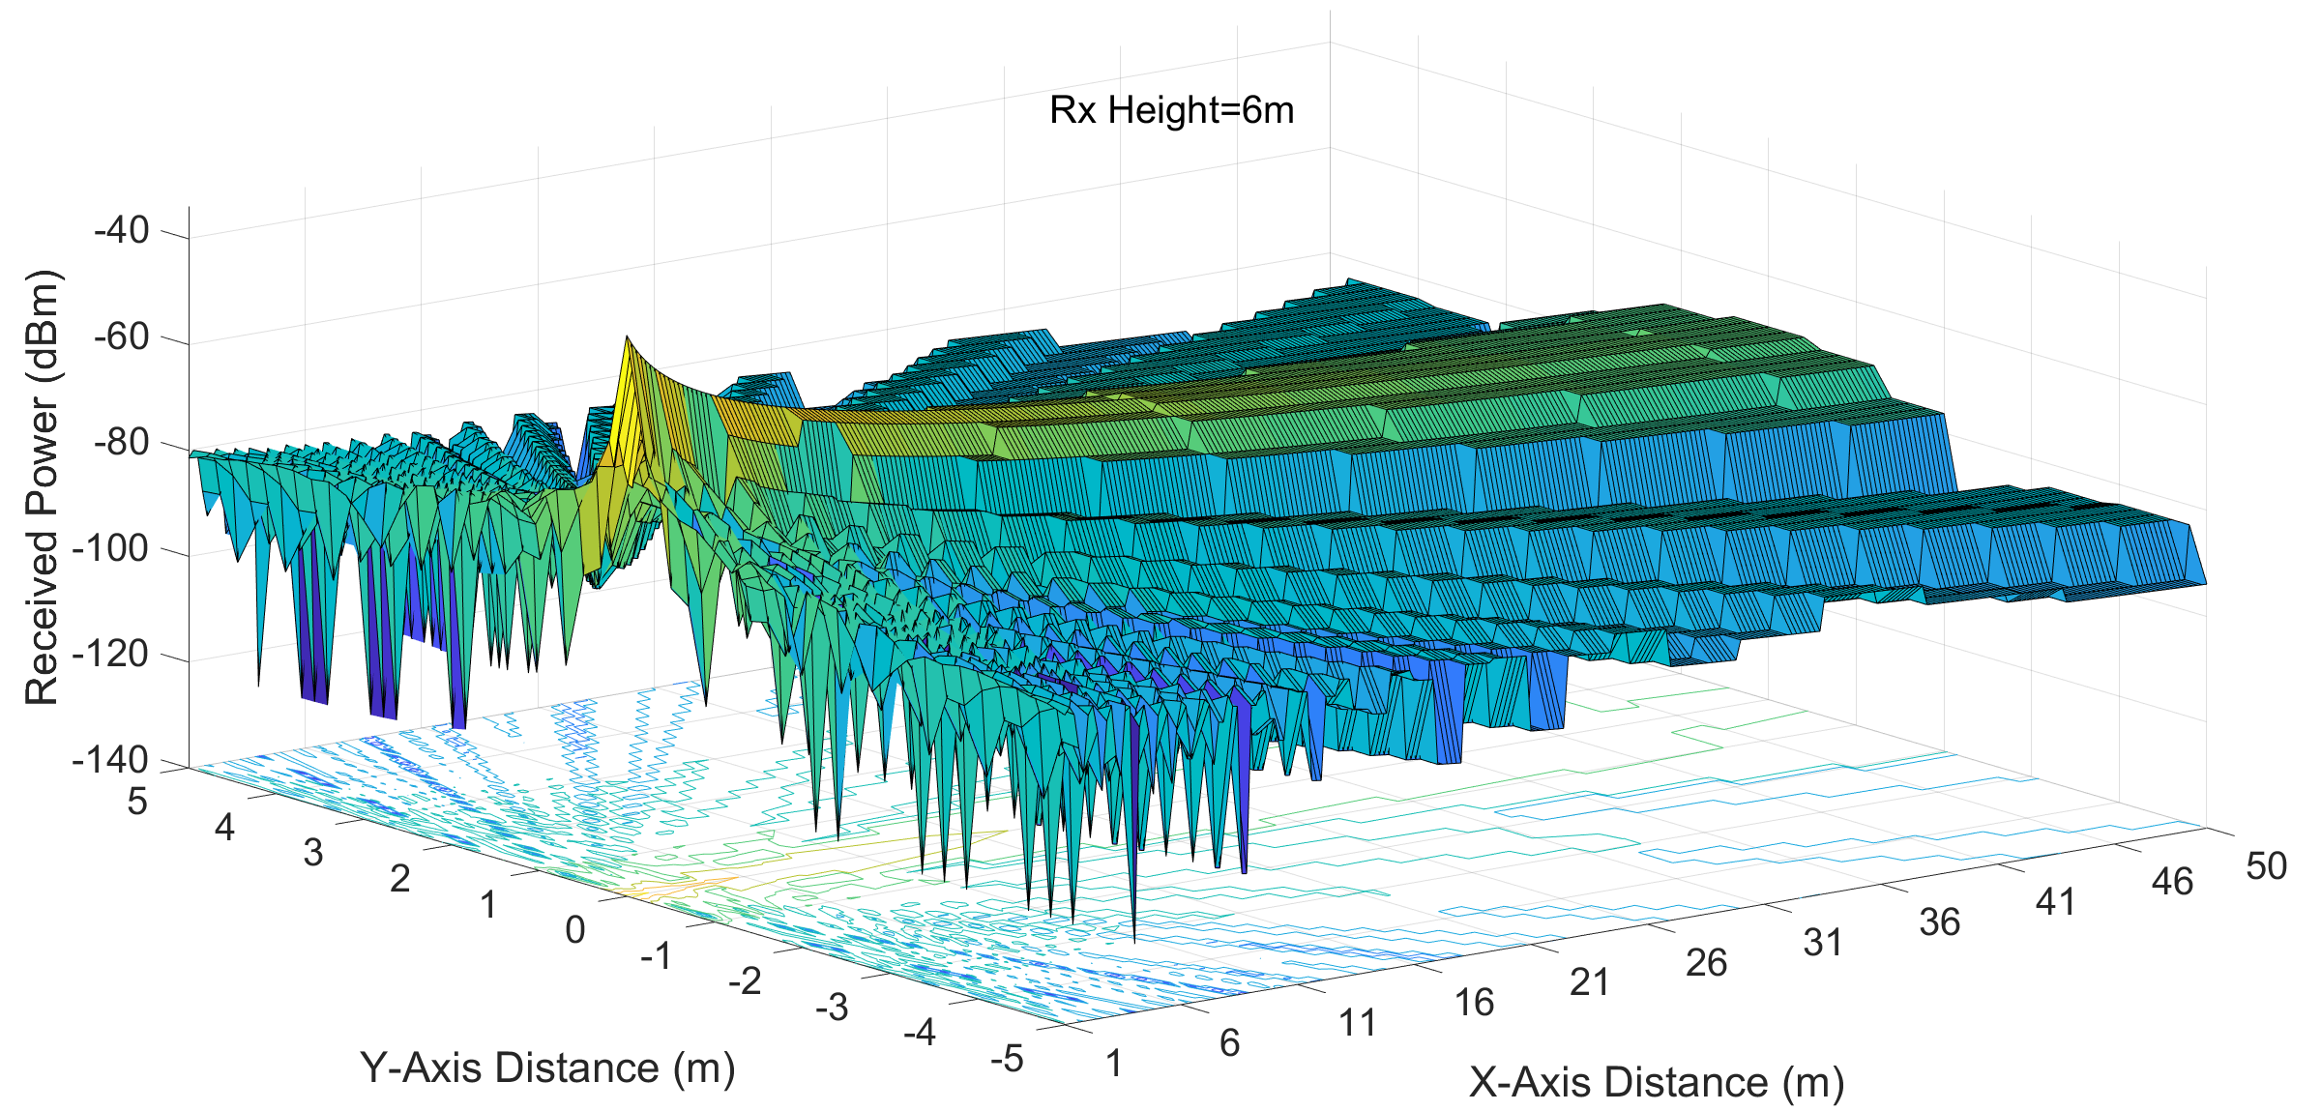
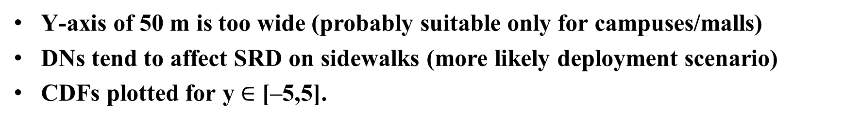
CDFs Y-Range 10m, X-Range 50m, Tx Power 34 dBm
Y-axis of 50 m is too wide (probably suitable only for campuses/malls)
DNs tend to affect SRD on sidewalks (more likely deployment scenario)
CDFs plotted for y $∈$ [–5,5].

Slide 11
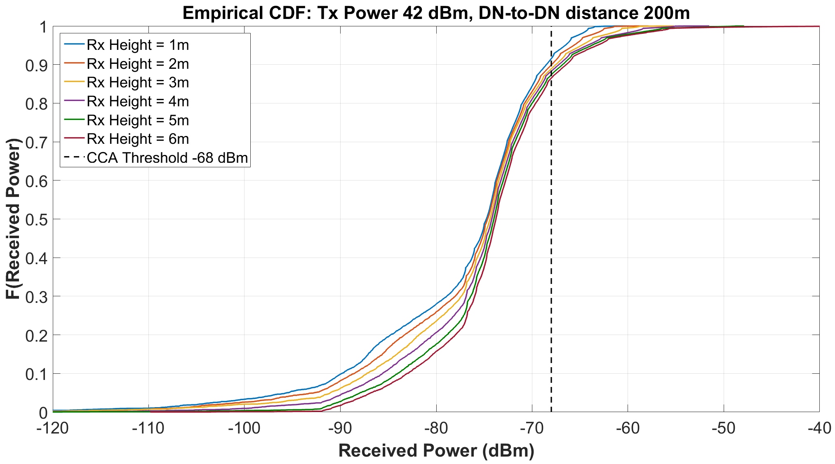
CDFs for X-Range 200m, Tx Power 42 dBm
The curves in this case are ‘closer’ to each other than the case with Tx Power 34 dBm and X-Range 50m
(We provide scatter plots on slide 13 for intuition on this aspect)

Slide 12
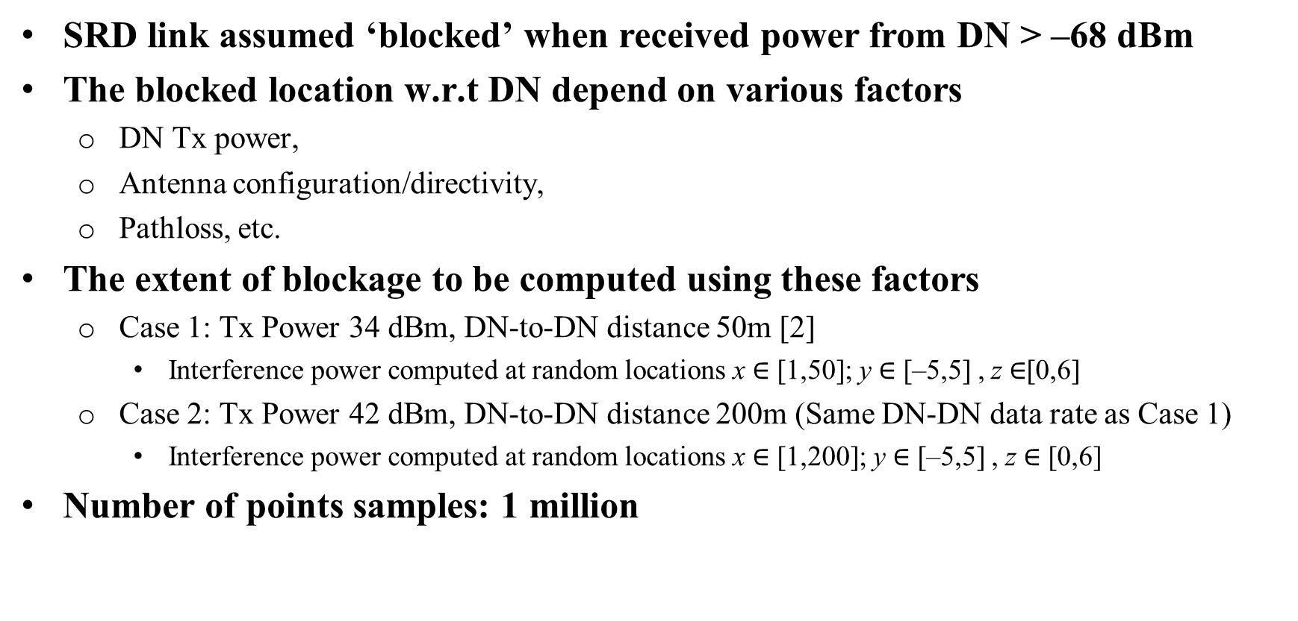
Locations of SRD Link Blockage
SRD link assumed ‘blocked’ when received power from DN > –68 dBm
The blocked location w.r.t DN depend on various factors
  DN Tx power,
  Antenna configuration/directivity,
  Pathloss, etc.
The extent of blockage to be computed using these factors
  Case 1: Tx Power 34 dBm, DN-to-DN distance 50m [2]
    Interference power computed at random locations x $∈$ [1,50]; y $∈$ [–5,5] , z $∈$[0,6]
  Case 2: Tx Power 42 dBm, DN-to-DN distance 200m (Same DN-DN data rate as Case 1)
    Interference power computed at random locations x $∈$ [1,200]; y $∈$ [–5,5] , z $∈$ [0,6]
Number of points samples: 1 million

Slide 13
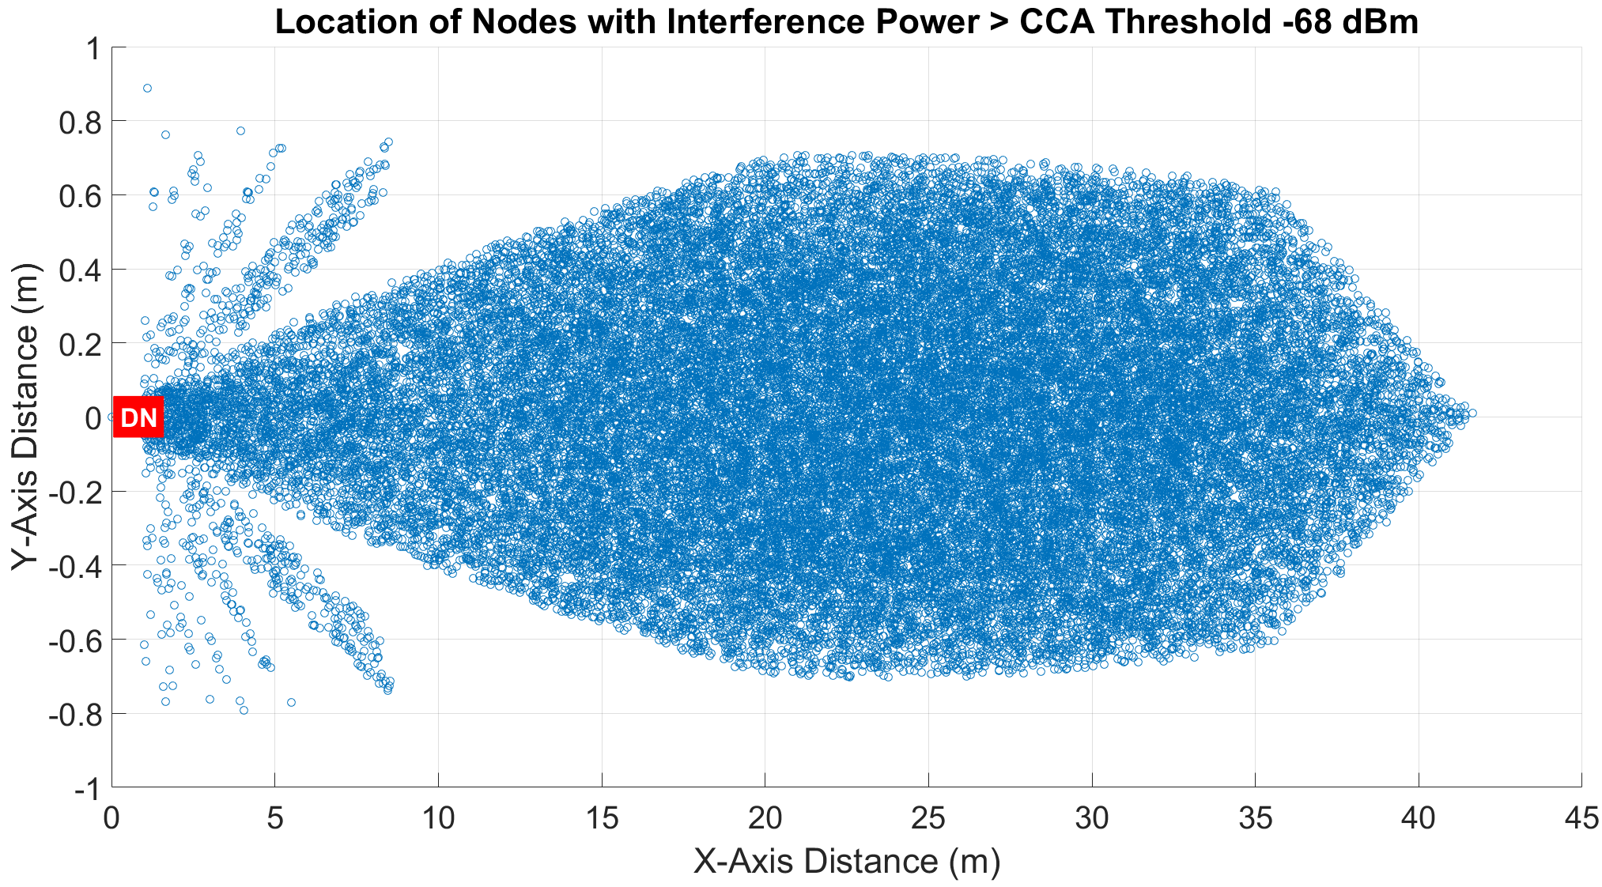
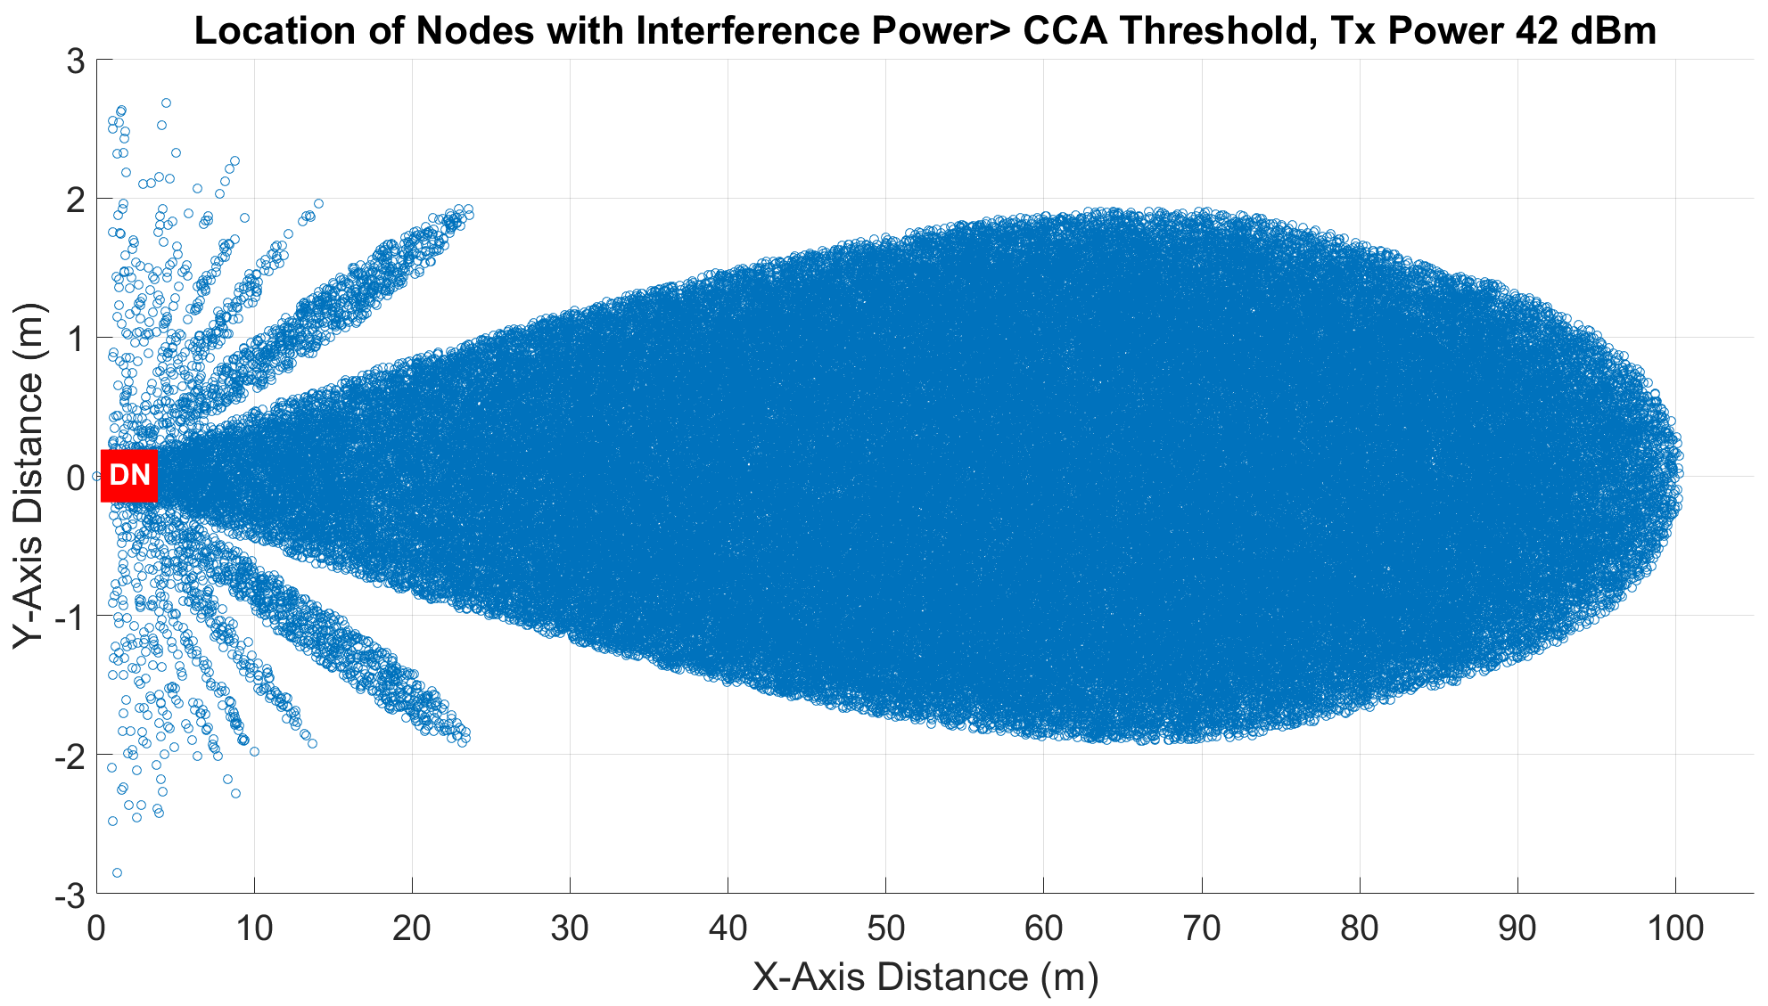
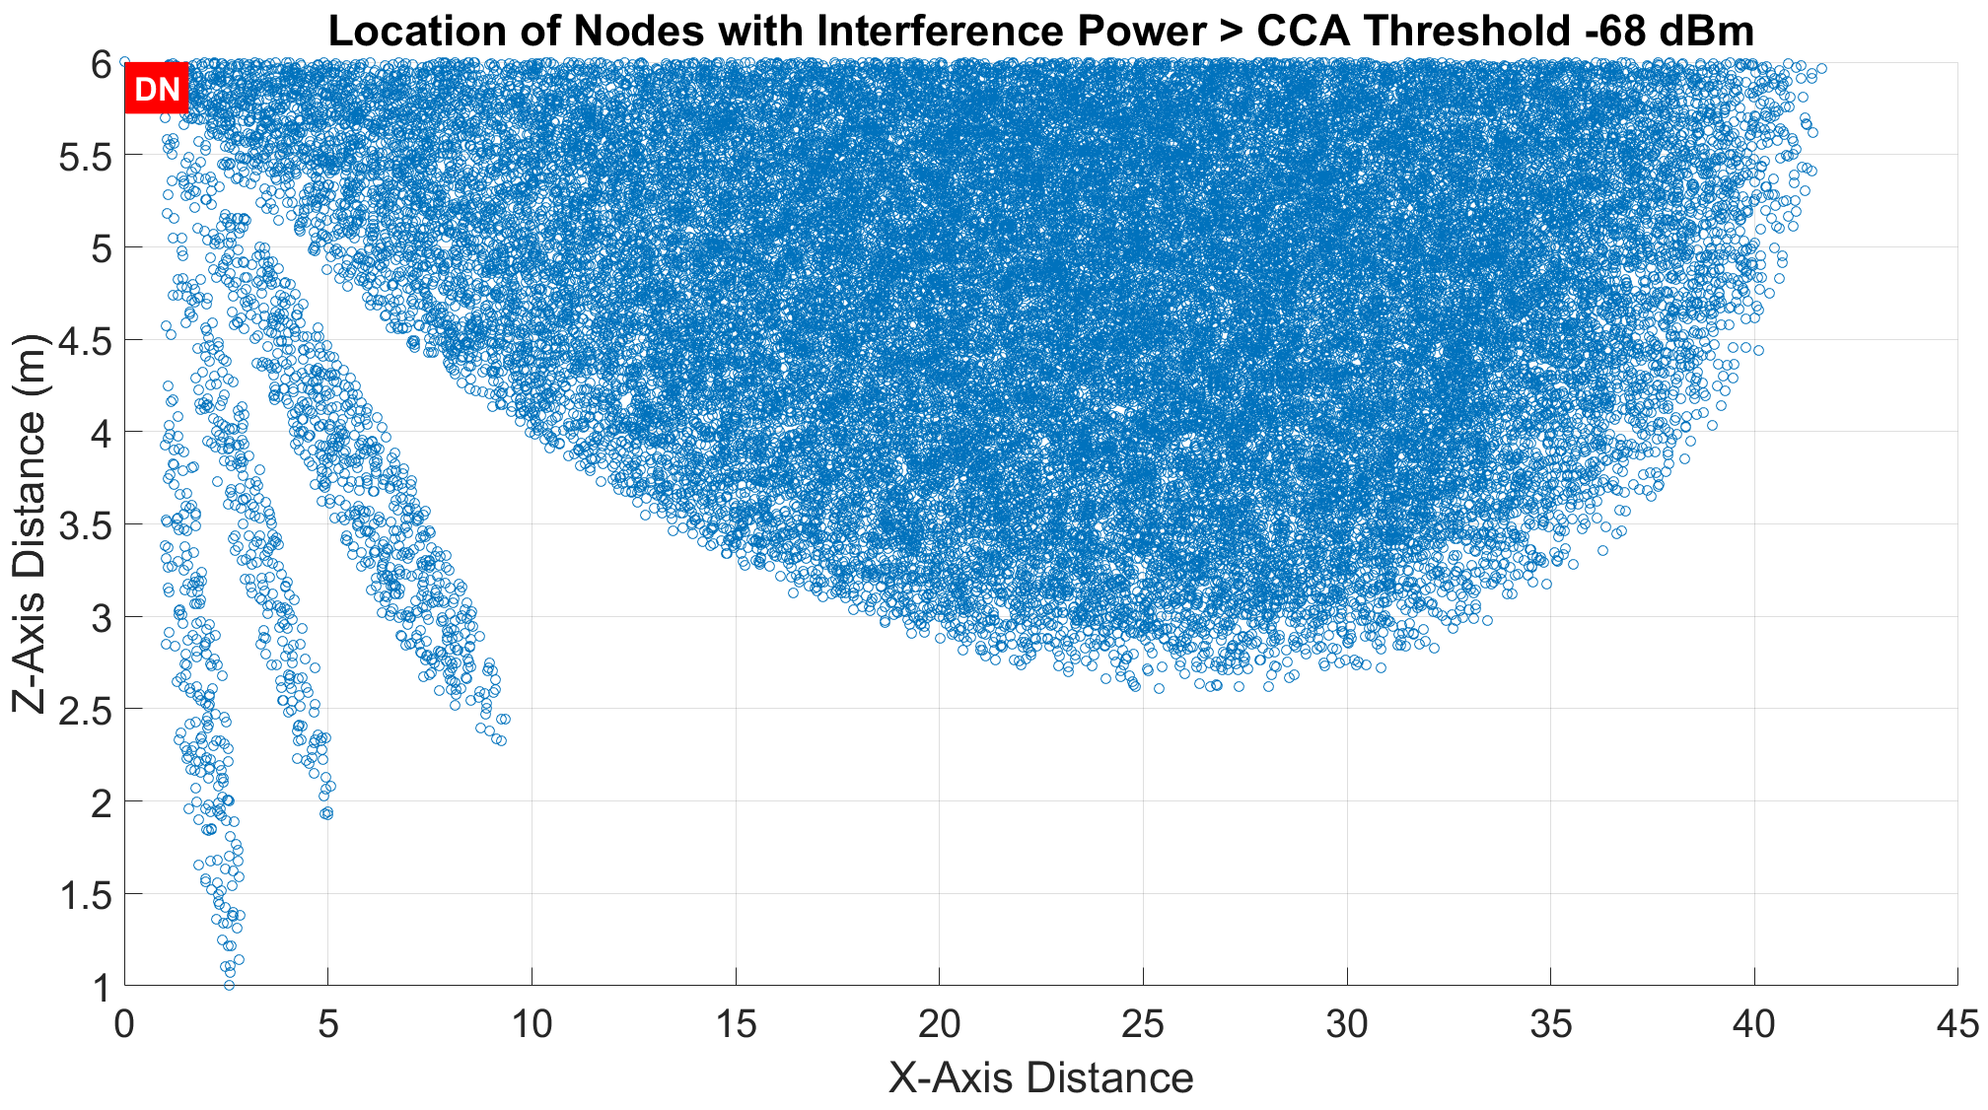
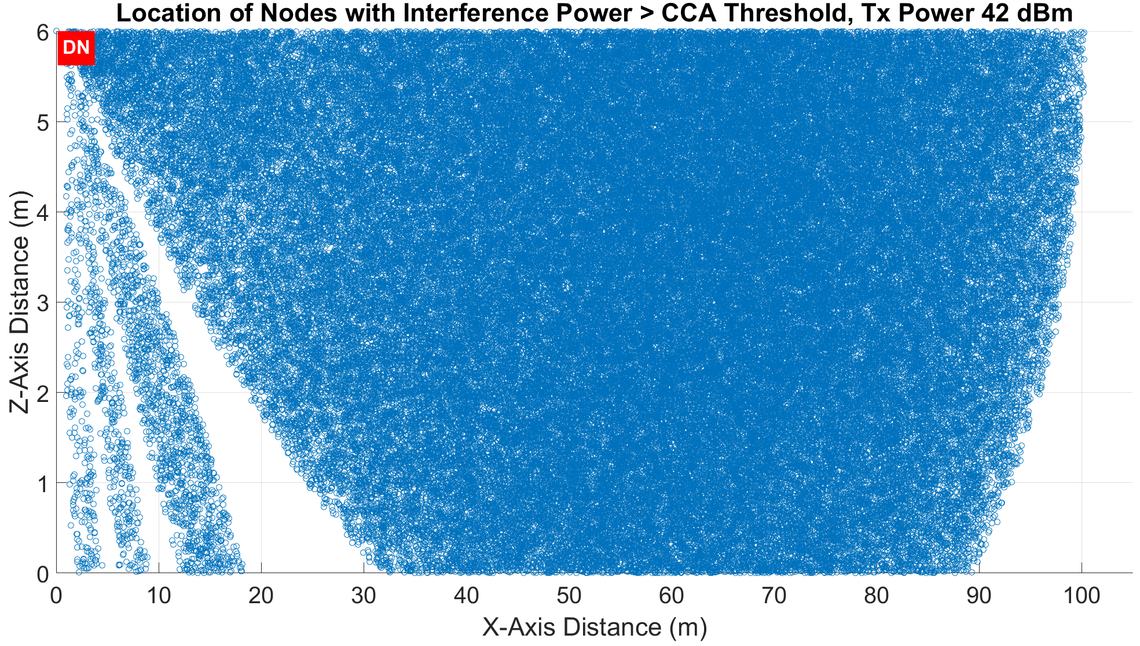
Visualization of Blockage
Case 1: Tx Power 34 dBm, DN-to-DN distance 50m
Case 2: Tx Power 42 dBm, DN-to-DN distance 200m

Slide 14
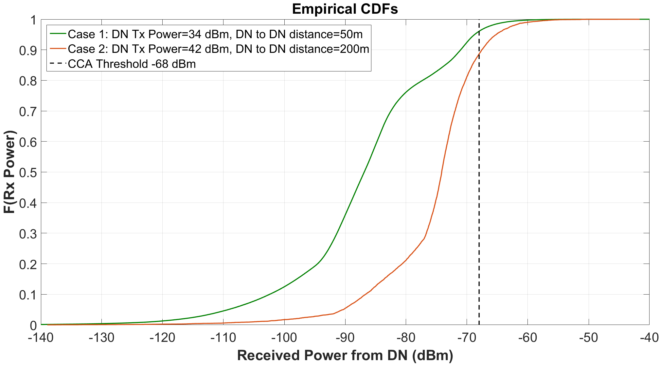
CDF of Received Interference Power from DN
Locations sampled uniformly at random
Two cases have the same DN-to-DN data rate
Even with DN Tx power control, DN-to-DN distance impacts co-existence
  Gives network deployment/design insights

Slide 15
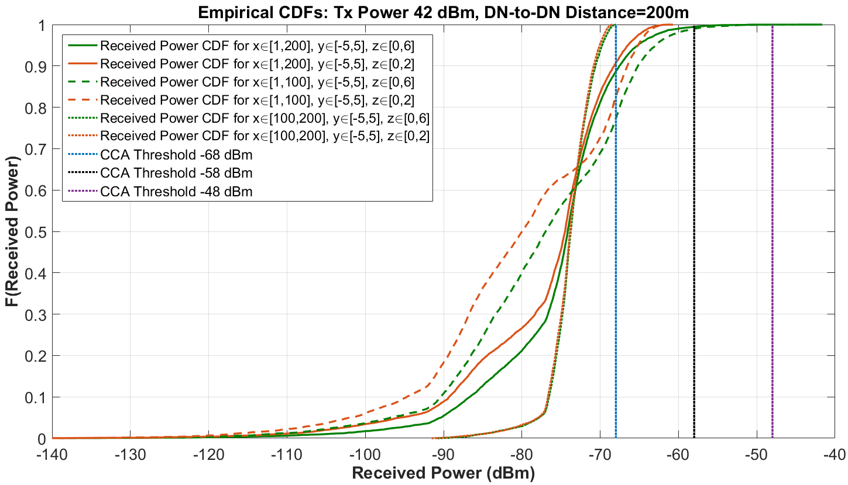
Received Interference Power Comparison:
DN-to-DN Distance = 200m, Target MCS 21 (SNR 26dB), Tx Power=42 dBm
Most locations ‘blocked’ within the ‘first half’ of X-Y plane

Slide 16
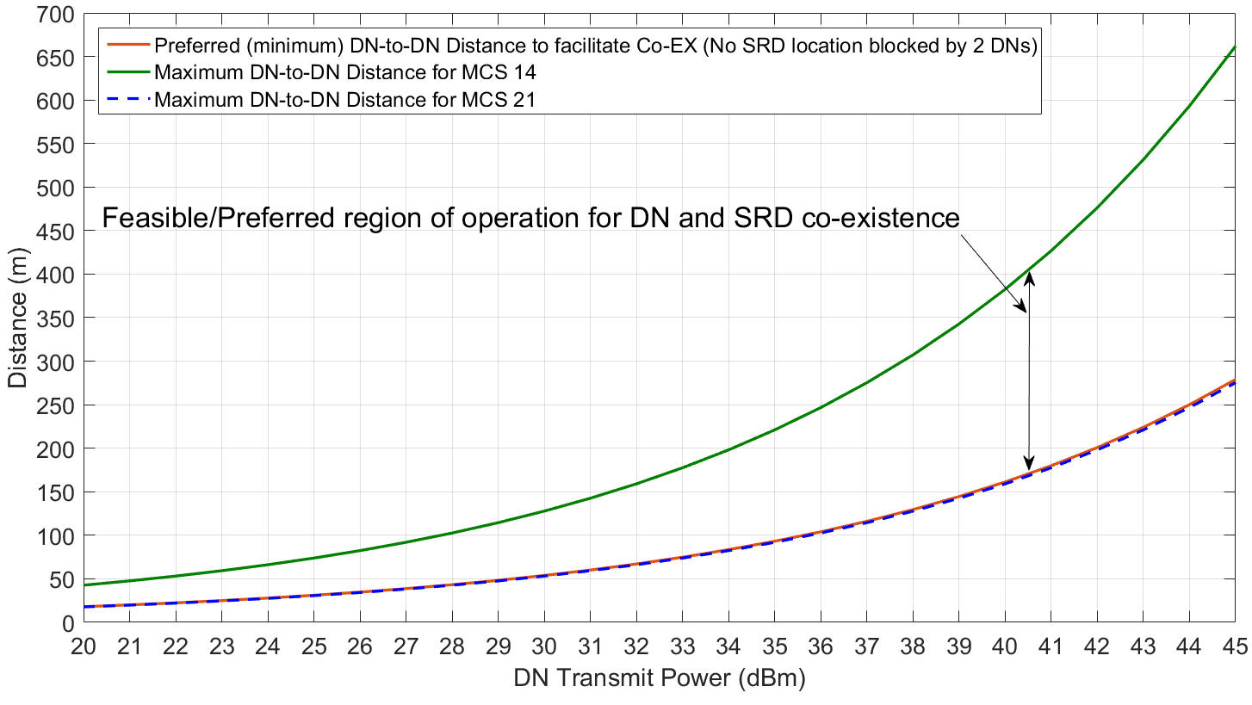
Ideal Operating/Deployment Regions
What should be DN Tx power and DN-to-DN distance so that
  DN target MCS is met
  DN-SRD co-existence is enhanced (no location faces interference from 2 DNs)
Curves shown for 2 sample MCS values (MCS14=SINR 18dB, MCS 21=SINR 26dB)

Slide 17
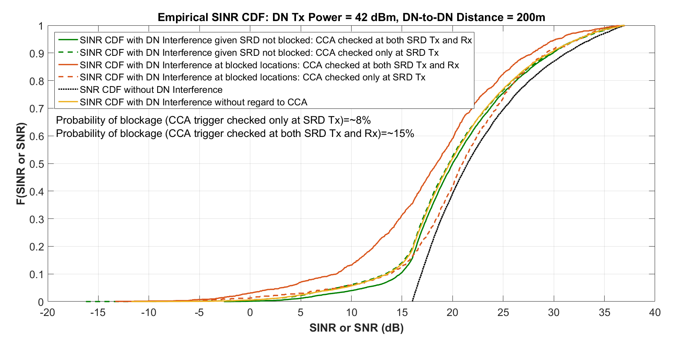
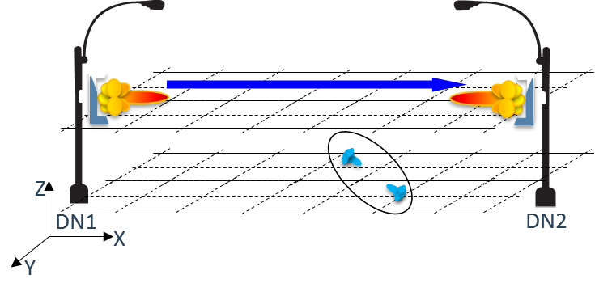
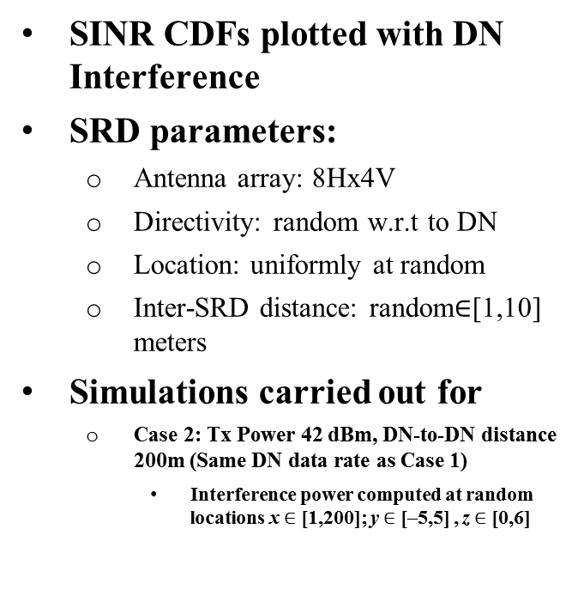
SINR CDFs for DN-to-DN Distance of 200m with MCS 21
SINR CDFs plotted with DN Interference
SRD parameters:
  Antenna array: 8Hx4V
  Directivity: random w.r.t to DN
  Location: uniformly at random
  Inter-SRD distance: random$∈$[1,10] meters
Simulations carried out for
  Case 2: Tx Power 42 dBm, DN-to-DN distance 200m (Same DN data rate as Case 1)
    Interference power computed at random locations x $∈$ [1,200]; y $∈$ [–5,5] , z $∈$ [0,6]

Slide 18
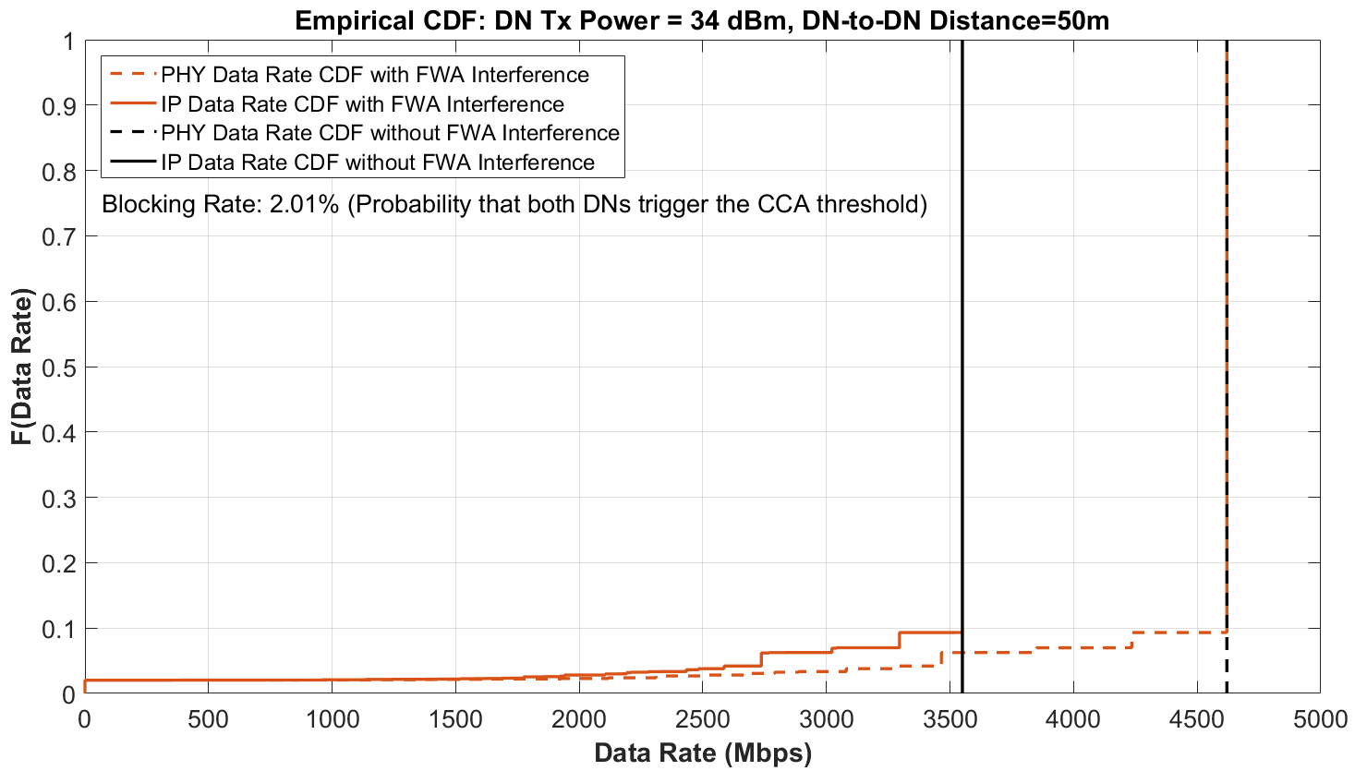
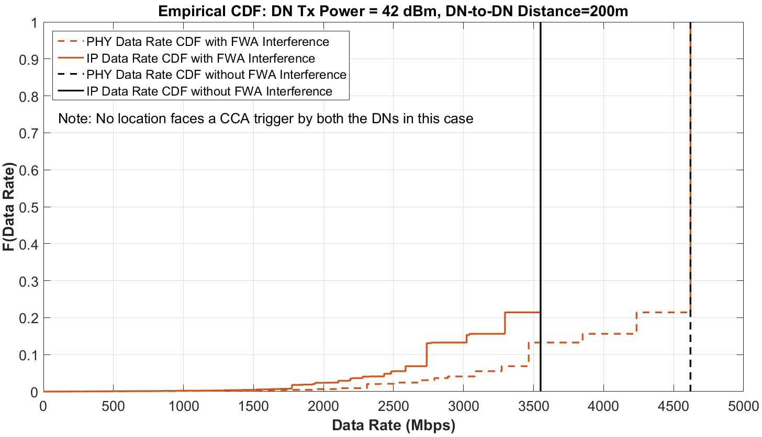
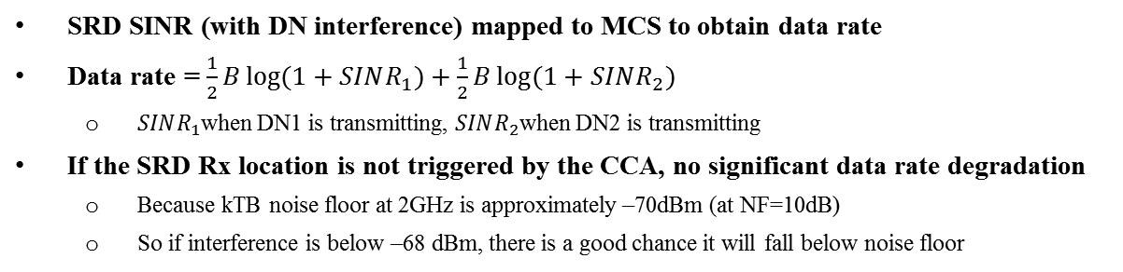
Instantaneous Data Rate CDFs for Random SRD Loc./Dir.
SRD SINR (with DN interference) mapped to MCS to obtain data rate
Data rate = $\frac{1}{2}B\log{(1+SINR_{1})}+\frac{1}{2}B\log{(1+SINR_{2})}$
  $SINR_{1}$when DN1 is transmitting, $SINR_{2}$when DN2 is transmitting
If the SRD Rx location is not triggered by the CCA, no significant data rate degradation
  Because kTB noise floor at 2GHz is approximately –70dBm (at NF=10dB)
  So if interference is below –68 dBm, there is a good chance it will fall below noise floor

Slide 19
Conclusions
DN operations may impact certain SRD links (even with transmit power control (TPC))
  Depends on DN Transmit Power and DN-to-DN distance
  DN deployment should account for possible SRD traffic and co-existence
SRD throughput is largely limited by SRD CCA trigger
  Caveat: depends on whether CCA threshold is checked at both SRD Tx and SRD Rx or only at SRD Tx alone
Frameworks and schemes to enhance SRD co-existence needed
  Simulations provide network design/deployment insights
  Design DN-to-DN Distance and transmit power accounting for both DN target MCS and SRD co-existence considerations
    Example: For DN-to-DN Distance of 200m, with TPC (42 dBm for 11ay MCS21/SNR26dB) we observe that no SRD link is blocked by both DNs through simulations

Slide 20
References
IEEE 802.11-18/0131r0, “Distribution Networks and Short Range Devices Coexistence”
IEEE 802.11-18/0488r1, “Field Measurement Results for Distribution Networks and Short Range Devices Coexistence”
3GPP TR 38.901, “Study on channel model for frequencies from 0.5 to 100 GHz (Release 14)”

