Slide 1
Co-existence of Distribution Nodes and Short Range Devices
Date: May 2018
DCN: 11-18-0833-00-00ay
Name | Affiliation | Address | Phone | Email
Aditya V. Padaki | Samsung Research America | 1301 E. Lookout Dr, Richardson, TX 75082, USA. |  | a.padaki@samsung.com
Jianhua Mo |  |  |  | jianhua.m@samsung.com
Boon Loong Ng |  |  |  | b.ng@samsung.com
Charlie Zhang |  |  |  | jianzhong.z@samsung.com

Slide 2
Overview
Introduction
Why co-existence important?
What’s been done until now?
What’s lacking?
Problem Setup
Interference heat maps
SINR CDFs
Throughput CDFs
Simulation Parameters
Simulation Results
NOTE: In this presentation, ‘Tx Power’ means EIRP.

Slide 3
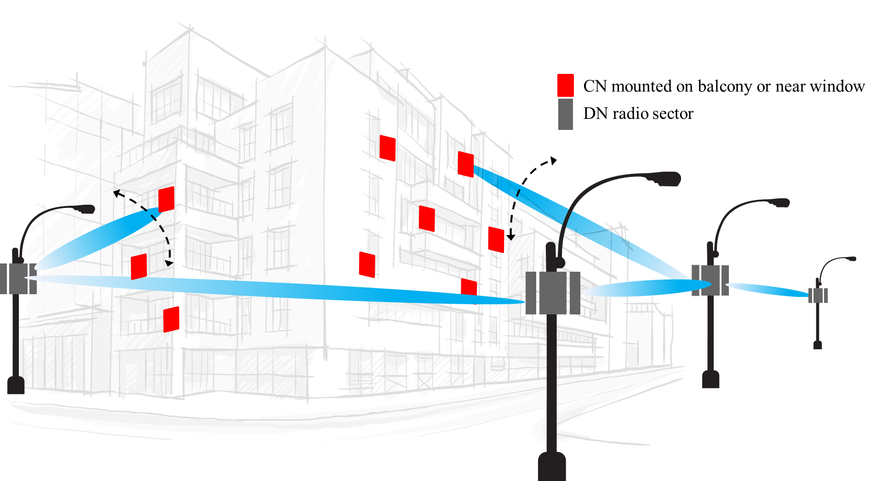
Introduction
Distribution Nodes (DN) may adversely impact the Short Range Devices (SRD)
Ensuring co-existence between DN and SRD is critical to design and deployment of distribution network
Extensive co-existence analysis is required to protect SRDs
Experimental studies have been carried out in the previous contributions [1][2]
Analysis for more test cases required
Ways to enhance co-existence need to be studied
Figures source: IEEE 802.11-18/0131r0
Notes:
131, 488

Slide 4
Co-existence Study Simulations
Probability that SRD link is established
Intuitive understanding of received power strengths as a function of distance, height
Generation of received power CDF
If the power > CCA threshold, SRD link not established
Given link is established, study the performance degradation
Given interference<CCA threshold, what is the impact on SRD throughput?
Simulations to generate CDFs of SINR and data rate

Slide 5
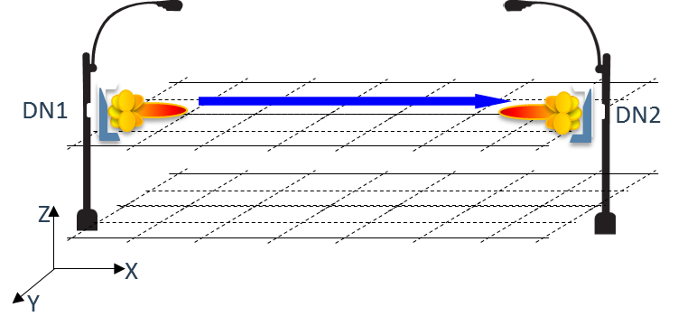
Generation of Interference Heat Map
Fix the parameters
Locations of FWA Tx and FWA Rx,
Tx power
Antenna array configuration/beam pattern
Form layers of 2-D grids at various vertical heights
Compute the Rx power at each intersection of the grid lines
3GPP Street Canyon path loss model for 60 GHz [3]
Assume omni-directional Rx antenna for SRD devices for the purpose of CCA threshold calculation
Repeat for different parameters
Path Loss Model: 3GPP Street Canyon
$$PL_{LOS}=32.4+21\log_{10}\left(d_{3D}\right)+20\log_{10}{f_{c}}$$

Slide 6
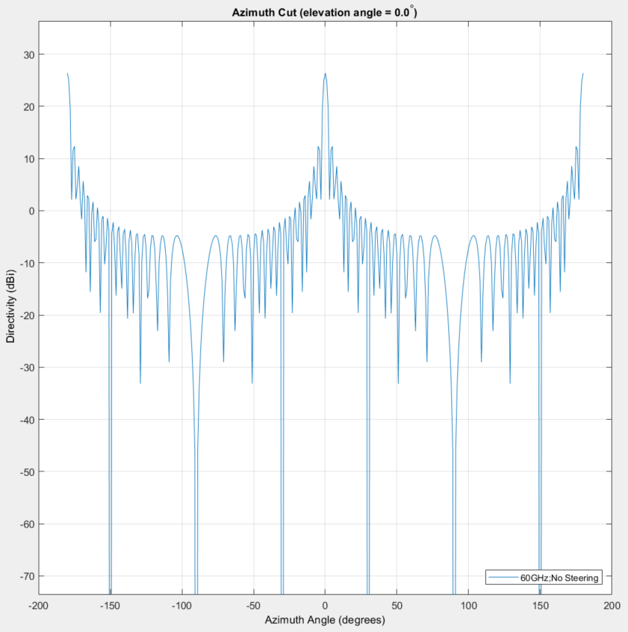
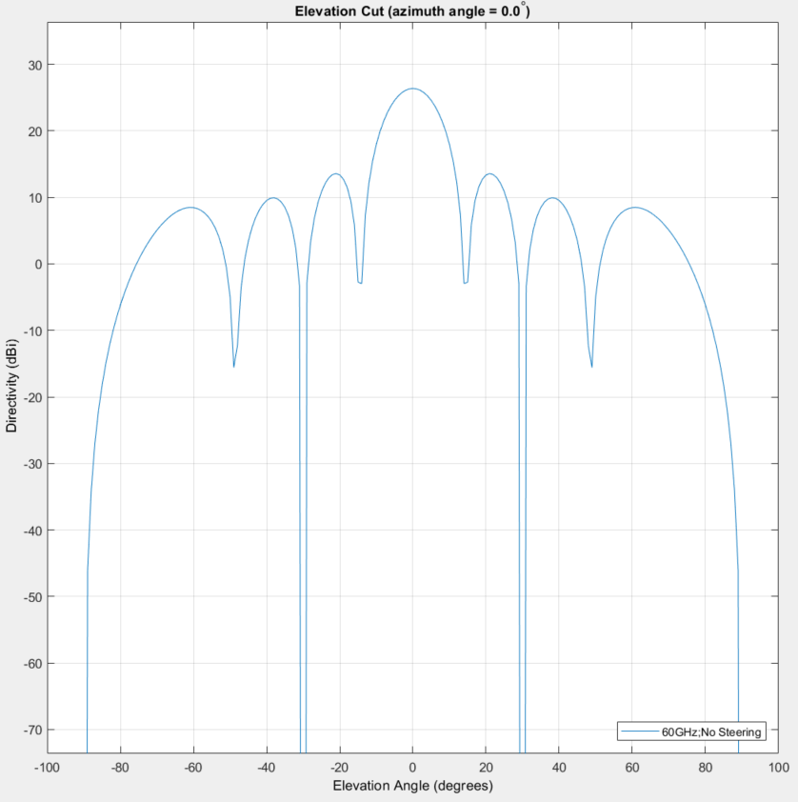
DN Antenna directivity pattern (36Hx8V)

Slide 7
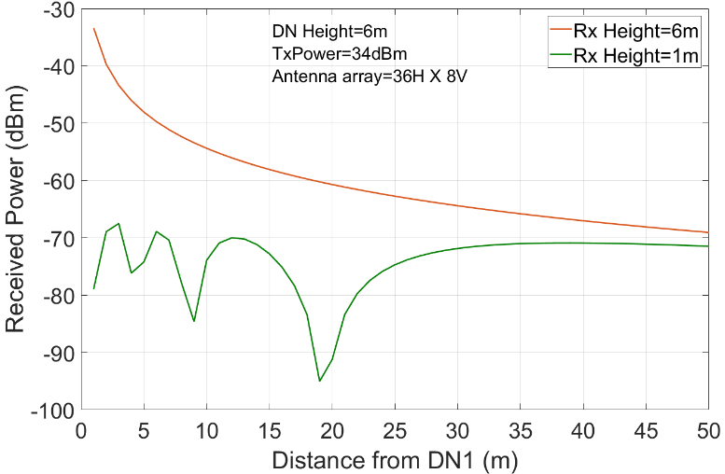
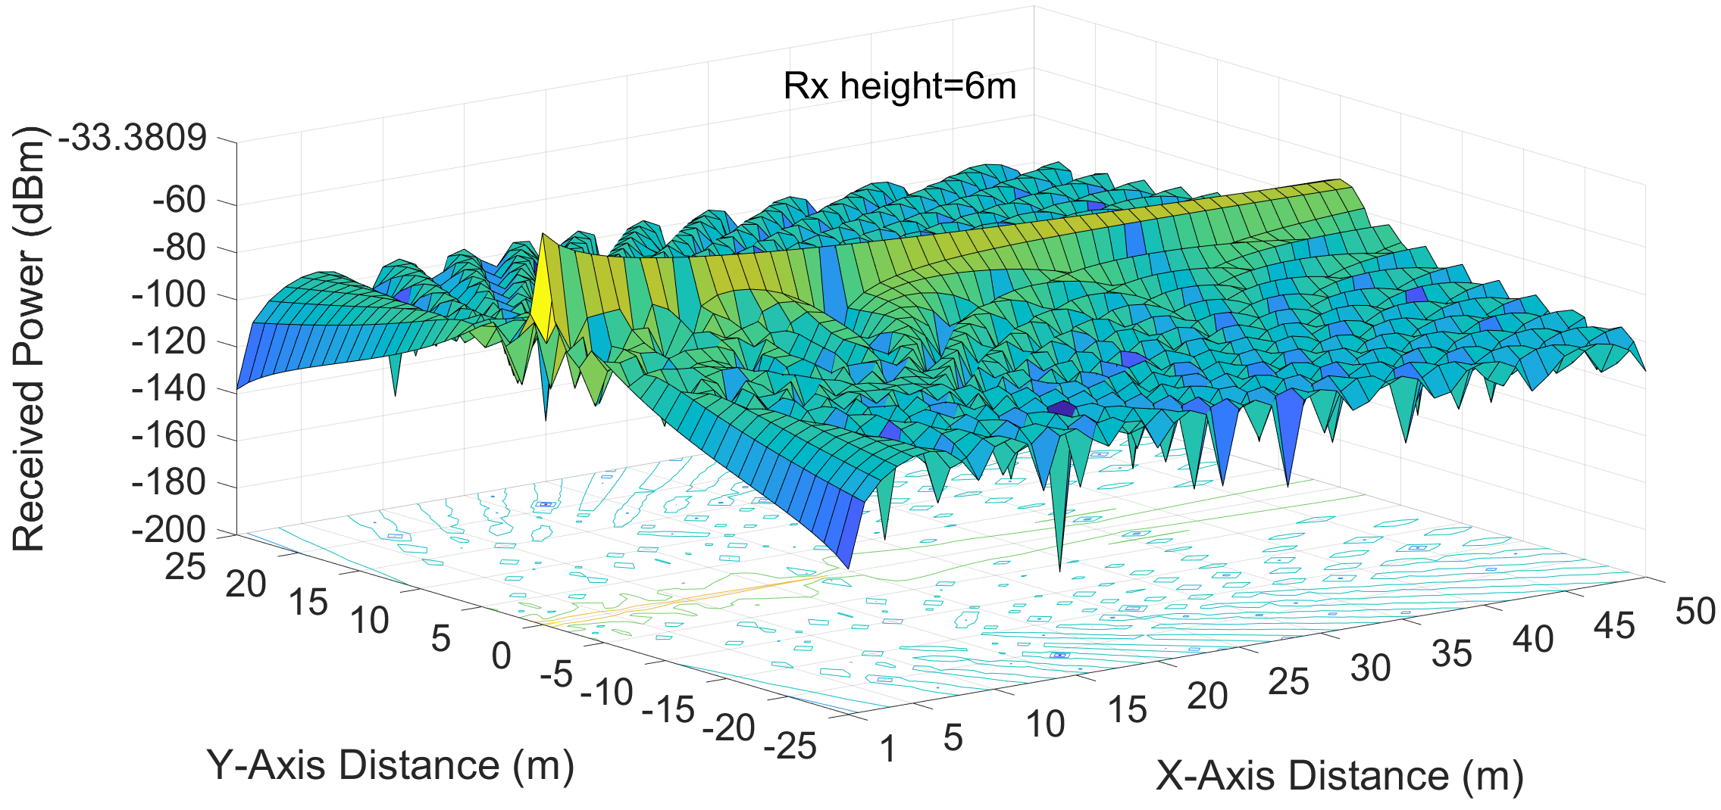
Interference Heat Map
Example interference heat map for SRD Rx Height=6m (worst case scenario)
Signal level drops considerably
Received Power level along y=0 for two levels of Rx height
Results similar to [2]

Slide 8
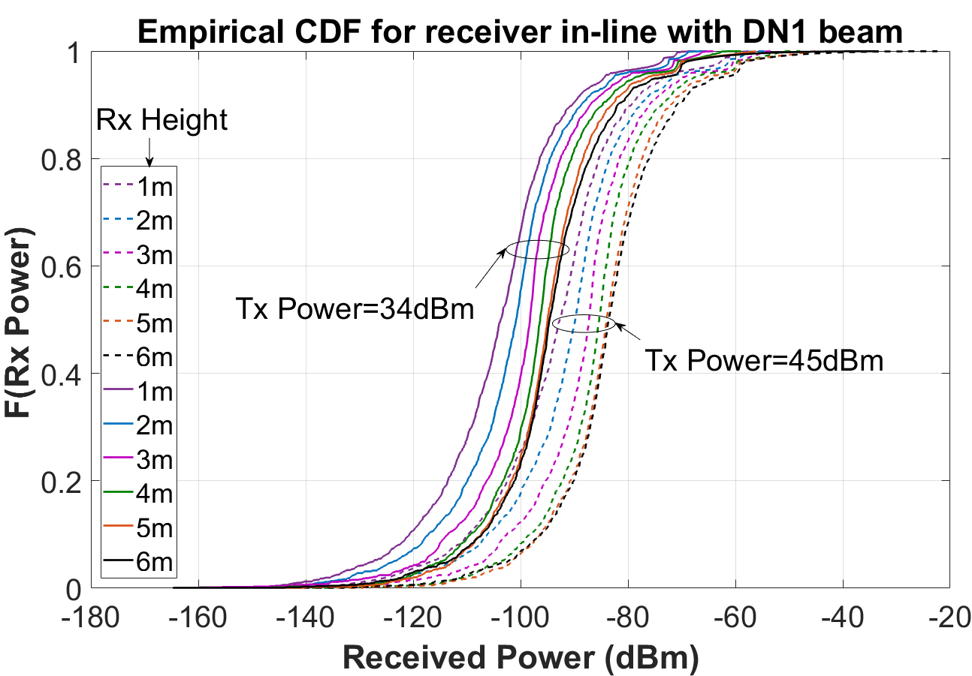
CDFs of Interference Received Power
(power control)
Use the data collected to generate CDFs of received power
Intuition for different types of scenarios
CCA Threshold

Slide 9
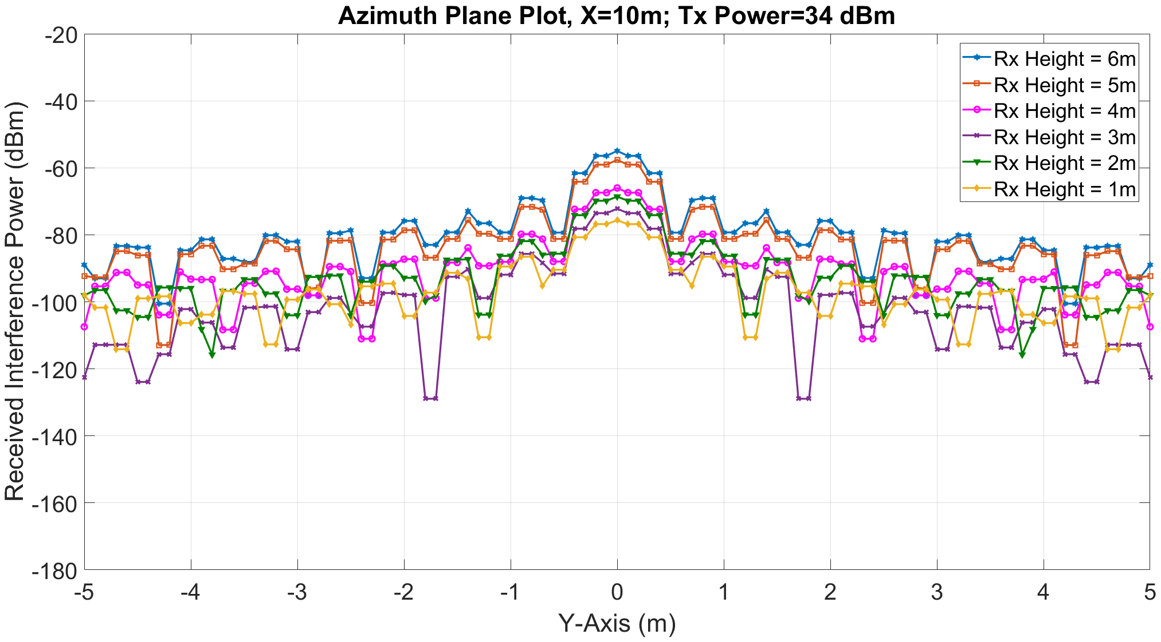
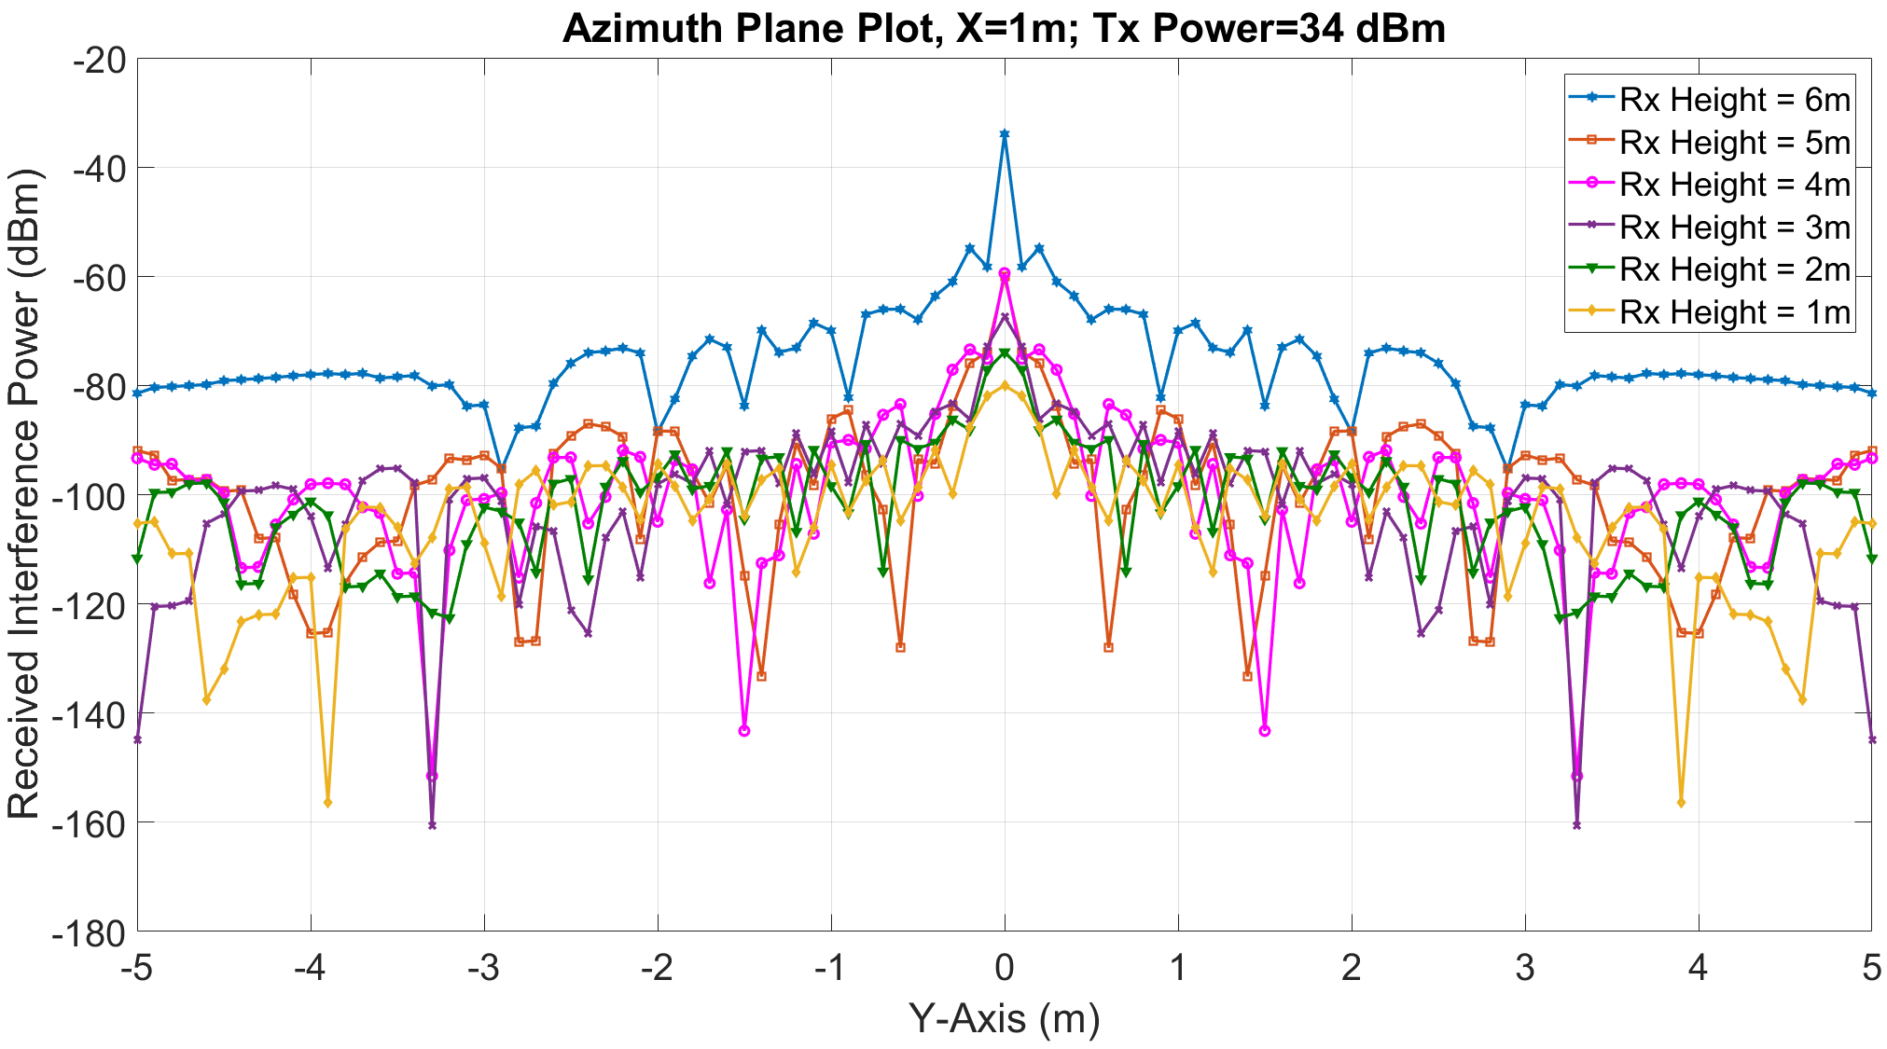
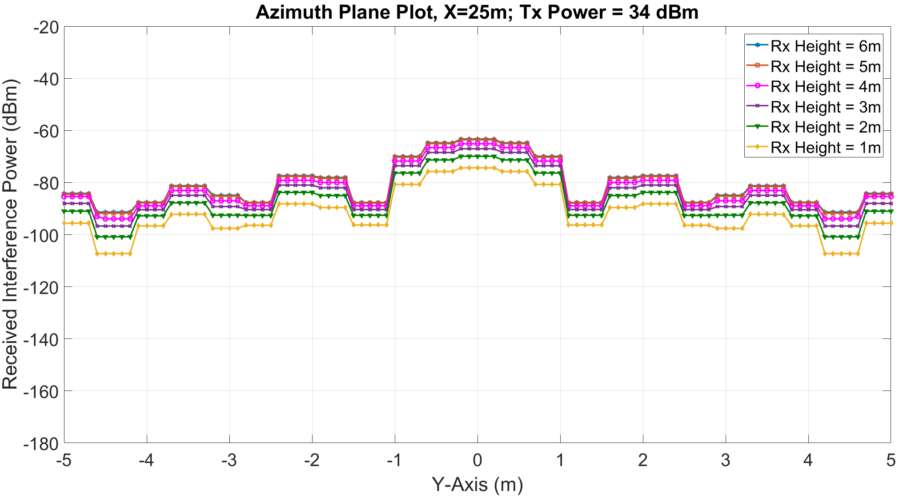
Azimuth-Elevation Variation of Interference
Received power drops with y-axis

Slide 10
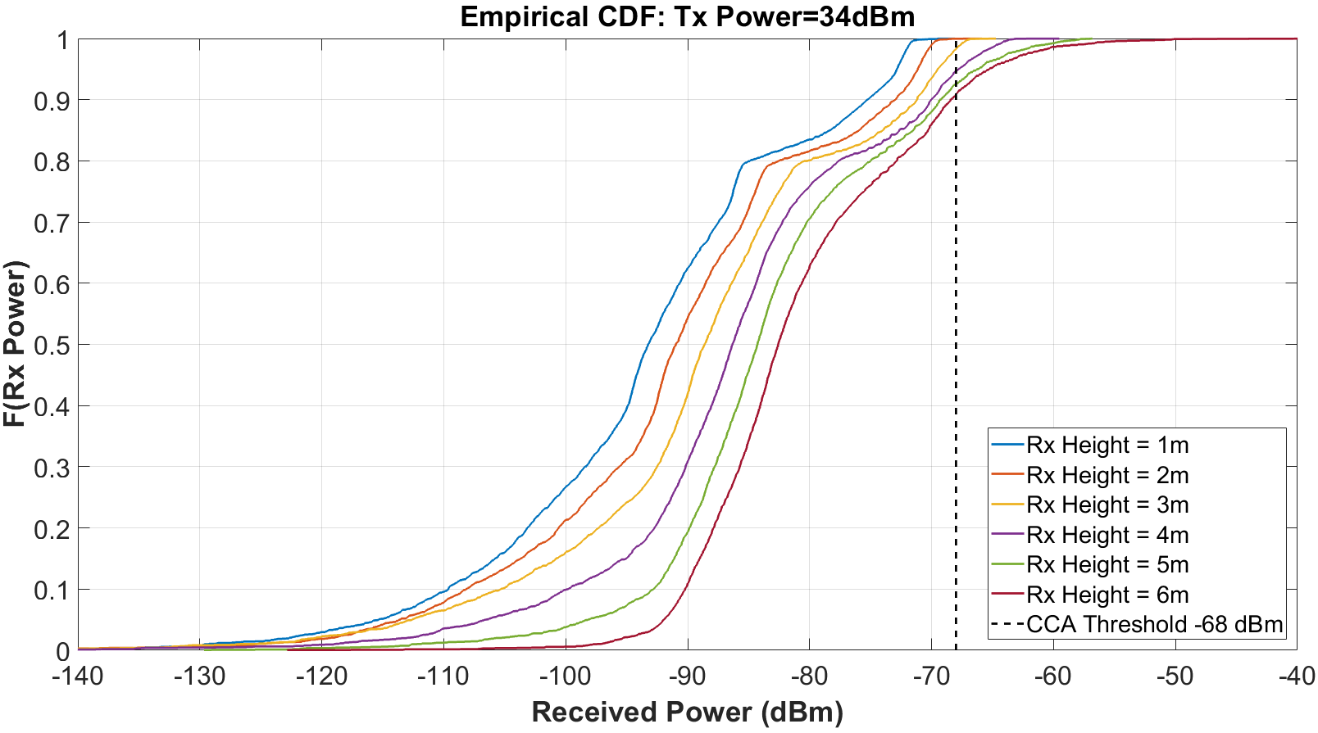
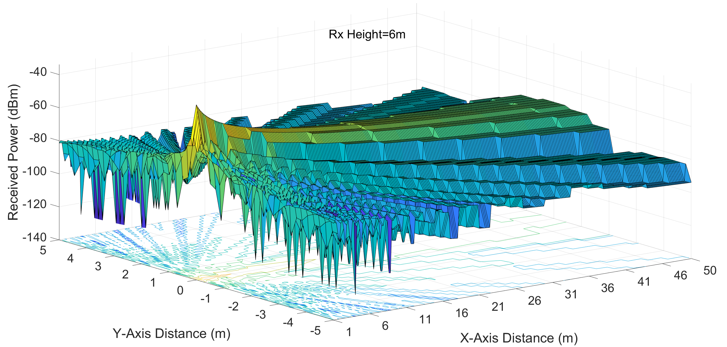
CDFs Y-Range 10m, X-Range 165m, Tx Power 45 dBm
Y-axis of 50 m is too wide
DNs tend to affect SRD on sidewalks (SRDs on middle of street unlikely)
CDFs plotted for y $∈$ [–5,5].

Slide 11
CDFs for X-Range 165m, Tx Power 45 dBm
The curves in this case are ‘closer’ to each other than the case with Tx Power 34 dBm and X-Range 50m
(We provide scatter plots on slide 13 for intuition on this aspect)

Slide 12
Locations of SRD Link Blockage
SRD link is blocked when received power from DN > –68 dBm
The blocked location w.r.t DN depend on various factors
DN Tx power,
Antenna configuration/directivity,
Pathloss, etc.
The extent of blockage to be computed using these factors
Case 1: Tx Power 34 dBm, DN-to-DN distance 50m
Interference power computed at random locations x $∈$ [1,50]; y $∈$ [–5,5] , z $∈$[1,6]
Case 2: Tx Power 45 dBm, DN-to-DN distance 165m (Same DN data rate as Case 1)
Interference power computed at random locations x $∈$ [1,165]; y $∈$ [–5,5] , z $∈$ [1,6]
Number of points samples: 1 million

Slide 13
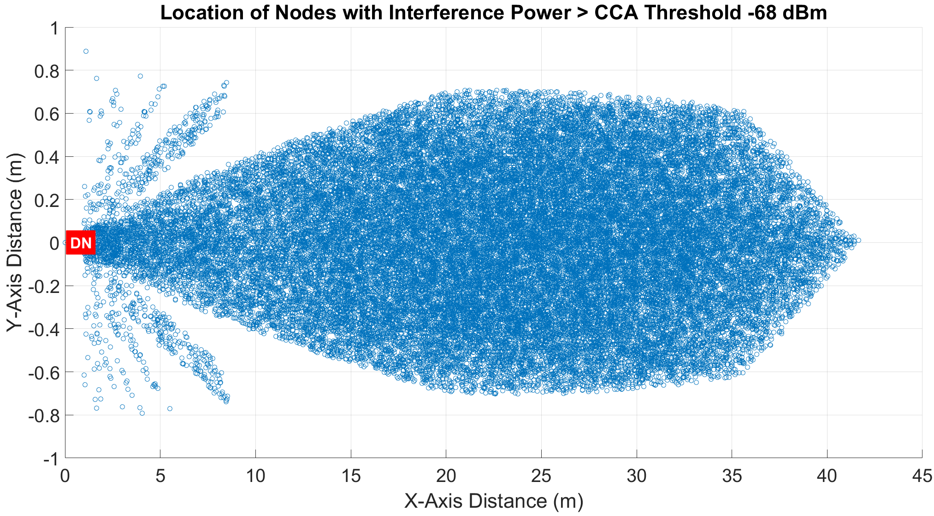
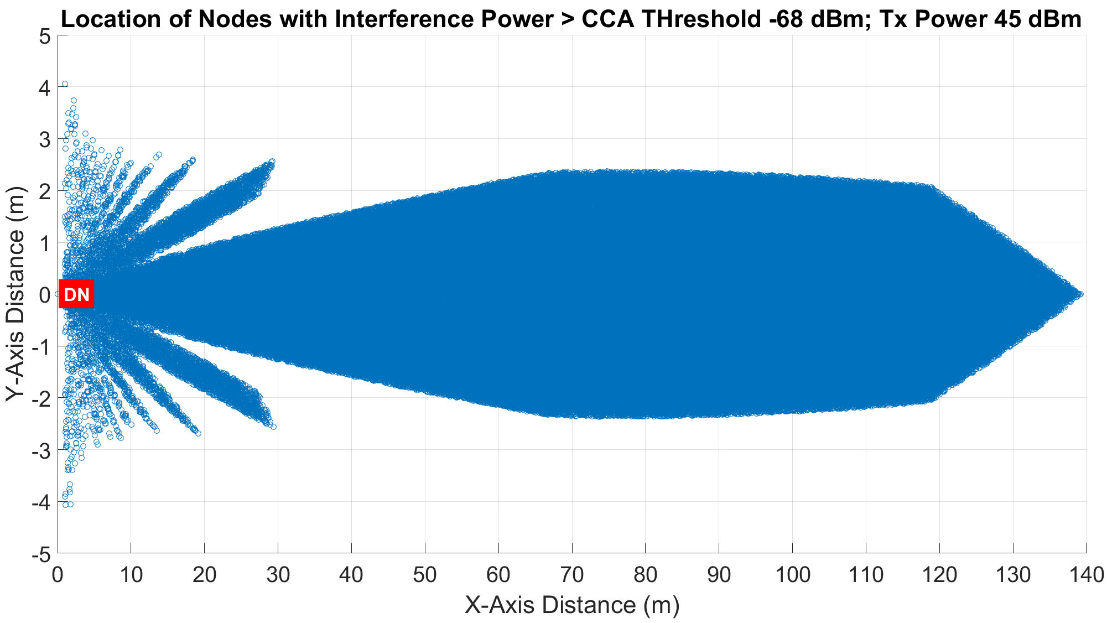
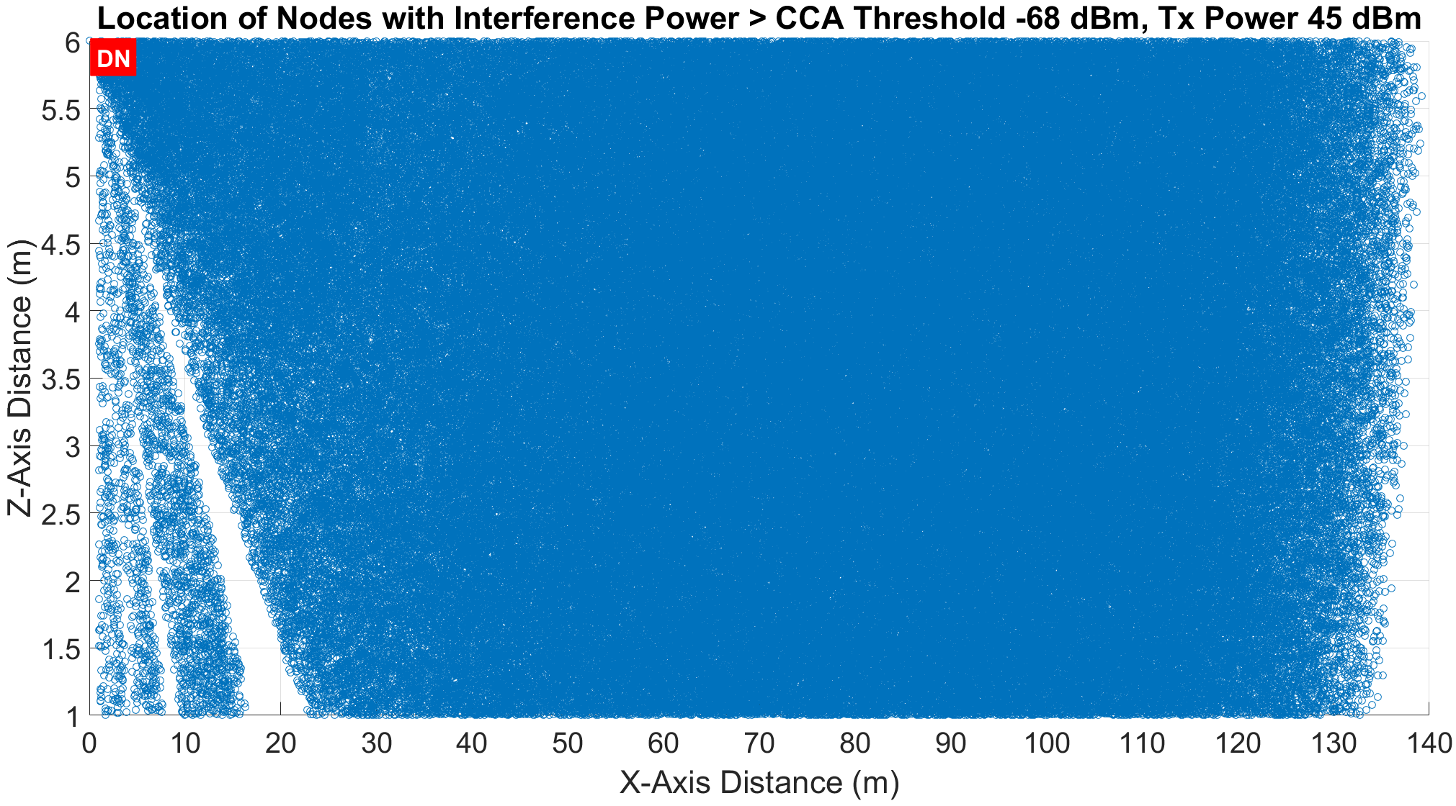
Visualization of Blockage
Case 1: Tx Power 34 dBm, DN-to-DN distance 50m
Case 2: Tx Power 45 dBm, DN-to-DN distance 165m

Slide 14
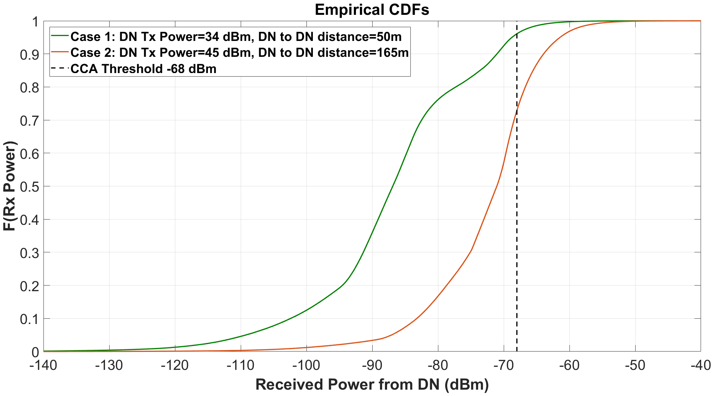
CDF of Received Interference Power from DN
Locations sampled uniformly at random
Two cases have the same DN-to-DN data rate
Even with DN Tx power control, DN-to-DN distance impacts co-existence
Gives network deployment/design insights

Slide 15
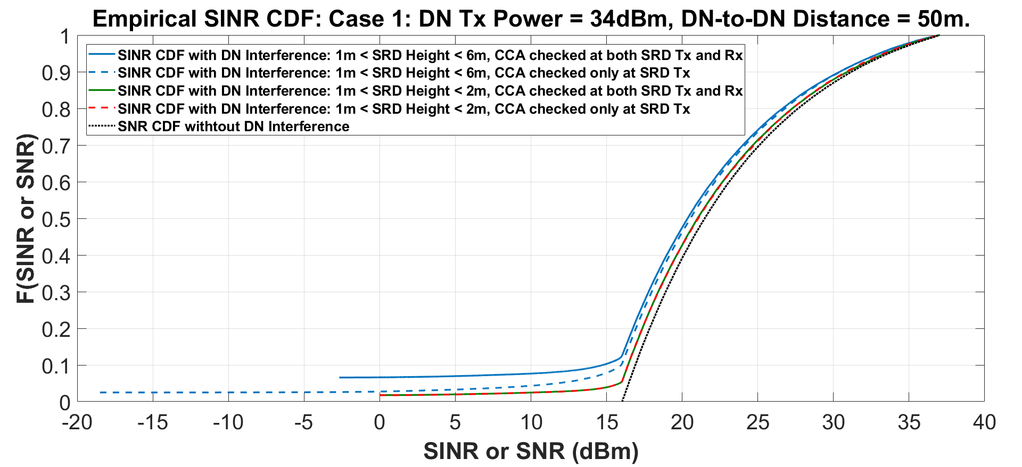
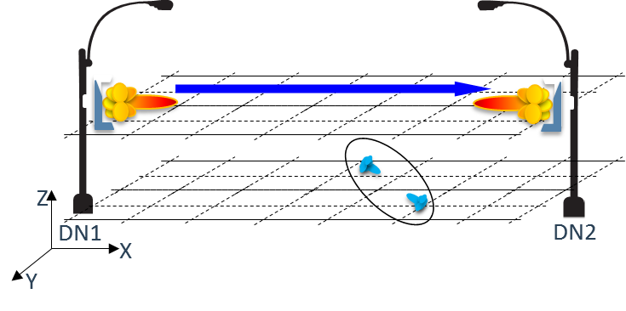
SINR CDF with Random SRD locations and directivity (1/2)
SINR CDFs plotted when DN Interference < CCA threshold
SRD parameters:
Antenna array: 8Hx4V
Directivity: random w.r.t to DN
Location: uniformly at random
Inter-SRD distance: random$∈$[1,10] meters
Simulations carried out for with 1M instantiations for 2 cases as before
Case 1: Tx Power 34 dBm, DN-to-DN distance 50m
Interference power computed at random locations x $∈$ [1,50]; y $∈$ [–5,5] , z $∈$ [1,6]

Slide 16
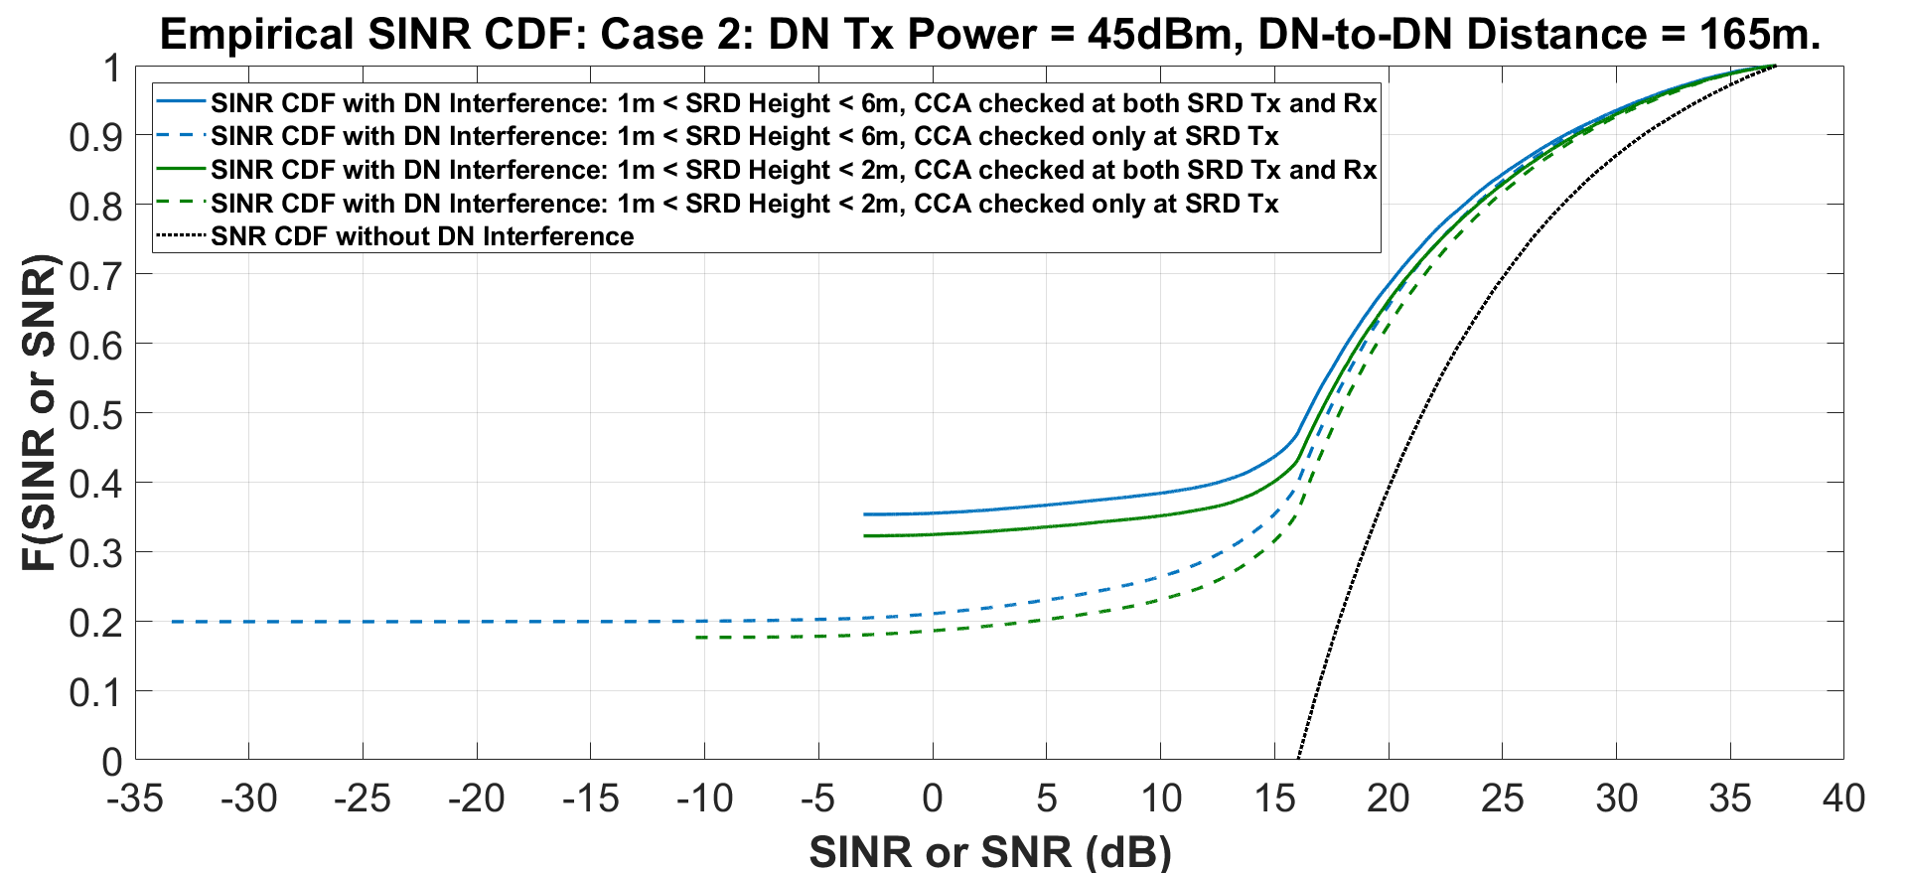
SINR CDF with Random SRD locations and directivity (2/2)
SINR CDFs plotted when DN Interference < CCA threshold
SRD parameters:
Antenna array: 8Hx4V
Directivity: random w.r.t to DN
Location: uniformly at random
Inter-SRD distance: random$∈$[1,10] meters
Simulations carried out for with 1M instantiations for 2 cases as before
Case 2: Tx Power 45 dBm, DN-to-DN distance 165m (Same DN data rate as Case 1)
Interference power computed at random locations x $∈$ [1,165]; y $∈$ [–5,5] , z $∈$ [1,6]
For the same DN data rate, DN-to-DN distance impacts SRD SINR

Slide 17
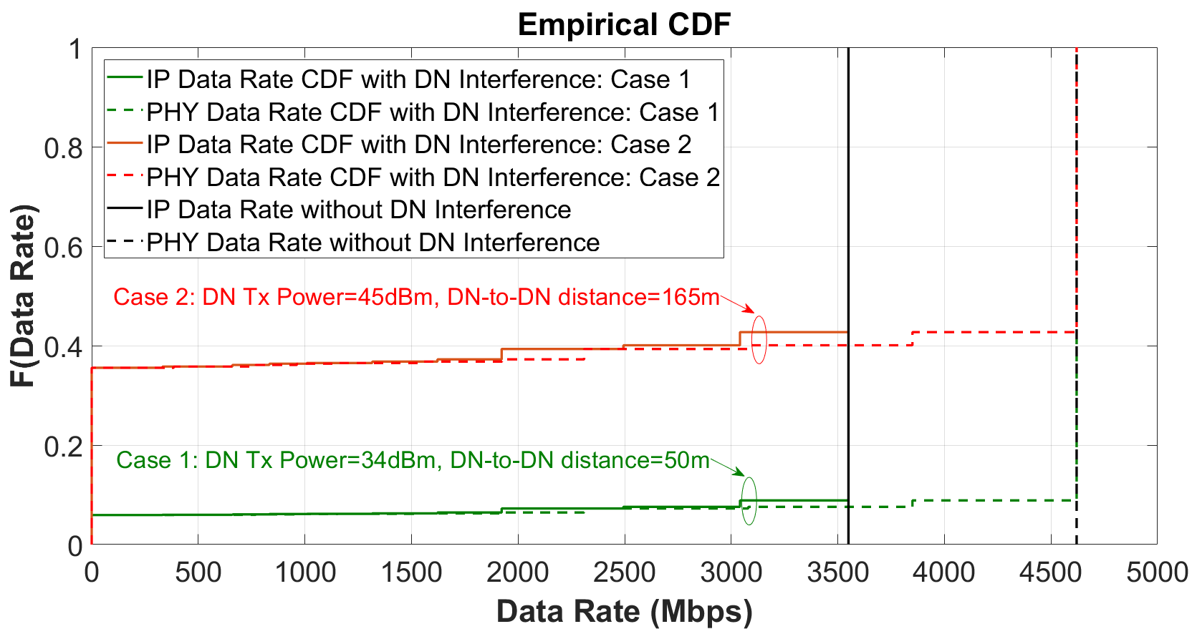
Data Rate CDF with Random SRD locations/directivity
NOTE: CCA Threshold checked at both SRD Tx and SRD Rx
Even at max distance 10m, with 34 dBm EIRP, SRD SNR = 16 dB (highest MCS, 12)
SRD SINR (with DN interference) mapped to MCS and data rate
If the SRD link is established, DN interference will not significantly degrade the SRD data rate (without the hidden node problem)
Because kTB noise floor at 2GHz is approximately –70dBm (at NF=10dB)
So if interference is below –68 dBm, there is a good chance it will fall below noise floor

Slide 18
Conclusions
DN-to-DN distance impacts SRD co-existence, even with DN Tx power control
Network design/deployment insights
DN deployment should account for co-existence issues
Co-existence is largely limited by DN blocking channel access to SRD
Caveat: depends on whether CCA threshold is computed at both SRD Tx and SRD Rx or only at SRD Tx
Frameworks and schemes to enhance SRD co-existence needed

Slide 19
References
IEEE 802.11-18/0131r0, “Distribution Networks and Short Range Devices Coexistence”
IEEE 802.11-18/0488r1, “Field Measurement Results for Distribution Networks and Short Range Devices Coexistence”
3GPP TR 38.901, “Study on channel model for frequencies from 0.5 to 100 GHz (Release 14)”

