Slide 1
WUR frame for FDMA
Date: 2018-05-07
Authors:
Name | Affiliation | Address | Phone | Email
Taewon Song | LG Electronics | 19, Yangjae-daero 11gil, Seocho-gu, Seoul 137-130, Korea |  | taewon.song@lge.com
Suhwook Kim |  |  |  | suhwook.kim@lge.com
Jeongki Kim |  |  |  | jeongki.kim@lge.com
Kiseon Ryu |  |  |  | kiseon.ryu@lge.com
Jinsoo Choi |  |  |  | js.choi@lge.com

Slide 2
Abstract
The concept of FDMA transmission scheme has been proposed in the current SFD [1], [2]
Each 20MHz only contains one 4MHz sub-channel for wake-up signal transmission
Basic concept for FDMA is specified, however, detailed procedures are not specified yet
There has been an issue regarding padding if durations of FDMA WUR frames are different
One of unspecified procedure is how to deal with the case when there is no STAs to be waken up in the PCR primary channel
In this contribution…
First, we examine a primary channel interruption problem
Next, we suggest WUR Null frame, a new type of WUR frame to resolve it

Slide 3
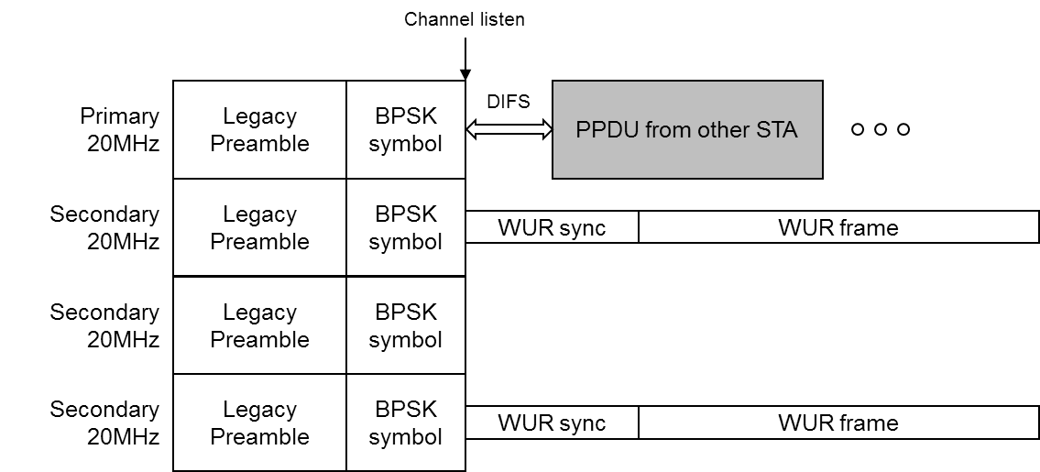
Primary channel interruption
When the primary channel is vacant, primary channel interruption problem can be occurred
As shown below, STAs can cut in on primary channel while the AP is transmitting WUR signal if there is no STAs to be waken up
MAC efficiency will decrease in this situation since channel access opportunity decreases

Slide 4
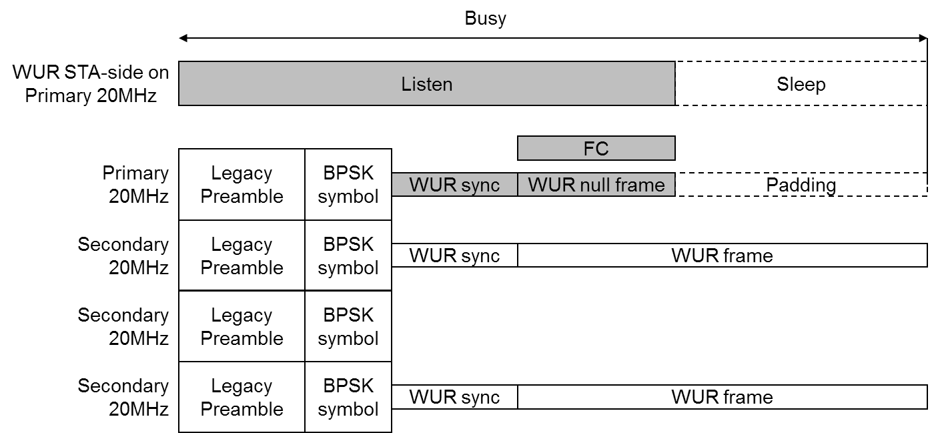
WUR Null frame
When there is no STA to be waken up in primary channel, the AP transmit a WUR Null frame
Use another type ID for WUR null frame
Once the STAs on primary 20MHz channel detect a frame that is WUR Null frame, they can sleep after decoding FC in the MAC header
STAs on the primary channel can detect that the channel is busy

Slide 5
WUR Null frame format
WUR Null frame follows a form of WUR frame as follows
One part of Type subfield is assigned for WUR Null frame
The duration of WUR Null frame plus padding is longer than that of WUR Wake-up frames in other channels
WUR Null frame is transmitted in LDR only
FCS doesn’t need to be included since transmission in LDR is relatively reliable
Padding symbols are TBD and Padding follows WUR Null frame

Slide 6
Conclusion
Primary channel interruption problem should be resolved
Primary channel interruption problem can harm overall MAC efficiency
In order to deal with the primary channel interruption problem, we suggest WUR Null frame
Using WUR Null frame, primary channel interruption problem can be avoided as well as the STAs on primary 20MHz don’t have to waste power

Slide 7
Straw Poll 1
Do you agree to define a WUR Null frame as shown in Slide 5?
Y
N
A

Slide 8
References
[1] 11-17/0575r11, “Spec framework”
[2] 11-17/1625r6, “Efficient FDMA Transmission Schemes for WUR WLAN”

