Slide 1
WUR Power Spectral Density
Date: 2018-05-07
Authors:

Slide 2
Introduction
Investigate the Power Spectral Density (PSD) of the WUR Signal
For analysis purposes we analyze the Data Field with random data
  Consider both the High and Low Data Rates

Slide 3
Simulation
Simulated the Data Field
Random Data, typically 10K bits
High Data Rate MC-OOK 2 µs ‘On’ Symbol
  32-pt FFT
  seq = [1, 1, 1, 0, -1, 1, -1]
Low Data Rate MC-OOK 4 µs ‘On’ Symbol
  64-pt FFT
  seq = [1, 1, 1, -1, -1, -1, 1, 1, -1, 1, 1, -1, 1]

Slide 4
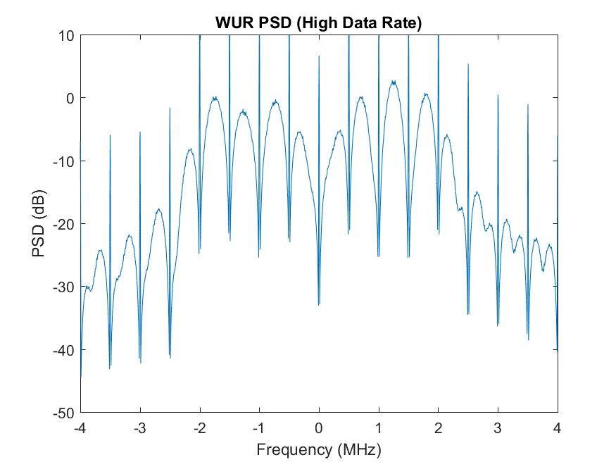
High Data Rate PSD

Slide 5
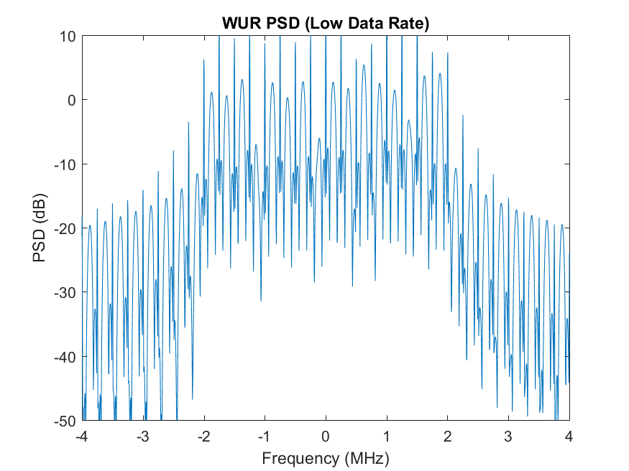
Low Data Rate PSD

Slide 6
FCC Part 15.247
FCC Part 15.247 include the following,
  (e) For digitally modulated systems, the power spectral density conducted from the intentional radiator to the antenna shall not be greater than 8 dBm in any 3 kHz band during any time interval of continuous transmission.
We need to ensure, that with the maximum allowed transmit power of 30 dBm, the maximum power in any 3 kHz band is less than 8 dBm

Slide 7
Maximum Power in 3 kHz
Calculated the Maximum power in any 3 kHz window, compared to the total power and max power in 3 kHz window if TX power is 30 dBm
Data Rate | Max Power in 3 kHz Relative to Total Power (dB) | Max Power in 3 kHz when Total TX power is 30 dBm (dBm)
Low | -12.5 | 17.5
High | -10.4 | 19.6
This exceeds the FCC 8 dBm limit

Slide 8
Reason for Spectral Lines
There is strong autocorrelation between MC-OOK ‘On’ symbols
This leads to spectral lines in the Power Spectral Density
To eliminate these spectral lines, we need to break this strong autocorrelation
It turns out that applying a random phase rotation to the MC-OOK ‘On’ symbols works well

Slide 9
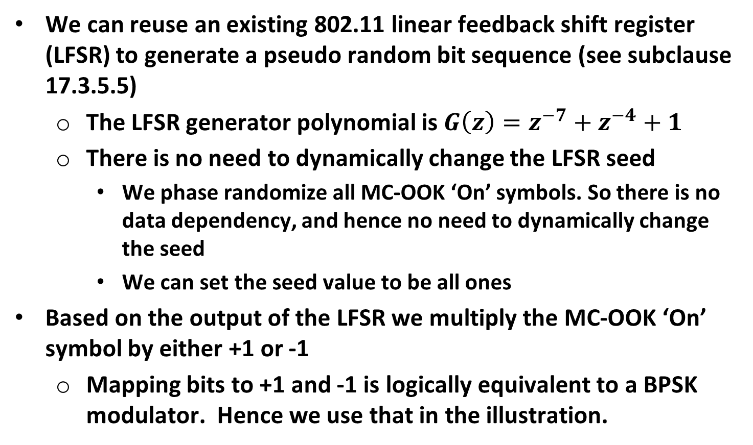
MC-OOK ‘On’ Symbol Phase Randomizer using LFSR
We can reuse an existing 802.11 linear feedback shift register (LFSR) to generate a pseudo random bit sequence (see subclause 17.3.5.5)
  The LFSR generator polynomial is $G\left(z\right)=z^{−7}+z^{−4}+1$
  There is no need to dynamically change the LFSR seed
    We phase randomize all MC-OOK ‘On’ symbols. So there is no data dependency, and hence no need to dynamically change the seed
    We can set the seed value to be all ones
Based on the output of the LFSR we multiply the MC-OOK ‘On’ symbol by either +1 or -1
  Mapping bits to +1 and -1 is logically equivalent to a BPSK modulator. Hence we use that in the illustration.

Slide 10
Illustration
Example Figure, based on modifying Figure 32.2 from the Draft
Phase randomizer applied to MC-OOK ‘On’ symbol prior to transmission

Slide 11
Simulate with Phase Randomizer
Modified the simulation to apply a random phase rotation of either 0 or 180 degrees to each MC-OOK ‘On’ symbol
  This is equivalent to multiply each ‘On’ symbol randomly by either +1 or -1

Slide 12
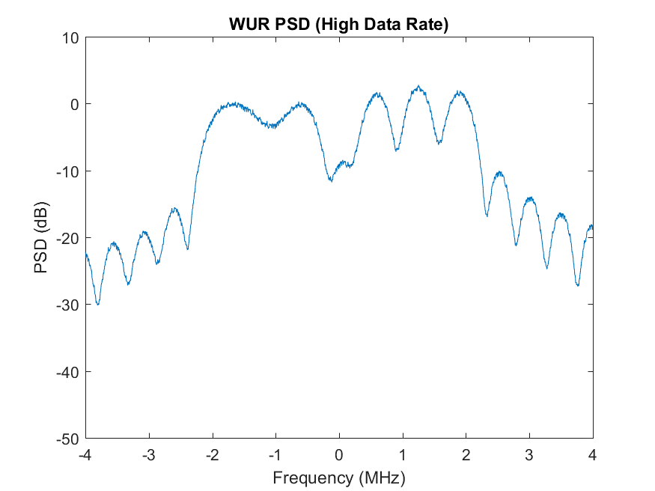
High Data Rate PSD

Slide 13
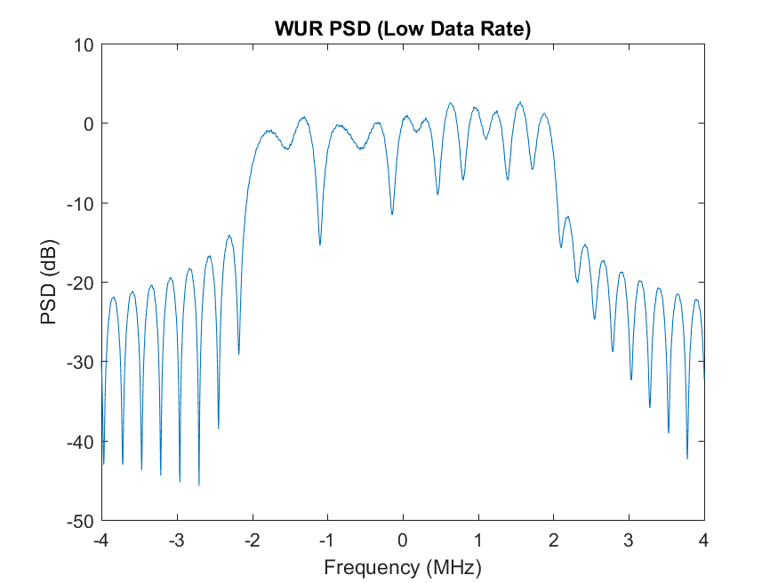
Low Data Rate PSD

Slide 14
Maximum Power in 3 kHz
Calculated the Maximum power in any 3 kHz window, compared to the total power and max power in 3 kHz window if TX power is 30 dBm
Data Rate | Max Power in 3 kHz Relative to Total Power (dB) | Max Power in 3 kHz when Total TX power is 30 dBm (dBm)
Low | -27.4 | 2.6
High | -27.0 | 3.0
This is well below the FCC 8 dBm limit

Slide 15
Conclusions
Demonstrated spectral lines in the PSD
Results in more than 8 dBm in some 3 kHz bands, exceeding FCC limits
One very simple method of eliminating the spectral lines is to use a phase randomizer on the MC-OOK ‘On’ symbols
  Use of a simple LFSR
  Multiply each ‘On’ symbol by either +1 or -1 based on LFSR output
  Power in all 3 kHz bands well below FCC 8 dB limit

Slide 16
Straw Poll #1
Do you support adding the following to the Spec Framework Document
  “Prior to transmission a pseudo random phase rotation is applied to the ‘On’ symbol, in both the Sync and Data Fields”
  Yes
  No
  Abstain

