Slide 1
Observations on DMG CCA level
Date: 2018-05-08
Name | Affiliation | Address | Phone | Email
Sam Alex | Facebook | 1 Hacker Way Menlo Park, CA 94025 USA |  | sampalex@fb.com
Payam Torab |  |  |  | ptorab@fb.com
Djordje Tujkovic |  |  |  | djordjet@fb.com
Michael Grigat | Deutsche Telekom | Deutsche-Telekom-Allee 7, 64372 Darmstadt, Germany |  | m.grigat@telekom.de
Nikolas Olaziregi | Nokia | Copernicuslaan 50, 2018 Antwerp, Belgium |  | nikolas.olaziregi@nokia.com

Slide 2
Motivation
The 802.11ad (and 802.11ay) standards defined the preamble detect (PD) and energy detect (ED) levels in the same manner as 802.11n/ac standard, which is not a directional PHY like DMG
Omni directional clear channel assessment (CCA) at minimum sensitivity level (-68dBm), while providing simple and fair access to the channel, might prevent efficient spatial reuse of the spectrum for directional systems
In this presentation we show that the current preamble detect threshold of -68 dBm provides little to no gain, and often times hurts the performance for highly directional systems

Slide 3
CCA levels for Omni and Directional system
Omni
STA
DMG
STA
Beamformed
Omni
STA
Omni
CCA
DMG
STA
DMG
STA
Omni
CCA
Preamble detect at MCS 1 receive sensitivity means transmitting can hurt the neighbor’s performance with similar interference level at the RX
Preamble detect at MCS 1 receive sensitivity does not mean transmitting can hurt the the neighbor’s performance
Omni system with omni CCA
Directional system with omni CCA

Slide 4
Modeling
Simple intuitive modeling to get insight into medium access performance of directional systems
Methodology
  For a given density of users, find the set of users who can transmit simultaneously for different CCA threshold values
  Compute the interference caused to each other due to the simultaneous usage of the channel
  Compute the link SINR and overall throughput of the system of users

Slide 5
Assumptions (1)
Simulation setup
  TX nodes are randomly placed in the area and its peer RX are placed such that their link distance is randomized to span up to 10m
  Simulation is run on a per link basis
CCA complete modeling with propagation
  Active transmission can trigger CCA at some neighboring STAs (potential interferers), silencing them and stopping them from interfering with desired link
  The neighboring STAs whose CCAs are not triggered will transmit and cause interference
  The CCA trigger propagation is accurately modeled by repeating steps (1) and (2), all through the edge of the network

Slide 6
Assumptions (2)
Interference and SINR calculation
  Interference from TX nodes that were not blocked is added at desired link RX
  SINR at each receiver is computed based on the power received through its desired link as well as all interference signals, accounting for TX and RX antenna patterns for all links
CCA definitions
  Omni directional CCA: The node uses a quasi Omni antenna pattern for performing CCA
  Directional CCA: The node uses the same TX antenna pattern that it uses for data transmission for the purpose of CCA
  1wayCCA: Only the TX node performs CCA. CS or CTS to self
  2way CCA: Both TX and RX nodes perform CCA. This models the RTS/CTS mechanism. So the TX power from both the TX and RX of the desired link could trigger CCA on a potential interferer’s TX and/or RX, thereby blocking it
    Note: The nodes blocked by the 2way CCA will be a superset of the nodes blocked by the 1way CCA mechanism

Slide 7
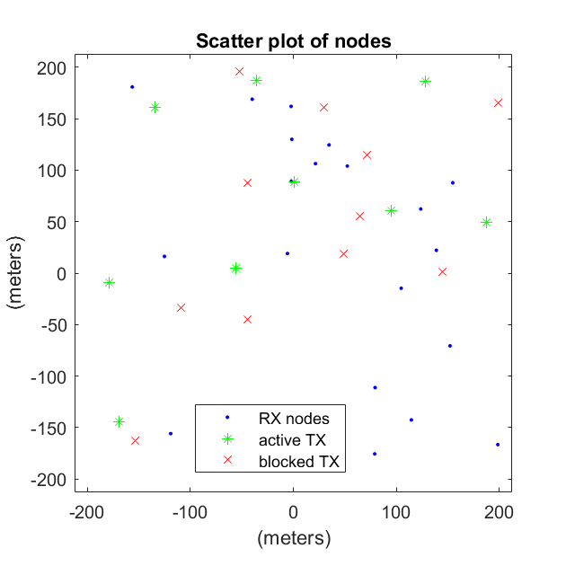
Example of Active and Blocked Nodes
Figure shows TX nodes that are blocked and TX nodes that are active
Omni directional CCA was used here, so it can be seen that the non-blocked nodes are separated by some minimum distance that correspond to the CCA threshold used (-68dBm)
Blocks
Interferer TX
Interferer TX
Blocks
Interferer TX
No Interference
Interference
No Interference
Blocks
Blocks
Desired TX
Desired link
Desired RX
Blocks
No Interference
Blocks
Interferer TX

Slide 8
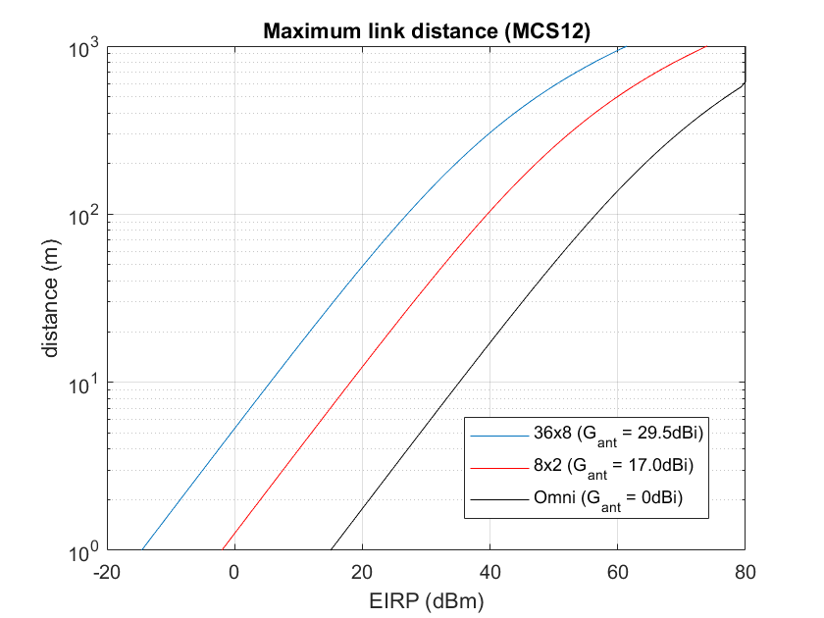
Assumptions
MCS | Sensitivity (dBm) | Spectral Eff. (bps/Hz) | SNR reqd (dB)
1 | -68 | 0.25 | 4
2 | -66 | 0.5 | 6
3 | -65 | 0.63 | 7
4 | -64 | 0.75 | 8
6 | -63 | 1 | 9
7 | -62 | 1.25 | 10
8 | -61 | 1.5 | 11
9 | -59 | 1.63 | 13
10 | -55 | 2 | 17
11 | -54 | 2.5 | 18
12 | -53 | 3 | 19
Parameters
  Noise floor = -72dBm
  Receiver sensitivity and SNR required based on IEEE 802.11ad spec, assumes 10dB NF and 5dB implementation loss
Link distance calculation
  Link distance for a class of devices is computed based on EIRP and RX antenna gain of that class. The link distance is limited to the distance that can support the highest MCS. Only path loss is considered here, TX EVM requirements etc. are ignored for now. Plot of link distance with EIRP and RX antenna gain is shown.
  With a FCC/ETSI EIRP limit of 40dBm the maximum distances are 300m, 100m and 20m for 36x8, 8x2 and Omni antenna, respectively
  For an indoor SRD with 8x2 antenna, an EIRP of 25dB is sufficient to support MCS 12 anywhere within an indoor area of say 10mx10m.
Max for P2MP
(outdoor)
Outdoor
EIRP limit
(for Indoor)
Indoor

Slide 9
Simulation scenarios
High density scenarios
  Indoor (1 user/m² in a 10m x 10m area)
  Outdoor (320 user/km² in a 250m x 250m area)
Various assumptions on antenna capability and CCA applied
  Scenario 1: Omni system with Omni CCA
  Scenario 2: Direction system with Omni CCA
  Scenario 3: Directional system with Directional CCA

Slide 10
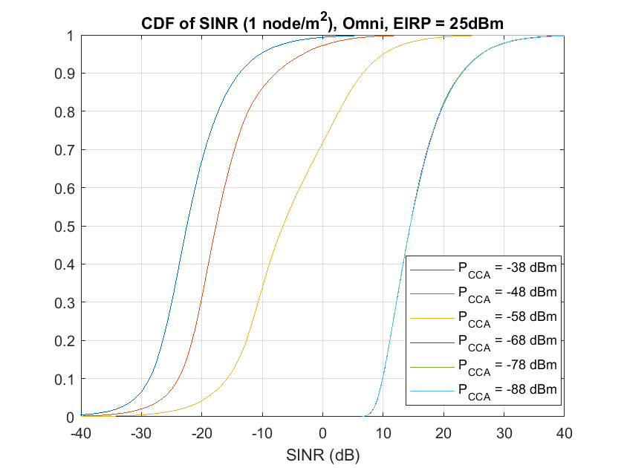
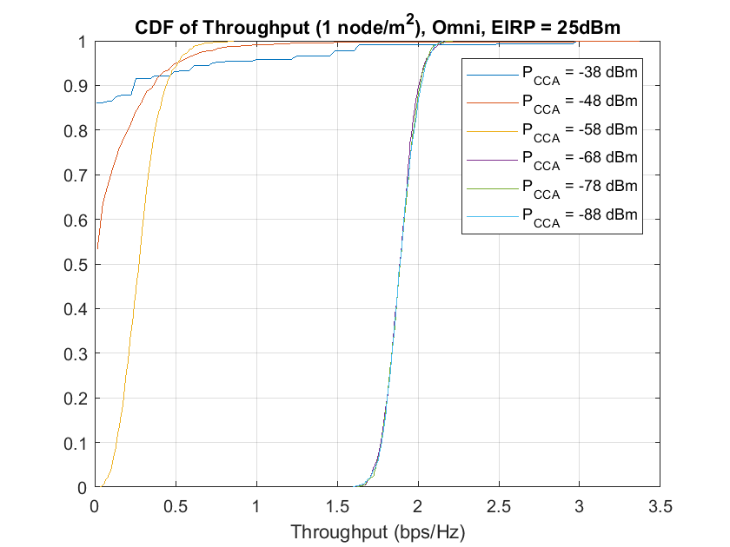
Scenario 1A: Omni Antenna with 25dBm EIRP, Indoor
For Omni antenna, if CCA is turned off or set to high level, link SINRs degrade and the sum of throughput of all users (sum throughput) suffers significantly
In this case, CCA threshold ~ -68dBm and lower provides best performance for 25dBm EIRP with maximum link distance of 10m

Slide 11
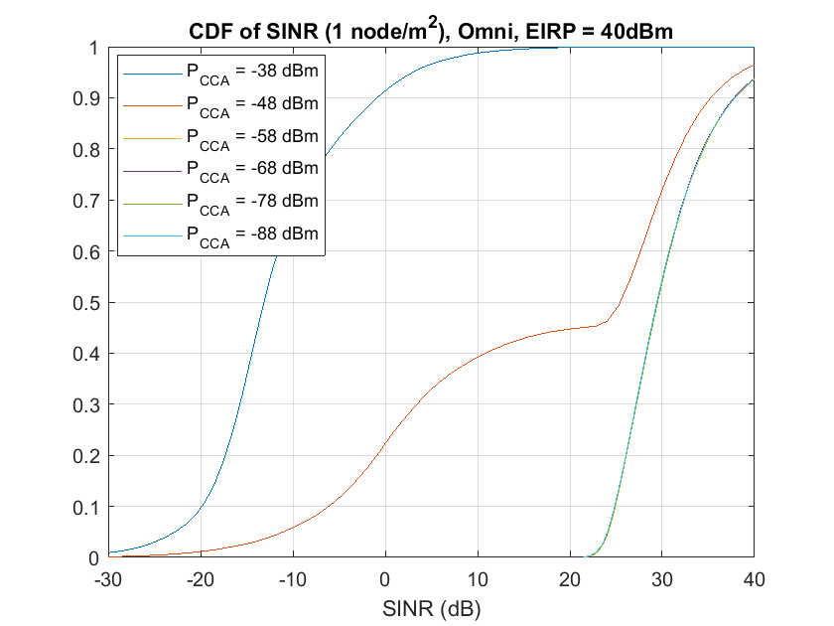
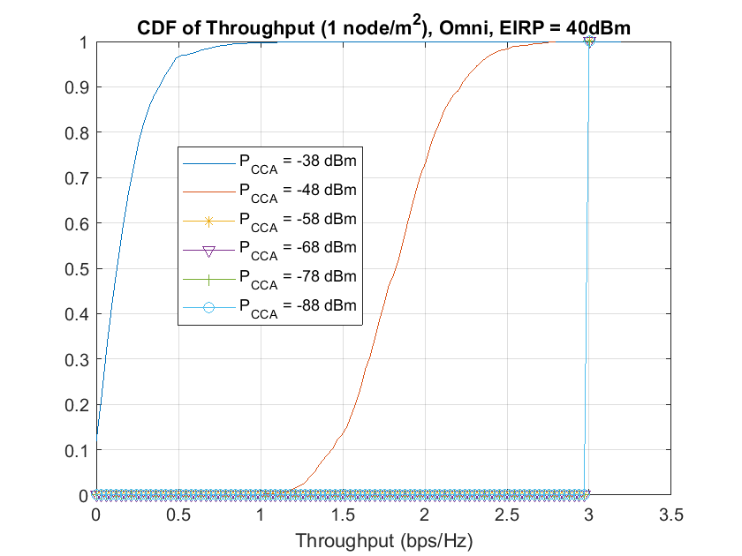
Scenario 1B: Omni Antenna with 40dBm EIRP, Indoor
With 40dBm EIRP all links are able to attain MCS12
The CCA threshold in this case can increase by 15dB without adverse effects to performance
  CCA thresholds of -58dBm or lower gave the best performance.
Likewise, if EIRP were reduced bellow 25dBm (especially in power control scenario), we might want to take the CCA level lower

Slide 12
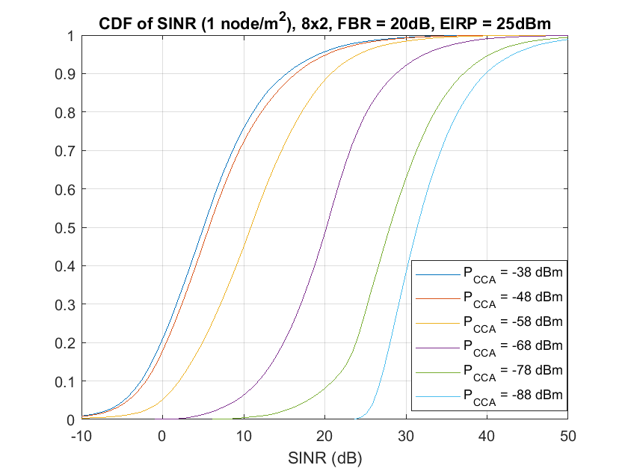
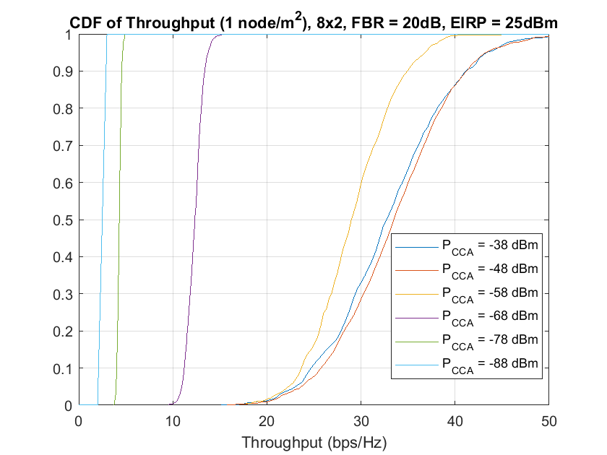
Scenario 2A: 8x2 Array, Omni CCA, 25 dBm, Indoor
In directional antenna case, increasing CCA threshold reduces the SINRs achievable per link, but it improves the sum Tput
  Instead of very few links hogging the medium, more links can be active contributing to higher spatial capacity and ultimately better spectrum utilization
  Same is not possible in Omni scenario
Setting the threshold around -48dBm provides the best throughput, despite link SINRs falling below 0dB 10% of the time (high density scenario)

Slide 13
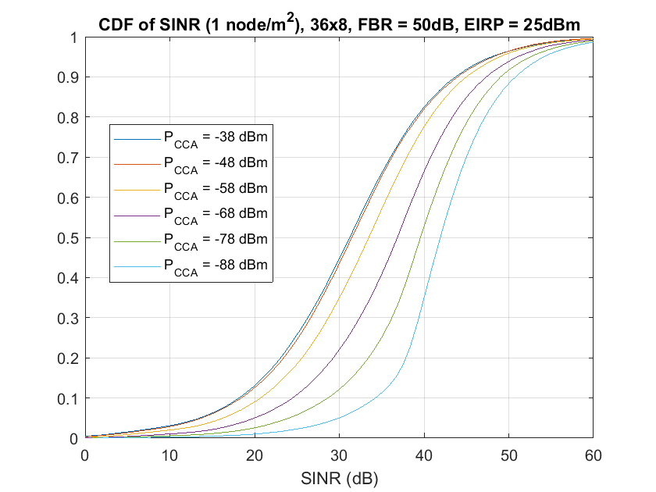
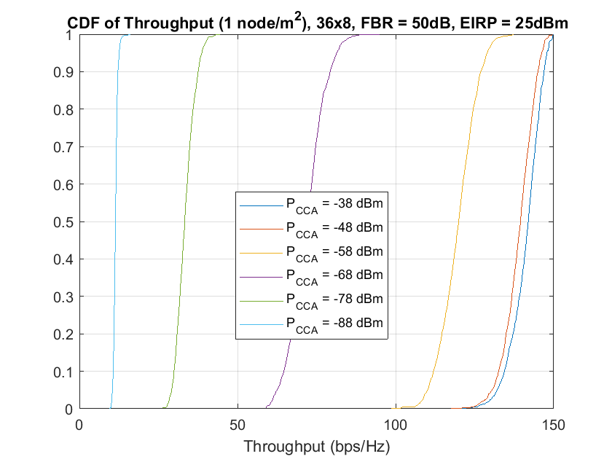
Scenario 2B: 36x8 Array, Omni CCA, 25 dBm, Indoor
As directivity further increases, CCA threshold has smaller impact on SINRs, but progressively larger impact to sum throughput
This clearly shows a trend that LBT doesn’t play beneficial role in high directivity systems
  SINRs are 90% of the time above 18dB, and lower CCA thresholds don’t improve SINRs as much
  In turn, lower CCA thresholds degrade throughput significantly, owing to unnecessary channel back off

Slide 14
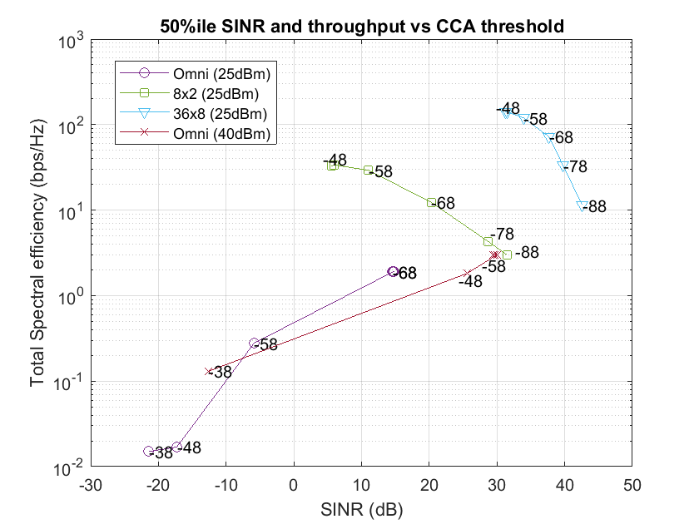
Trajectory of SINR and Total Spectrum Efficiency (SE) vs CCA threshold (Indoor scenario)
Trajectory of median (50%ile) SINR vs achieved total throughput is shown in the plot
As CCA thresholds reduce, all systems approach the single node throughput, i.e. no spatial reuse of spectrum
For 8x2 SRD, CCA threshold of -68dBm is not optimal, but -48dBm and above gives the best performance (sum Tput achieved)
  Individual per link SINR is not strong enough to meet MCS12 but better overall spectrum utilization is achieved in this case
In turn for 36x8 SRD, both increased Tput and no compromise on highest MCS per link is achieved when increasing CCA threshold to -48dBm
Single link throughput

Slide 15
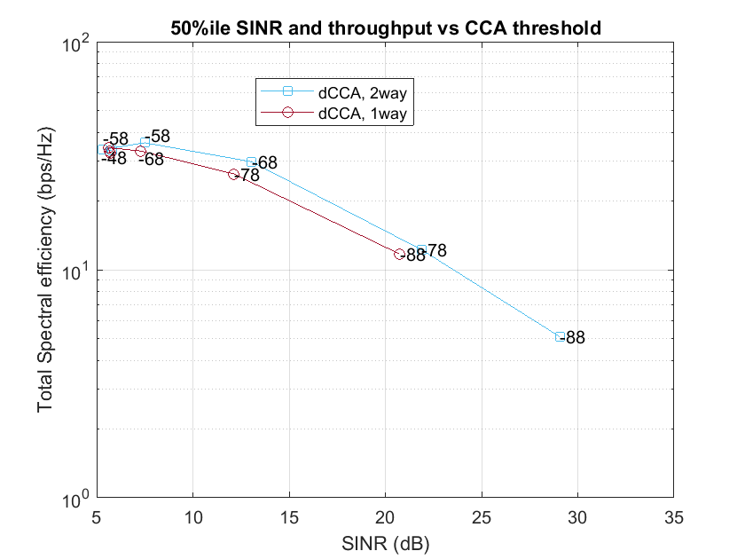
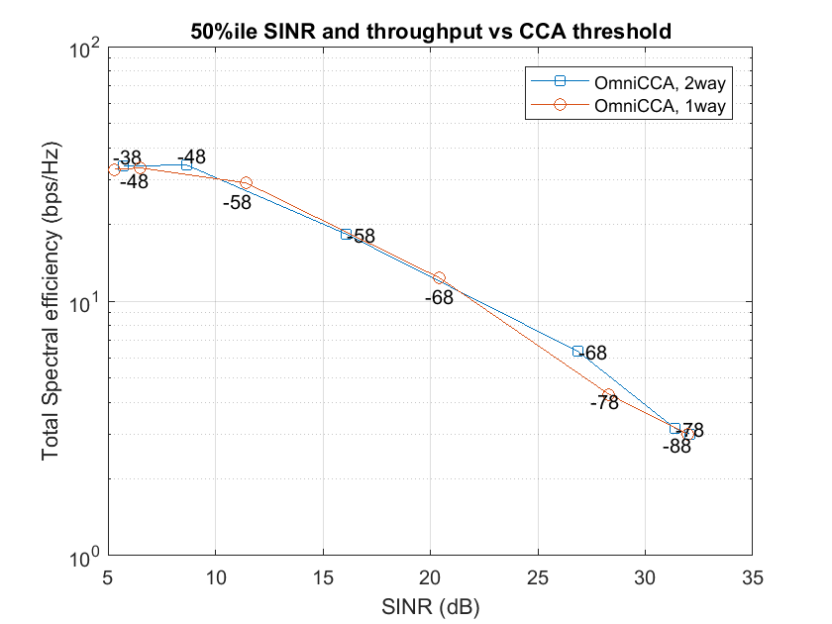
Scenario 3: 8x2 array, directional CCA (Indoor scenario)
Directional CCA doesn’t degrade the trajectory, but only the optimal CCA thresholds may change, as the TX node now has a more telescopic view of the world
  Directional CCA applicable to P2P links
Directional CCA is slightly superior to Omni CCA, in terms of the sum throughput achievable, provided it is performed at both sides of the link (RTS-CTS) (loss in airtime for transmitting RTS and CTS is not accounted here)
Single link throughput
Single link throughput

Slide 16
High density Outdoor scenario
20 users (10 links)
User density: 320 users/km²
Area: 250x250 m²
EIRP: 40dBm

Slide 17
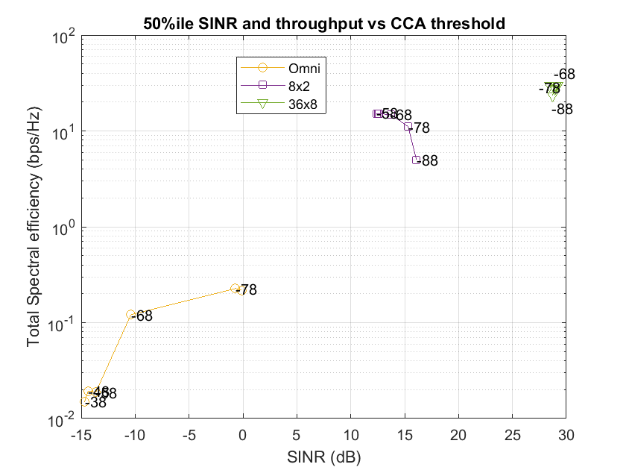
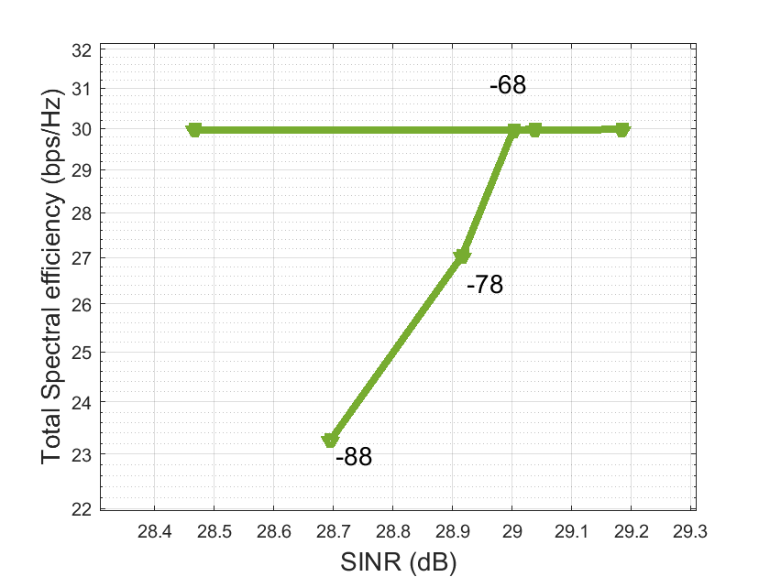
Trajectory of SINR and Total Spectrum Efficiency (SE) vs CCA threshold (Outdoor scenario)
For outdoor scenario, with 40dBm EIRP, we see similar behavior between Omni and directional antennas
In this case omni antenna with 40dBm cannot close the link
Zoom-in at 36x8
Single link throughput

Slide 18
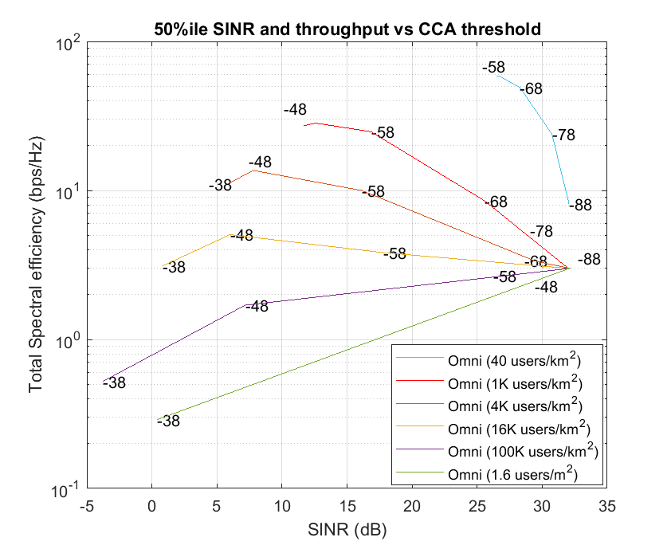
Density and Spatial Reuse – more density values
Omni systems, 40dBm EIRP
How does the trajectory vary with different user densities (users/km²)?
For devices with Omni antenna, as density increases the trajectory varies as follows
  At low densities, the best system throughput is achieved at high CCA thresholds, or when CCA is turned off
  At mid densities, an optimal point (CCA threshold) is seen where system throughput is maximized
  At high densities, CCA thresholds should be set to low values, as the system throughput falls below single link throughput if more than one device starts transmitting
Highest
achievable
Total SE and
50%ile SINR
Increasing
user density
Single link throughput

Slide 19
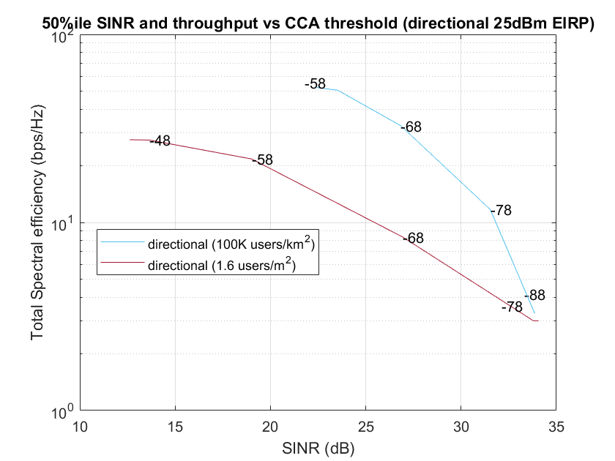
Density vs Spatial Reuse – more density values
Directional system with Omni CCA
In the case of directional antenna, even at extreme densities (1.6users/m²), higher CCA thresholds provide the better system throughput
Single link throughput

Slide 20
Conclusion
We showed that the current preamble detect level of -68dBm, which corresponds to MCS1 sensitivity, likely adapted from 2.4/5 GHz omni systems, is very suboptimal from spatial reuse perspective
Our study shows that for directional systems with any kind of CCA spatial capacity improves with increasing (relaxing) the CCA (preamble detect) threshold
For example, a 10 dB relaxation of CCA level to -58 dBm increases the spatial capacity by 66%
We also observe that additional mechanisms such as directional CCA with RTS/CTS results in incremental spatial capacity improvement compared to relaxing the CCA threshold

Slide 21
Straw poll
Do you support further study of EDMG CCA level with the goal of relaxing it?
  Yes:
  No:
  Abstain:

