Slide 1
Adjacent Channel Rejection Requirement
Name | Affiliation | Address | Phone | Email
Djordje Tujkovic | Facebook | 1 Hacker Way Menlo Park, CA 94025 |  | djordjet@fb.com
Alireza Mehrabani |  |  |  | tarighat@fb.com
Krishna Gomadam |  |  |  | kgomadam@fb.com
Nabeel Ahmed |  |  |  | nabeel@fb.com
Payam Torab |  |  |  | ptorab@fb.com
Nikolas Olaziregi | Nokia | Copernicuslaan 50, 2018 Antwerp, Belgium |  | nikolas.olaziregi@nokia.com
Michael Grigat | Deutsche Telekom | Deutsche-Telekom-Allee 7, 64372 Darmstadt, Germany |  | m.grigat@telekom.de

Slide 2
Background, Outline
DMG (and EDMG) are the only 802.11 PHYs that have not specified Adjacent Channel Rejection (ACR) requirements
In this contribution,
  We present a simulation model and results for DMG
  Example specifications for adjacent channel rejection for DMG
  Run two straw polls for DMG and EDMG

Slide 3
Key Components Impacting ACI Rejection
LNA non-linearity
Analog baseband low-pass filter (LPF)
ADC sampling rate
Digital low-pass filter and/or raised-cosine filter
LNA
Analog BB-LPF
ADC
Digital RRC-LPF

Slide 4
Key Components Impacting ACI Rejection (DMG)
Example simulation parameters
  LNA IP1dB: -33dBm
  LNA NF: 9dB
  Analog LPF: 5th order Butterworth, cut-off (-3dB) frequency: 1.3GHz, input referred SNR of 35dB
  ADC sampling rate: 2x1.76GHz=3.52GHz
  Raised cosine filter: 0.25 roll-off, 12-tap
  Frequency offset between target and adjacent waveforms: -40ppm
  In addition to above explicit contributors to RX EVM, an implementation loss of 3dB and RX EVM floor of 24dB are included.
LNA
Analog BB-LPF
ADC
Digital RRC-LPF
Other Losses

Slide 5
DMG Baseline simulation (no ACI)

Slide 6
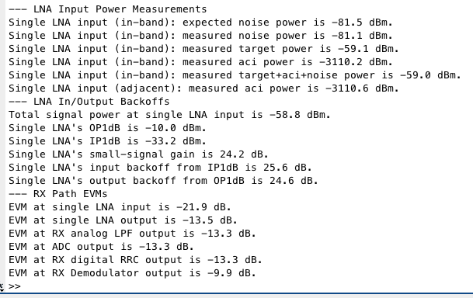
Baseline Simulation: MCS9 without ACI
LNA
Analog BB-LPF
ADC
Digital RRC-LPF
Other Losses
EVM: -21.9dB
Sig Power: -59dBm
Noise Power: -81dBm
EVM: -13.5dB
EVM: -13.3dB
EVM: -13.3dB
EVM: -13.3dB
EVM: -9.9dB
~2.5dB margin to SNR requirement

Slide 7
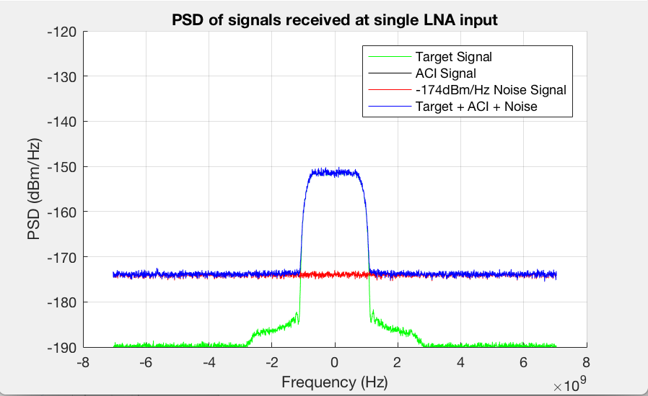
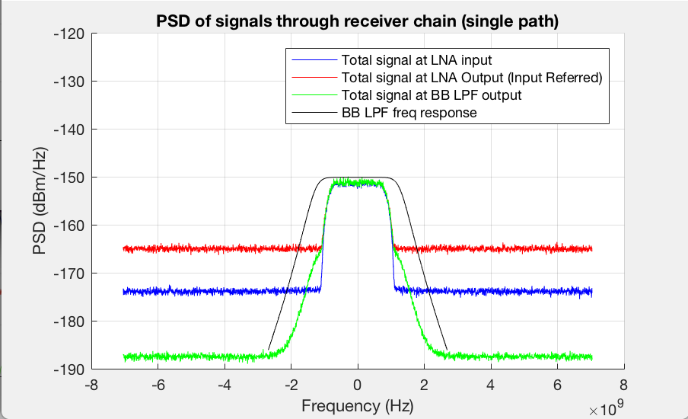
Baseline Simulation: MCS9 without ACI
LNA
Analog BB-LPF
ADC
Digital RRC-LPF
Other Losses
EVM: -21.9dB
Sig Power: -59dBm
Noise Power: -81dBm
EVM: -13.5dB
EVM: -13.3dB
EVM: -13.3dB
EVM: -13.3dB
EVM: -9.9dB
35dB

Slide 8
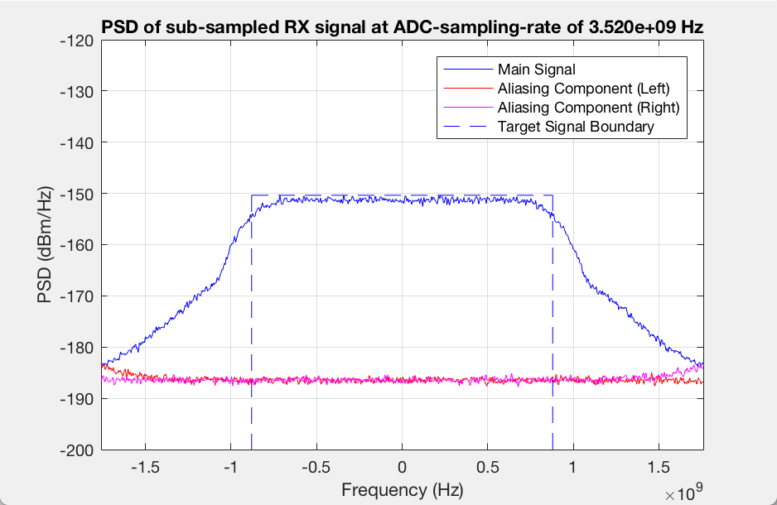
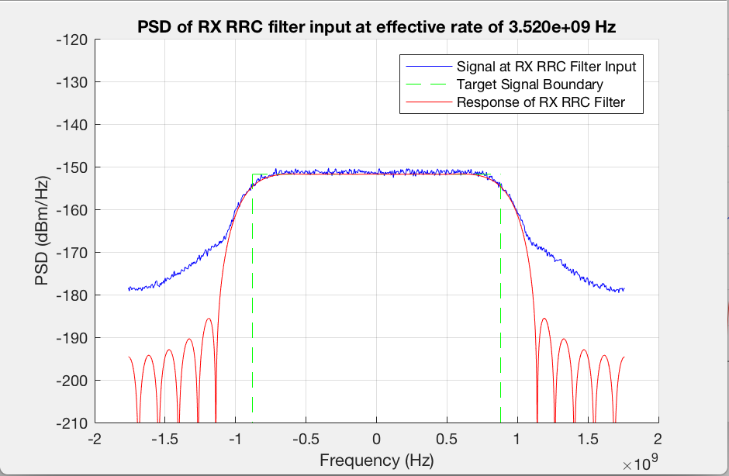
Baseline Simulation: MCS9 without ACI
LNA
Analog BB-LPF
ADC
Digital RRC-LPF
Other Losses
EVM: -21.9dB
Sig Power: -59dBm
Noise Power: -81dBm
EVM: -13.5dB
EVM: -13.3dB
EVM: -13.3dB
EVM: -13.3dB
EVM: -9.9dB
Analog LPF NF dominates aliased in-band noise

Slide 9
ACI Rejection simulation

Slide 10
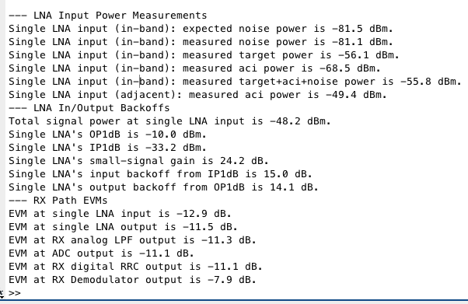
ACI Rejection Simulation: MCS9
LNA
Analog BB-LPF
ADC
Digital RRC-LPF
Other Losses
EVM: -12.9dB
Sig Power: -56dBm
ACI Power: -49dBm
Noise Power: -81dBm
EVM: -11.5dB
EVM: -11.3dB
EVM: -11.1dB
EVM: -11.1dB
EVM: -7.9dB
~0.5dB margin to SNR requirement

Slide 11
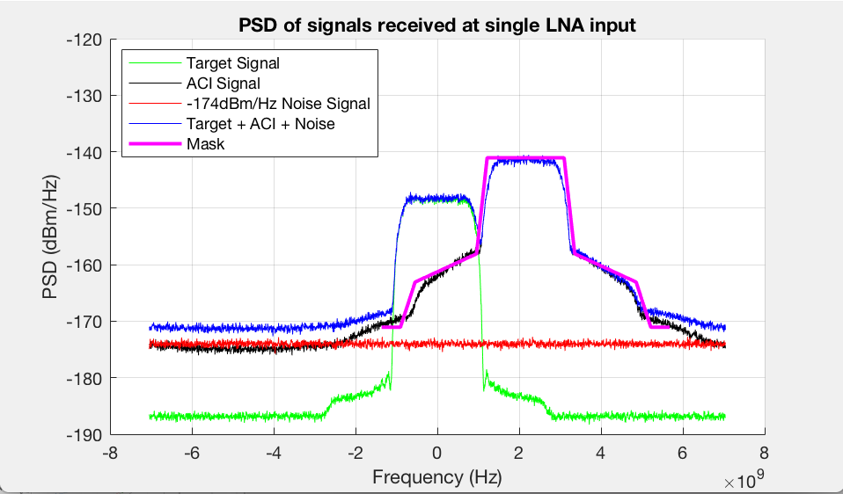
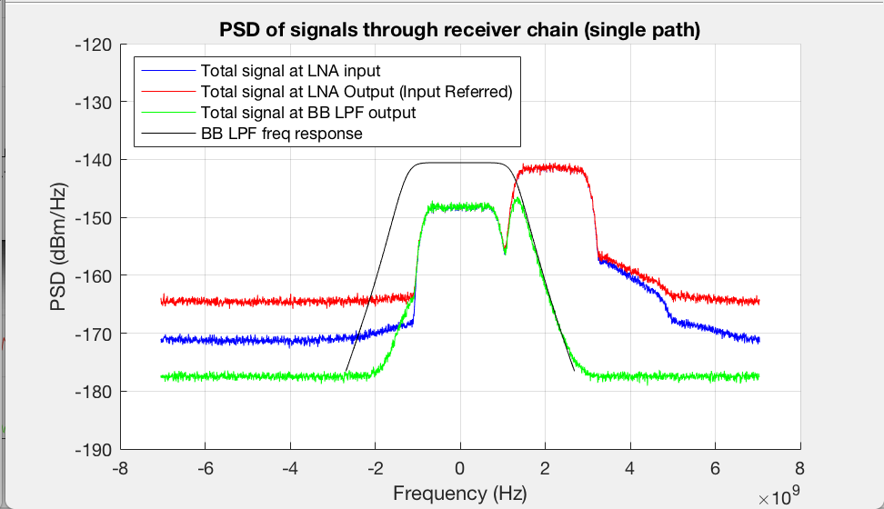
ACI Rejection Simulation: MCS9
LNA
Analog BB-LPF
ADC
Digital RRC-LPF
Other Losses
EVM: -12.9dB
Sig Power: -56dBm
ACI Power: -49dBm
Noise Power: -81dBm
EVM: -11.5dB
EVM: -11.3dB
EVM: -11.1dB
EVM: -11.1dB
EVM: -7.9dB
29dB

Slide 12
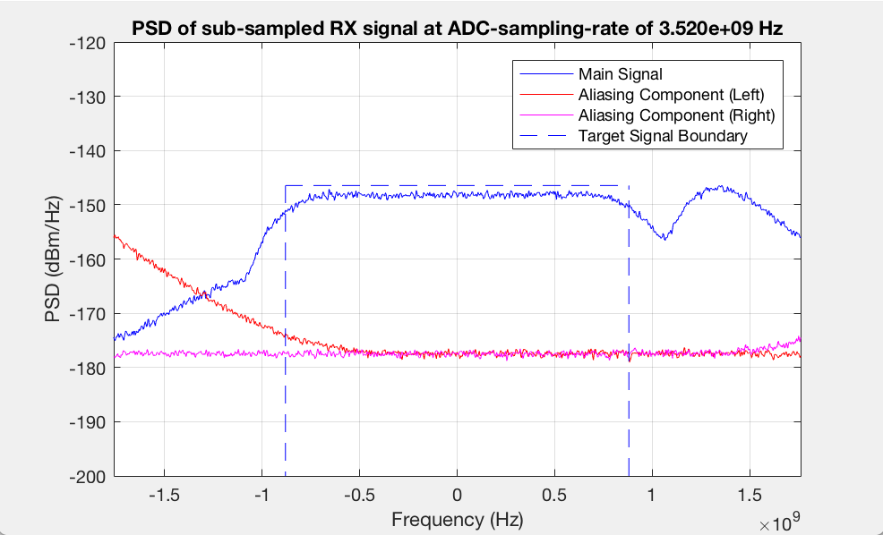
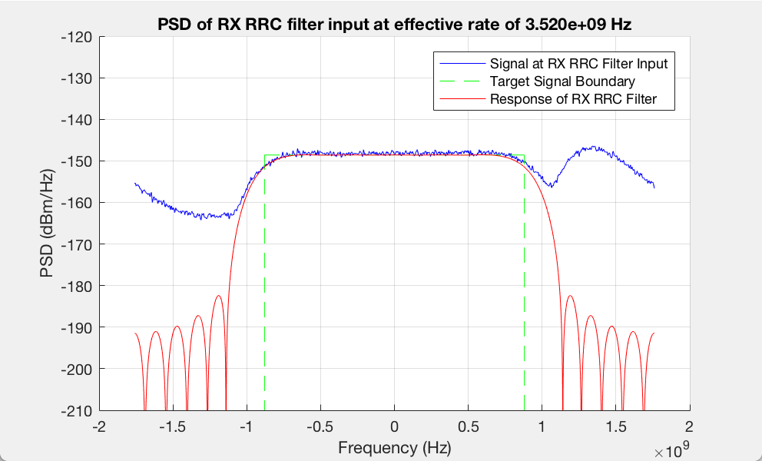
ACI Rejection Simulation: MCS9
LNA
Analog BB-LPF
ADC
Digital RRC-LPF
Other Losses
EVM: -12.9dB
Sig Power: -56dBm
ACI Power: -49dBm
Noise Power: -81dBm
EVM: -11.5dB
EVM: -11.3dB
EVM: -11.1dB
EVM: -11.1dB
EVM: -7.9dB
Elevated Aliased In-Band Interference

Slide 13
RX EVM vs. ACI Power: MCS9
Simulation parameters
LNA IP1dB: -33dBm
LNA NF: 9dB
Analog LPF: 5th order Butterworth, cut-off (-3dB) frequency: 1.3GHz, input referred SNR of 35dB
ADC sampling rate: 2x1.76GHz=3.52GHz
Raised cosine filter: 0.25 roll-off, 12-tap
Frequency offset between target and adjacent waveforms: -40ppm
Additional implementation loss: 3dB
RX EVM floor: 24dB
Target: MCS9 @ -56dBm (3dB above sensitivity)
Observation
Considering target SNR of ~7.5dB for MCS9 decoding, ACI level of -49dBm can be rejected ( +7dBr)
MCS9 Requirement

Slide 14
RX EVM vs. ACI Power: MCS12
Simulation parameters
LNA IP1dB: -33dBm
LNA NF: 9dB
Analog LPF: 5th order Butterworth, cut-off (-3dB) frequency: 1.3GHz, input referred SNR of 35dB
ADC sampling rate: 2x1.76GHz=3.52GHz
Raised cosine filter: 0.25 roll-off, 12-tap
Frequency offset between target and adjacent waveforms: -40ppm
Additional implementation loss: 3dB
RX EVM floor: 24dB
Target: MCS12 @ -50dBm (3dB above sensitivity)
Observation
Considering target SNR of ~13dB for MCS9 decoding, ACI level of -49dBm can be rejected ( +1dBr)
MCS12 Requirement

Slide 15
Dependency on Key Parameters (MCS9)
MCS9 Requirement
MCS9 Requirement
Analog LPF: 3rd order Butterworth, cut-off freq.: 1.0GHz
ADC sampling rate: 1.5x1.76GHz=2.64GHz
Analog LPF: 5th order Butterworth, cut-off freq.: 1.3GHz
ADC sampling rate: 2x1.76GHz=3.52GHz

Slide 16
Example Adjacent Channel Rejection Specs
Example 1
Example 2
MCS | Adjacent channel rejection (dBr)
0
1
2
3
4
5
6 | +10
7
8 | +8
9 | +6
10
11
12 | -9
MCS | Adjacent channel rejection (dBr)
0
1
2
3
4
5
6 | +12
7
8 | +9
9 | +7
10
11
12 | -1
Analog LPF: 3rd order Butterworth, cut-off freq.: 1.0GHz
ADC sampling rate: 1.5x1.76GHz=2.64GHz
Analog LPF: 5th order Butterworth, cut-off freq.: 1.3GHz
ADC sampling rate: 2x1.76GHz=3.52GHz

Slide 17
Adjacent Channel Rejection Specification Framework
Starting with DMG, i.e., a Clause 20 section (see the straw poll)
  EDMG requirements added later in Clause 30
Language similar to other PHYs (except 1% PER)
  “Adjacent channel rejection is measured by setting the desired signal’s strength 3dB above the IEEE MCS-dependent sensitivity, and raising the interfering signal power until 1% PER for the PSDU length of 4096 octets. The difference in power between the signals in the interfering channel and the desired channel is the corresponding adjacent channel rejection. The center frequency of the adjacent channel is 2.16 GHz away from the center frequency of the desired channel.”
Interfering signal assumed to be a valid DMG signal

Slide 18
Straw poll 1 – Adjacent channel rejection requirements
Do you agree with having ACR requirements for TDD-capable DMG devices?
 | Mandatory (“shall”) for TDD-capable DMG devices | Recommended (“should”) for TDD-capable DMG devices
Yes:
No:
Abstain:

Slide 19
Straw poll 2 – Adjacent channel rejection requirements
Do you agree with having Mandatory ACR requirements for EDMG devices?
  Yes:
  No:
  Abstain:

Slide 20
backup

Slide 21
Receiver Tolerance to High Input Power (1/2)
802.11ad spec already mandates receivers to decode a signal arriving at 10microwatt/cm², with same performance as sensitivity level.
Input power at single LNA input
  10microwatt/cm2 = -20dBm/cm²
  Antenna spacing (half wavelength) ~ 2.5mm
  ~16 elements within 1cm²
  Power received per antenna ~ -20-10*log10(16)=-32dBm
  Considering 2dB loss from antenna to RFIC port, power at LNA input ~-34dBm

Slide 22
Receiver Tolerance to High Input Power (2/2)
Let’s use the same receiver model in this contribution to evaluate this requirement for MCS12 (no ACI)
LNA
Analog BB-LPF
ADC
Digital RRC-LPF
Other Losses
EVM: -27.7dB
Sig Power: -34.1dBm
Noise Power: -81dBm
EVM: -23.5dB
EVM: -18.0dB
EVM: -17.8dB
EVM: -17.8dB
EVM: -13.9dB
Dominated by LNA non-linearity
~1dB margin to SNR requirement for MCS12
LNA Non-linearity impact

Slide 23
PA Model to Create 802.11ad Mask
PA model is reused from 11ad evaluation methodology document.
Rapp model with following parameters is used:
  g=4.650, Asat=0.580, s=0.810, alpha=2560, beta=0.114, q1=2.4, q2=2.3

