Slide 1
Updated results on WUR performance with multiple TX antennas
Date: 2018-05-07
Authors:

Slide 2
Introduction
Studies so far looked at WUR performance with single Tx antenna
AP will Transmit with multiple antennas, to be compatible with legacy WLAN devices (Example: .11ax, .11ac)
How to best make use of multiple Tx antennas for the WUR transmission?
Legacy preamble uses CSD for multi antenna transmission, with CSD of 200 ns for second Tx antenna (Table 19-9 in the Spec)
In this presentation we address what CSD values are good for WUR in different scenarios: low and high data rates, different channel conditions, different number of Tx antennas

Slide 3
Impact of CSD on WUR performance
Not using any CSD can create undesired nulls at some of the STA locations
The RF signals from the multiple antennas can add up destructively at the receiver, depending on the location of the receiver
Impact of CSD
CSD changes the shape of waveform
May result in variations of performance
CSD can create increased frequency selectivity of channel
How much more frequency selectivity can we observe in 4 MHz bandwidth

Slide 4
WUR packet structure
24 µs
Legacy+WUR mark
Wake-up preamble
MAC header
Payload
FCS
Low Rate
S
S
128 µs
Higher Rate
S Complement
64 µs
S: 32 bit sequence, with bit duration of 2 usec

Slide 5
WUR multi antenna transmission with CSD per OFDM symbol
WUR Packet
OFDM Symbol 1
OFDM Symbol 2
--------
OFDM Symbol N
Tx1
H1
CSD
CSD
CSD
WUR Packet
OFDM Symbol 1
OFDM Symbol 2
--------
OFDM Symbol N
H2
Rx
Tx2
For Tx2, the WUR packet is constructed by applying cyclic shift to each OFDM symbol in the STF/LTF/Preamble/Data fields
The overall Tx power was equally divided among the Tx antennas
MISO channel with correlated small scale fading across the TX antennas
The RF signal from Tx1 and Tx2 are combined at the Rx

Slide 6
Receiver Processing
The RF signals from multiple Tx are combined at the Rx
The combined RF signal correlated with 32-bit sequence 2S-1, to determine rate and timing
OOK decoding is done based on the estimated timing

Slide 7
Simulation parameters
TX Parameters
2 Transmit antennas, with CSD values = [0 200 400 600 800 1000 1500 3000] ns
For low rate, we used 13 L-STF coefficients to generate the 4 us OOK pulse
For high rate, we use optimized 7 IFFT coefficients (with 32 pt. FFT approach) to generate 2 us OOK pulse [1]
RX Parameters
4 MHz LPF (IIR) – generated using MATLAB
Third order Butterworth filter
Cutoff freq. = 2.5 MHz, Sampling freq. =160 MHz
Processed both I and Q component of received signal
Channels: AWGN and Channel D
No phase noise and No ACI
2.4 GHz band operation
SNR measured at 20 MHz bandwidth

Slide 8
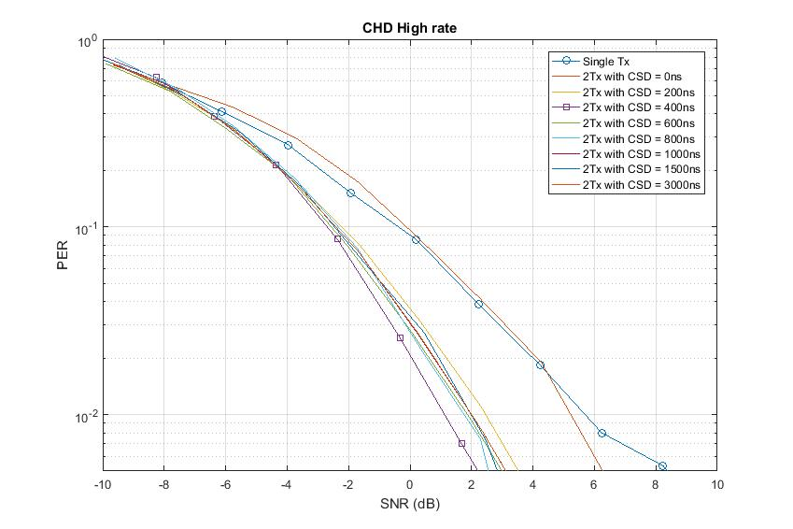
Performance in Channel D (2 Tx case)
Performance gains with CSD in Channel D
Diversity gain from increased frequency selectivity (even with 200 ns legacy CSD value)
Following CSD values provides best performance with 2 Tx antennas
CSD = 3000 ns for Low rate, CSD = 400 ns for high rate
Performance difference between different CSD: 1 dB (Low rate @1% PER) and 1.5 dB (High rate @1% PER)

Slide 9
Channel D, 2 Tx antennas
Low rate
High rate
Scenario | SNR @10% PER | SNR @ 1% PER
Single Tx | -3.95 dB | 1.48 dB
2 Tx, CSD = 0 ns | -3.51 dB | 2.38 dB
2 Tx, CSD = 200 ns | -4.87 dB | -0.37 dB
2 Tx, CSD = 400 ns | -5.33 dB | -1.05 dB
2 Tx, CSD = 600 ns | -5.61 dB | -0.88 dB
2 Tx, CSD = 800 ns | -5.04 dB | -0.67 dB
2 Tx, CSD = 1000 ns | -5.34 dB | -0.60 dB
2 Tx, CSD = 1500 ns | -5.36 dB | -0.92 dB
2 Tx, CSD = 3000 ns | -5.72 dB | -1.06 dB
Scenario | SNR @10% PER | SNR @ 1% PER
Single Tx | -0.37 dB | 5.69 dB
2 Tx, CSD = 0 ns | -0.11 dB | 5.23 dB
2 Tx, CSD = 200 ns | -2.22 dB | 2.46 dB
2 Tx, CSD = 400 ns | -2.69 dB | 1.12 dB
2 Tx, CSD = 600 ns | -2.56 dB | 1.87 dB
2 Tx, CSD = 800 ns | -2.33 dB | 1.76 dB
2 Tx, CSD = 1000 ns | -2.41 dB | 1.99 dB
2 Tx, CSD = 1500 ns | -2.45 dB | 1.99 dB
2 Tx, CSD = 3000 ns | -2.41 dB | 2.00 dB
In general, Higher CSD values provides better performance
Provides more phase variations within the 4 MHz bandwidth
Best performance: CSD = 3000 ns for Low rate, CSD = 400 ns for high rate

Slide 10
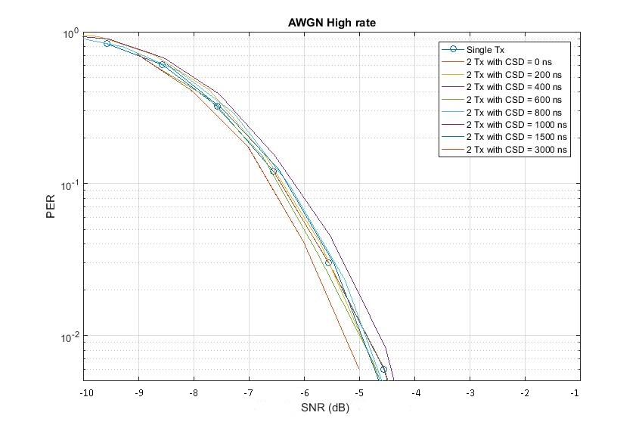
Performance in AWGN (2 Tx case)
High data rate: Performance difference between different CSD values < 0.8 dB
Low data rate: Very poor performance for certain CSD values (200, 800 and 1000 ns)
In AWGN, applying CSD is equivalent to using different OOK pulse
Effective pulse transmitted on air = OOK pulse form Tx1+cyclic shifted version of the pulse
For certain CSD values, the shape of effective pulse not suitable for AWGN channel (Appendix)
The choice of CSD = 3000 ns for low rate and CSD = 400 ns for high rate works well even in AWGN
No observable performance degradation, compared to single Tx antenna case
Optimum CSD setting can be dependent on the choice of 2 us/4 us OOK pulse shape!

Slide 11
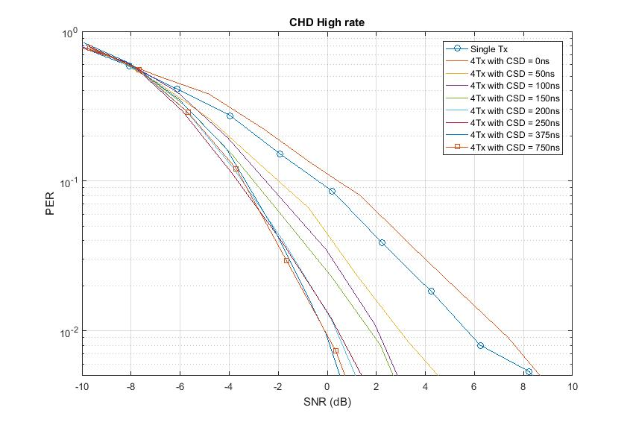
Performance in Channel D (4 Tx case)
Here, CSD is delay between two successive antennas
For Example, CSD = 50 ns => [0 50 100 150] ns delay for Tx1, Tx2, Tx3 and Tx4
Performance gains with CSD in Channel D
Diversity gain from increased frequency selectivity (even with 200 ns CSD)
Following CSD values provides best performance with 4 Tx antennas
CSD = 750 ns for both Low and High rate
Performance difference between different CSD: 4 dB (Low rate @1% PER) and 3 dB (High rate @1% PER)

Slide 12
Channel D, 4 Tx antennas
Low rate
High rate
Scenario | SNR @10% PER | SNR @ 1% PER
Single Tx | -3.95 dB | 1.48 dB
4 Tx, CSD = 0 ns | -3.34 dB | 3.05 dB
4 Tx, CSD = 50 ns | -4.64 dB | 1.31 dB
4 Tx, CSD = 100 ns | -5.26 dB | -0.58 dB
4 Tx, CSD = 150 ns | -5.50 dB | -1.32 dB
4 Tx, CSD = 200 ns | -6.04 dB | -1.93 dB
4 Tx, CSD = 250 ns | -6.08 dB | -2.26 dB
4 Tx, CSD = 375 ns | -6.04 dB | -2.07 dB
4 Tx, CSD = 750 ns | -6.63 dB | -2.72 dB
Scenario | SNR @10% PER | SNR @ 1% PER
Single Tx | -0.37 dB | 5.69 dB
4 Tx, CSD = 0 ns | 0.44 dB | 7.07 dB
4 Tx, CSD = 50 ns | -1.98 dB | 2.95 dB
4 Tx, CSD = 100 ns | -2.51 dB | 2.05 dB
4 Tx, CSD = 150 ns | -3.00 dB | 1.75 dB
4 Tx, CSD = 200 ns | -3.46 dB | 0.36 dB
4 Tx, CSD = 250 ns | -3.55 dB | 0.43 dB
4 Tx, CSD = 375 ns | -3.33 dB | -0.11 dB
4 Tx, CSD = 750 ns | -3.43 dB | -0.11 dB
In general, Higher CSD values provides better performance
Provides more phase variations within the 4 MHz bandwidth
Best performance: CSD = 750 ns for both Low and high rate

Slide 13
Summary
Studied impact of multiple TX antennas on the WUR performance
Applying CSD in Channel D improved performance, due to increased frequency selectivity
Legacy CSD = 200 ns is reasonably good, but not the best
CSD = 3000 ns (low rate) and CSD = 400 ns (high rate) provides best performance for 2 TX antennas
CSD = 750 ns provides best performance for both low and high data rate with 4 TX antennas
Optimal CSD setting can be a function of the 2 us/4 us OOK pulse shape
Applying CSD in AWGN is equivalent to changing the OOK pulse
Some CSD values can cause significant performance degradation (up to 3 dB in low rate!)

Slide 14
References
[1] Vinod Kristem, Shahrnaz Azizi, Thomas Kenney, “2 us OOK pulse
for high rate, IEEE 802.11-18/97r0,” January 2018

Slide 15
Appendix

Slide 16
Envelope of combined OOK pulse (Low rate)
For CSD values of 200 ns, 400 ns and 800 ns, the resulting pulse shape is not so suitable for AWGN
Ideal rectangular pulse works best for AWGN

Slide 17
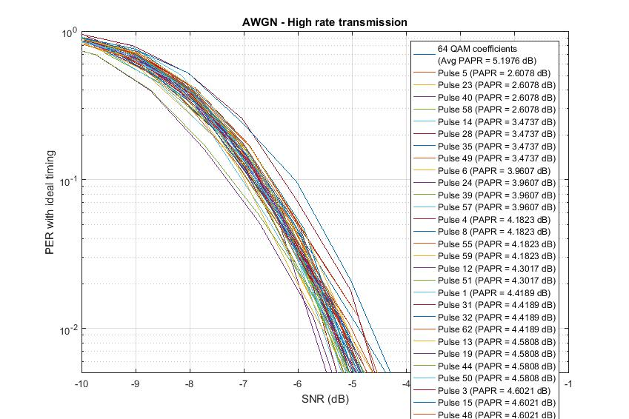
Performance with 32 pt FFT Approach (AWGN)
Performance shown for 64 different pulse shapes
Shape of the pulse has a significant impact on performance, although the energy in the pulse is the same
1.5dB @ 10% PER and @ 1% PER

Slide 18
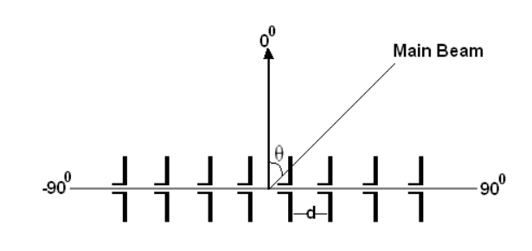
WUR AWGN modeling (with random Departure angle)
WUR RX
Here, we model the random phase between the pulses transmitted from the multiple TX antennas
Generated the Angle of Departure (AOD) ~ U[-180 deg,180 deg]
Phase difference between successive TX antennas – exp(j*pi*cos(AOD))
CSD applied on top of the random phase
WUR TX

Slide 19
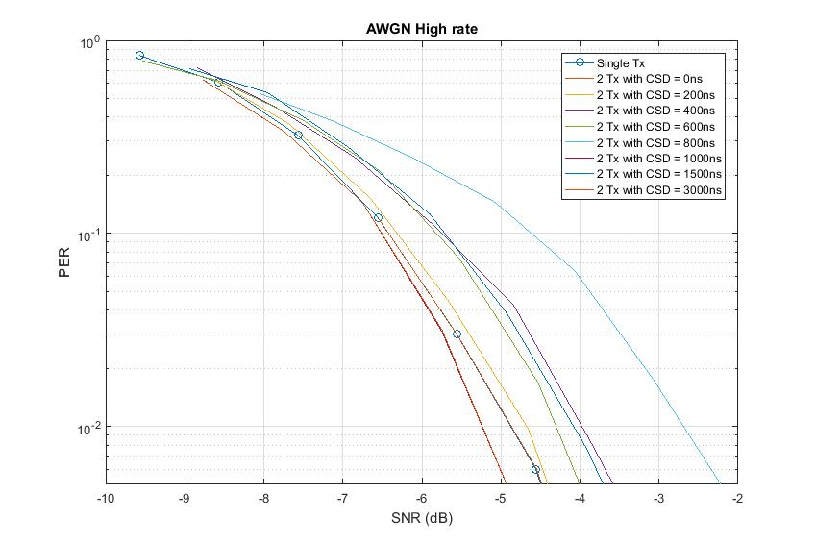
Performance in AWGN (With CSD and random phase)
Performance gap between different CSD values increased when random phase is modeled
Introducing random phase with CSD will further change the shape of the combined OOK pulse
Performance gap between CSD values is 2 dB (@10% PER)
Consistent with our earlier observations that changing 7 IFFT coefficients can result in this kind of performance differences.

