Slide 1
Differential OOK for WUR
Date: 2018-04-30
Authors:

Slide 2
Background
OOK Modulation is not robust in noisy environments with broadband noise/interferer
Sending the OOK WUR pattern sequentially on two frequencies could solve this disadvantage.

Slide 3
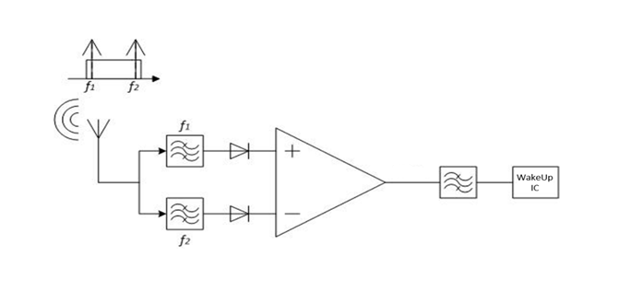
Differential FSK WuRx Approach
Main Features
  Two different frequency channels modulate complementary signals.
  Differential wake-up signal.
Goals
  Sensitivity increment.
  Enhanced noise/interferer resilience.
  Low power consumption

Slide 4
Sensitivity results
Comparison between the OOK and the FSK WuRx for the address-based detection mode.

Slide 5
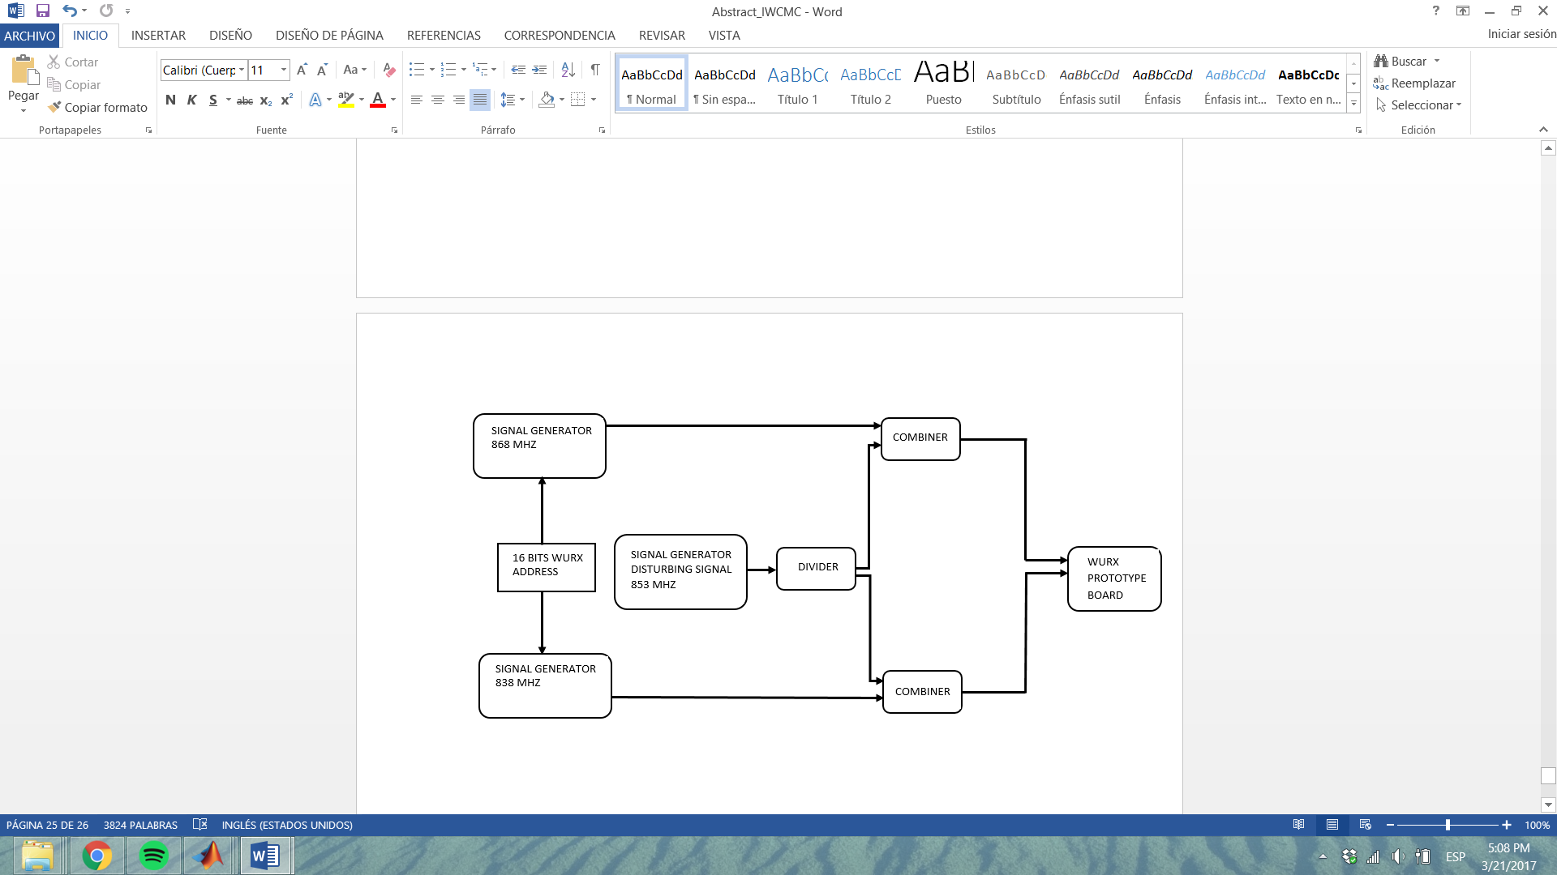
Analysis of the noise resilience
Measurement setup for analyzing the noise/interferer resilience of the FSK WuRx.
  Generate an interferer and add it to the wake-up signals.

Slide 6
Results of the interferer resilience analysis
Interferer: pulsed signal of 200 Hz modulated on a 853 MHz.
Difference Amplifier Gain = 20 V/V
Wake-up modulating frequency = 20 kHz

Slide 7
Summary of the presented FSK WuRx
Features of the FSK WuRx
  Sensitivity: [-54 dBm @120 kHz, -61 dBm @20 kHz ].
  Data rate: 8.1 kbps
  Current consumption: 11.2 μA
  Power consumption: 70.2 μW
  Noise/Interferer resilience:
    -17/-16 dB CIR (in-band interferers)
    Up to -39 dB CIR for out-of-band interferers.

Slide 8
Reference
[1] J. Saez, T. Ungan, L. M. Reindl and T. Kumberg, "Development and characterization of a robust differential wake-up receiver for wireless sensor networks," 2017 13th International Wireless Communications and Mobile Computing Conference (IWCMC), Valencia, 2017, pp. 1209-1214 URL: http://ieeexplore.ieee.org/stamp/stamp.jsp?tp=&arnumber=7986457&isnumber=7986245

