Slide 1
Field Measurement Results for Distribution Networks and Short Range Devices Coexistence – Part 2
Date: 2018-05-08
Name | Affiliation | Address | Phone | Email
Sam Alex | Facebook | 1 Hacker Way Menlo Park, CA 94025 USA |  | sampalex@fb.com
Alireza Mehrabani |  |  |  | tarighat@fb.com
Nabeel Ahmed |  |  |  | nabeel@fb.com
Payam Torab |  |  |  | ptorab@fb.com
Djordje Tujkovic |  |  |  | djordjet@fb.com
Michael Grigat | Deutsche Telekom | Deutsche-Telekom-Allee 7, 64372 Darmstadt, Germany |  | m.grigat@telekom.de

Slide 2
Background
Motivation is to study coexistence between Short Range DMG Devices (SRDs) and TDD-capable DMG devices serving the Fixed Wireless Access (FWA) use case [1]
  Reminder: TDD-capable DMG devices utilize service period (SP) allocations and are 802.11ad-compliant
Previously, we showed ray tracing simulations for both indoor and outdoor scenarios in [2] and [3], respectively
We also showed field measurements for coexistence between FWA and SRDs that use scheduled service period (SP) allocations [3]
  Summary from [3]: No significant throughput drop under aggressive corner case scenarios

Slide 3
Outline of presentation
In this presentation we focus on field measurements for outdoor scenarios with SRDs that use contention based access period (CBAP) allocation
  Study includes corner case measurements with high EIRP and perfect alignment between SRD and Distribution Network links
We also address the following 2 questions raised by group in past meetings
  Impact of TDD devices to SRD performance when links are perfectly aligned, i.e., is there a permanent blocking effect in limited number of cases?
  Expected coex performance with low-cost FWA devices utilizing lower antenna gains
Preliminary simulation and field measurements show healthy coexistence between TDD-capable DMG devices with transmit power control and SRDs utilizing both CBAP and SP allocations

Slide 4
Field Measurement: Test cases
Standalone baseline reference
  FWA without external interference (can be found in [3])
  SRD devices without interference
Coex performance
  Impact of FWA to SRD with max Tx EIRP
  Impact of FWA to SRD with Tx power control
  Impact of SRD to FWA
Deployment scenario
  Collinear links
  Perpendicular links and various angles between SRD link and FWA link

Slide 5
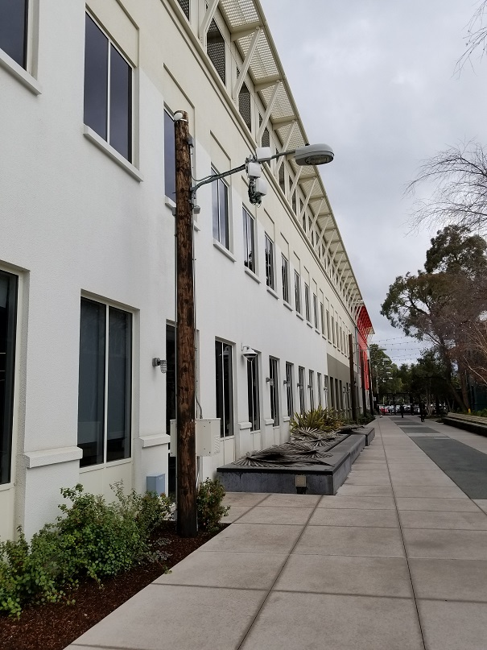
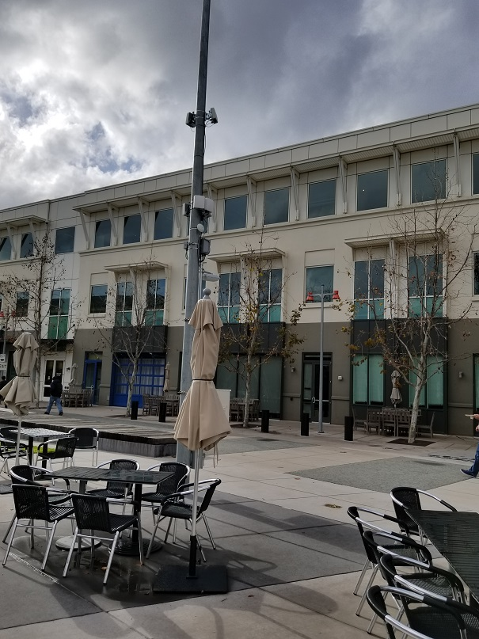
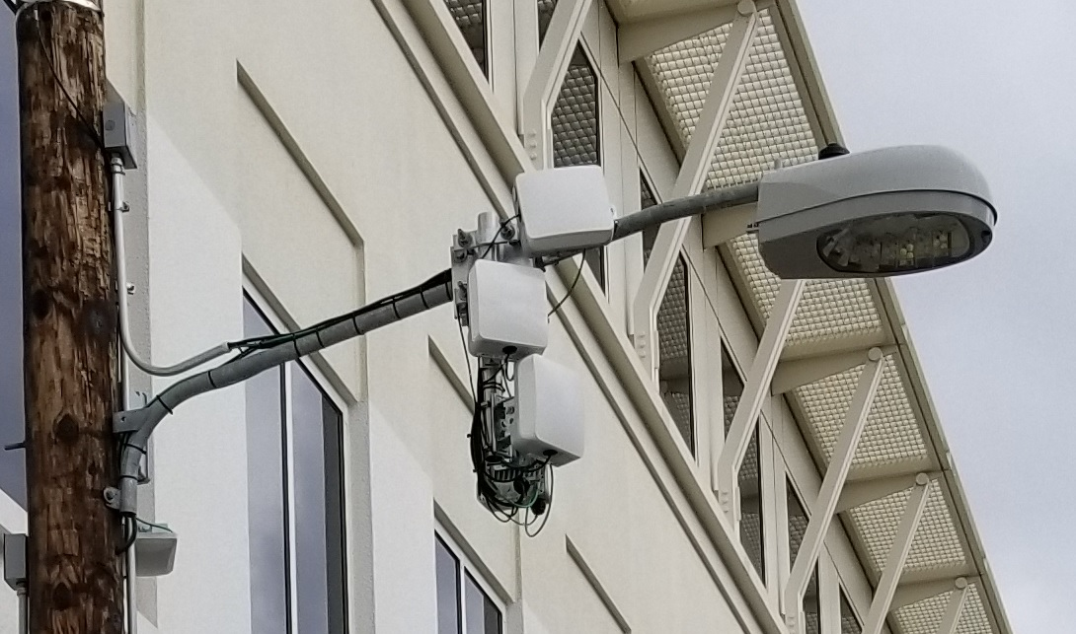
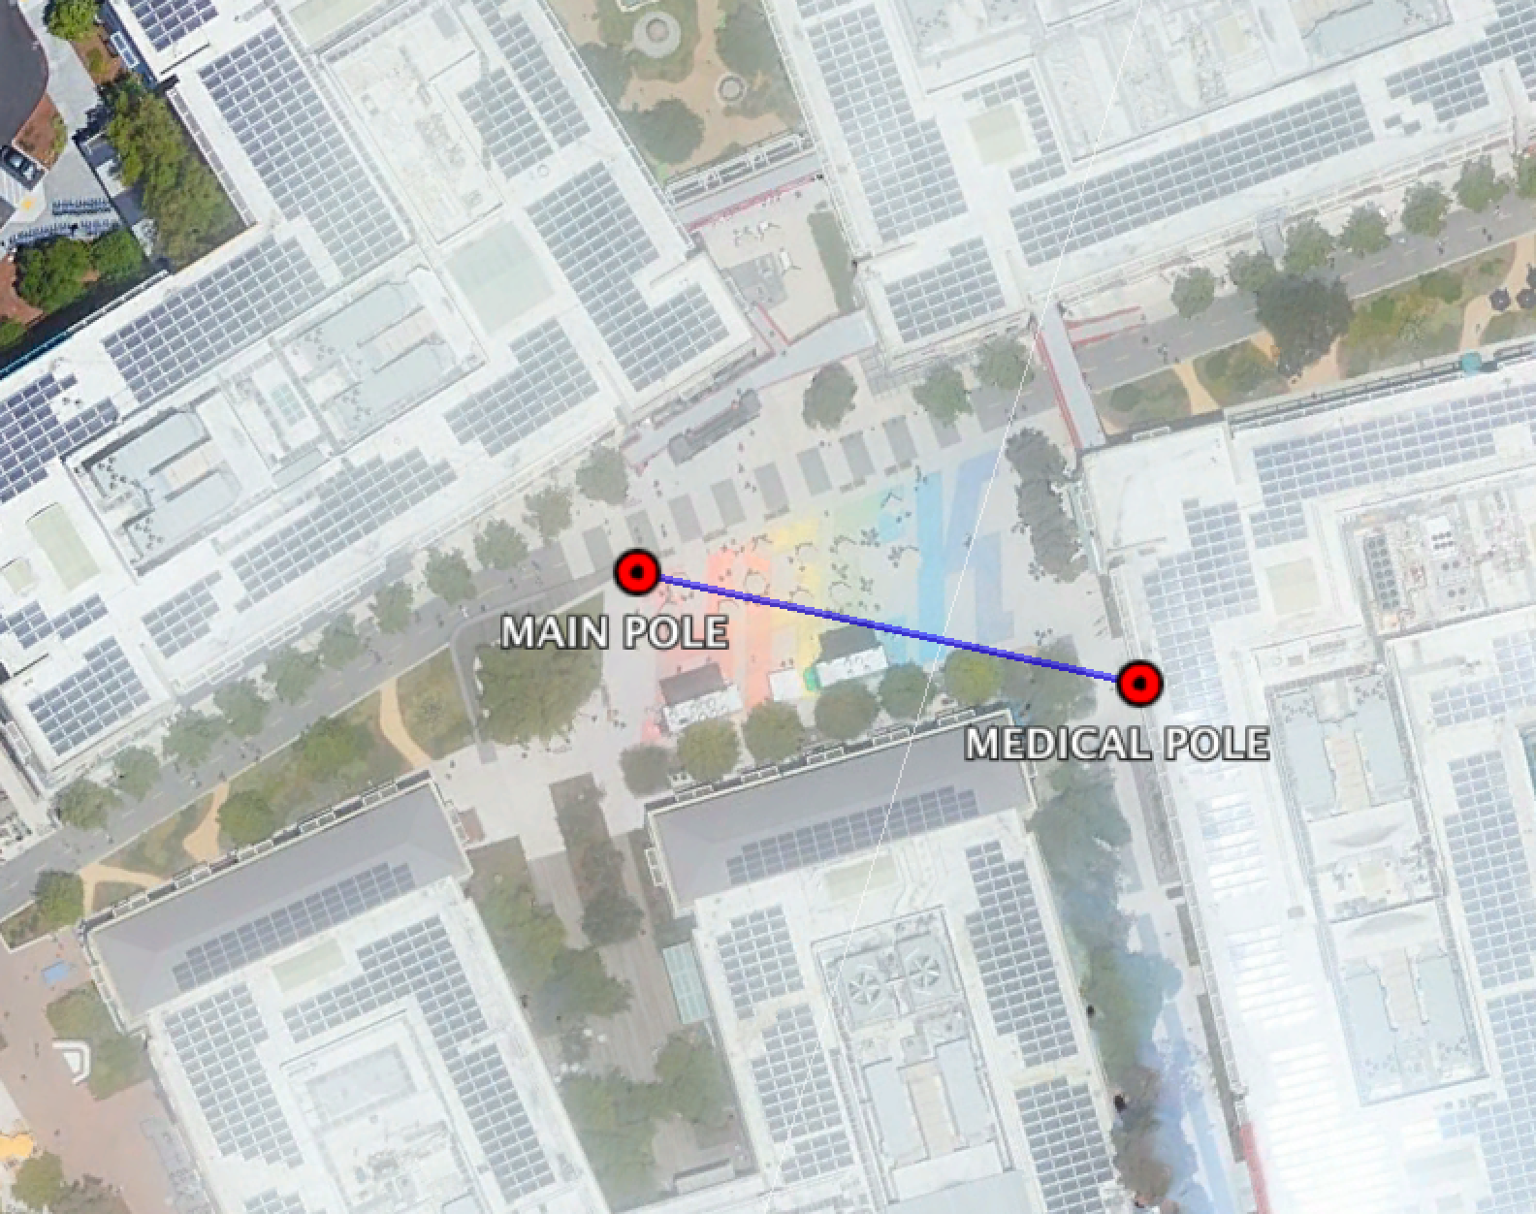
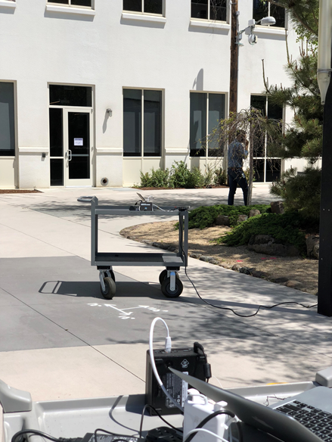
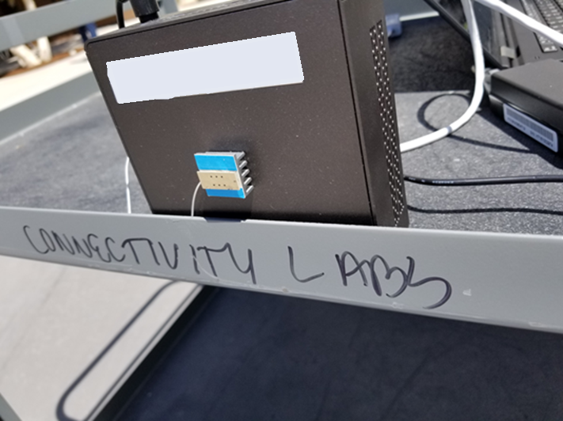
Test setup and equipment
Measurements performed at Facebook campus in Menlo Park, CA (Hacker square comparable in size to the simulated City square scenario)
FWA device: 60GHz TDD-capable prototype
SRD: Qualcomm 60GHz 11ad test device using CBAP
DN1
DN2
DN2
DN1
SRD link
WiGig test
device (AP/STA)

Slide 6
Equipment Specifications
SRD
  EIRP ~ 20-25dBm, ~12-15dBi antenna gain, varies with pointing direction
  3Gbps (unidirectional) offered UDP traffic
  Automatic MCS selection
TDD-capable device
  36 horizontal x 8 vertical elements, ~30dBi antenna gain
  Transmit power control (TPC) with maximum average EIRP = 40dBm
    Also manually tested transmit power up to max ~45dBm to create aggressive scenarios
  TCP 1Gbps + 1Gbps bidirectional offered traffic
  Automatic MCS selection

Slide 7
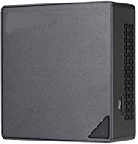
Measurement setup
(TPC/max 45dBm)
(TPC/max 45dBm)
FWA link
6m
SRD link
1m<link_dist<20m
1m
Distribution node 1 (DN1)
50m
Distribution node 2 (DN2)
Single 50m DN-DN link at Hacker square, 6m above the ground, line of sight (LOS)
SRD link in between the two DNs, 1m above the ground
Baselines established for both SRD and FWA devices, with no interference
DN-DN link configured for either 35dBm (as TPC selected Tx power level with lot of margin for 50m link) or 45dBm (the maximum Tx power capability)
Note: 45 dBm is not allowed in any country at this time (just a temporary experiment)

Slide 8
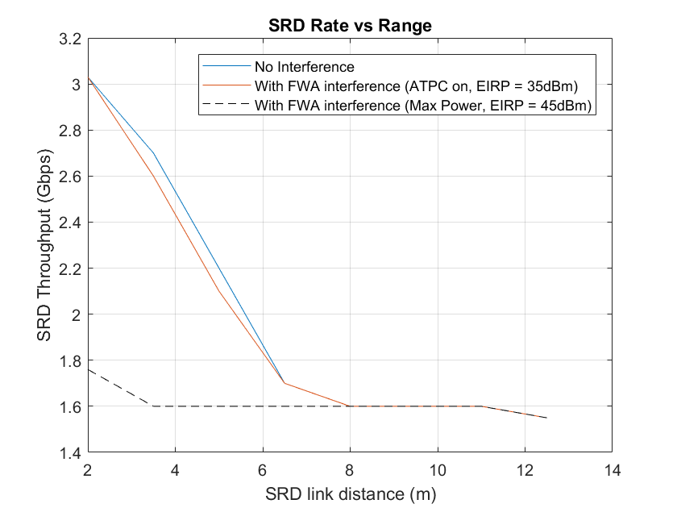
SRD Throughput Impact – Static Inline Scenario
The plot shows SRD throughput as a function of SRD link distance with and without inline (collinear) interference
Baseline: SRD without interference
Interference scenario
  In the presence of interference throughput is capped without TPC
  With TPC degradation is minimal relative to the baseline (no interference)
Link Alignment
  SRD performance improves when links are misaligned, such that full SRD throughput is achieved when the links are perpendicular
ACI scenario
  No impact with SRD and TDD links on different channels

Slide 9
Effect of link alignment (1)
We created a lab setup to study the extremely rare scenario of perfect and static alignment between TDD and SRD links on the same channel and with full buffer traffic – to investigate if SRD link experiences permanent blocking
  A high interference scenario is artificially generated in the lab in a 10m x 15m area
  FWA links are place around 15m from each other and full power is transmitted (approx. 45dBm) on both the FWA nodes (again, 45 dBm is above regulatory limits in all countries)
  UDP traffic is enabled on the SRD link and SRD throughput is plotted. SRDs are placed around 1.5m away from each other
  100% loading on the FWA link

Slide 10
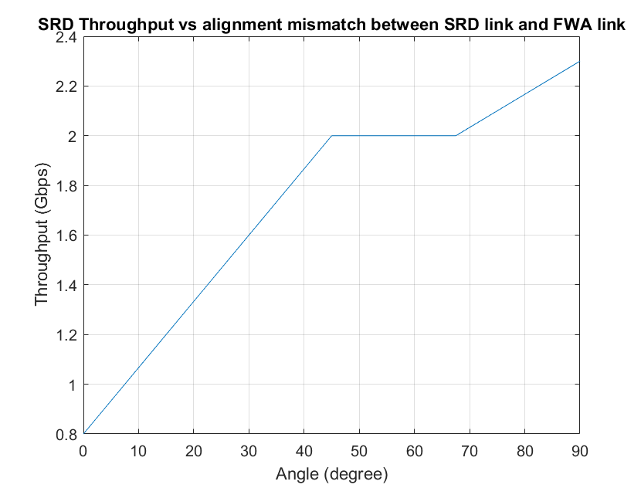
Effect of link alignment (2)
In spite of perfect link alignment and 100% loading, SRD was still able to pass traffic, with no loss of control function or link disconnect and provided around 0.8 Gbps throughput
Misalignment, as expected, improved throughput on SRD link, reaching +75% of full link capacity when the links are perpendicular to each other
75% of baseline throughput with perpendicular arrangement
Worst-case SRD throughput (SRD links perfectly aligned and static, TDD link 45 dBm EIRP and 100% duty cycle)

Slide 11
Operation under collinear static alignment
Periods with no interference from FWA links (aka CCA-idle periods)
From [3], owing to TPC on FWA nodes, SRD will in the worst case experience interference with high enough power to trigger the CCA only from one side of the FWA link
With TDD allocation on FWA link, CCA-idle opportunities always exist
  Equal 200 µsec TX/RX slots in each direction used in the measurement experiment
  Even for asymmetric bidirectional traffic, minimum allocation in opposite direction is required for BACK, TCP ACKs, and link maintenance
  Beam direction switching to reach multiple client nodes (12-16 client nodes in our prototype)
  As a half-duplex packet-switched link layer protocol (and 802.11ad compatible), TDD operation always provides idle periods, i.e., link utilization can never reach 100%

Slide 12
Operation under collinear static alignment
Idle periods utilized by SRD to start the TXOP
With aSlotTime of 5µs and contention window (CW) decrements performed on a per slot basis, opportunities for SRD to establish TXOP are abundant
From [3], upon establishing TXOP, performance of SRD link is governed by SINR, which is showed in [3] to be sufficiently good for healthy throughput irrespective of TX/RX duty cycle

Slide 13
TDD mode idle periods and SRD performance
SRD Transmission
(TXOP/SP)
>10dB SINR
In very aggressive worst cases (ref [3])
Preamble detect
level -68 dBm
Preamble detect level
TDD
Transmission (several tens of microseconds)
TDD
transmission
TDD
transmission
aSlotTime
CCA clear
CCA triggered
EDCA backoff
TXOP acquired (or SP) (several milliseconds)
(sufficient SINR)

Slide 14
Impact of link loading
We changed the TDD link loading in our lab setup to emulate different idle period durations; measured UDP throughputs (listed below) show sharing
Total throughput of FWA and SRD links indicates medium shared fairly and efficiently
Point-to-point SRD link in this case utilized quasi-omni pattern for CCA and -68 dBm preamble detection threshold
  Using directional pattern for CCA (valid for P2P links), and/or defining higher level for CCA threshold would provide even higher utilization of wireless medium
Scenario | TDD link loading | SRD throughput (Gbps) | Total (SRD+FWA) throughput (Gbps)
Both TDD devices transmitting at full buffer | Maximum | 0.8 | 2.8
One TDD device transmitting at full buffer, the other transmitting Block ACK and management/control frames | ~50% | 1.6 | 2.6
No data transmission in either direction, sporadic management and control frames | ~0% | 3.0 | 3.0

Slide 15
EIRP vs Antenna gain (1)
All simulations and field measurements show minimal impact on SRD with high antenna gains for TDD links
How about fixed wireless links with low-gain antennas (larger antenna beamwidths) that could potentially interfere with SRDs over larger areas?
These devices should have limited EIRP, depending on the potential interference that they can cause
Deciding the EIRP vs. gain is a regulatory (geography dependent) topic
  Typical language is X dB EIRP penalty (backoff) for each dBi antenna gain below a certain threshold (less antenna gain, lower EIRP)
  Some DMG channels may not even be available to SRDs in different regulatory domains

Slide 16
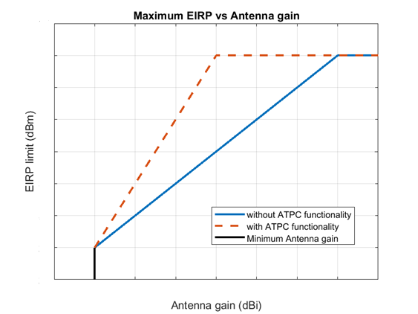
EIRP vs Antenna gain (2)
Refer to discussions in ETSI BRAN and CEPT for formulations under development
Typical EIRP vs. antenna gain targets is shown here
Allowed EIRP normally has a floor, although a cliff requiring minimum antenna gain has also been discussed

Slide 17
Impact of SRD devices to FWA
Some interference to TDD link, due to early weak interference
Using different Golay codes on the TDD link significantly reduced the impact of SRD interference
See [4] for proposed co-channel interference requirements for TDD mode operation

Slide 18
Conclusion
Simulation and field measurements show healthy coexistence between TDD-capable DMG devices with transmit power control and SRDs utilizing both CBAP and SP allocations
No permanent blocking effect observed, even for the worst case of perfectly aligned FWA and SRD links
  When power control is applied at the FWA nodes, there is minimal impact seen on SRD links
  Even without Tx power control, SRD links were seen to be able to coexist well albeit the reduced throughput when FWA was transmitting at the max power (45dBm)
CCA-idle interference periods provide sufficient opportunity to establish TxOP on SRD links
  Upon establishing TxOP, performance of SRD link is governed by SINR, which is to be sufficiently good for healthy Tput irrespective of TX/RX duty cycle

Slide 19
Acknowledgment
The authors would like to thank Qualcomm, for providing their SRD equipment, tools and support for successfully performing the coexistence studies and measurements presented herewith

Slide 20
References
[1] IEEE 802.11-17/1019r0, mmWave Mesh Network Usage Model
[2] IEEE 802.11-18/0131r0, Distribution Networks and Short Range Devices Coexistence
[3] IEEE 802.11-18/0488r1, Field measurement results for distribution networks and short range devices coexistence
[4] IEEE 802.11-18/0750r0, Co-channel Interference Mitigation Requirements for Millimeter wave distribution networks

