Slide 1
1st Vice Chair Report - May 2018 – Warsaw, Poland
Date: 2018-05-07
Authors:

Slide 2
Abstract
Agenda Items for 1st Vice Chair -
M3.3 II Other WG meeting plans
M3.4 II Meeting room locations
M3.5 II Next meeting reminder
M3.6 II Meeting registration
M3.7 II Recording attendance
M3.8 II File server
M3.9 II Breakfast, breaks, Social logistics
Friday:
F3.1.1 II Straw Poll of membership regarding this meeting location
F3.1.2 DT Future venues status and discussion

Slide 3
Monday– 802.11 Opening Plenary
802.11 First Vice Chair Report

Slide 4
M3.3 Other WG meeting plans
802.1 802.3 (Meeting May 21-25)
802.11 802.15 802.18 802.19
802.21 802.24 802.22
Treasurer Report: 11-18/0615r0
Patent policy (in IEEE-SA bylaws), patent policy (slide set), and antitrust guidelines

Slide 5
M3.4 Meeting room locations
Floor plans next two slides.
PROGRAM APP Go to Play Store or App Store Find and Install: The Event App by EventsAir Event Code: 802wirelessinterim Click on AGENDA to see the combined schedule.
To personalise your agenda, please log in using: Login: Your registered email address Password: ieeeieee (please reset your password to change your password)

Slide 6
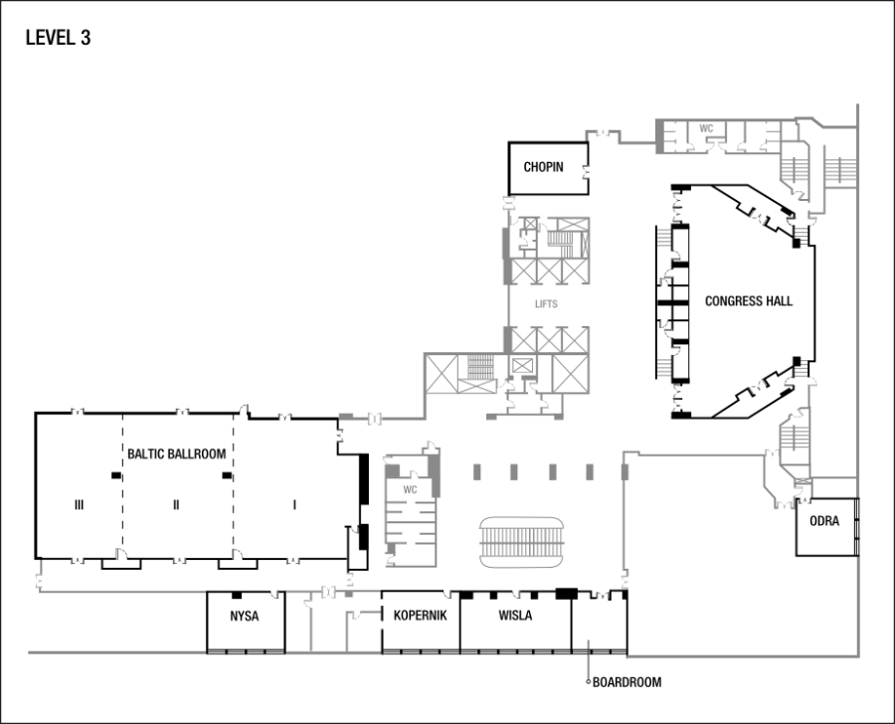

Slide 7
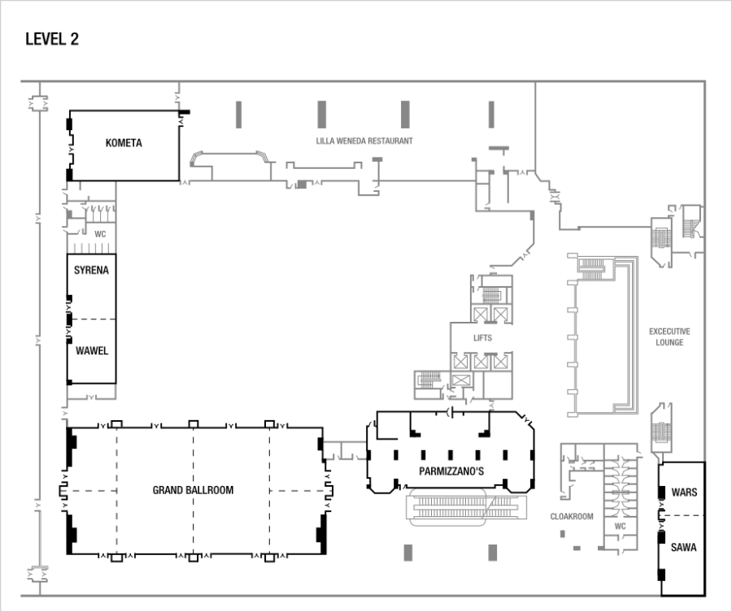

Slide 8
Online Calendar Schedule
The WG meetings can also be added to your calendar.
802.11 WG meeting calendar is here: http://schedule.802world.com/ics/show?group=11
Other WGs and the 802 EC calendar are also available.
Note: the schedule on this calendar will be updated as will IMAT.

Slide 9
M3.5 Next meeting reminder
Next 802 Plenary: 8-13 July 2018–
Grand Hyatt, San Diego, CA, USA Hotel Reservation Meeting Registration
Early registration $800 early, $900 regular, $1100 late with a $300 discount for early/regular/late attendees if attendee stays at least one night in the hotel.
Early Deadline: Friday May 25, 2018
Next 802 Wireless Interim: 9-14 Sept 2018
Hilton Waikoloa Village, Kona, HI, USA
Notes:
ROOM RATES • SINGLE/DOUBLE OCCUPANCY*: $US 199.00 per night *Children 21 years of age and younger may be share accommodations at no additional charge. • EXTRA ADULT*: $US 25.00 per night *Children 21 years of age and younger may be share accommodations at no additional charge. IEEE 802 GROUP RATE DEADLINE Friday June 15, 5:00 PM Pacific Time REGISTRATION for the JULY 2018 session is available. The meeting planner is working with IEEE to ensure that all the necessary protocols are in place for the General Data Protection Regulation (GDPR) roll out on May 25, 2018. IEEE information related to the EU GDPR is available at http://sites.ieee.org/gdpr/ . The registration rates for the July 2018 IEEE 802 Plenary Session in San Diego, CA USA are: $800 early, $900 regular, $1100 late with a $300 discount for early/regular/late attendees if attendee stays at least one night in the hotel room block
Deadlines: Early: Friday May 25, 2018, Regular: Friday June 29, 2018, Late: After Friday June 29, 2018
Attendees urgently requiring a letter of invitation to the JULY session to facilitate a VISA may email 802info@facetoface-events.com with the Subject Line 802-0718-Invitation Letter Request. Invitation letter information required is as follows:
Passport Number:
Passport Country of Issue:
Passport Issue Date: DD/MM/YYYY
Passport Expiration Date: DD/MM/YYYY
Date of Birth: DD/MM/YYYY
City and Country of Birth:
In order to comply with the GDPR regulations, all invitation letter requests must be submitted via the registration site starting May 25, 2018.

Slide 10
M3.6 II Meeting registration
Net Registrations as of Monday AM: 3:44am |  | 279
Reported Primary WG:
802.11 - WLAN (Primary) | 220
802.15 - WPAN (Primary) | 53
802.18 R-Reg (Primary) | 3
802.19 Coexistence (Primary) | 2
802.21- Media Independent Handoff (Primary) | 6
802.24 - Smart Grid (Primary) | 1

Slide 11
M3.7 Recording attendance
It is a requirement that attendees record their participation at an 802.11 session and declare their affiliation. This record is usually made using the IMAT attendance system.
If you wish to participate without recording attendance, send an email per session to the WG 2nd vice chair declaring your participation and affiliation. You cannot gain or maintain 802.11 voting membership using this method.
You must record 75% attendance of required 802.11 slots in a session for that session to count towards gaining or maintaining 802.11 voting membership
You need a single IEEE-SA web account
The IEEE SA web account requires a working email address
do not remove your email address from the account
Use the email address associated with that web account when registering attendance
If you change email addresses, update the web account, don’t create a new web account, or your membership status may not be calculated properly
Record attendance using this URL: IMAT.IEEE.ORG/

Slide 12
M3.8 Local File Document Server information
Links for Attendance, Documents, Registration and information about the session can be found at ieee802.linespeed.io (we recommend creating a bookmark).
Accessible from the Local Wi-Fi network:
SSID: IEEE802 -- Password: ieeeieee

Slide 13
M3.09 FOOD & BEVERAGE
Continental Breakfast
7:30am – 9am
Morning Coffee/Tea
9am – 11am
Afternoon Coffee/Tea/Sodas
2pm – 4pm
Afternoon Snacks
802.1 & 802.3 – 3:00pm
Wireless Groups - 3:30pm
Please notify serving staff if you have any allergies.

Slide 14
M3.09 FOOD & BEVERAGE
IEEE 802 Cash Lunch Sales located at Red Bar, Lobby Level Monday – Thursday 11:30am to 1:30pm. Menu changes daily and includes salads, sandwiches items fresh off the grill plus more.
Cash or credit card only.
Perks Coffee and More, 24-hour Coffee Shop, Entry Level. You can pre-order your lunch & pick up at a time you set;
Charge to your room, cash or credit card
O'H American Grill, Lobby Level. Daily breakfast buffet and lunch buffet for $21 ( Did you recieve your $3 off coupon when you checked into the hotel?); Charge to your room, cash or credit card

Slide 15
Network Assistance
Links for Attendance, Documents, Registration and information about the session can be found at ieee802.linespeed.io (we recommend creating a bookmark).
The Network HelpDesk in Warsaw will be located in the NOC on Level 3 in Nysa.
If you have any issues getting or staying connected during the week, please go to the Network HelpDesk in the NOC on Level 3 in Nysa.

Slide 16
WEDNESDAY SOCIAL
Date: Wednesday May 9, 2018 Time: 6.30pm (pre-dinner drinks from 6pm) Venue: Lilla Weneda, Level 2, Warsaw Marriott Hotel Entertainment: Local Polish Entertainment Dress code: Casual
The dinner will be a stand up dinner, so that you are free to wander around and chat with your colleagues.
During the evening we will be entertained by a local group of folk dancers.
We look forward to seeing you there and enjoying some local Polish food, drink and entertainment.

Slide 17
802.11 Mid-Week Plenary
Agenda Items:
2.5 – Announcements
5.1 – Room Change Reports

Slide 18
W5.1 Room Change Requests
Release:
Add:

Slide 19
802.11 WG Closing Plenary
Agenda Items:
3.1.1 – Straw Poll
3.1.2 -- Future venues status and discussion

Slide 20
F3.1.1 -Straw Poll regarding this meeting location
Straw Poll:
How many people would like to come back to this venue?
Yes --
No –
Like the Social –
Disliked the Social –
Did not go to Social –

Slide 21
F3.1.2: Future Venue Insight
Future 802 Wireless Interims:
September 9-14, 2018, Hilton Waikoloa Village, Kona, HI, USA
January 13-18, 2019 Hilton St. Louis at the Ballpark (TBC)
May 12-17, 2019, Grand Hyatt Atlanta in Buckhead , Atlanta, Georgia, USA
September 15-20, 2019 - Marriott Hanoi, Hanoi Vietnam (TBC)

Slide 22
F3.1.2: Future Venue Insight
Future 802 Plenary Sessions:
July 8-13, 2018 Manchester Grand Hyatt, San Diego, CA, USA
November 11-16, 2018 Marriott Marquis Queen's Park, Bangkok, Thailand
March 10-15, 2019 Hyatt Regency Vancouver and Fairmont Hotel Vancouver, Vancouver, Canada
July 14-19,2019 Austria Congress Centre, Vienna, Austria
November 10-15, 2019 Hilton Waikoloa Village, Kona, HI, USA

Slide 23
References
Plenary Meeting Status File: EC-16/66r2
https://mentor.ieee.org/802-ec/dcn/16/ec-16-0066-02-00EC-802-plenary-future-venue-contract-status.xlsx
802 Executive Secretary Report: EC-18/0028r0

