Slide 1
802.11ax D2.0 Comment Resolution - Discussion on SR and CCA -
Date: 2018-03-05
Authors:

Slide 2
Introduction
In this contribution, we highlight some missing language on CCA behavior which could make the SR mechanism introduced in 11ax D2.0 inefficient

Slide 3
Related Comment on 11ax D2.0
CID | Clause Number(C) | Page(C) | Line(C) | Comment | Proposed Change
14119 | 27.9.2.4 | 295 | 58 | There is no requirement on when the STA that issued the CCARESET.request primitive during the inter-BSS PPDU re-issues the BUSY indication. If there is no such requirement, multiple SR transmissions will just collide with one another. | Define requirement on how the HE STA issues the BUSY indication when a) the inter-BSS is still being sent and b)another HE STA starts an SR PPDU transmission.
Similar concern raised in CID14289

Slide 4
What is OBSS_PD based SR?
From 802.11 D2.0
OBSS_PD based SR (and other SR mechanisms) allows the STA return to CCA IDLE while the OBSS PPDU is being transmitted

Slide 5
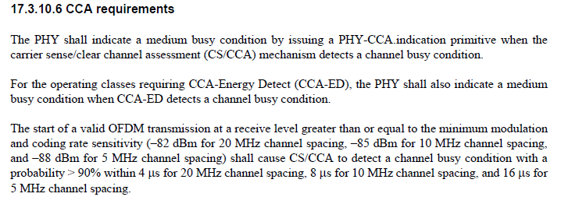
What is the requirement during CCA IDLE?
From 802.11-2016
During CCA IDLE state, the STA is mandated to detect an OFDM transmission that arrives at -82dBm in any SINR condition
* Note: in other PHY Clauses, this requirement is imposed when the medium is "in an otherwise idle channel”, however this condition is omitted here

Slide 6
How does this effect SR?
Will an HE STA that returned to CCA IDLE during OBSS PPDU, be able to detect another signal that arrives above -82dBm, in any SINR condition as required by the specification?
Unlikely if SINR is low
Let’s look at an example…

Slide 7
Example Scenario
STA1
98dB loss
AP A
STA2
STA1 and STA2 are both connected to AP A
The loss between STA1 and STA2 is 98dB
If STA1 transmits at 21dBm, STA2 will receive at -77dBm
If STA1 transmits at 19dBm, STA2 will receive at -79dBm
Both above CCA Thresh.

Slide 8
Example Scenario
STA1
-80dBm
OBSS STA
AP A
-80dBm
STA2
STA1 and STA2 detects an OBSS PPDU at -80dBm
According to the OBSS_PD rule STA1 and STA2 may go back to CCA IDLE if they lower their TxPower from 21dBm to 19dBm

Slide 9
Example Scenario
STA1
19dBm
AP A
19-98= -79dBm
-80dBm
STA2
STA1 wins the contention and start transmission at 19dBm to AP A
STA2 receives STA1 at -79dBm which is above the CCA Threshold
However STA2 can NOT detect STA1 because it is already experiencing -80dBm interference from the OBSS STA

Slide 10
How likely will intra-BSS collision occur during SR?
PHY Header
Data
OBSS PPDU
4000usec
PHY Header
Data
STA1
DIFS
34usec
PHY Header
Data
STA2
Contention Window
……
DIFS34+CW225xSlot9=2059usec
If we assume OBSS PPDU is 4msec, and STA1 and STA2 are using Contention Window=255 (4 collisions), there is 100% probability of collision because min/max wait time both fall within the OBSS PPDU
Collision is likely because all STAs start contention at the same time

Slide 11
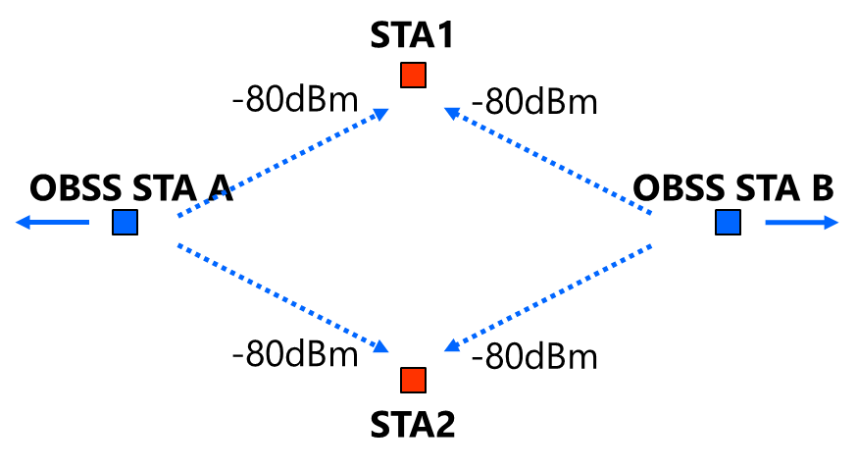
FAQ: Doesn’t this happen already?
YES, but with significantly lower probability
If there are two OBSS STAs(STA A and B above),
that are hidden from one another
which both fall within “above PD (-82dBm), below ED(-62dBm)” range,
transmit PPDUs that partially overlap
then, two intra-BSS STAs may not able to detect each other, causing collision
However, it only takes one OBSS PPDU in SR case, as discussed in prev. slide
The problem existed before SR but surfaced extremely rarely

Slide 12
Conclusion
The document depicted an omission to the baseline spec related to CCA
Because of this omission, STAs will be unable to comply with the baseline spec in low SINR conditions
Because of this omission, HE STAs are very likely to cause intra-BSS collision during SR transmission opportunity

Slide 13
Possible Remedy
17.3.10.6 CCA requirements
Modify the third paragraph as follows:
For a non-HE STA, tThe start of a valid OFDM transmission in an otherwise idle channel at a receive level greater than or equal to the minimum modulation and coding rate sensitivity (-82 dBm for 20 MHz channel spacing, -85 dBm for 10 MHz channel spacing, and -88 dBm for 5 MHz channel spacing) shall cause CS/CCA to detect a channel busy condition with a probability > 90% within 4 us for 20 MHz channel spacing, 8 us for 10 MHz channel spacing, and 16 us for 5 MHz channel spacing.
For an HE STA, the start of a valid OFDM transmission at a signal-to-noise ratio greater than or equal to 6 dB and at a receive level greater than or equal to the minimum modulation and coding rate sensitivity (-82 dBm for 20 MHz channel spacing, -85 dBm for 10 MHz channel spacing, and -88 dBm for 5 MHz channel spacing) shall cause CS/CCA to detect a channel busy condition with a probability > 90% within 4 us for 20 MHz channel spacing, 8 us for 10 MHz channel spacing, and 16 us for 5 MHz channel spacing.

Slide 14
Strawpoll
Do you think a remedy is necessary?
Yes – some standardized rule for signal detection dependent on SINR is necessary (an example in slide 13)
No – keep the spec as is
Don’t Care – I don’t want to hear about SR anymore

