Slide 1
802.11 Full Duplex
Date: 2018-03-06
Authors:

Slide 2
Enabling In-Band Full Duplex Communication
Demonstration of Full Duplex System: Video
This presentation is not intended to sell you on a
particular full duplex implementation

Slide 3
802.11 Full Duplex can enable IEEE 802.11 to keep pace with increased user demand
802.11 Full Duplex will allow simultaneous uplink and downlink on the same spectrum simultaneously
  Maximal use of available spectrum
Benefits of Full Duplex:
  Latency
    Perform control while sending data, cut-through routing, can drastically reduce latency.
  Scalability
    As number of users increase, self-interference cancellation can improve throughput by an order of magnitude.
  Throughput
    For multimedia, gaming and symmetric traffic applications, throughput can be the main value proposition.

Slide 4
Is Full Duplex practical?
Wired standards like DOCSIS have already adopted Full Duplex as part of the standard to leverage its advantages
DOCSIS 3.1 FDX- Standardizes full duplex over 600 MHz of bandwidth with 4K QAM downstream and 1K QAM upstream
  Requires wideband self-interference cancellation and isolation with an ultra-low noise figure
DOCSIS is more difficult due to ultra-long time delays in reflections
WiFi is harder to due rapid channel variations & MIMO
  A challenge that requires quick adaptation and schemes that scale well with antennas

Slide 5
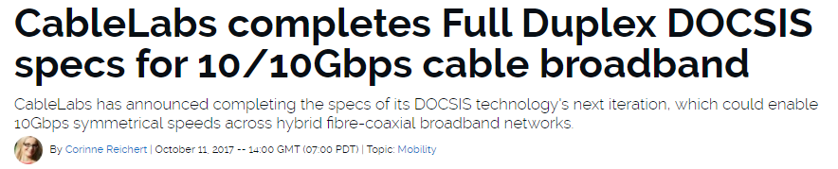
DOCSIS Full Duplex
Full Duplex DOCSIS is being tested today
  Cable Labs interop testing ongoing
  Product releases from Q1 2019 onwards
  WiFi the next step: A symmetric cable link not as useful without a high-throughput WiFi AP

Slide 6
Agenda
What is Full Duplex?
How can 802.11 benefit from Full Duplex?
Technical considerations
Possible implementation options for Full Duplex
Adoption of full duplex to DOCSIS standard
Q&A

Slide 7
Benefits of Full Duplex
Most common misconceptions:
  Only useful when symmetric traffic
  Even then, gives you just 2x benefit in throughput
The reality
  full duplex can mean in-band or adjacent band cancellation
  Adjacent band cancellation results in more users supported and fewer collisions for each node
  If done right, cancel over entire 83 MHz at 2.4 GHz or from 4.9 GHz – 6+ GHz
  Has implications for multi-channel/multi-band systems, relaying, meshing and beyond
Adjacent
In-Band

Slide 8
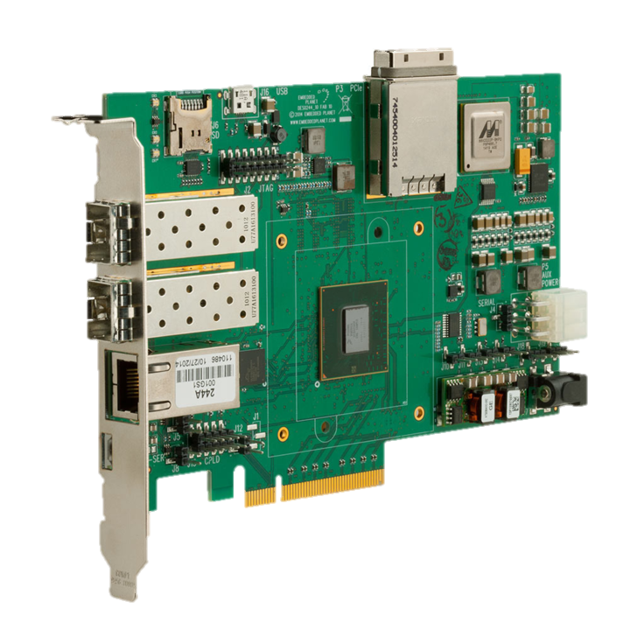
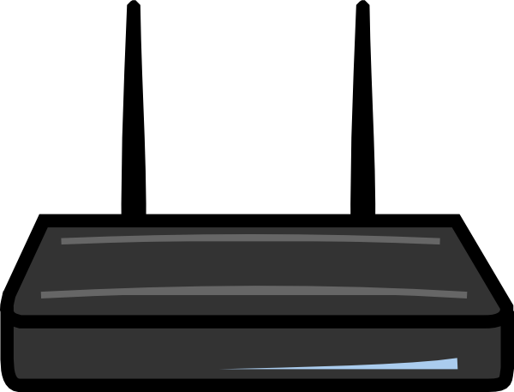
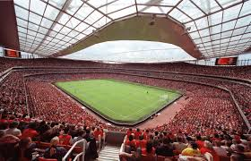
Benefits of Full Duplex
Benefit #1: Channel packing and scalability
  Achieved through adjacent channel interference cancellation
  Channels 1, 6 and 11 or multiple 5GHz bands
Channel 11
Channel 6
Channel 1

Slide 9
Benefits of Full Duplex
Benefit #2: Latency
  In-band or adjacent band
  ACK/NACK and control while doing data
  Cut-through routing and low-latency meshing
Benefit #3: Throughput
  In-band or adjacent band
  Support symmetric or uplink-heavy applications
  Video conferencing, multimedia systems, gaming, IoT and many others

Slide 10
Antenna Spacing based Architectures
Lead by multiple institutions: DoD, Rice University, University of Waterloo
Positives:
Significant Isolation Benefits, compliments other schemes
MIMO compatible
Negatives
Space constraints may limit its applicability

Slide 11
Non-magnetic Circulators based Architectures
Lead by UT Austin, Columbia, University of California
Positives:
Significant Isolation Benefits, compliments other schemes
Non-magnetic, works in small size, weight and power (SWAP)
Negatives
Potentially difficult with MIMO

Slide 12
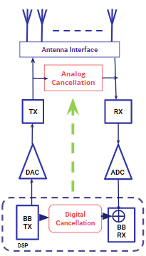
Active Cancellation Architectures
Reflection/Echo signal must be cancelled to allow demodulation of desired Rx signal
  Analog cancellation is mandatory to prevent saturation of front-end LNA due to strong reflections/echoes
  Digital cancellation can augment analog cancellation to enhance interference rejection and improve SNR
30-50dB cancellation
40-50dB cancellation

Slide 13
Active Cancellation Approaches
Lead by DoD, Stanford, Berkeley, UT Austin, Huawei, Intel, Cisco and many many others
Easier to do: Digital Cancellation
Harder: High dynamic range, low NF, power efficient Analog Cancellation
Many approaches
RF delay lines, SAW/BAW and RF phase shifters
Optical and RF/optical hybrid architectures
Positives
MIMO capable, can be compact, wideband and power-efficient

Slide 14
Architectural Benefits
MIMO
  Active cancellation approaches work well with MIMO
  Traditional MIMO complexity is n². It is possible to achieve nlogn using clever schemes
OFDM/OFDMA
  Works well with OFDMA, which offers added benefits in estimation and tracking
  DOCSIS 3.1 FDX based on OFDMA/OFDMA
MAC layer
  Enable a “listen-while-talk” MAC
  Is legacy compatible. Can detect and dynamically adjust for legacy nodes
  Reduces collisions in the overall network

Slide 15
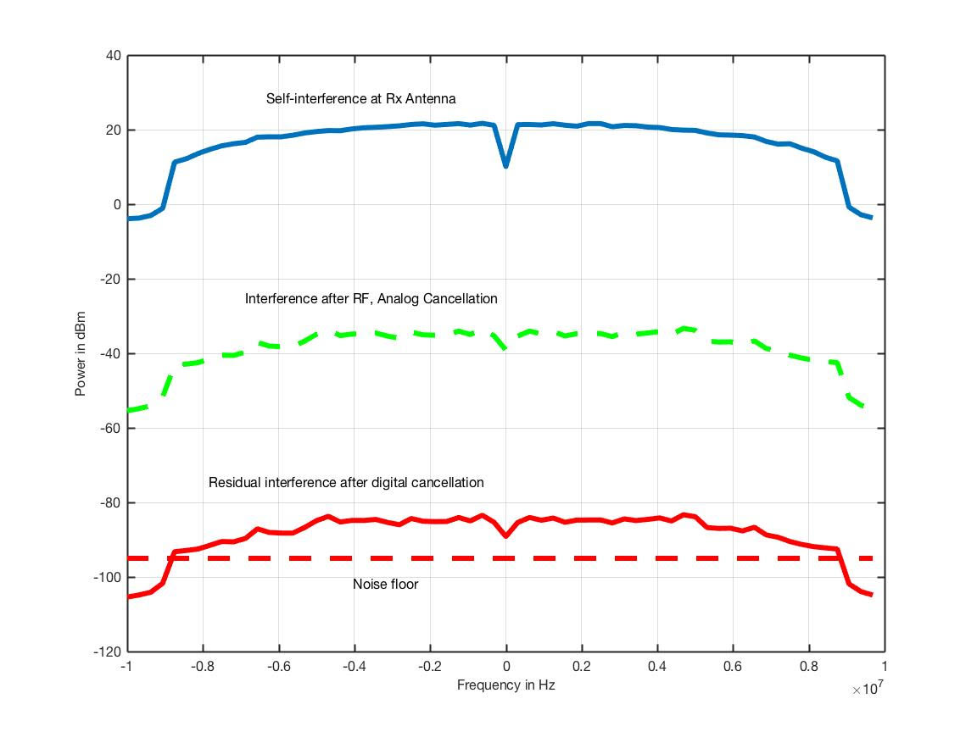
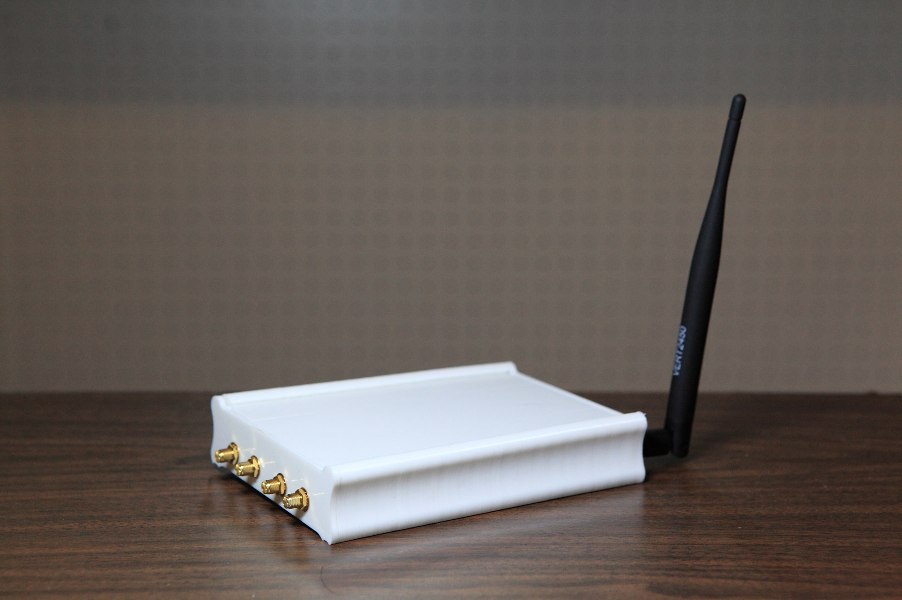
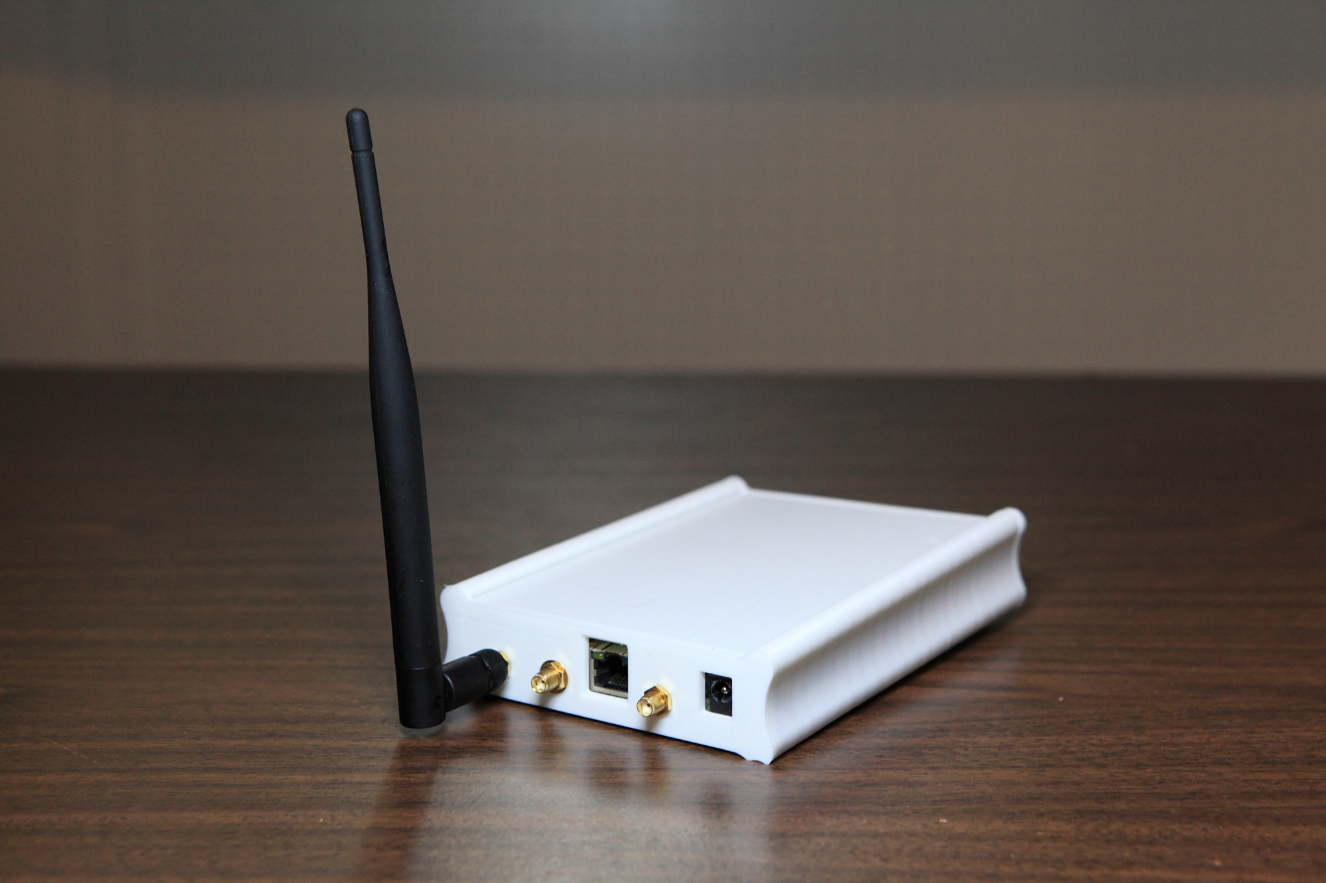
Successful Full Duplex Lab Prototype
Full Duplex 2.4GHz, 20 MHz BW, 100 Mbps
Total cancellation of ~100dB
~50dB
~50dB
Timeframe: March 2016
Notes:
This is for 802.11ac MCS9

Slide 16
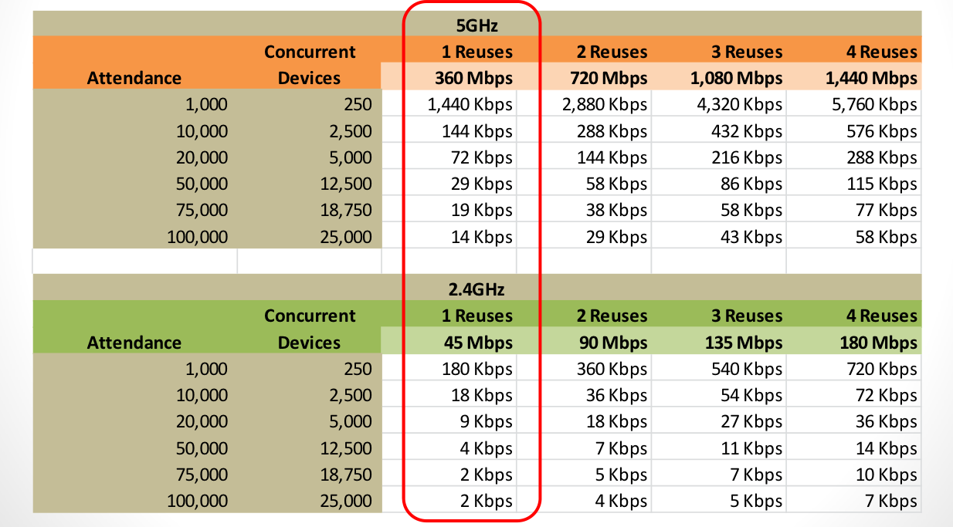
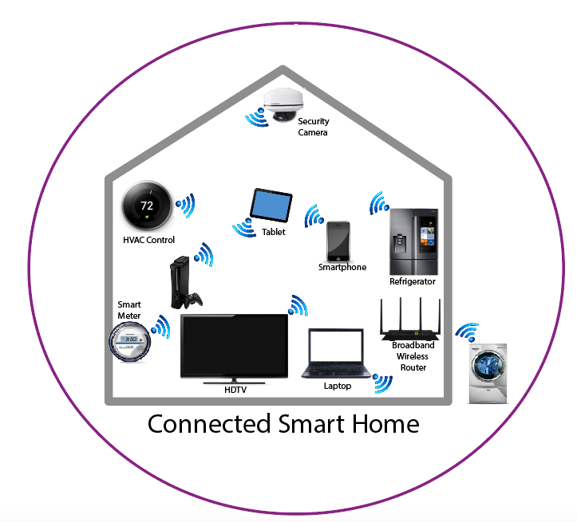
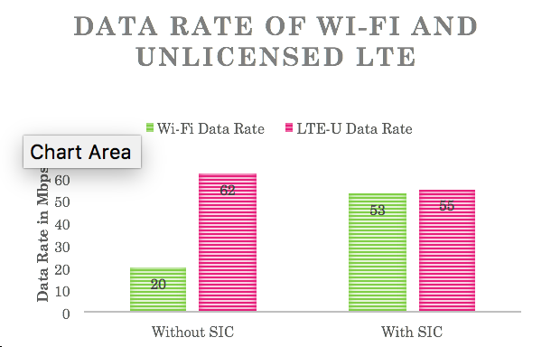
Use case for Full Duplex in 802.11
Frequency
Multi-channel AP
Full Duplex
+
802.11
Frequency
Full Duplex Mesh
LTE/
LAA
Wi-Fi
Frequency
Multi-RAT Platform

Slide 17
Layer II “Listen While Talk”
AP
Collision Detection instead of Collison Avoidance
  With Full Duplex, 802.11 radios can detect if there frame is colliding with another radio’s frame in real-time
  Reduction in the signaling overhead to communicate the collision
  AP can pre-emptively declare collision while it is receiving the energy from both STA
Multi-band transmission
  Full duplex enables radios to transmit in adjacent and overlapping frequency band to make better use of the spectrum
Sense Collison
STA
STA
AP
Indicate
Collision
Indicate
Collision
Sense Collison
STA
STA

Slide 18
Legacy-Compatibility
Legacy-aware
  Full duplex has capability to hear other nodes while transmitting
  Can determine legacy presence and enable coexistence
  Better throughput between two full duplex nodes
  Lower collisions when legacy nodes present
Improved Scheduling with OFDMA
  Flexible uplink and downlink scheduling with simultaneous transmit and receive capability at the access point
  Legacy-compatible with ax, ac and others

Slide 19


802.11 throughput enhancement with interference cancellation
Indoor dense environment: Walls and surroundings cause
Multi-path fading effects
UE
AP
With Full Duplex Echo Cancellation
802.11 network model of dense indoor venues like conferences, concerts, sporting events, offices
Without Full Duplex
Echo Cancellation
Assumptions: 5GHz UNI-I, 4x4 MU-MIMO capable AP, 80MHz Channel Bandwidth, ZFBF receiver

Slide 20
References
Bharadia, Dinesh, Emily McMilin, and Sachin Katti. "Full duplex radios." ACM SIGCOMM Computer Communication Review 43.4 (2013): 375-386.
Duarte, Melissa, and Ashutosh Sabharwal. "Full-duplex wireless communications using off-the-shelf radios: Feasibility and first results." Signals, Systems and Computers (ASILOMAR), 2010
Debaillie, Björn, et al. "Analog/RF solutions enabling compact full-duplex radios." IEEE Journal on Selected Areas in Communications 32.9 (2014): 1662-1673.
Chung, MinKeun, et al. "Prototyping real-time full duplex radios." IEEE Communications Magazine 53.9 (2015): 56-63.
Barghi, Sanaz, et al. "Characterizing the throughput gain of single cell MIMO wireless systems with full duplex radios." Modeling and Optimization in Mobile, Ad Hoc and Wireless Networks (WiOpt), 2012 10th International Symposium on. IEEE, 2012.
Korpi, Dani, et al. "Advanced self-interference cancellation and multiantenna techniques for full-duplex radios." Signals, Systems and Computers, 2013 Asilomar Conference on. IEEE, 2013.
Goyal, Sanjay, et al. "A distributed MAC protocol for full duplex radio." Signals, Systems and Computers, 2013 Asilomar Conference on. IEEE, 2013.
Tong, Zhen, and Martin Haenggi. "Throughput analysis for wireless networks with full-duplex radios." Wireless Communications and Networking Conference (WCNC), 2015 IEEE. IEEE, 2015.

