Slide 1
IEEE 802.11ba: more than a wake-up radio
Date: 2018-03-08
Authors | Affiliations | Address | Phone | email
Eduard Garcia-Villegas | Universitat Politècnica de Catalunya (UPC)¹ |  |  | eduardg@entel.upc.edu
Elena López-Aguilera | Universitat Politècnica de Catalunya (UPC)¹ |  |  | elopez@entel.upc.edu
Ilker Demirkol | Universitat Politècnica de Catalunya (UPC)¹ |  |  | ilker.demirkol@entel.upc.edu
Josep Paradells-Aspas | Fundació i2CAT and Universitat Politècnica de Catalunya (UPC)¹ |  |  | josep.paradells@entel.upc.edu
(1) supported by ERDF and the Spanish Government through project TEC2016-79988-P, AEI/FEDER, UE
Eduard Garcia-Villegas (UPC)

Slide 2
abstract
The work of the TGba will provide IEEE 802.11 devices with an additional power-saving mode by using a secondary radio or Wake-Up Radio (WUR). The purpose of the WUR is to wake-up the primary connectivity radio (PCR) upon reception of a wake-up packet (WUP).
However, the development of a simpler low power radio, capable of receiving messages sent from a fully compliant IEEE 802.11 radio, brings new opportunities.

Slide 3
TGba focuses on Wake-Up
Wake-Up Radio (WUR) project has a narrow focus on the definition of the PHY and the MAC layers of an auxiliary wake-up signal [1]
The reception of the wake-up frame by the WUR can trigger a transition of the PCR out of sleep. The WUR is a companion radio to the PCR [2]

Slide 4


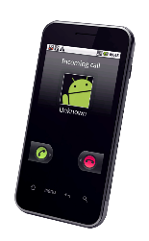
Applications of Waking-up an IEEE 802.11-based PCR
Diverse usage models [3] …
Smart home: one AP serves STAs without power limitations sharing space with tens of low-power battery-driven sensors/actuators of smart home applications.
Warehouse: each container/box or each shelf is equipped with sensors that report the location or state of the stored goods in a warehouse.
Cattle farm: livestock carries different sensors monitored from farmer’s phone.
Wearable devices: personal or body area networks in fitness/health applications connected to a smartphone.

Slide 5



Applications of Waking-up an IEEE 802.11-based PCR
Diverse usage models [3] …
Moving goods: freighted containers or parcels, equipped with sensors, are located and tracked.
Intelligent Transportation System (ITS): portable ITS communication (e.g. as per IEEE 802.11p) devices must be power-efficient (e.g. carried by pedestrians or cyclists).

Slide 6
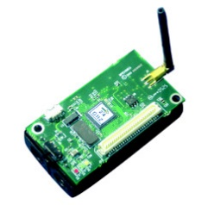
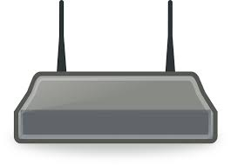
Basic operation of IEEE 802.11 WUR
Diverse usage models [3] …
but all based on the same use case:
  the primary radio (and possibly other systems) of a low-power device is put to sleep to save energy
  application-level communication with the sleeping device is required
  Wake-Up Packet (WuP) is sent to wake-up the device’s primary radio
zZzZz
PCR
(IEEE 802.11)
WURx
Wake up!

Slide 7
Basic operation of IEEE 802.11 WUR
Diverse usage models [3] …
but all based on the same use case:
  the primary radio (and possibly other systems) of a low-power device is put to sleep to save energy
  application-level communication with the sleeping device is required
  Wake-Up Packet (WuP) is sent to wake-up the device’s primary radio
  normal IEEE 802.11 communication occurs through the primary radio
I’m awake!
PCR
(IEEE 802.11)
WURx
Primary radio communication

Slide 8
IEEE 802.11 WUR beyond wake-up
Other proposed usage models (e.g. [4], [5]), regarded as out of scope, were excluded:
  WuP forwarding
  Out-of-band signaling
  Power-save mode for APs (Wake-Up AP)
  …
We argue that the presence of a secondary radio in Wi-Fi devices enables a wide range of new and interesting applications that go beyond the current scope of TGba

Slide 9
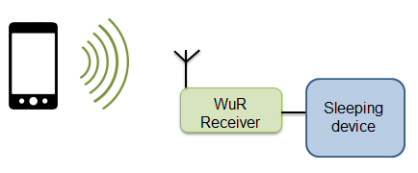
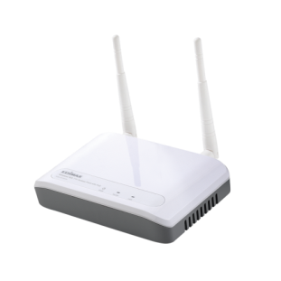
IEEE 802.11 WUR beyond wake-up
WuP forwarding
multi-hop path is created on-demand according to source routing or reactive routing approach (e.g. AODV, IEEE 802.11s’s HWMP).
Sleeping nodes along such path must be woken-up by forwarding WUP
Active mesh node
Sleeping mesh node
WUP transmission
Legacy IEEE 802.11
Notes:
outdoor urban scenario where some nodes are installed in streetlights, which only receive power during the night and, therefore, those nodes run on batteries most of the day.

Slide 10
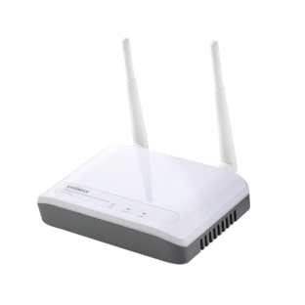
IEEE 802.11 WUR beyond wake-up
Out-of-band signaling
PCR performs normal operation while WUR listens to other channels
  Synchronization signaling
    E.g.: anchor nodes participating in location/positioning
  Neighbor/Service discovery
    E.g.: building of an ad-hoc wireless mesh
    E.g.: Smart scanning (STA discover neighboring APs through WuR)
← accepted!
@2.4GHz
Ch.1
@2.4GHz
Ch.6

Slide 11
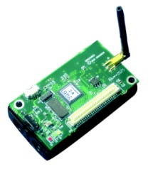
IEEE 802.11 WUR beyond wake-up
Beyond 802.11 itself
Low-power, low-cost, simple IEEE 802.11ba-like receiver can be mounted on devices (with or) without a PCR
  If present, the PCR may even not be IEEE 802.11-compatible
  Small appliances may not be able to take advantage of a fully compliant IEEE 802.11 PCR
    E.g. a lamp holder, smoke detector, automated shade, you name it…
IEEE 802.11
IEEE 802.15.4
Wake-up, facilitate network onboarding, discovery, etc. of non- IEEE 802.11 devices

Slide 12

WUR beyond wake-up: example
Implemented proof of concept: smart socket [6]
based on (pre TGba) 802.11 WUR [7]
  Circuit capable of receiving OOK-modulated signals generated by a legacy IEEE 802.11 transmitter and consuming in the μW scale
    Transmission of simple commands: switch on/off/intensity/etc.
Receiver
OOK-modulated signal
Legacy IEEE 802.11g transmitter
WuR
Relay switch
Power Adapter
Wall plug
Appliance

Slide 13
WUR beyond wake-up: example
Implemented proof of concept: smart socket [6]
AP fed through smart socket
  AP automatically switched off when not in use (no associated STAs) for a given period: reduced interference, improved security, save energy:
    Home: ~25 kWh (yearly savings)
    Office building: ~1,800 kWh
    Campus WLAN: ~25,500 kWh
Receiver
WuR
Legacy IEEE 802.11g transmitter
Relay switch
Power Adapter
Wall plug

Slide 14
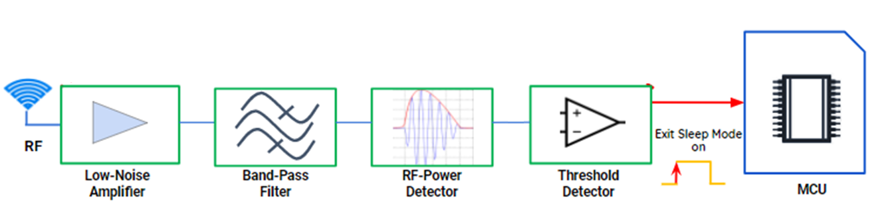
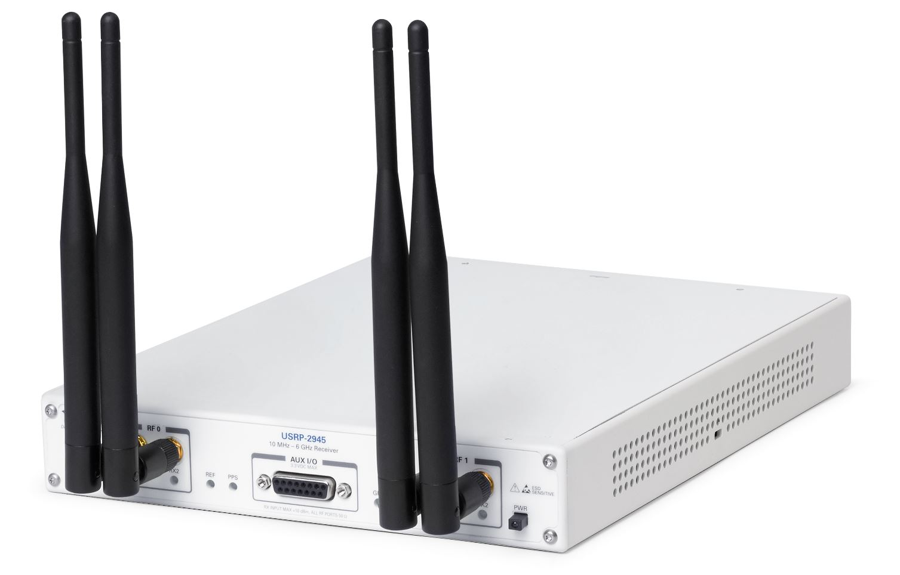
WUR beyond wake-up: example
Implemented proof of concept: smart socket v2
based on Draft 802.11ba WuR frame
  Circuit capable of receiving TGba-like OOK-modulated signals generated by SDR transmitter and consuming in the mW scale
    Transmission of simple commands: switch on/off/intensity/etc.
Receiver
PIC MCU
TGba signal by SDR

Slide 15
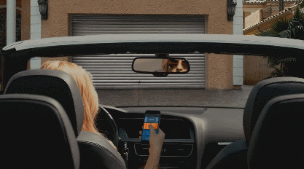
Summary
A low-power low-cost and simple radio, capable of receiving messages from an IEEE 802.11 device, can be used for many applications beyond the wake-up use case for which it is initially intended.
Support of some of those new applications may involve additional functional requirements.
For example, it could allow a Wi-Fi device to talk to “non Wi-Fi things” and, thus, an 802.11ba-enabled transmitter (e.g. smartphone, smartwatch, etc.) may become the universal remote control

Slide 16
References
[1] 11-16/0936r4, A CSD Proposal for Wake-up Radio (WUR), Nov. 2016
[2] 11-16/1045r9, A PAR Proposal for Wake-up Radio, Nov. 2016
[3] 11-17/0029r10, WUR Usage Model Document, Sep. 2017
[4] 11-17/0372r3, Additional usage models for WUR, Mar. 2017
[5] 11-17/0728r2, AP Power Saving, Jul. 2017
[6] Rizzo, Emanuela. Development and performance evaluation of Wi-Fi wake-up radio. MS thesis. Universitat Politècnica de Catalunya, 2016.
[7] Oller, J.; Garcia, E.; Lopez, E.; Demirkol, I.; Casademont, J.; Paradells, J.; Gamm, U.; Reindl, L. IEEE 802.11-enabled wake-up radio system: Design and performance evaluation. Electron. Lett. 2014, 50, 1484–1486.

Slide 17
Straw Poll 1
What do you think of the use of IEEE 802.11ba transmissions for purposes beyond Wake-Up (such as those in this presentation)?
  Out of the scope of the IEEE 802.11WG
  Within the scope of IEEE 802.11WG but I don’t support the idea
  Maybe as a future amendment/extension of IEEE 802.11ba
  No opinion/Don’t care
  Need more information
  Results: A(0) / B(3) / C(25) / D(5) / E(29)
Eduard Garcia-Villegas (UPC)

