Slide 1
IEEE 802.11ba: more than a wake-up radio
Date: 2018-03-06
Authors | Affiliations | Address | Phone | email
Eduard Garcia-Villegas | Universitat Politècnica de Catalunya (UPC)¹ |  |  | eduardg@entel.upc.edu
Elena López-Aguilera | Universitat Politècnica de Catalunya (UPC)¹ |  |  | elopez@entel.upc.edu
Ilker Demirkol | Universitat Politècnica de Catalunya (UPC)¹ |  |  | ilker.demirkol@entel.upc.edu
Josep Paradells-Aspas | Fundació i2CAT and Universitat Politècnica de Catalunya (UPC)¹ |  |  | josep.paradells@entel.upc.edu
(1) supported by ERDF and the Spanish Government through project TEC2016-79988-P, AEI/FEDER, UE
Eduard Garcia-Villegas (UPC)

Slide 2
abstract
The work of the TGba will provide IEEE 802.11 devices with an additional power-saving mode by using a secondary radio or Wake-Up Radio (WUR). The purpose of the WUR is to wake-up the primary connectivity radio (PCR) upon reception of a wake-up packet (WUP).
However, the development of a simpler low power radio, capable of receiving messages sent from a fully compliant IEEE 802.11 radio, brings new opportunities.

Slide 3
TGba focuses on Wake-Up
Wake-Up Radio (WUR) project has a narrow focus on the definition of the PHY and the MAC layers of an auxiliary wake-up signal [1]
The reception of the wake-up frame by the WUR can trigger a transition of the PCR out of sleep. The WUR is a companion radio to the PCR [2]

Slide 4



Applications of Waking-up an IEEE 802.11-based PCR
Diverse usage models [3] …
Smart home: one AP serves STAs without power limitations sharing space with tens of low-power battery-driven sensors/actuators of smart home applications.
Warehouse: each container/box or each shelf is equipped with sensors that report, the location or state of the stored goods in a warehouse.
Cattle farm: livestock carries different sensors monitored from farmer’s phone.
Wearable devices: personal or body area networks in fitness/health applications connected to a smartphone.

Slide 5



Applications of Waking-up an IEEE 802.11-based PCR
Diverse usage models [3] …
Moving goods: freighted containers or parcels, equipped with sensors, are located and tracked.
Intelligent Transportation System (ITS): portable ITS communication (e.g. as per IEEE 802.11p) devices must be power-efficient (e.g. carried by pedestrians or cyclists).

Slide 6
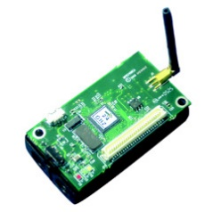
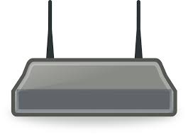
Basic operation of IEEE 802.11 WUR
Diverse usage models [3] …
but all based on the same use case:
  the primary radio (and possibly other systems) of a low-power device is put to sleep to save energy
  application-level communication with the sleeping device is required
  Wake-Up Packet (WuP) is sent to wake-up the device’s primary radio
zZzZz
PCR
(IEEE 802.11)
WURx
Wake up!

Slide 7
Basic operation of IEEE 802.11 WUR
Diverse usage models [3] …
but all based on the same use case:
  the primary radio (and possibly other systems) of a low-power device is put to sleep to save energy
  application-level communication with the sleeping device is required
  Wake-Up Packet (WuP) is sent to wake-up the device’s primary radio
  normal IEEE 802.11 communication occurs through the primary radio
I’m awake!
PCR
(IEEE 802.11)
WURx
Primary radio communication

Slide 8
IEEE 802.11 WUR beyond wake-up
Other proposed usage models (e.g. [4], [5]), regarded as out of scope, were rejected:
  WuP forwarding
  Out-of-band signaling
  Power-save mode for APs (Wake-Up AP)
  …
We argue that the presence of a secondary radio in Wi-Fi devices enables a wide range of new applications that go beyond the current scope of TGba

Slide 9

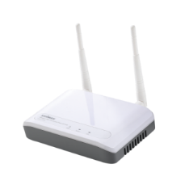
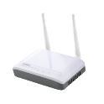
IEEE 802.11 WUR beyond wake-up
WuP forwarding
multi-hop path is created on-demand according to source routing or reactive routing approach (e.g. AODV, IEEE 802.11s’s HWMP).
Sleeping nodes along such path must be woken-up by forwarding WUP
Active mesh node
Sleeping mesh node
WUP transmission
Legacy IEEE 802.11

Slide 10
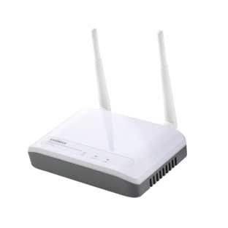
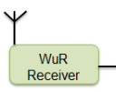
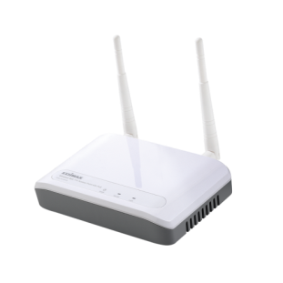


IEEE 802.11 WUR beyond wake-up
Out-of-band signaling
PCR performs normal operation while WUR listens to other channels
  Synchronization signaling
    E.g.: Anchor nodes participating in location/positioning
  Neighbor/Service discovery
    E.g.: building of an ad-hoc wireless mesh
    E.g.: Smart scanning (STA discover neighboring APs through WuR)
← accepted!
@2.4GHz
Ch.1
@2.4GHz
Ch.6

Slide 11

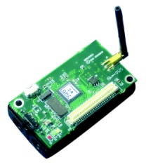
IEEE 802.11 WUR beyond wake-up
Beyond 802.11 itself
Low-power, low-cost, simple IEEE 802.11ba-like receiver can be mounted on devices (with or) without a PCR
  If present, the PCR may even not be IEEE 802.11-compatible
  Small appliances may not be able to take advantage of a fully compliant IEEE 802.11 PCR
    E.g. a lamp holder, garage door opener, automated shade, you name it…
IEEE 802.11
IEEE 802.15.4
Wake-up, facilitate network onboarding, discovery, etc. of non- IEEE 802.11 devices

Slide 12
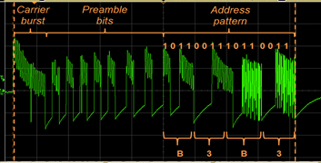

WUR beyond wake-up: example
Implemented proof of concept: smart socket [6]
based on (pre TGba) 802.11 WUR [7]
  Circuit capable of receiving OOK-modulated signals generated by a legacy IEEE 802.11 transmitter and consuming in the μW scale
    Transmission of simple commands: switch on/off/intensity/etc.
Receiver
OOK-modulated signal
Legacy IEEE 802.11g transmitter
WuR
Relay switch
Power Adapter
Wall plug
Appliance

Slide 13
WUR beyond wake-up: example
Implemented proof of concept: smart socket [6]
AP fed through smart socket
  AP automatically switched off when not in use (no associated STAs) for a given period: reduced interference, improved security, save energy:
    Home: ~25 kWh (yearly savings)
    Office building: ~1,800 kWh
    Campus WLAN: ~25,500 kWh
Receiver
WuR
Legacy IEEE 802.11g transmitter
Relay switch
Power Adapter
Wall plug

Slide 14
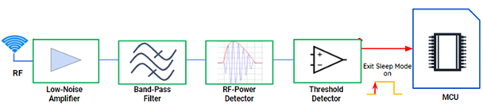

WUR beyond wake-up: example
Implemented proof of concept: smart socket v2
based on Draft 802.11ba WuR frame
  Circuit capable of receiving TGba-like OOK-modulated signals generated by SDR transmitter and consuming in the mW scale
    Transmission of simple commands: switch on/off/intensity/etc.
Receiver
PIC MCU
TGba signal by SDR

Slide 15
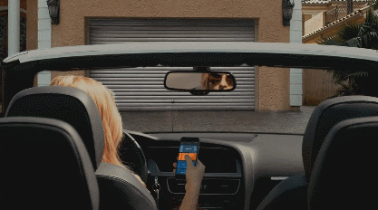
Summary
A low-power low-cost and simple radio, capable of receiving messages from an IEEE 802.11 device, can be used for many applications beyond the wake-up use case for which it is initially intended.
Support of some of those new applications may involve additional functional requirements.
For example, it could allow a Wi-Fi device to talk to “non Wi-Fi things” and, thus, an 802.11ba-enabled transmitter (e.g. smartphone, smartwatch, etc.) may become the universal remote control

Slide 16
References
[1] 11-16/0936r4, A CSD Proposal for Wake-up Radio (WUR), Nov. 2016
[2] 11-16/1045r9, A PAR Proposal for Wake-up Radio, Nov. 2016
[3] 11-17/0029r10, WUR Usage Model Document, Sep. 2017
[4] 11-17/0372r3, Additional usage models for WUR, Mar. 2017
[5] 11-17/0728r2, AP Power Saving, Jul. 2017
[6] Rizzo, Emanuela. Development and performance evaluation of Wi-Fi wake-up radio. MS thesis. Universitat Politècnica de Catalunya, 2016.
[7] Oller, J.; Garcia, E.; Lopez, E.; Demirkol, I.; Casademont, J.; Paradells, J.; Gamm, U.; Reindl, L. IEEE 802.11-enabled wake-up radio system: Design and performance evaluation. Electron. Lett. 2014, 50, 1484–1486.

Slide 17
Straw Poll 1
What do you think of the use of IEEE 802.11ba transmissions for purposes beyond Wake-Up (such us those in this presentation)?
  Out of the scope of the IEEE 802.11WG
  Maybe as a future amendment/extension of IEEE 802.11ba
  No opinion
Eduard Garcia-Villegas (UPC)

