Slide 1
Low Power Sensor Broadcast Use Cases
Date: 2018-03-05
Authors:
Name | Affiliations | Address | Phone | email
Bahar Sadeghi Laurent Cariou Daniel Bravo Robert Stacy | INTEL | 2111 NE 25th Ave Hillsboro, OR 97124 USA | +1-503-803-2471 | Bahareh.Sadeghi@intel.com

Slide 2
Abstract
This submission proposes use cases for consideration for Broadcast Service on WLAN [1]
[2] outlines sensor data collection as a use case for broadcast service on WLAN. This contribution further develops this use case for low power sensors.
Broadcast Services on WLAN is an enabler for low power Wi-Fi sensors with limited throughput requirements.

Slide 3









Motivation
Many of IoT use cases/services are cloud services
A simple and fast connection to the cloud enables low complexity, diverse set of services and use cases for low throughput low power IoT devices including sensors
BCS on WLAN enables a low overhead connection between a sensor and the cloud

Slide 4
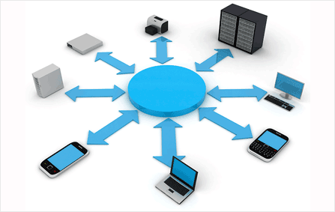

Use Case I
Sensor on the move:
IoT devices/Sensors with severe power constraints and in mobility send reports to their server through APs supporting BCS without the burden of performing scanning and association process.
  A STA may
    Either blindly transmit a self-contained PPDU and hope for it to be received and forwarded (example moving sensors in a large enterprise where an ESS is deployed with a blanket coverage with all/most APs supporting this service)
    Or scan for APs supporting such capabilities
Example use cases:
Asset tracking in enterprise/factories
Children tracking in resorts
Seamless smart city measurements
…

Slide 5
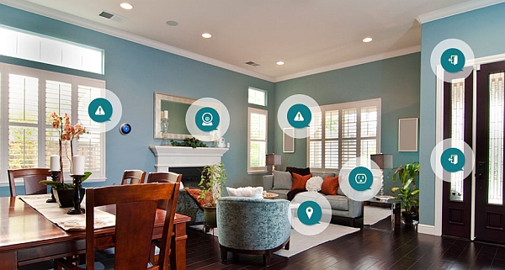
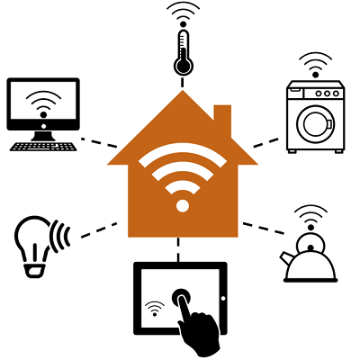
Use Case II
Zero setup sensor:
With an AP supporting BCS, the user can simply buy pre-configured IoT sensors and they will automatically connect to the end-server through the AP without any set up action required from the user.

Slide 6
Summary
BCS on WLAN enables easy and fast communication between an IoT device and an end-server
  A STA can communicate with an end-server through any AP supporting BCS
  APs supporting BCS can forward the packets from the STA to the end-server
  The PPDU is self-contained, i.e., it includes the addresses of the end server, possibly the credential and the data payload for the server
    It is assumed that the end-device and the end-server perform higher-layer association and security key exchange beforehand
BCS benefits IoT devices with throughput requirements comparable to association overhead
Security implications need to be addressed

Slide 7
References
[1] 11-18/326r0 – Call for contributions
[2] 11-17/1736r4 -- Broadcast Service on WLAN

