Slide 1
Discussion on WUR identifiers
Date: 2018-03-05
Authors:

Slide 2
WUR Identifiers
In the draft spec, 4 different types of WUR identifiers are defined
  Wake-up ID, Transmit ID, Group ID, OUI
Address field header contains one of the WUR identifiers
  WUR STAs must be able to distinguish whether the frame is unicast, groupcast or broadcast using the Address field
Therefore, WID, GID and TXID shouldn’t be duplicated in 12-bit domain
  WID, GID and TXID will share the same 12-bit domain
    0-4095
The detail of WUR ID assignment hasn’t been
discussed

Slide 3
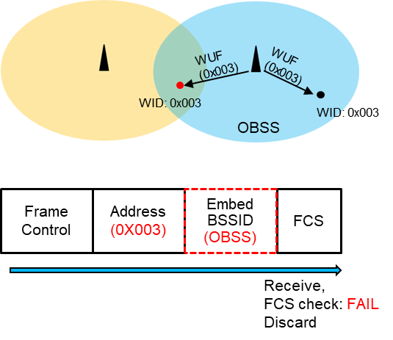
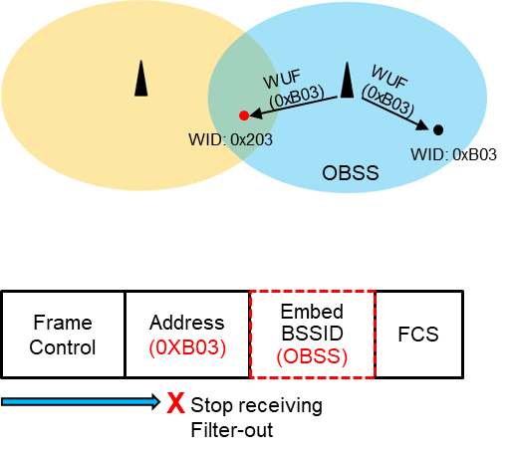
Considerations on WUR identifier
Since WUR identifiers are not unique device identifier, OBSS may use duplicated identifiers
  In this case, WUR STA with duplicated ID cannot verify if the received WUR frame is intended to it until it checks the embed BSSID value
    Mandating to process FCS
  The STA will consume unnecessary power as it receives and stores the frame and processes FCS
    Compare to listening the medium, receiving and processing a frame consumes more power
Considering dense BSS environment, WUR ID space needs to be appropriately defined
  Avoiding duplicated IDs as much as possible

Slide 4
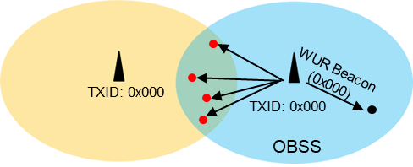
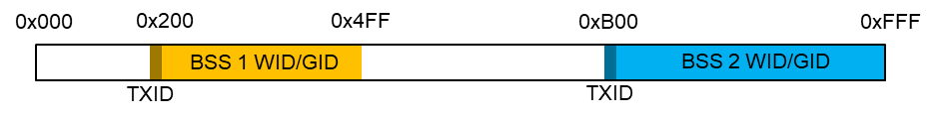
Transmit ID discussion
TXID could be the most frequently used identifier in a WUR BSS
  WUR Beacon, broadcast wake-up frame
TXID shouldn’t be a unified value
  If all WUR AP uses same TXID, WUR Beacon transmission will
  affect power consumption of adjacent OBSS STAs seriously
Also, TXID can be used to define the WUR ID space of a BSS
  WID/GID can be assigned from a predefined space based on the TXID
    WUR ID space becomes compact
      Reducing probability of WUR ID collision
    WUR ID space becomes predictable
      Easy and efficient WUR ID management
        E.g., ESS, Multi-AP network

Slide 5
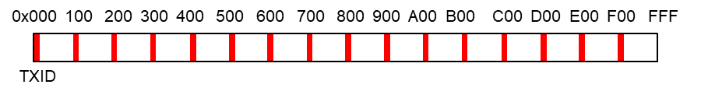
Proposal for Transmit ID
We propose that AP select its TXID from a 12-bit preset values
  The preset values are not used for WID and GID assignment
The TXID preset values could be:
  1) A pre-defined range in 12-bit domain, e.g., [0xF00,0xFFF]
  2) Evenly distributed on 12-bit domain, e.g., 0x000, 0x100, 0x200, …, 0xF00
We consider option 2 is more beneficial because,
  The TXID values has different MSBs
    STA could distinguish the target TXID faster
Option 1
Option 2
Target TXID (0xF00)
1 | 1 | 1 | 1 | 0 | 0 | 0 | 0 | 0 | 0 | 0 | 0
Target TXID (0xF00)
1 | 1 | 1 | 1 | 0 | 0 | 0 | 0 | 0 | 0 | 0 | 0
OBSS TXID (0xF04)
1 | 1 | 1 | 1 | 0 | 0 | 0 | 0 | 0 | 1 | 0 | 0
OBSS TXID (0xD00)
1 | 1 | 0 | 1 | 0 | 0 | 0 | 0 | 0 | 0 | 0 | 0
X
Stop receiving
X
Stop receiving

Slide 6
Summary
In this contribution, we have discussed considerations on WUR identifier assignment
  Avoiding duplicated WUR identifiers between OBSSs
Also, we proposed to use a preset for selecting Transmit ID

Slide 7
Strawpoll 1
Do you agree to add the following in the SFD?
  Transmit ID is selected from a 12-bit preset values
  The preset values are not used for Wake-up ID and Group ID assignment

Slide 8
Strawpoll 2
Do you agree to add the following in the SFD?
  The preset values for Transmit ID have TBD consecutive zero LSBs

