Slide 1
Digital Beamforming Feedback Format
Date: 2018/03/06
Authors:

Slide 2
Introduction
Advantages of adding Digital BF on top of analog BF for mm-wave have been highlighted in several presentations [1],[2]
Digital BF Feedback Format is however still undefined for both SC and OFDM
This presentation contains proposals for
    SC BF Feedback
    OFDM BF Feedback
  The feedback frame structure for SC and OFDM

Slide 3
SC Digital BF
Single Carrier
  Current draft assumes one beamformer for entire bandwidth
    Responder may compute the digital BF matrix information (DBFI) based on channel measurement and feed back
    DBFI contains the mapping between RF chains and Nsts
      Unreasonable to assume any form of compression
    Format and quantization can be kept similar to that of the channel measurement
      8b per real and 8b per imaginary part
 | Field | N bits | Meaning
Beamforming Feedback Matrix | TX Digital BF 1 | 8 + 8 | TX BF coefficient(s) for stream 1 to TX antenna 1
 | TX Digital BF 2 | 8 + 8 | TX BF coefficient(s) for stream 2 to TX antenna 1
 | … | … | …
 | TX Digital BF Nc x Nr | 8 + 8 | TX BF coefficient(s) for stream Nc to TX antenna Nr

Slide 4
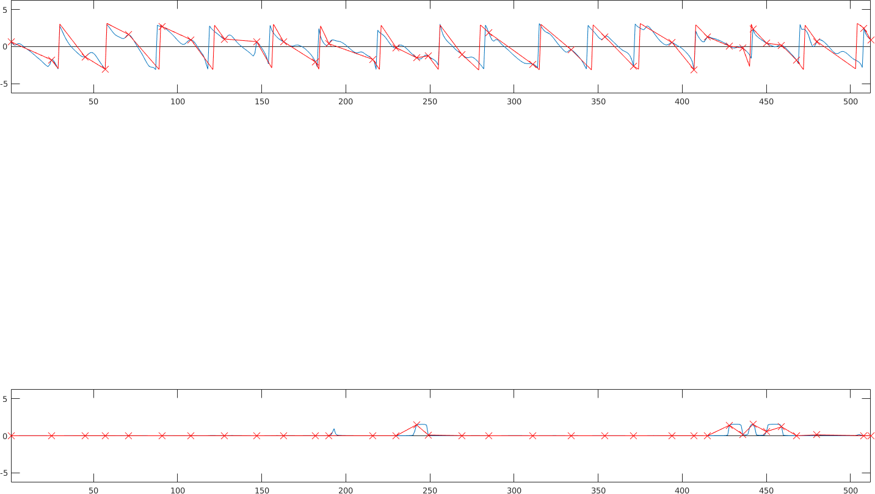
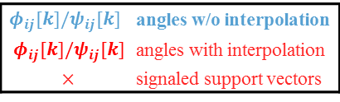
OFDM Digital BF
Traditionally
  Digital BF per subcarrier or groups of subcarriers
    in .ac Ng=1,2,4
  Givens rotations for further compression
Considerations
  Large number of subcarriers in .ay: 350:1607
    Compression with Givens rotations should be performed
  Relatively specific mm-wave channel
    Often flat or predictable spectral characteristic
    Strong frequency dependent attenuations can appear localized [3]
  In many cases, Givens angles evolve almost linearly over frequency
$φ_{ij}[k]/ψ_{ij}[k]$t | angles w/o interpolation
$$φ_{ij}[k]/ψ_{ij}[k]$$ | angles with interpolation
$$×$$ | signaled support vectors

Slide 5
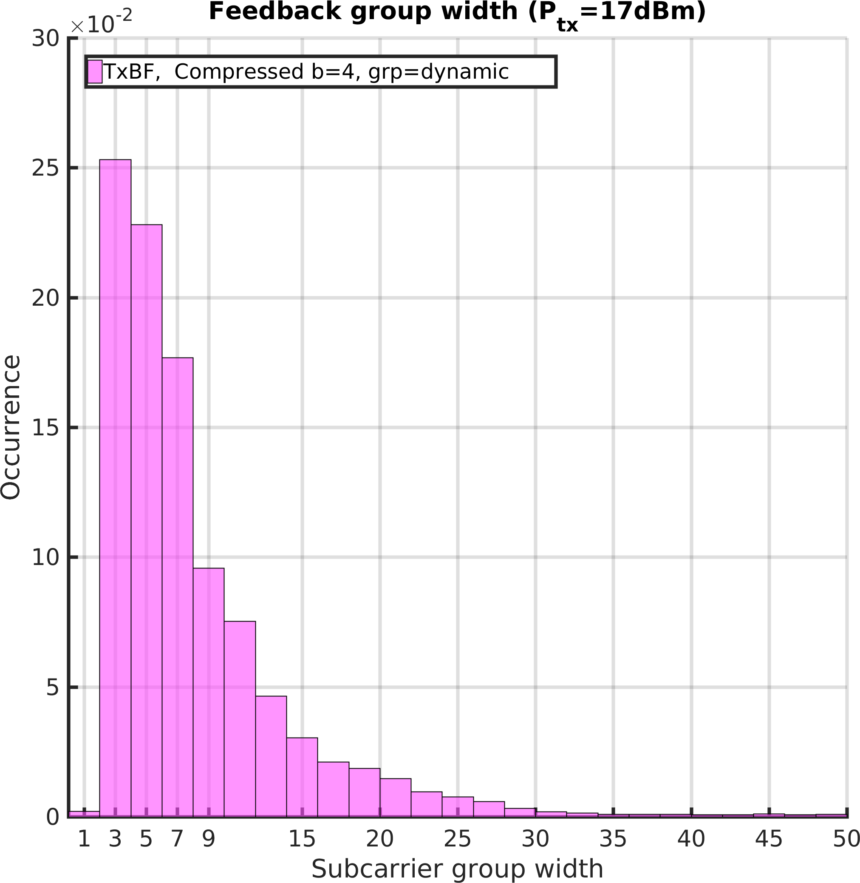
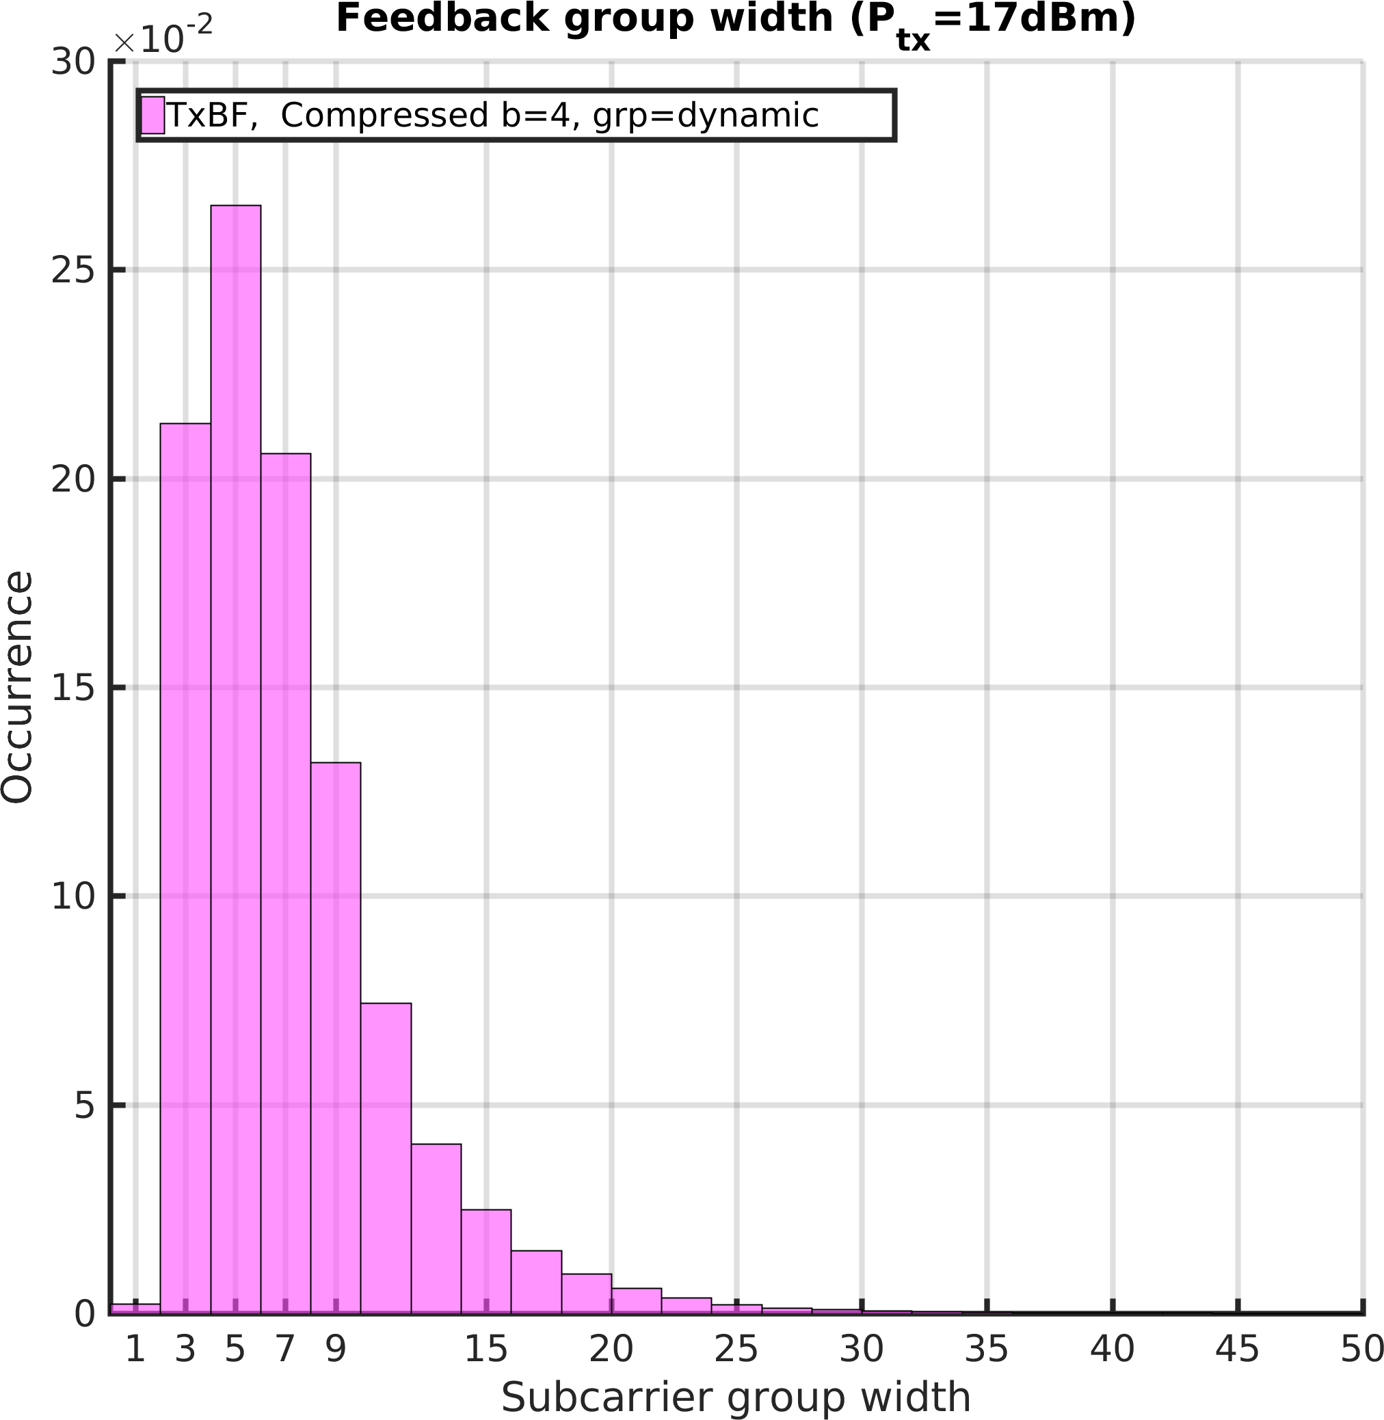

  Distribution of Group Width
LOS
NLOS
For rate loss $<2,5\%$ w.r.t. non-comp
Resulting group width $N_{g}>4$in $≈63/65\%$ (LOS/NLOS) of realizations,
not equally distributed

Slide 6
OFDM Digital BF
Dynamic Grouping Idea
  Allow variable distance between adjacent subcarriers
  For complexity reduction further constraints should be considered
Low Complexity Grouping
  Limited number of values for distance between adjacent subcarriers
      powers of 2 (1,2,4,8,16,32).
    allows for easy reconstruction at transmitter
  Similar construction for the dynamic subcarrier set as for fixed Ng
      No DC subcarriers
      Ensures that edge and {-2,2} are always present
    Construct as subset of the set of subcarrier indices as defined for fixed Ng=2 and the corresponding CB
      Allows for easy switch between fixed Ng and dynamic if necessary

Slide 7






OFDM Digital BF
Low Complexity Grouping
  An example on constructing the feedback subcarrier set
Support points
DC
$$s_{1}^{\left(i\right)}$$
$$s_{2}^{\left(i\right)}$$
$$s_{3}^{\left(i\right)}$$
Subcarrier set i
Metric $≥γ$
Metric $≤γ$
Metric $≥γ$
Subcarrier set i+1
New support point due to large error

Slide 8
OFDM Digital BF
Report size vs performance loss
Ng | Report Size (kb) | Average Rate (bpcu) | Report Size | Average Rate (bpcu)
Ng=2 | 14.6 | 12.65 | 13.76 | 2.171
Ng=4 | 7.2 (50%) | 12.64 | 6.874 (49%) | 2.168
Ng=8 | 3.6 (75%) | 12.63 | 3.437 (75%) | 2.156
Dyn [2, 2^i, 16] | 1.285 (91.2%) | 12.62 | 1.67 (87%) | 2.13
Dyn [2, 2^i, 32] | 0.75 (95%) | 12.62 | 1.42 (89.6%) | 2.117
  Setup:4x4, CR, LOS
  Setup:4x4, CR, NLOS
Our proposal
  allow one optional mode for dynamic grouping in addition to fixed size groupings [4]

Slide 9
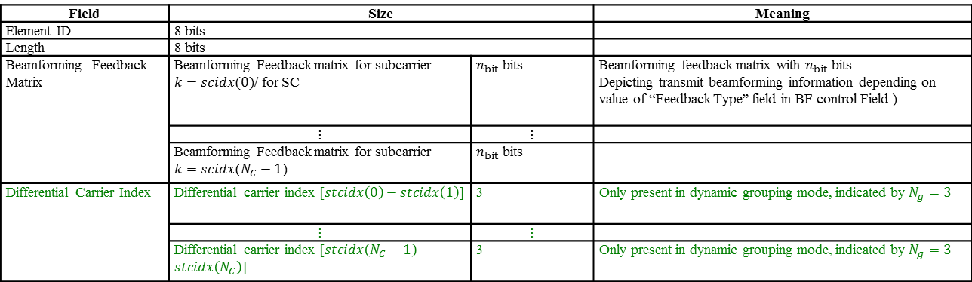
Signaling Proposal for SC and OFDM Digital BF
Beamforming Feedback Element should be created to carry the Fbck information
Field | Size |  | Meaning
Element ID | 8 bits
Length | 8 bits
Beamforming Feedback Matrix | Beamforming Feedback matrix for subcarrier $k=scidx(0)$/ for SC | $n_{bit}$ bits | Beamforming feedback matrix with $n_{bit}$ bits Depicting transmit beamforming information depending on value of “Feedback Type” field in BF control Field )
 | $$⋮$$ | $$⋮$$
 | Beamforming Feedback matrix for subcarrier $k=scidx(N_{C}−1)$ | $n_{bit}$ bits
Differential Carrier Index | Differential carrier index $[stcidx\left(0\right)−stcidx\left(1\right)]$ | 3 | Only present in dynamic grouping mode, indicated by $N_{g}=3$
 | $$⋮$$ | $$⋮$$
 | Differential carrier index $[stcidx\left(N_{C}−1\right)−stcidx\left(N_{C}\right)]$ | 3 | Only present in dynamic grouping mode, indicated by $N_{g}=3$
Beamforming Feedback Matrix
  For SC as defined in Slide 3 with n_bit=16xNcxNr
  For OFDM as defined in 9.4.1.30 (in the form of ordered Givens angles)

Slide 10
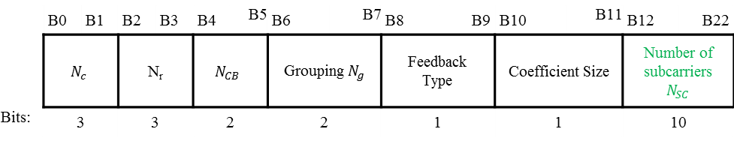
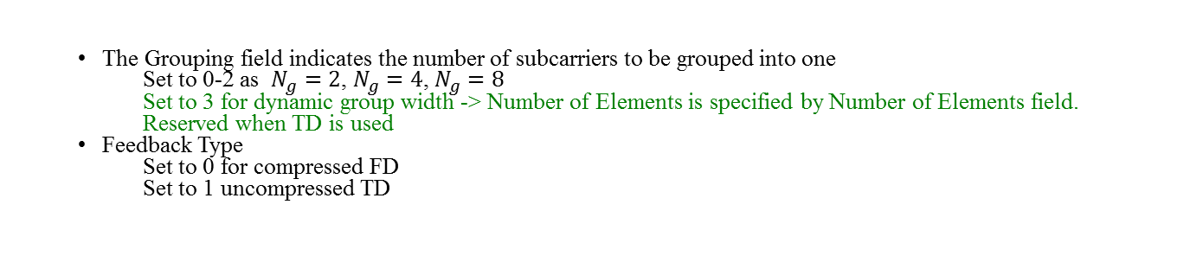
Signaling Proposal
EDMG Feedback Control Field should be created to carry information about the parameters information
 | B0 | B1 | B2 | B3 | B4 | B5 | B6 | B7 | B8 | B9 | B10 | B11 | B12 | B22
 | $$N_{c}$$ |  | N_{r} |  | $$N_{CB}$$ |  | Grouping $N_{g}$ |  | Feedback Type |  | Coefficient Size |  | Number of subcarriers $$N_{SC}$$
Bits: | 3 |  | 3 |  | 2 |  | 2 |  | 1 |  | 1 |  | 10
  The Grouping field indicates the number of subcarriers to be grouped into one
Set to 0-2 as $N_{g}=2$, $N_{g}=4$, $N_{g}=8$
Set to 3 for dynamic group width -> Number of Elements is specified by Number of Elements field.
Reserved when TD is used
  Feedback Type
Set to 0 for compressed FD
Set to 1 uncompressed TD

Slide 11
Conclusions
In this presentation we proposed
  SC digital BF feedback format
  An optional OFDM dynamic grouping mode which achieves better compression than traditional fixed grouping scheme with negligible performance loss
  An element to contain the Digital BF Feedback report based on
    SC feedback format and
    OFDM feedback format for fixed and dynamic subgrouping
  An element containing the parameters required for the digital beamforming feedback.

Slide 12
SP #1
Do you agree to allow an optional dynamic grouping mode for digital BF feedback in Slide 6?
Y/N/A

Slide 13
SP 2
Do you agree to introduce the digital BF feedback element for SC and OFDM and the EDMG feedback control element as shown in Slides 9-10?
(Y/N/A)

Slide 14
References
[1] Kome Oteri, Hybrid Hybrid Beamforming Feedback in 802.11ay. 11-18/192
[2] K. Oteri Hybrid Hybrid Beamforming Feedback for SC and OFDM in 802.11ay. 11-17/1533
[3] G. Bielsa et al, “60 GHz Range Boost: Exploiting Frequency Selectivity in Millimeter-Wave Networks”,
[4] S. Yun et al, “Tone grouping size for hybrid beamforming feedback in OFDM mode”, 11-18/382

