Slide 1
NDP Bandwidth Selection in Range Measurement
Date: 2018-03-06
Authors:

Slide 2
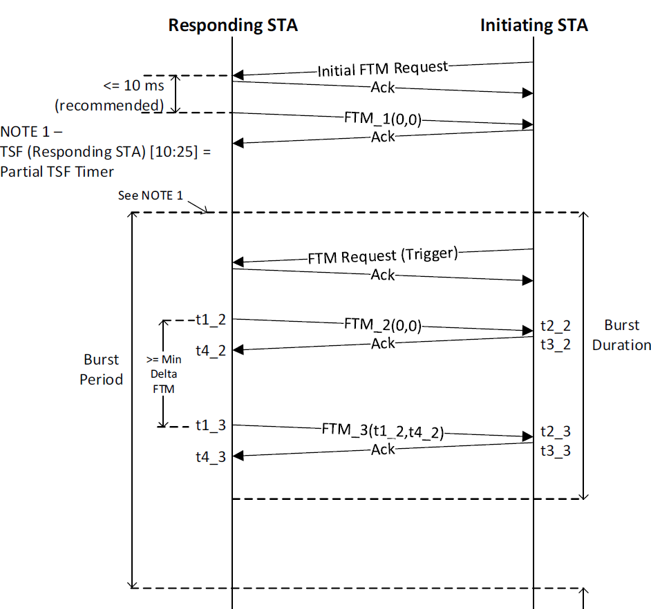
Recap of FTM
For the Fine Timing Measurement (FTM) frames transmitted during the FTM session:
The responding STA shall not use a bandwidth wider than that indicated by the STA in the initial Fine Timing Measurement frame.
For the Ack frames in response to the FTM frames,
The initiating STA use a same bandwidth as the FTM frame.

Slide 3
Recap of VHTz
The bandwidth and the MCS/rate of the ranging report are defined by:
The data rate/MCS of ranging report is solely decided by the rSTA.
The bandwidth of ranging report is not wider than the bandwidth of the soliciting NDPA.” [November 2017 - 11-17/1754r0]
Question:
In VHTz, what is a bandwidth of the DL NDP ?
In HEz, what is a bandwidth of the DL NDP (including the NDPA)?

Slide 4
VHTz: Bandwidth Selection of DL NDP
In order to keep that an UL NDP and a DL NDP provide the same measurement accuracy, it is desired that the bandwidth of a DL NDP is set to the same value as the bandwidth of a preceding UL NDP.
But, still the bandwidth of the LMR can be smaller than the bandwidth of the soliciting NDPA as shown in the below figures.
DL NDP
(80MHz)
LMR
(80MHz)
NDPA
UL NDP
(80MHz)
NDPA
NDPA
NDPA

Slide 5
HEz: Bandwidth Selection of DL NDP
For the same reason, the bandwidth of a NDP Announcement and a DL NDP is set to the same value as the bandwidth of UL NDPs transmitted in one or more preceding UL sounding phases.
The bandwidth of the LMR follows the baseline rules as the TXOP holder.
Trigger
Trigger
NDPA
(80MHz)
DL NDP
(80MHz)
LMR
(80MHz)
Trigger
Trigger
Trigger
Trigger
Trigger
Trigger
UL NDP
(80MHz)
UL NDP
(80MHz)
UL NDP
(80MHz)
UL NDP
(80MHz)
UL NDP
(80MHz)
UL NDP
(80MHz)
UL NDP
(80MHz)
UL NDP
(80MHz)

Slide 6
Straw Poll 1
Do you support the following NDP bandwidth selection rule in VHTz sounding?
The bandwidth of the transmitted NDPA sets the bandwidth of the UL and DL sounding NDP frames.
This bandwidth also corresponds to the bandwidth set by the bandwidth signaling TA field within the NDPA frame.

Slide 7
Straw Poll 2
Do you support the following NDP bandwidth selection rule in HEz sounding?
The TF of type Location and subtype Sounding is used for bandwidth selection and channel reservation of the UL and DL sounding.
The BW of the TF Location Sounding is the same bandwidth of the solicited UL and DL sounding NDP frames.
This bandwidth is also indicated by BW field in the TF Common Info field of the TF frame.

